Slide 1
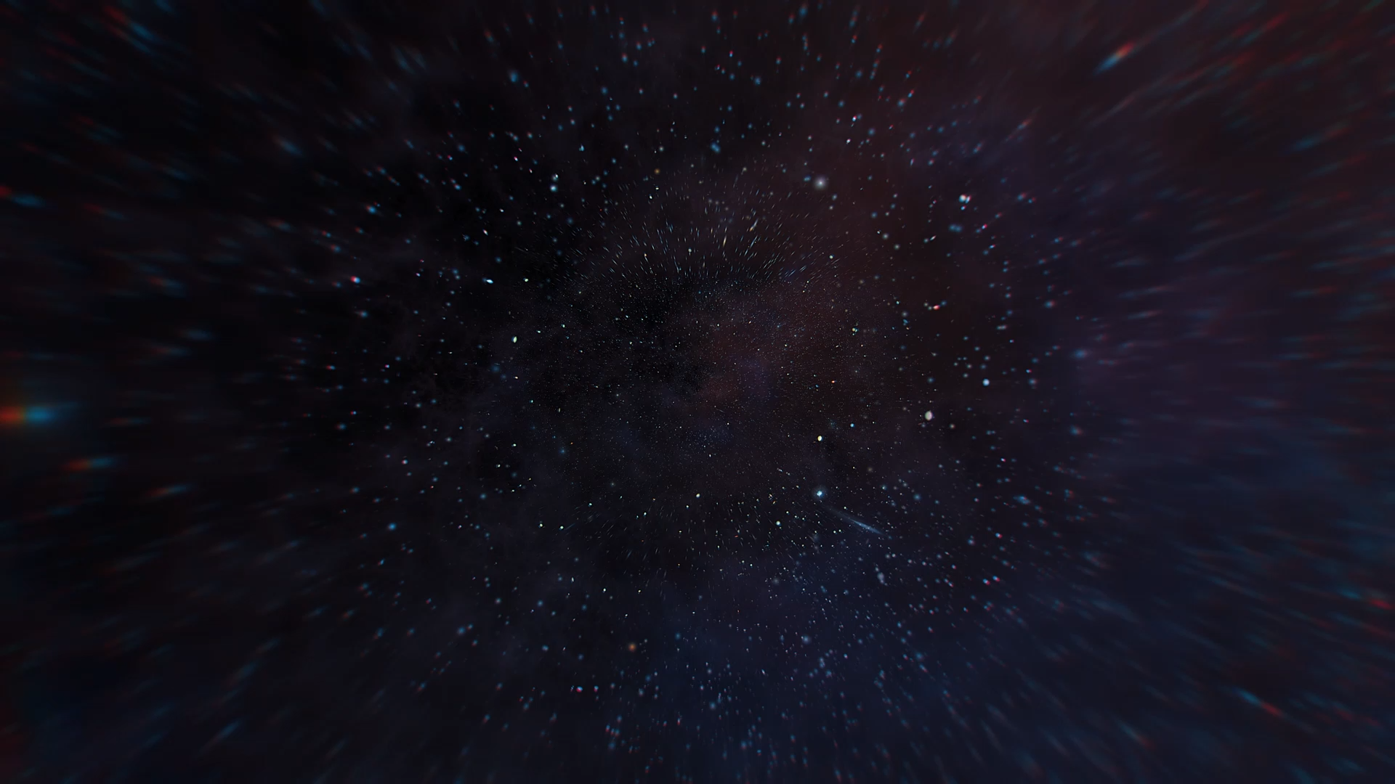
JOURNEY
One One
Two Two

Slide 2
JOURNEY
One One
Two Two
Left
Middle
Right

