Slide 1
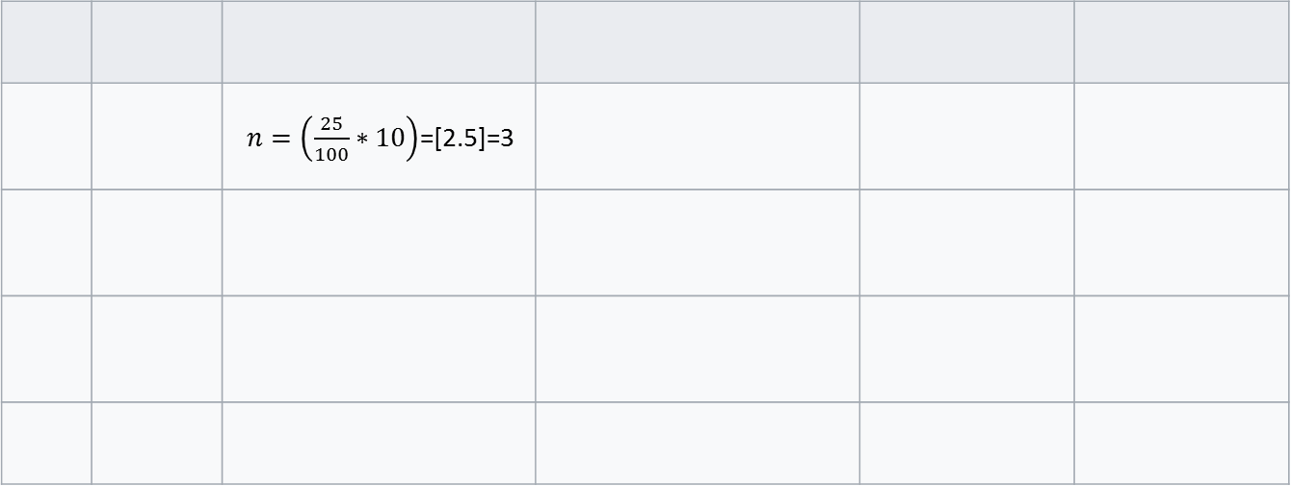
 |  | $n=\left(\frac{25}{100}∗10\right)$=[2.5]=3

