Slide 1
ULYSSES JOBURG NORTH
A BIT ABOUT ITS PAST

Slide 2
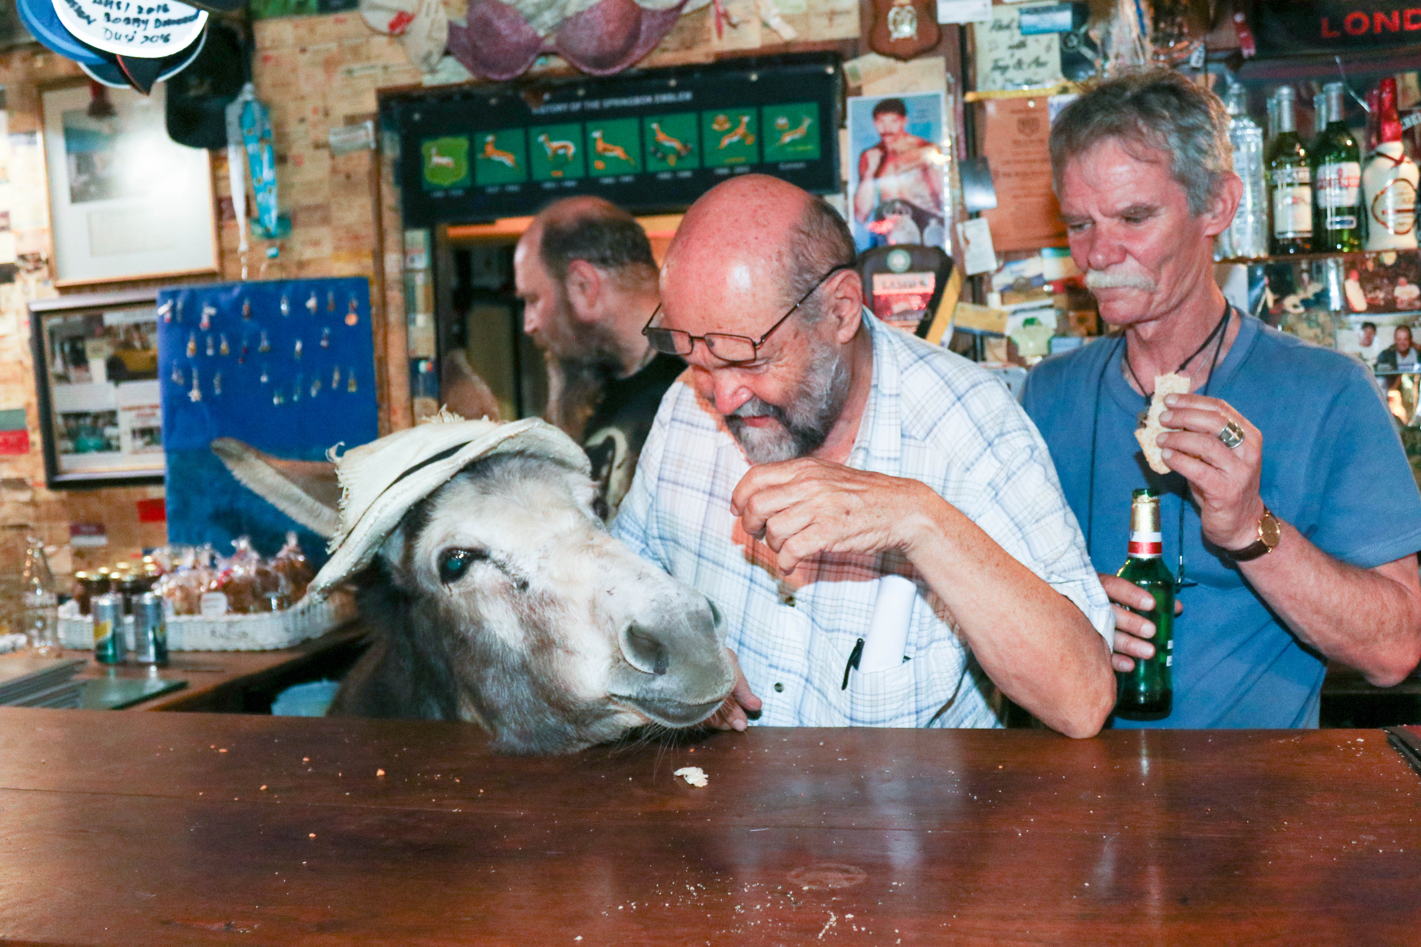

Slide 3
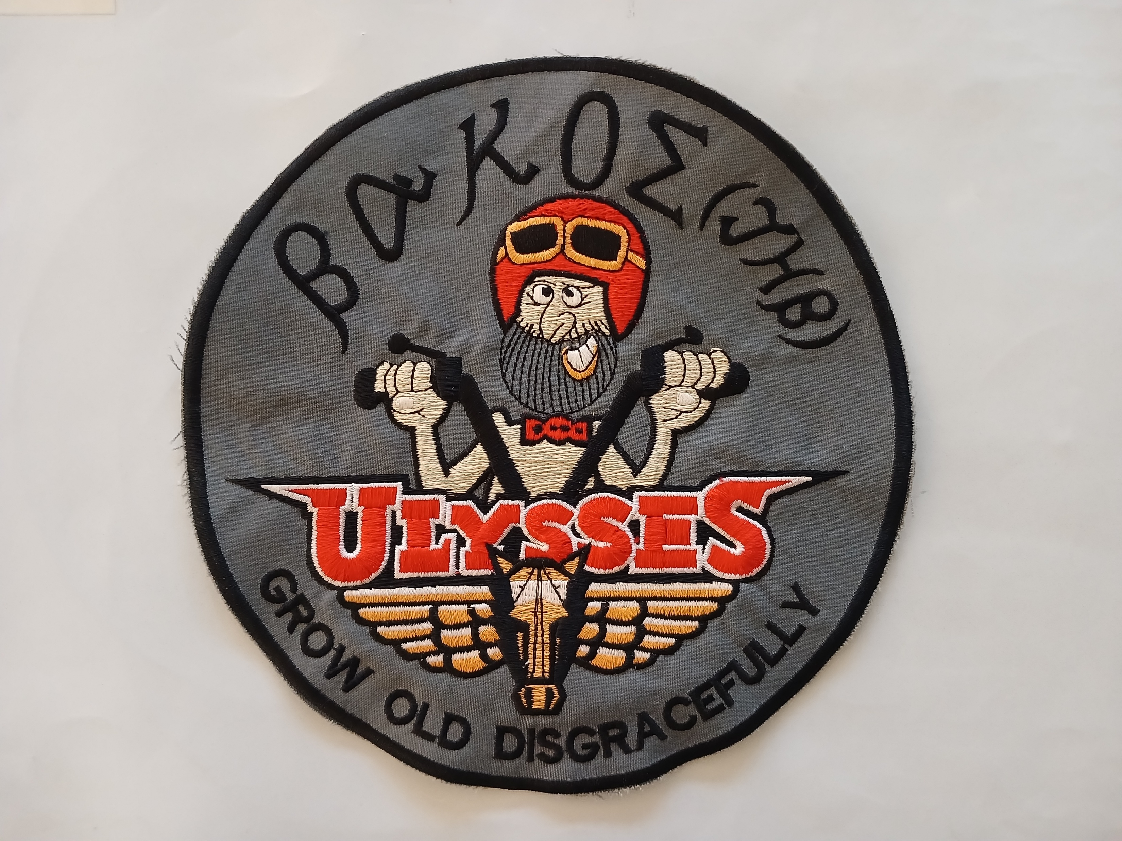

Slide 4


Slide 5



Slide 6
2004
Members 38
Youngest Member 32
Oldest Member 66

Slide 7
2004 Bike Breakdown
BMW 14
Honda 7
Suzuki 3
Yamaha 3
Triumph 3
Harleys 2
Kawasaki 2
Cagiva 1
Ducati 1
Laverda 1 Velocette 1 Ariel Square 4 1

Slide 8
2015
Members 94
Youngest Member 44
Oldest Member 79
Average age 59
Average Time 4.5 years
Members <2y 18 >5 yrs 29
Total People in UJN 179

Slide 9
2014 Bike Breakdown
BMW 36
Yamaha 10
Honda 7
Triumph 5
Suzuki 4
KTM 3
Kawasaki 2
Harley 2 Buel 1 Moto Guzzi 1 Pillion 23

Slide 10
Past President and Vice
Brian Esch Fanie Lewes Keith Nichols Mike Helberg Frans Havenga Brian Flowerday Neil Nel Nick Munday Alan Russel Len Rodrigues Steve De Villiers Jan Du Plessis

Slide 11
Jenny Gibbs
Sandra Hubbard
Misha
Little Mac
John Barnes
Richard Barnard
Brian Flowerday
Geof Harrison
Maryanne Munday
Blokkies
Fanie Lewes
Theo Bosman
Lucia Carr
Simon Carr
Paul Vallet
Ronnie Vrey
Annamarie Russell
Sandy Van Zijl
Dave Owens
Carol Andrews
Tony Glover
Leon Botha
Francois Van Straten
Gary Sanderson
Brian Esch
Motorbiking being dangerous
Since its formation we have had 25 members or ex members pass away
that I know of:
Cancer
Biking related
2 Emphysema
Bee Sting
1 scuba diving
Heart Attack
7 Unsure

Slide 12
amended | 2/11/12
AKASIA | 6
BETHAL | 28
BLOEMFONTEIN | 88
CENTURION | 99
DEEP SOUTH | 2
DURBAN | 99
EAST LONDON | 45
EAST RAND | 35
FAR EAST | 11
GARDEN ROUTE | 28
JO'BURG NORTH | 84
JO'BURG SOUTH | 20
KIMBERLEY
KLERKSDORP | 39
KROONSTAD | 11
KZN SOUTH COAST | 32
NAMIBIA | 11
PORT ELIZABETH | 2
PRETORIA | 37
QUEENSTOWN | 54
RSA (SIMON FOURIE) | 1
UNAFF | 1
UPINGTON
WELKOM | 39
WEST RAND | 29
WESTERN CAPE
WINELANDS
ZULULAND | 18
 | 819

