Slide 1
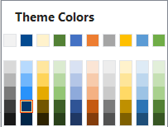
Dark Blue, Text 1, Darker 25%
Light Yellow,
Background 2, Darker 10%

