Slide 1
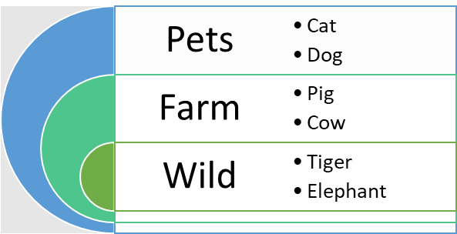
Pets
Cat
Dog
Farm
Pig
Cow
Wild
Tiger
Elephant

