Slide 1
Storage Management
Dr. Alexios Louridas

Slide 2
Mass Storage Structure

Slide 3

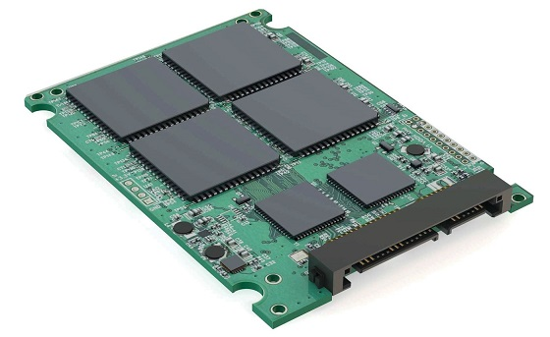
Mass Storage
Hard Disk Drives (HDDs)
Nonvolatile Memory Devices

Slide 4
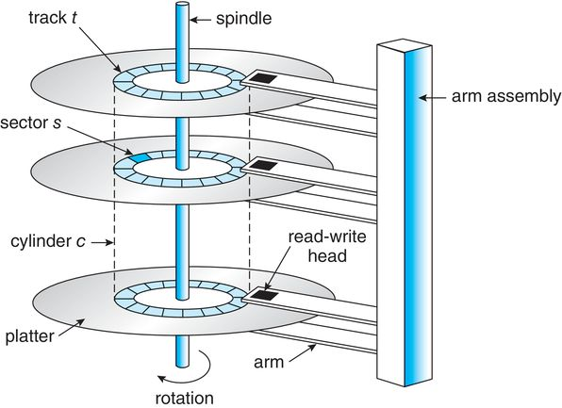
HDD Performance
Transfer Rate
The rate of data transfer from HDD to the computer bus.
Positioning or Random-Access Time
Consist of 2 parts:
Seek time – time to locate cylinder
Rotational latency – time to locate the sector
Head Crash
When the head damages the magnetic sections.
Effective Transfer Rates
Stated transfer rates are always higher than effective transfer rate from disk to OS.

Slide 5
SSD and Nand
Die
Plane
Block
Page

Slide 6
NVM Performance
Flash Translation Layer (FTL)
For nonvolatile memory, a table that tracks currently valid blocks.
Erasure
Erasure can happen on an entire block.
Over Provisioning
Space set aside for data writes that is not counted in the device free space. (20% of an SSD)
Wear Levelling
The effort to select all NAND cells over time as write targets to avoid premature media failure due to wearing out a subset of cells.

Slide 7
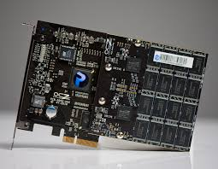
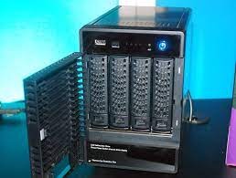
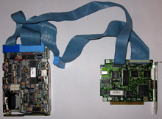
Drives to OS
local I/O ports
motherboards
network

Slide 8
HDD Scheduling

Slide 9
Scheduling
HDD Scheduling
NVM Scheduling
Disk-scheduling algorithms can improve the effective bandwidth of HDDs, the average response time, and the variance in response time
Because there are no moving parts there is no significant performance increase with use of similar scheduling algorithms.
Scheduling Algorithms
Scheduling Algorithms
Algorithms such as SCAN and C-SCAN are designed to make such improvements through strategies for disk-queue ordering. Performance of disk-scheduling algorithms can vary greatly on hard disks.
FCFS strategy is used.

Slide 10
Errors
Data storage and transmission are complex and frequently result in errors. Error detection attempts to spot such problems to alert the system for corrective action and to avoid error propagation. Error correction can detect and repair problems, depending on the amount of correction data available and the amount of data that was corrupted.

Slide 11
Device and Swap-Space Management

Slide 12
Device Management
Low-Level Formatting
OS Storage Device preparation
Sectors created, NVM pages initialised and FTL created.
Record its own data structures on devices.

Slide 13
OS Preparing a storage device
Partitioning
Volume creation
Logical Formatting
Partition 1
Partition 2
Partition 3
Implicit
  File system placed
Explicit
  RAID
File System Creation
Bootable file System
Raw Disk Allocation

Slide 14
Bad Sectors - Blocks
Sector Sparing
Device controller replaces a sector with a spare one. Usually in each cylinder there are a few spare sectors.
Typical Bad-Sector Management
1. Read logical block X -> ECC find block X is bad -> Device controller replaces block with a spare Y -> Any reads or writes on X are redirected to Y.
Sector Slipping
Move all sectors of a block by one space.
NVM Devices
Also suffer from bad pages. Its easier to deal with as they just become inactive. Device controller still needs to maintain a record of all bad pages.

Slide 15
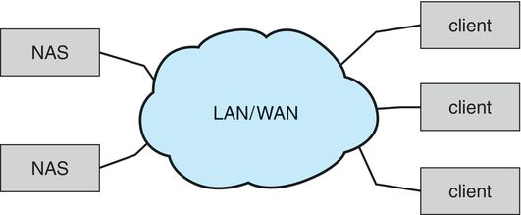

Storage Types
Host-attached
Network-Attached
Cloud
Storage Area Networks (SAN)
HDDs
SSDs
CD-DVD
Flash Drives
…

Slide 16
RAID Structure
Redundant Arrays of Independent Disks

Slide 17
Large system and RAID
Failure
Secondary storage become redundant using RAID algorithms.
Raid Algorithms
These algorithms allow more than one drive to be used for a given operation and allow continued operation.
Drive Failures
Automatic recovery techniques.
RAID Organisation
Multiple levels, each level provides some combination of reliability and high transfer rates.

Slide 18
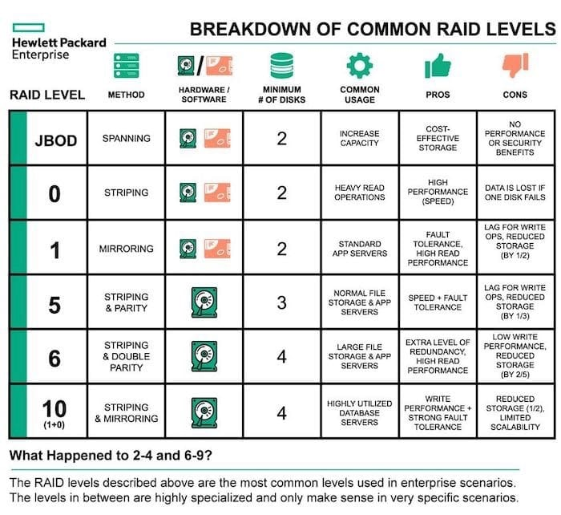
RAID Levels

Slide 19
Object Storage
Object storage is used for big data problems such as indexing the Internet and cloud photo storage. Objects are self-defining collections of data, addressed by object ID rather than file name. Typically it uses replication for data protection, computes based on the data on systems where a copy of the data exists, and is horizontally scalable for vast capacity and easy expansion

Slide 20
Thank you
I big thank you to Bob Eager, software carpentry for sharing their bash resources and Abraham Silberschatz; Peter B. Galvin; Greg Gagne book on Operating Systems for the valuable help in creating the lecture materials (images, resources etc…)

