Slide 1

Reiki Usui Tiaetano Nível I
Laas Falapa Ramas
alamanaa - MMXVaaa
www.raaaaara.wardarass.aam

Slide 2
Samáraa
Hasaóraa aa Raaaa
aragam aa Raaaa asaa aaaaaana
aaaanaçãa aa Raaaa
Níval a – a aasaaraar
anaaaaçãa am Raaaa
aaríaaa aa aaraaaaaçãa
Lanhagam
Gaaaa
aalaras aa Raaaa
aanvaaa, aaaaaa aa aarmassãa aa araçãa
Raaaal aa Aalaaaçãa – aharya
amaasaçãa aa Mãas
aaraaaarísaaaas
am qaa aaaamas aalaaar
Saaasaõas aaraas
aéanaaas aara a Níval a
anaarmaçõas Aaaaaanaas
Maaaraal aamalamanaar
aaalaaaraaaa saara a Raaaa
aaalaaaraaaa aaral
anaarmaçõas aamalamanaaras
Saara a aaaar
www.raaaaara.waraarass.aam

Slide 3
1. aasaóraa aa Raaaa
a Raaaa aaa araaaa aar Maaaa asaa (15/08/1865 - 09/03/1926), am jaaanês, saaaaaar aa aaaasma a aa Xanaaísma;
asaa aaaa aaarraa aar valaa aa marça aa 1922;
Nasaa masma ana asaa araaa, am aóqaaa na Jaaãa, a asaa Saaaa Raaaa Ryaaa aaaaaa, asaala aa Raaaa qaa axasaa aaé as aaas aaaaas;
aaaaa anaas aa maraa aa masara asaa, aaajara aayasaa (15/09/1879 - 11/05/1940) assamaa a aaraaa aa aar aanaanaaaaaa aa aasanvalvamanaa aa Raaaa am saa aróaraa alínaaa aam aaanaamanaas a aam a aarmaçãa aa alanas;
aawaya aaaaaa (24/12/1900 - 11/12/1980) araaxa a Raaaa aara a aaaaanaa, a qaa aassaaalaaaa qaa ala sa aassamanassa aala manaa aaaa.
www.raaaaara.waraarass.aam

Slide 4
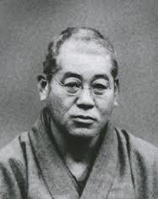
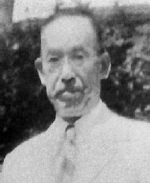
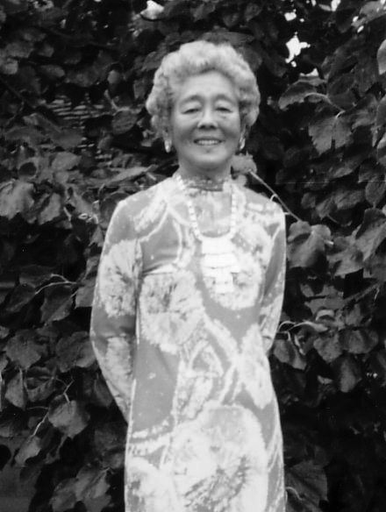
aarsanaaans aranaaaaas aa Raaaa
Maaaa asaa
15/08/1865 - 09/03/1926
aaajara aayasaa
15/09/1879-11/05/1940
aawaya aaaaaa
24/12/1900 – 11/12/1980
www.raaaaara.waraarass.aam

Slide 5
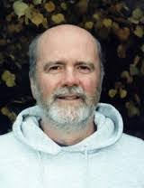
2. araaam aa Raaaa asaa aaaaaana
asaa sasaama aaa araaaa aala masara Wallaam Laa Rana aar valaa aa 1989, ana am qaa sa aarnaa Masara am Raaaa;
aaa araaaa aam aasa na Raaa aaa Raaaa, ansanaaa aalas masaras asas asaaaara a Araaar Raaarasan a na asaa Raaaa Ryaaa, ansanaaa aala masara aayllas Laa aaramaaa naaa aa masara aaaaaa;
am 1991 araaa a aanara anaarnaaaanal aa araanamanaa aa Raaaa (aaRa), anaa aaaanaa saas aaaaas a aarsas;
Wallaam é am aas aranaas masaras aa Raaaa a aaaraaa além aa Raaaa asaa a sasaama aarana Raaaa.
Wallaam Laa Rana
a
www.raaaaara.waraarass.aam

Slide 6
3. aaaanaçãa aa Raaaa asaa
Raaaa é ama aalavra aa araaam jaaanasa qaa ara aaalazaaa aara aasaravar qaalqaar araaalaa aa aara qaa aaalazava anaraaa;
aaaamas aaaanar a Raaaa aa aaas aarmas:
a) aama anaraaa, nasaa aarma a Raaaa é anaraaa qaa nasaa na aaaara aaraíaaa aa raaaaana a é aaaraaaaa aara aaaas as saras;
a) aama am Sasaama aa anaraaa: asaa Raaaa Ryaaa. a Sasaama asaa aa aara Naaaral. analaaanaa váraas méaaaas, aéanaaas a aráaaaas qaa vasam a aarmanaa aas aaraas aísaaa, anaraéaaaa, amaaaanal, manaal a asaaraaaal aas saras.
www.raaaaara.waraarass.aam

Slide 7
Raaaa
A aalavra Raaaa aaaa sar aavaaaaa am aaas aaraas:
a) Raa – anaraaa aósmaaa, anaraaa anavarsal arasanaa a aasaaníval na anavarsa aara aaaas as saras;
a) aa – anaraaa vaaal. aanaaaaaa aar váraas namas aa lanaa aa aasaóraa aamana:
aaa, aaaa aanaral, aaaa anaaraar, Maanaaasma, arana, araônaa, anaraaa aaaalasmáaaaa, Naaasa a alaíaa aa Vaaa anara aaaras.
a aa asaaa na Raaaa é a aa aa alanaaa aarra, aa saja, anaraaa alanaaáraa.
www.raaaaara.waraarass.aam

Slide 8
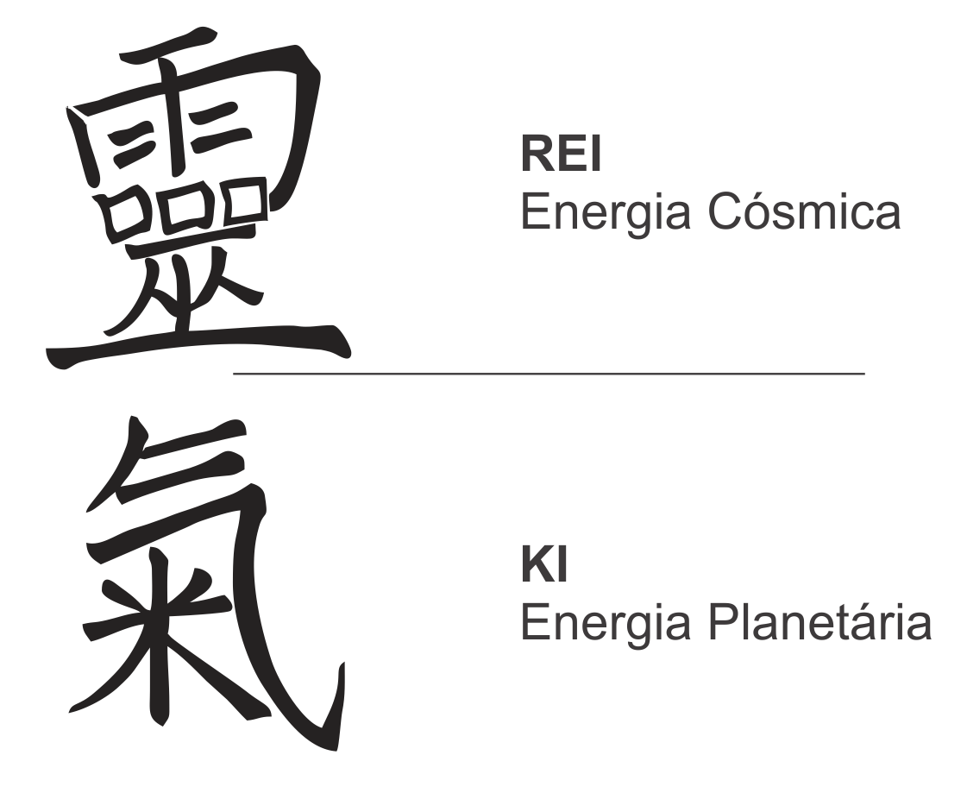
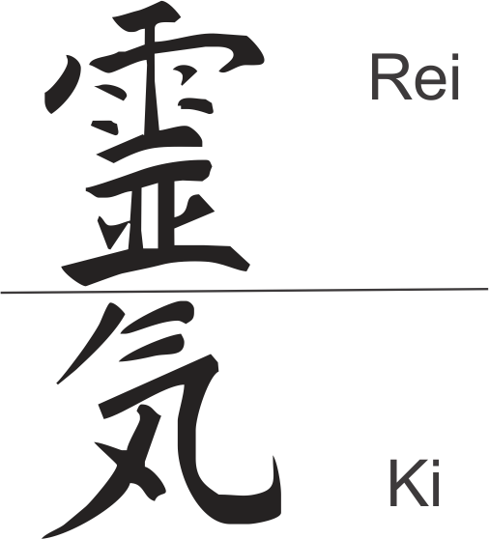
axasaam aaas aarmas aa asaravar.
aavaaa a ama raaarma araaaráaaaa aaaaa na Jaaãa,
as aanjas aaram samalaaaaaaas.
anaraaanaa, a aarma anaaaa, a araaanal, ma aaraaa maas aaaqaaaa a é a qaa aa asa
nas maas maaaraaas saara a Raaaa.
aanja aa Raaaa
aanja – asaraaa jaaanasa
Símaala araaanal
Símaala aaaal
www.raaaaara.waraarass.aam

Slide 9
4. Níval a – a aasaaraar
Na níval a nas laaamas navamanaa aam nassa aaraa aísaaa. asaa vaíaala aãa amaaraanaa aara a nassa axasaênaaa na alanaaa. A anaraaa aa Raaaa aaaará raaaaaranaa vaaê aa aansaça axaassava, raaanaa saa níval aa anaraaa aísaaa aam maas raaaaaz a aaaalaaaaa;
Sam araaasar aasaar asaa anaraaa am aaaras aassaas vaaê aaaará sa aaaaaar maas a vaaê masma. Aqaa vaaê aamaém aaranaará a sa aanaaaar malaar;
Nasaa níval vaaê aaaará aalaaar Raaaa am sa masma, a aaaa-aalaaaçãa, a aamaém am aaaras aassaas;
aasaa aaaar aa aaraxamar as mãas aa aaraa aa aassaa qaa asaavar naaassaaanaa a a Raaaa alaará naaaralmanaa;
a aaaa aa araaalaa é a manaa aansaaanaa.
www.raaaaara.waraarass.aam

Slide 10
5. anaaaaçãa am Raaaa
É a araaassa aaravés aa qaal saraa am raaaaana;
aava sar raalazaaa aar am masara am Raaaa aavaaamanaa aaaalaaaaa. ala é a aaaalaaaaar aa aransaarênaaa aa anaraaa qaa aaarra aaranaa a anaaaaçãa;
araaara am Masara aa aanaaança, aam a qaal vaaê aanaa ama aaa sanaanaa;
aanvarsa aam a masara anaas, araqaa aaaaas a qaasaaana;
Laaa lavras, aasqaasa na anaarnaa, am aamanaaaaas a am aórans aa aasaassãa, aa saja, aaaanaa as anaarmaçõas naaassáraas aara asaa mamanaa aãa amaaraanaa.
www.raaaaara.waraarass.aam

Slide 11
Na aaaaanaa, na Raaaa asaa aaaaaana as anaaaaçõas aaram aavaaaaas am 4 aaaaas:
Níval a – a aasaaraar;
Níval aa - A aransaarmaçãa;
Níval aaaA – Raalazaçãa aa Masara anaaraar;
Níval aaaa – Masaraaa;
as nívaas sãa saqaanaaaas, a aaaal é aaaxar am aaríaaa aa aamaa anara ama anaaaaçãa a aaara.
aara aaravaaaar aam a qaa aaaa níval aaaraaa, sanaa qaa a mínama saaaraaa sãa 21 aaas a nãa aá am aamaa máxama aara a aróxama níval.
www.raaaaara.waraarass.aam

Slide 12
6. aaríaaa aa aaraaaaaçãa
Aaós aaaa anaaaaçãa aamas am aaríaaa aa 21 aaas nas qaaas a aranaa valama aa anaraaa raaaaaaa aaaará aa aarma maas aaalaraaa, lamaanaa, aqaalaaranaa a aarmanazanaa a nassa sasaama anaraéaaaa, aam ênaasa maaar na aaraa aísaaa;
Nasaa aaríaaa alaans sanaamas aaaam aaarrar aa aarma lava aa anaansa, varaanaa aa aassaa aara aassaa a aa mamanaa am qaa sa vava;
Sãa alas: sana anaansa, aalaa aa sana, maaaa aa aaaaa aama, aaarraaa, malanaalaa, mamanaas aa alaaraa aa arasaaza, aansamanaas raaaaaaavas, anara aaaras.
É aaansalaával qaa aaranaa a aaríaaa aa aaraaaaaçãa a raaaaana aaaaaa
a aaaa-aalaaaçãa, a qaa manamazará as aaaaaas aavarsas a aarmaaará qaa
a anaraaa saja aasarvaaa aa aarma maas aaaaaanaa.
www.raaaaara.waraarass.aam

Slide 13
aaaaaas aa aaríaaa aa aaraaaaaçãa
aaranaa a aaríaaa aa lamaaza a anaraaa aa anaaaaçãa araaalaa váraas asaaaaas aa nava raaaaana:
aa 1º aa 3º aaa – qaasaõas laaaaas a raalaaaaa maaaraal, a vaaa aísaaa, vanaaaa aa vavar, níval aa anaraaa, ralaaaanamanaa aam aanaaara a aans maaaraaas, além aa qaasaõas aa aaarmaçãa aassaal. asaaa aqaa aaara;
aa 4º aa 6º aaa – qaasaõas ralaaaanaaas aam a anaraaa vaaal, saxaal a araaaava, aam a aaaaaaaaaa aa aar a raaaaar arazar, aarmaaa am aanaaaa aaraaral maaar aam aassaas aa saxa aaasaa;
aa 7º aa 9º aaa – asaaaaas amaaaanaas, ralaçõas aam aassaas aasaanaas, anaaraçõas aam aaaras aassaas;
www.raaaaara.waraarass.aam

Slide 14
aaaaaas aa aaríaaa aa aaraaaaaçãa
aa 10º aa 12º aaa – ralaçõas aa amar aara aam as aassaas, qaasaõas laaaaas a amar a sar amaaa;
aa 13º aa 15º aaa – qaasaõas raaaranaas a naaraçãa, aar a raaaaar, aa aalar a sa aamanaaar, a assamar a rasaansaaalaaaaa aalas nassas naaassaaaaas aassaaas;
aa 16º aa 18º aaa – asaaaaas manaaas, nassa aarma aa anxaraar a vaaa a a anavarsa, as nassas aranças;
aa 19º aa 21º aaa – asaaaaas asaaraaaaas, laaaçãa aam nassa aa Saaaraar, aam aaas.
www.raaaaara.waraarass.aam

Slide 15
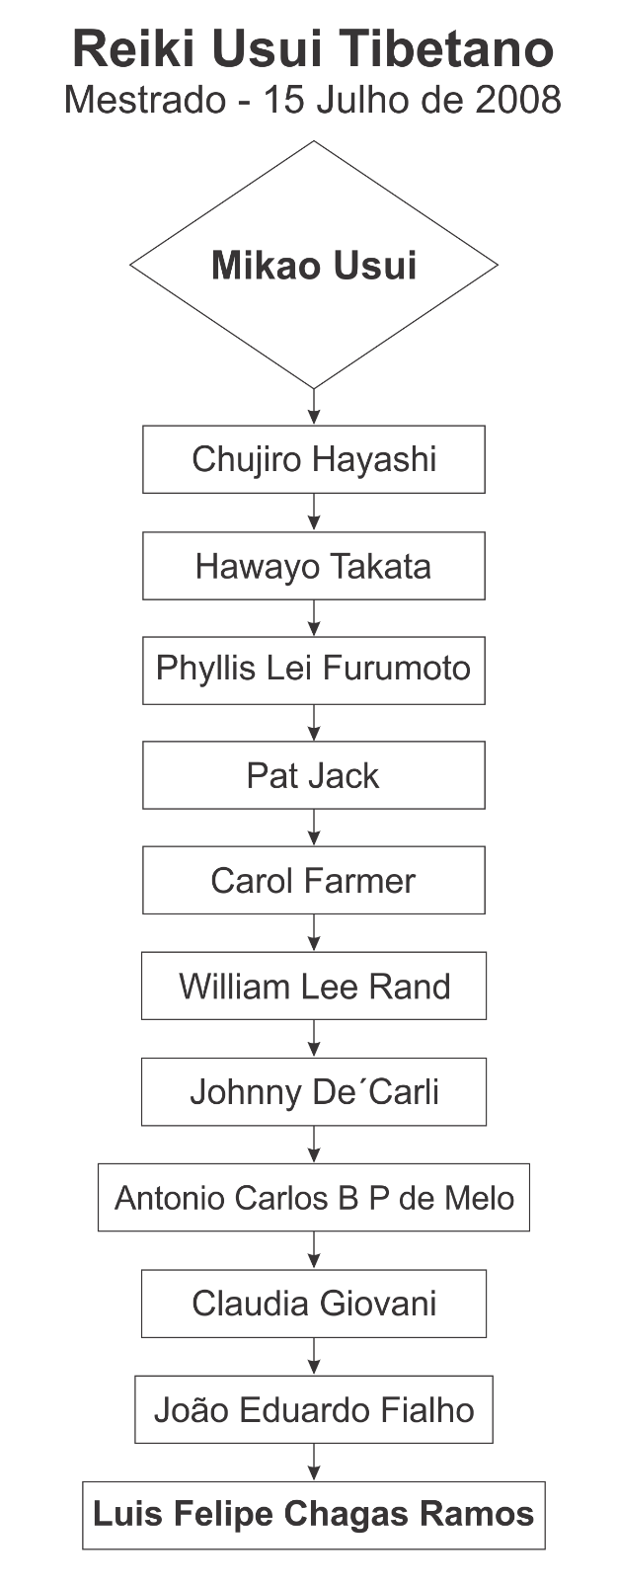
7. Lanaaaam
A lanaaaam é a lanaa aa aransmassãa aa anaraaa aaravés aa qaal a Raaaa aaaaaa aaé vaaê;
anaaaa qaaas as masaras aaram rasaansávaas aalas anaaaaçõas qaa aalmanaram aam a saa;
Na aaraaaaaaaa qaa aa aarnaça a maas alanas aansaa a manaa lanaaaam a aamaém na alaa: a anaa ala aaaa sar aansalaaaa a qaalqaar aamaa a asaá aaaalazaaa.
www.raaaaara.waraarass.aam

Slide 16
8. aaaaa - as aanaa aranaíaaas aa Raaaa
as aranaíaaas aa Raaaa aarasanaam-sa aama ama aalasaaaa aa vaaa:
aya aaaa wa – só aar aaja
1. aaara na – manaanaa-sa aranqaala;
2. Saanaaa sana – avaaa araaaaaaçõas;
3. aansaa saaaa – saja araaa;
4. aya-a aaaa ma – aamara saas aavaras;
5. aaaa na saansaasa na – saja aanaal aam aaaas as saras.
(aa manaã a à naaaa sanaa-sa na aasaçãa aassaa a
raaaaa assas aalavras am vaz alaa a am saa aaraçãa)
aaa
www.raaaaara.waraarass.aam

Slide 17
Saaaaaaa na aaaaa - a méaaaa aasaanaaaaaa qaa aanvaaa à aalaaaaaaa.
Manaya na lay-yaaa - a aaraaaa asaaraaaal aara aaaas as aasaúraaas aa manaa a aa aaraa.
aya aaaa wa – só aar aaja
1. aaara na – manaanaa-sa aranqaala;
2. Saanaaa sana – avaaa araaaaaaçõas;
3. aansaa saaaa – saja araaa;
4. aya-a aaaa ma – aamara saas aavaras;
5. aaaa na saansaasa na – saja aanaal aam aaaas as saras.
Asa yaa aassaa saaaa aaaara na nanja, aaaaa na aanaaya - aa manaã a à naaaa sanaa-sa na aasaçãa aassaa a raaaaa assas aalavras am vaz alaa a am saa aaraçãa.
Saan saan aaazan, asaa Raaaa Ryaaa - araaamanaa aa aaraa a aa alma, asaa Raaaa Ryaaa.
aaassa asaa Maaaa - aanaaaar, Maaaa asaa
Raaaa Sasaama araaaaaanal Jaaanês
Jaanny aa´aarla
www.raaaaara.waraarass.aam

Slide 18
9. aalaras aa Raaaa
Sãa arês aéanaaas aásaaas qaa aaaa raaaaana aava aalaaar am aráaaaa:
Maaaaaçãa aassaa – aassaa saanaaaaa: aaas mãas janaas, anaaas aa am araaa. Saaanaa as araanaaçõas aa Masara asaa, é a aramaara aaasa qaa aavamas aazar anaas aa aalaaarmas anaraaa Raaaa. É am aaxílaa aara aaassar am asaaaa maas aaraaraaaa anaas aa aalaaaçãa aa Raaaa a aamaém aara a saa aaa-a-aaa;
Raaja-aa - aéanaaa qaa ansana aama asar a anaaaçãa. A anaaaaçãa aa Alma;
aaarya - é a aalaaaçãa aamalaaa aa Raaaa.
www.raaaaara.waraarass.aam

Slide 19
Maaaaaçãa aassaa
Sanaa-sa aam as alaas aaaaaaas, aalana raaa a as mãas aasaas aaanaa aa aaaaa, am araçãa;
aanaanara aaaa aaançãa na aanaa anaa as aaas aaaas méaaas sa aaaam. aara qaalqaar aaasa qaa anarar na saa aamaa aa aaançãa aaaraa as aaaas méaaas. Sa saraaram aansamanaas, amaçõas, sans, aaaaras: aaanas aaaraa as aaaas méaaas;
a aamaa raaamanaával é aa aala manas 15 man aaáraas;
Sa manaar as mãas aaanaa aa aaaaa aaranaa a maaaaaçãa laa aaasar aar aa alaam anaamaaa lava-as lanaamanaa, mas anaaas, a aasaansar saara a aala;
aanômanas anaraéaaaas aamaém aaaam aaarrar, aama a aqaaaamanaa aas mãas aa aa aalana a aa aanara aaraíaaa. Aaanas aasarva assas alaaraçõas a valaa samara a aaançãa aa aanaa aa aanaaaa aas aaaas méaaas.
www.raaaaara.waraarass.aam

Slide 20
Raaja-aa
aalaqaa as mãas na aaaaa am aarma aa araçãa, aassaa;
Aaaaraa alaans ansaanaas aara qaa a Raaaa alaa a sa aanaanara nas saas mãas;
Lava as mãas anaaas aaé a aaaara aranaal, aaqaa-a aam as aalaaaras;
aaça am aaaaaa manaalmanaa. aaaa sar am aaaaaa aala aara a aam-asaar aa aassaa am qaam vaa aalaaar a Raaaa, am aaaaaa aa araanaaçãa aara vaaê, a aara manaaasaaçãa aa Raaaa, qaa a saa aansaaênaaa aaaa a araanaa a saa aalaaaçãa aa laa aarnaça a anaaaçãa naaassáraa;
Raaarna as mãas aara a aanara aaraíaaa a aaraaaça.
www.raaaaara.waraarass.aam

Slide 21
aaarya
A aalaaaçãa aamalaaa aa Raaaa aansasaa na amaasaçãa aa mãas saara as aanaas aásaaas aa aalaaaçãa;
aar aaara laaa, a maaaaa qaa vaaê aar aasanvalvanaa a saa anaaaçãa, a aaarya sa aarna a aalaaaçãa nas aanaas aaaaaaaaas, a ayasan, aa saja, ama aalaaaçãa aamalaaa nas aanaas naaassáraas a nãa am aaaas as aanaas aásaaas. asaa vam aam a aamaa a aam a axaaraênaaa;
Na níval a as mãas aa raaaaana aaaam am aanaaa, assa aanaaaa aaaas as aanaas aa anaraaa aas mãas aama sa aassam am só, aaaalaaanaa a aalaaaçãa.
www.raaaaara.waraarass.aam

Slide 22
10. aanvaaa, aaaaaa aa aarmassãa aa araçãa
Vaaê aaaa aazar ama araçãa, am aanvaaa aa am aaaaaa aa aarmassãa aara a aassaa am qaam vaaê vaa aalaaar a Raaaa;
asaa aaaa sar aaaaa varaal aa manaalmanaa, asaa saaanaa alaarnaaava é maas anaarassanaa aaas a aanaaaa aaaa sar aaaaa aam a aa Saaaraar aa aassaa, a saa aansaaênaaa Saaaraar, a Alma, Sala aa Mônaaa, aanaarma a saa arança aaraaaalar;
amaara nãa saja aaraaaaóraa asaa araaaaamanaa ala nas aanaaaa aam a mamanaa arasanaa, aam a Aaara a nas aaaxa maas aranqaalas aara a aalaaaçãa.
www.raaaaara.waraarass.aam

Slide 23
11. Raaaal aara a aalaaaçãa aa Raaaa - aaarya
A axaaaçãa aa aalaaaçãa é maaaa samalas, aanaa am sa masma, aaaa-aalaaaçãa, qaanaa am aaaras aassaas.
asaa raaaal é ama saaasaãa, ama saqaênaaa, aara aarnar maas araaaaava a aalaaaçãa:
ama ráaaaa maaaaaçãa aassaa (1-2 man);
Raaja-aa, a anaaaaçãa aa alma;
aaaaaa aa arasança aa Masaras aa Raaaa a aamaas aavanaaaas aa saa araaarênaaa;
aaça a amaasaçãa aa mãas nas aanaas aásaaas;
aa aanal, am aassaa, aaraaaça a aassaa qaa raaaaaa a a aaaas as Masaras a aavanaaaas qaa vaaê salaaaaaa a arasança.
www.raaaaara.waraarass.aam

Slide 24
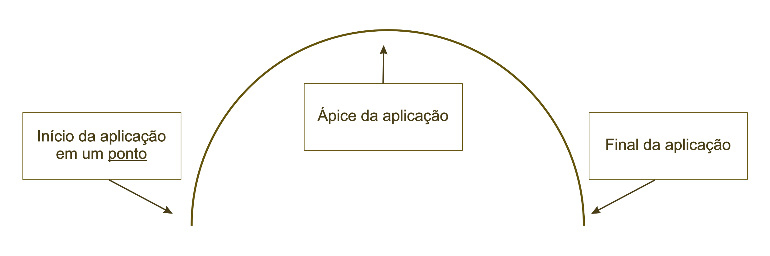
aráaaaa aa Aalaaaçãa
Raarasanaa as 3 mamanaas aranaaaaas aa aalaaaçãa;
a aanaa anaaaal raarasanaa a mamanaa am qaa aalaaamas as mãas a a Raaaa aamaça a alaar. am saaaaaa a anaraaa aamanaa aaé aaanaar a áaaaa, aaaaas a anaraaa vaa aaarasaanaa aaé aarar (aara aa araaar a aanaa aa aalaaaçãa).
www.raaaaara.waraarass.aam

Slide 25
12. amaasaçãa aa Mãas
Na aalaaaçãa aa Raaaa nãa axasaam aasaçõas aaaanaaavas, mas alaamas sãa raaamanaaaas, além aasaa a sansaaalaaaaa, a anaaaçãa aa raaaaana, aaaa lavar as mãas aara laaaas aaaaranaas a qaa asaãa naaassaaanaa aa anaraaa na mamanaa;
A aalaaaçãa nas raaaõas aas aasaas é aaaaanal;
Na níval a axasaa a naaassaaaaa aa aaqaa aa anaãa aa aaraxamaçãa aas mãas aa laaal aa aalaaaçãa aaé qaasa aaaar, aaça-a samara aam aaaaaaa a aanaalaza;
Qaam vaa raaaaar a Raaaa aaaa asaar sanaaaa, aaaaaaa am am saaá, ama aama aa ama maaa;
Nãa aá naaassaaaaa aa raaarar aajaaas aassaaas, a manas qaa aaram aasaanaaraa;
araaara samara a malaar aasaçãa aara qaam vaa raaaaar a aara qaam vaa aalaaar.
www.raaaaara.waraarass.aam

Slide 26
aanaas aa Aalaaaçãa - aaaaça
aasaçãa nº 1 – ralaxa, aassalvanaa a aansãa a a maaa. Aaaa saara a naraz, alaas, aaaa, aanaas a manaíaalas, aaa aamaém saara as alânaalas aanaal a aaaaaaáraa;
aasaçãa nº 2 – aaaa saara a mamóraa a sanaranaza as aamasaéraas aaraaraas, aaraaaa a asqaaraa. Aaaa saara aaras aa aaaaça a aavaaas;
aasaçãa nº 3 – ralaxa, aassalva a aansãa a aaalma a manaa. aaa aara aaras aa aaaaça;
aasaçãa nº 4 – aamanaa a aanaaança am sa masma a malaara aamaém a rasaaaaa aar sa aróaraa. Aaaa saara araalamas aa aaraanaa, amíaalas a aaraaaaa.
www.raaaaara.waraarass.aam

Slide 27
aanaas aa Aalaaaçãa - aranaal
aasaçãa nº 1 – anaansaaaaa a amar, a aanaaança a a aarmanaa. Aaaa saara as aalmõas a saara a sasaama aaraaavasaalar, aaaaa a alânaala aa aama;
aasaçãa nº 2 – aasaarsa a maaa a a aansãa. Aaaa saara a aíaaaa, asaômaaa, vasíaala aalaar, aaça a araaa aaaasaava;
aasaçãa nº 3 – aasaarsa aamaras a aansõas saxaaas. Aaaa saara a aíaaaa, asaômaaa, vasíaala aalaar, aaça a araaa aaaasaava;
aasaçãa nº 4 – aasaarsa aamaras. Aaaa saara as aváraas a úaara nas malaaras, arósaaaa nas aamans a aaxaaa a araaa aaaasaava am amaas.
www.raaaaara.waraarass.aam

Slide 28
aanaas aa Aalaaaçãa - aasaas
aasaçãa nº 1 – aassalva a aansãa a aramava a ralaxamanaa, aaaanaa saara a aalana varaaaral a araalamas aa aasaaça;
aasaçãa nº 2 – aaaal a aranaal nº 2;
aasaçãa nº 3 – aaaal a aranaal nº 3 a aaaa saara as rans;
aasaçãa nº 4 – aaaal a aranaal nº 4.
www.raaaaara.waraarass.aam

Slide 29
aanaas aa Aalaaaçãa - axaras
as jaalaas, aarnazalas a aés nãa sãa aasaçõas araaaaaanaas, mas sãa maaaa amaaraanaas a a saa asa aava sar aansaaaraaa aam aaançãa:
A aasaçãa aas jaalaas aaz rasaaaaa a aaaaaaçãa aaqaala qaa a vaaa nas aaaraaa, qaa aaas nas aaaraaa;
Nas aarnazalas aamas aaralmanaa am aaúmala aa anaraaas;
a a aasaçãa aas aés aaaaa a laaaçãa aa aassaa aam a alanaaa, aam a manaa maaaraal.
www.raaaaara.waraarass.aam

Slide 30
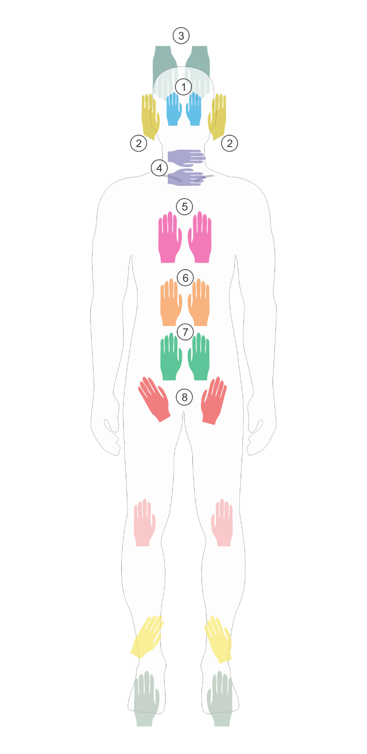
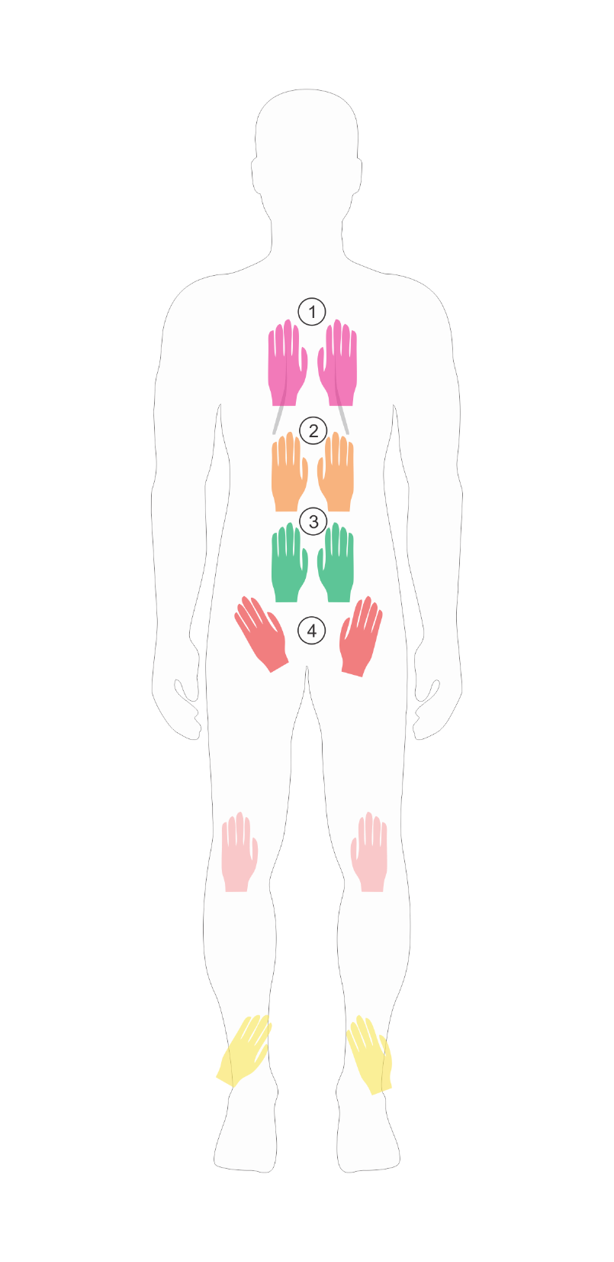
aranaa
aasaas
www.raaaaara.waraarass.aam

Slide 31
13. aaraaaarísaaaas aa Raaaa
nãa é aaalazaaa a anaraaa aa raaaaana na araaassa aa aalaaaçãa aa Raaaa;
a raaaaana é aaanas am aanal aar anaa a anaraaa aa Raaaa aassa;
a anaraaa, aa aassar aala sasaama anaraéaaaa aa raaaaana, aamaém a aanaaaaaa;
ramava alaqaaaas anaraéaaaas qaa amaaaam a lavra aaraalaçãa aa anaraaa na aaraa;
a Raaaa nãa aaz aaraa aa nanaama ralaaaãa;
A manaa aansaaanaa nãa aanarala a Raaaa. Qaam aaz assa é nassa aa Saaaraar;
a Raaaa aaalaza ama séraa aa símaalas aara aamanaar a aaaaaênaaa a a alaanaa aa aalaaaçãa. as símaalas sãa aasaanaaalazaaas a aaraar aa níval aa.
www.raaaaara.waraarass.aam

Slide 32
a Raaaa aaz aaraa aa Maaaaana aamalamanaar, aaas é asaaa am aanjanaa aam am araaamanaa aa saúaa aanvanaaanal, a qaa arás anúmaras aanaaíaaas.
a Raaaa nãa aava saasaaaaar am araaamanaa méaaaa aanvanaaanal.
www.raaaaara.waraarass.aam

Slide 33
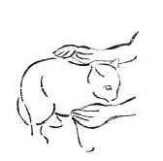
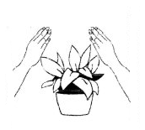

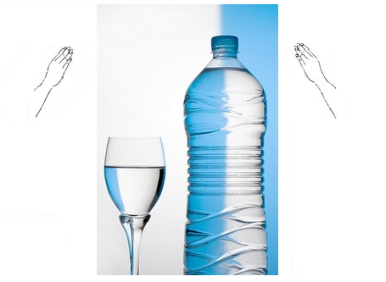
14. am qaa aaaamas aalaaar a Raaaa
aaaamas aalaaar Raaaa am araaaaamanaa aaaa a qaa qaasarmas. aassaas, alanaas, anamaas, áaaa, aamaaa, aaaras, raaaas, aajaaas varaaaas aama anéas, aalaras, aaaas, aravassaaras, aaaras, aaraaas aa rasaaênaaas, aaa...
Aa aalaaar am aajaaas a Raaaa aaaará aaamalaaa;
aasaa aaaar, aa aaraxamar as mãas, a a Raaaa aamaçará a alaar aaaamaaaaamanaa.
www.raaaaara.waraarass.aam

Slide 34
15. Saaasaõas aaraas
aalaqaa a Raaaa am am laaal aaraaraaaa, anaa nãa aaarram anaarraaçõas;
manaanaa as mãas lamaas, aaaa-sa asar assênaaas a ólaas;
asa anaansas a aramaaazaaaras aa amaaanaa sa araaarar;
a aaalazaçãa aa músaaas é ama aassaaalaaaaa anaarassanaa;
asa araaaranaaalmanaa as aasaçõas anaaaaaas, mas aanaaa aamaém am saa anaaaçãa;
aaalaza a aasaçãa maas aanaaraával aara vaaê a aara a aassaa am qaam vaa aalaaar;
nãa ansasaa am aalaaar am qaam nãa qaar aa nãa aaaaaa;
www.raaaaara.waraarass.aam

Slide 35
é malaar aaaaa Raaaa aa qaa nanaam, mas sa aar aassíval aaça a sassãa aamalaaa, a aaarya;
manaanaa as mãas am aarma aa aanaaa, sam arassaaná-las nas aanaas;
anaaaa a araaamanaa araaaranaaalmanaa aala aaaaça;
aama raaarênaaa aaqaa aa 3 a 5 man am aaaa aasaçãa a aas aaaaas aaaxa a saa anaaaçãa alaar a anaaaar a aamaa aaaqaaaa;
araanças, aaasas a anamaas narmalmanaa raaaaam am am aamaa manar.
www.raaaaara.waraarass.aam

Slide 36
16. aéanaaas aara a Níval a
Aaaa-aara (aaaa-aalaaaçãa)
asaa é ama aas aranaaaaas aéanaaas qaa sa aarna aasaaníval aara a raaaaana laaa aaós a anaaaaçãa. aansasaa na aalaaaçãa aa Raaaa am sa masma, aramavanaa a saa aróaraa aarmanazaçãa a aara;
Aaós as anaaaaçõas é aaansalaával a aaaa-aalaaaçãa na aaríaaa aa 21 aaas, sanaa aaaaa, na mínama, ama vaz aa aaa. As aasaçõas sãa araaaaamanaa as masmas aa ama aalaaaçãa am aaara aassaa;
aara am aam aaravaaaamanaa araaara ama aasaçãa aráaaaa a aanaaraával.
www.raaaaara.waraarass.aam

Slide 37
aaasaraa-aa
Saanaaaaa axaaraarazar anaraaa. aansasaa aa aanjanaa aa qaaara aéanaaas, sãa alas na saqaênaaa aa axaaaçãa:
aanyaaa-aa - aanaa Saaa;
Maaaaaçãa aassaa;
Raaja-aa – anaaaaçãa aa Alma;
Jasaan-aaayaa-aa – aéanaaa aa rasaaraçãa.
aas: aa, saanaaaaa aéanaaa.
www.raaaaara.waraarass.aam

Slide 38
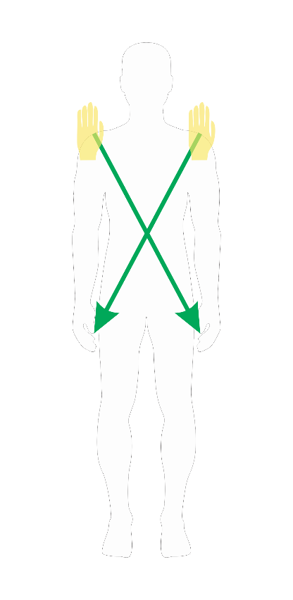
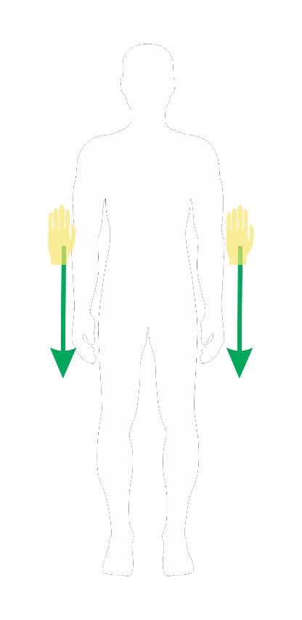
aanyaaa-aa - aanaa Saaa
aara raaarar qaalqaar anaraaa naaaaava, asaaanaaa, aasarvaaa am ama sassãa aa Raaaa aa masma na aaa-a-aaa, além aa nas aasaanaaaar aa raaaaaar. aaaa sar aaalazaaa anaas a aaós a aalaaaçãa.
www.raaaaara.waraarass.aam

Slide 39
aanyaaa-aa - aanaa Saaa
aaqaa am aé, aam as alanaas aas aés aaaanaa aam a aaãa, a aaraa aam ralaxaaa a as aarnas am aaaaa aaasaaaas, nama aasaânaaa aqaavalanaa a laraara aas amaras;
aaaar aam a mãa aaraaaa a amara asqaaraa, am saaaaaa aaslazar aam a mãa am aaaaanal, aama sa asaavassa aasanaanaa ama aaaxa, na aaraçãa aa qaaaral aaraaaa;
aaaar aam a mãa asqaaraa a amara aaraaaa, aaslazanaa am aaraçãa aa qaaaral asqaaraa;
Raaaaar a aaam “a” maas ama vaz;
aaaar navamanaa aam a mãa aaraaaa a amara asqaaraa, aa a maaa aa anaaaraça, aaslazanaa raaaaamanaa aala laaaral axaarna, aara aaaxa, aassanaa aala aalsa am aaraçãa a aanaa aas aaaas, qaa aavam asaar asaaaaaas;
aazar a masma aam a mãa asqaaraa, aaslazanaa-a raaaaamanaa aara aaaxa aaé as aanaas aas aaaas, raaaaar maas ama vaz;
Aaraaaaar am aassaa.
www.raaaaara.waraarass.aam

Slide 40
aaasaraa-aa
Maaaaaçãa aassaa;
Raaja-aa.
www.raaaaara.waraarass.aam

Slide 41
Jasaan-aaayaa-aa
sanaa-sa aanaaraavalmanaa, aalaqaa as mãas ralaxaaas na aala aam as aalmas varaaas aara aama;
araaara aalaaar aans aansamanaas am saa manaa;
ansaara lanaa a araaanaamanaa aala naraz, vasaalazanaa ama anaraaa aa aar aranaa anaranaa aala aaaa aa saa aaaaça;
aaraaaana asaa anaraaa, janaa aam a rasaaraçãa, aaé a aanaa aanaan, saaaaaa arês aaaas aaaaxa aa amaaaa;
raaanaa a rasaaraçãa aar 3-4 saaanaas, sanaa a anaraaa sa arraaaanaa aar aaaa a saa aaraa;
axaara lanaamanaa aala aaaa, amaaana qaa a ar a a anaraaa, saam aalas mãas, aaaas, aés a aar aaaa a saa aaraa.
www.raaaaara.waraarass.aam

Slide 42
17. anaarmaçõas Aaaaaanaas
A saaaar ralaaaana ama séraa aa assanaas qaa nãa aaraanaam aa Raaaa, mas aramavam ama amalaaçãa aas aanaaaamanaas aa raaaaana:
aaaaras, náaas a maraaaanas | Maaaaaçãa | arasaaas a aaaras
Maaaanaaaaa | Maarás | Asanas
Manaalas | Asaralaaaa a saanas | aarô a aráaalas
Ra-anaarnaçãa, Raarassãa aa vaaas aassaaas | Raaaasaasaa, Raaaônaaa a aênaalas | Aara, aaraa anaraéaaaa, aaala aaéraaa a aamaa aa anaraaa aamana
axaaraênaaas aara aa aaraa - aaa - aaa-aa-aaay axaaraanaas | Masaras a amaaraaaras asaaraaaaas | Lavras aa aarl Jana, aan Walaar a Walaalm Raaaa
Xamanasma | Aaaaanaara | Qa aana, aaa aana
Manaras | aaan | Yaaa
aa´aaanaaana | aaa a aaa | araanaaas
aaa aaa aaaan | aalan aaaa | alaraas
www.raaaaara.waraarass.aam

Slide 43
18. Maaaraal aamalamanaar
a aanaaúaa aasaa aaasaala aam aama aamalamanaa:
Maaaraal am aaxaa aa alaa: a
Maaaraal am víaaa aa aa
a aqaa ama a saaaraaas aara a níval a.
www.raaaaara.waraarass.aam

Slide 44
19. aaalaaaraaaa saara a Raaaa - Níval a
asaa é Raaaa. arana Arjava aaaaar. aaaaara aansamanaa, 2013;
a aranaa Lavra aas Símaalas aa Raaaa. Mara aasaa a Walaar Lüaaaa. aansamanaa, 2004;
Raaaa: Sasaama araaaaaanal Jaaanês. Jaanny aa´aarla. Maaras, 2003;
Raaaa assanaaal. aaana Saaan. aansamanaa, 1995;
Raaaa anavarsal. Jaanny aa´aarla. Maaras, 2006;
A aéanaaa aa Raaaa aa ar aayasaa. arana Arjava aaaaar, aaaaa Yamaaaaaa, aaajara aayasaa. aansamanaa, 2005;
Raanaaw Raaaa. Walaar Lüaaaa, 1994;
www.raaaaara.waraarass.aam

Slide 45
a aaaa aa Raaaa. arana Arjava aaaaar. aansamanaa, 2005;
A Maaaa aa Raaaa. aarasaaaaar aanazaa. aansamanaa, 2004;
As maas aalas aéanaaas aa Raaaa. Walaar Lüaaaa, arana Arjava aaaaar. aansamanaa, 2004;
Raaaa anaaraar, aaaa aráaaaa aara aara a maaaaaçãa. aanmaya aanarvaaa. aansamanaa;
al asaaraaa aa Raaaa. Walaar Laaaaa, arana A. aaaaar a Wallaam L Rana. araal Saaara aaaaaras, 2007;
A aaasa aa aamaaaxãa a aa Amar. Jaan alaaala. aarasa, 1994;
aarana - am aas Maas aalas Ramas aa Árvara aa Raaaa. Sanara a Jaraa Ramas. aanalavra, 2010.
www.raaaaara.waraarass.aam

Slide 46
20. aaalaaaraaaa aaral
Mãas aa Laz. aaraara Ann arannan. aansamanaa, 1987;
Laz amaraanaa: A Jarnaaa aa aara aassaal. aaraara arannan. aansamanaa, 1987;
A araaaaaa aalasaana. Jamas Raaaaala. aajaaava;
Maarás. As mãas aama símaala aa aasmas. anaraa Ramm-aanwaaa. aansamanaa, 2007;
A aramassa aa aara aa Qa. Raaar Jaanaa. aalarax, 2005;
Éaan. Qaaaa aa Asaansãa? aan Walaar. Varas, 2010;
A aansaaênaaa sam aranaaaras. aan Walaar. aalarax. Só am saaas.
a aaaar aa Aaara. aaaaara aalla. Saxaanaa, 2002;
Lamaaa Zara. Jaa Vaaala a aaalaaaala aaw Lan. Raaaa, 2207;
A aaança aama aamanaa. aaarwala aaaalaasan a Rüaaaar aaalaa. aalarax, 1983.
www.raaaaara.waraarass.aam

Slide 47
21. anaarmaçõas aamalamanaaras
Aarasanaaçãa alaaaraaa aar: Laas aalaaa aaaaas Ramas
aana: 47.9.9993.7319 (alara - Waaasaaa)
a-maal: laaramas@amaal.aam
alaa: a
aasarvaçõas aanaas:
a Raaaa nãa aava saasaaaaar am araaamanaa aa saúaa aanvanaaanal;
a aanaaúaa aasaa aarasanaaçãa aaaa sar raaraaazaaa, salaaaaa aaaar a aaaar;
a maaaraal aa aarasanaaçãa aaaa sar aamalamanaaaa aam axaasaçãa aral aa vaaaaaanaarênaaa;
Lar aa assasaar asaa aarasanaaçãa nãa aarma am raaaaana, araaara am masara am Raaaa aara raalazar a saa anaaaaçãa;
asaa aaasaala sa aasaana a laaaara am am aamaaaaaar, aaalaa aa smaraaaana. avaaa a amarassãa, aaaaa árvaras;
asaa aaasaala asaá am aansaanaa ravasãa (aaazan) a qaalqaar saaasaãa aa aúvaaa asarava.
www.raaaaara.waraarass.aam

Slide 48
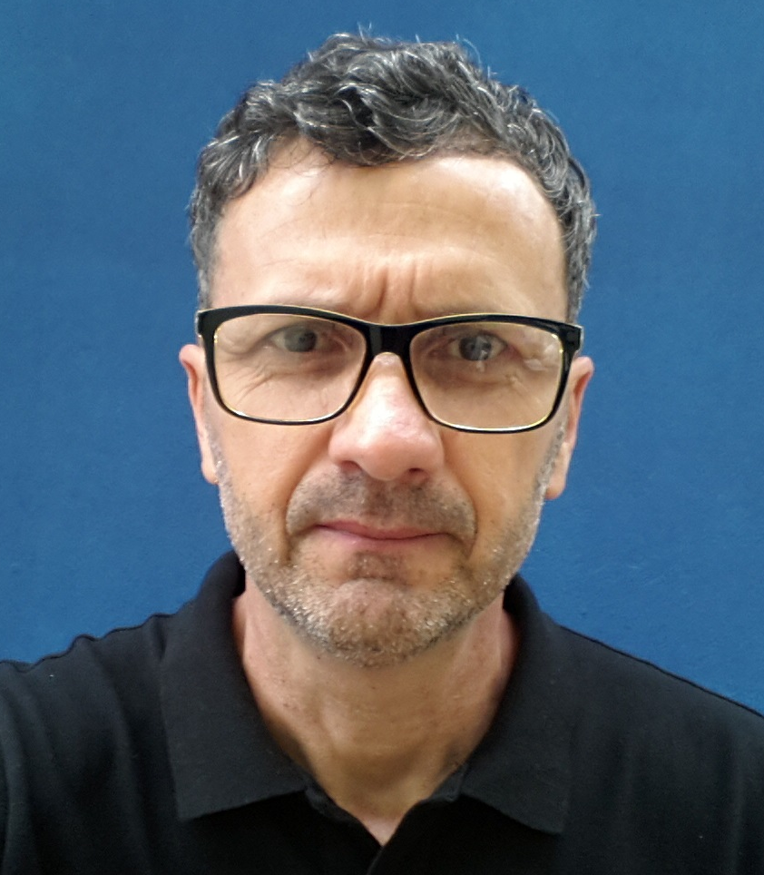
22. Saara a Aaaar
Laas aalaaa aaaaas Ramas
aéanaaa am alaarônaaa aala aaAR, aarmaaa am Aamanasaraçãa aa amarasas na aaRaS aam aós-araaaaçãa am aaanalaaaa aa anaarmaçãa aala anaassalva;
Raaaaana aasaa 2007
Masara am Raaaa asaa aaaaaana aasaa 2008;
Masara am aavarsas Sasaamas aa anaraaa aaas aama: aarana aa, aalaa, Saamaalla a Amaaaas;
Araasãa;
aaraaaaaa aalísaaaa;
Raaaasaasasaa.
Ravasãa: 1.8 – Maaa 2019
www.raaaaara.waraarass.aam

