Slide 1
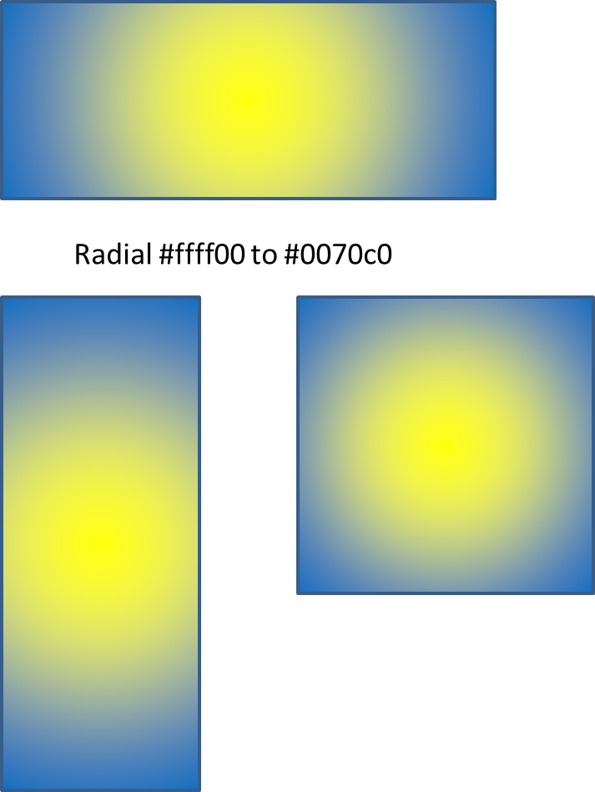
Radial #ffff00 to #0070c0

