Slide 1
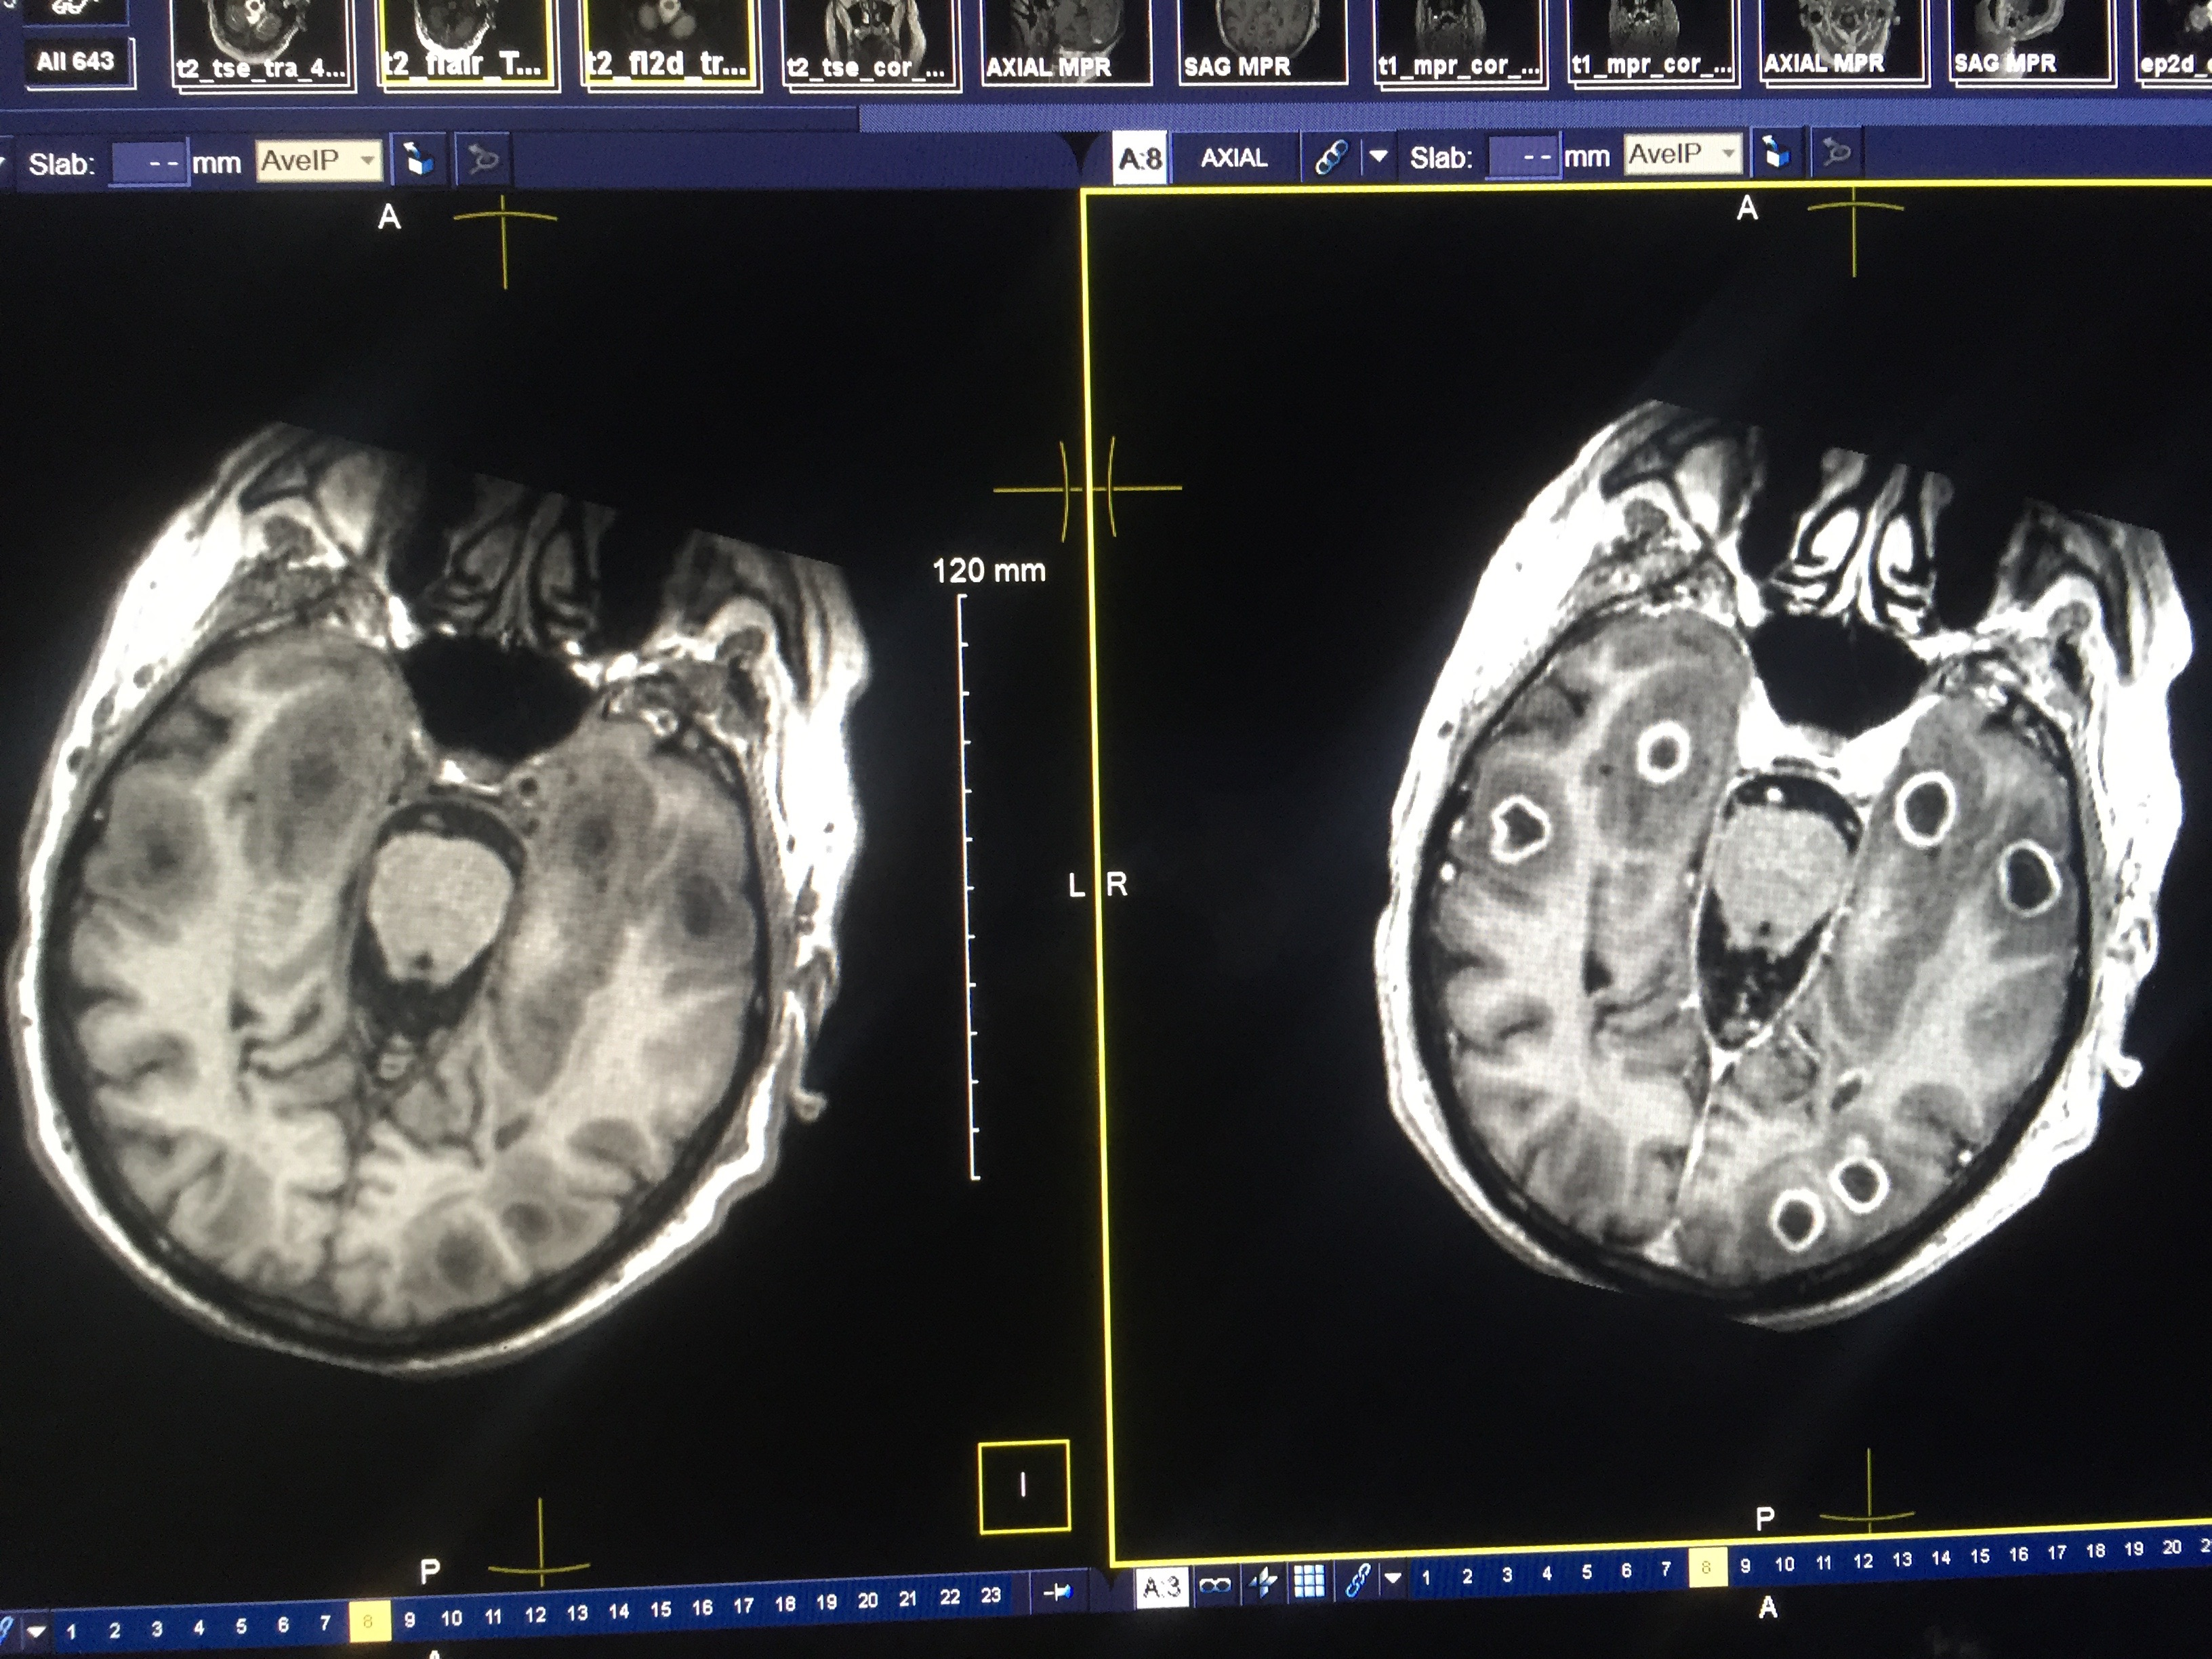
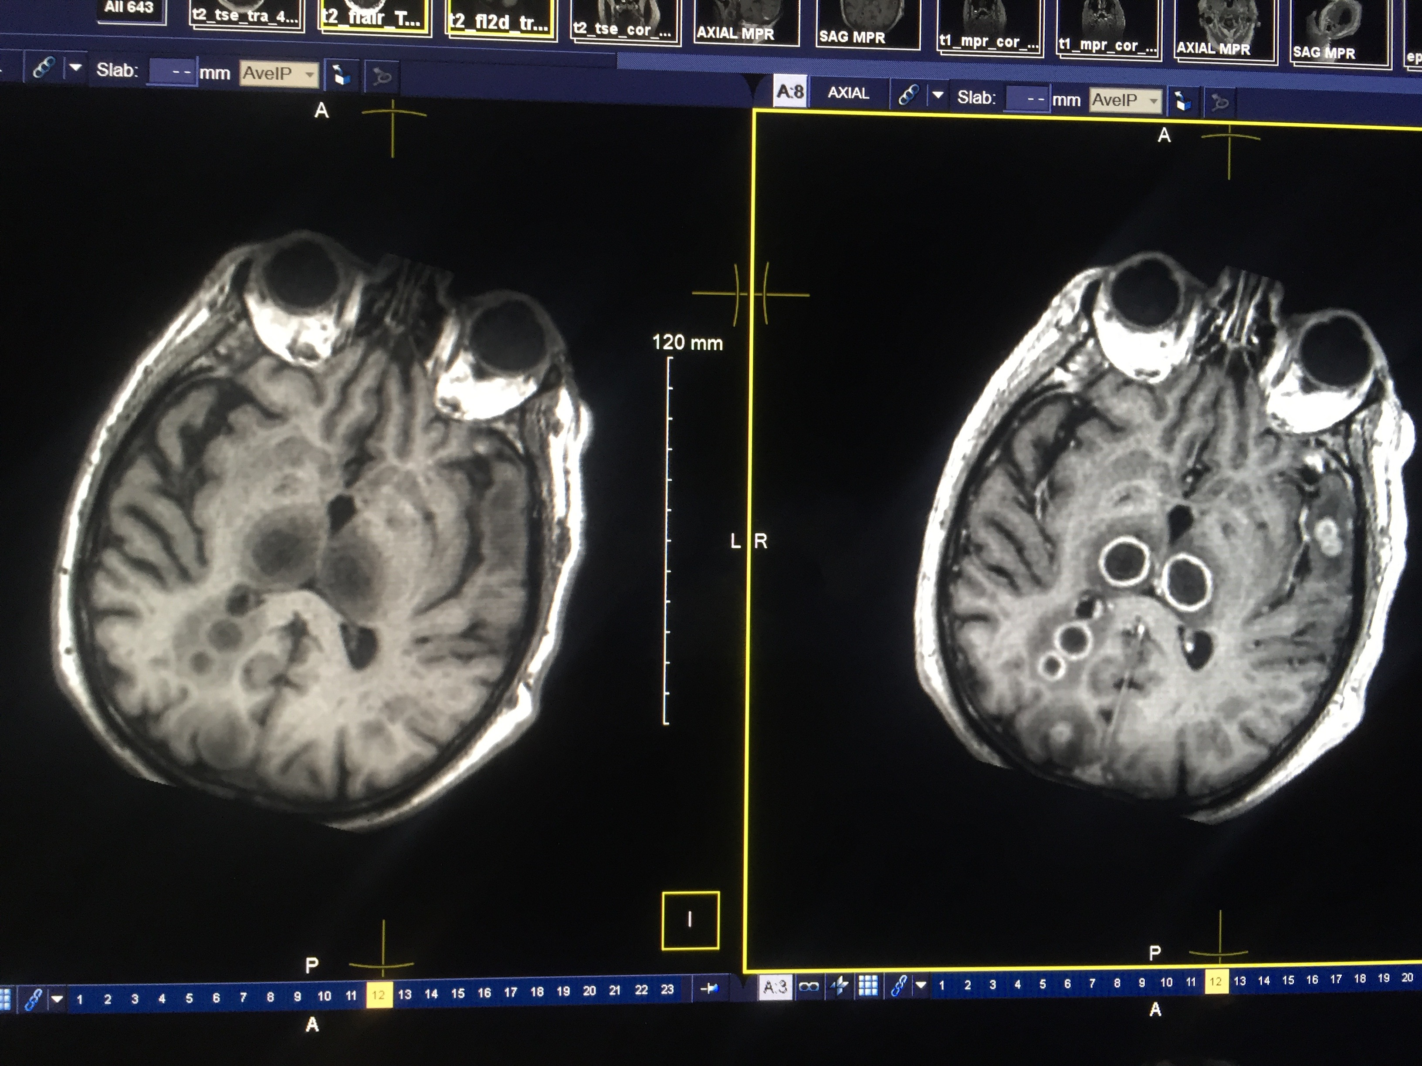
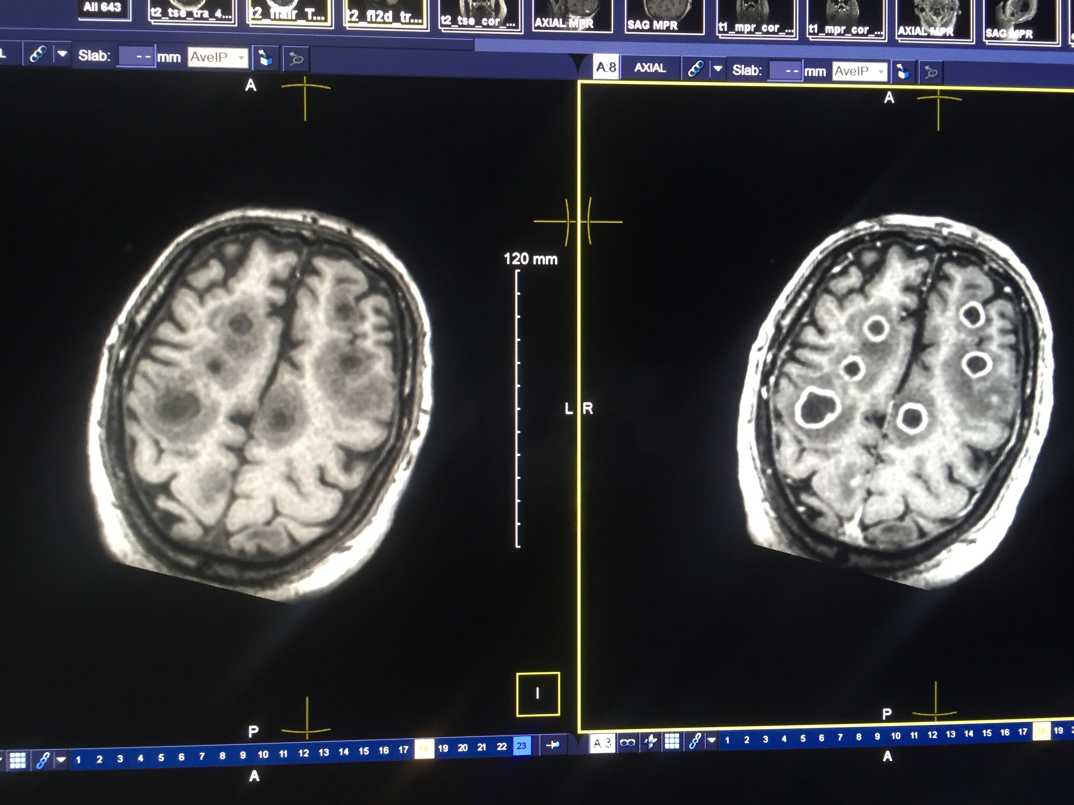
XXXXXXXXXXXXXXXXXXXXXXXXXXXXXXXXXXXXXXXXXXXXXXXXXXXXXXXXXXXXXXXXXXXXXXXXXXXXXXXXXXXXXXXXXXXXXXXXXXXXXXXXXXXXXXXXXXXXXXXXXXXXXXXXXXXXXXXXXXXXXXXXXXX
Notes:
multifocal supratentorial well defined, think walled rim enhancing lesions sc

