Slide 1
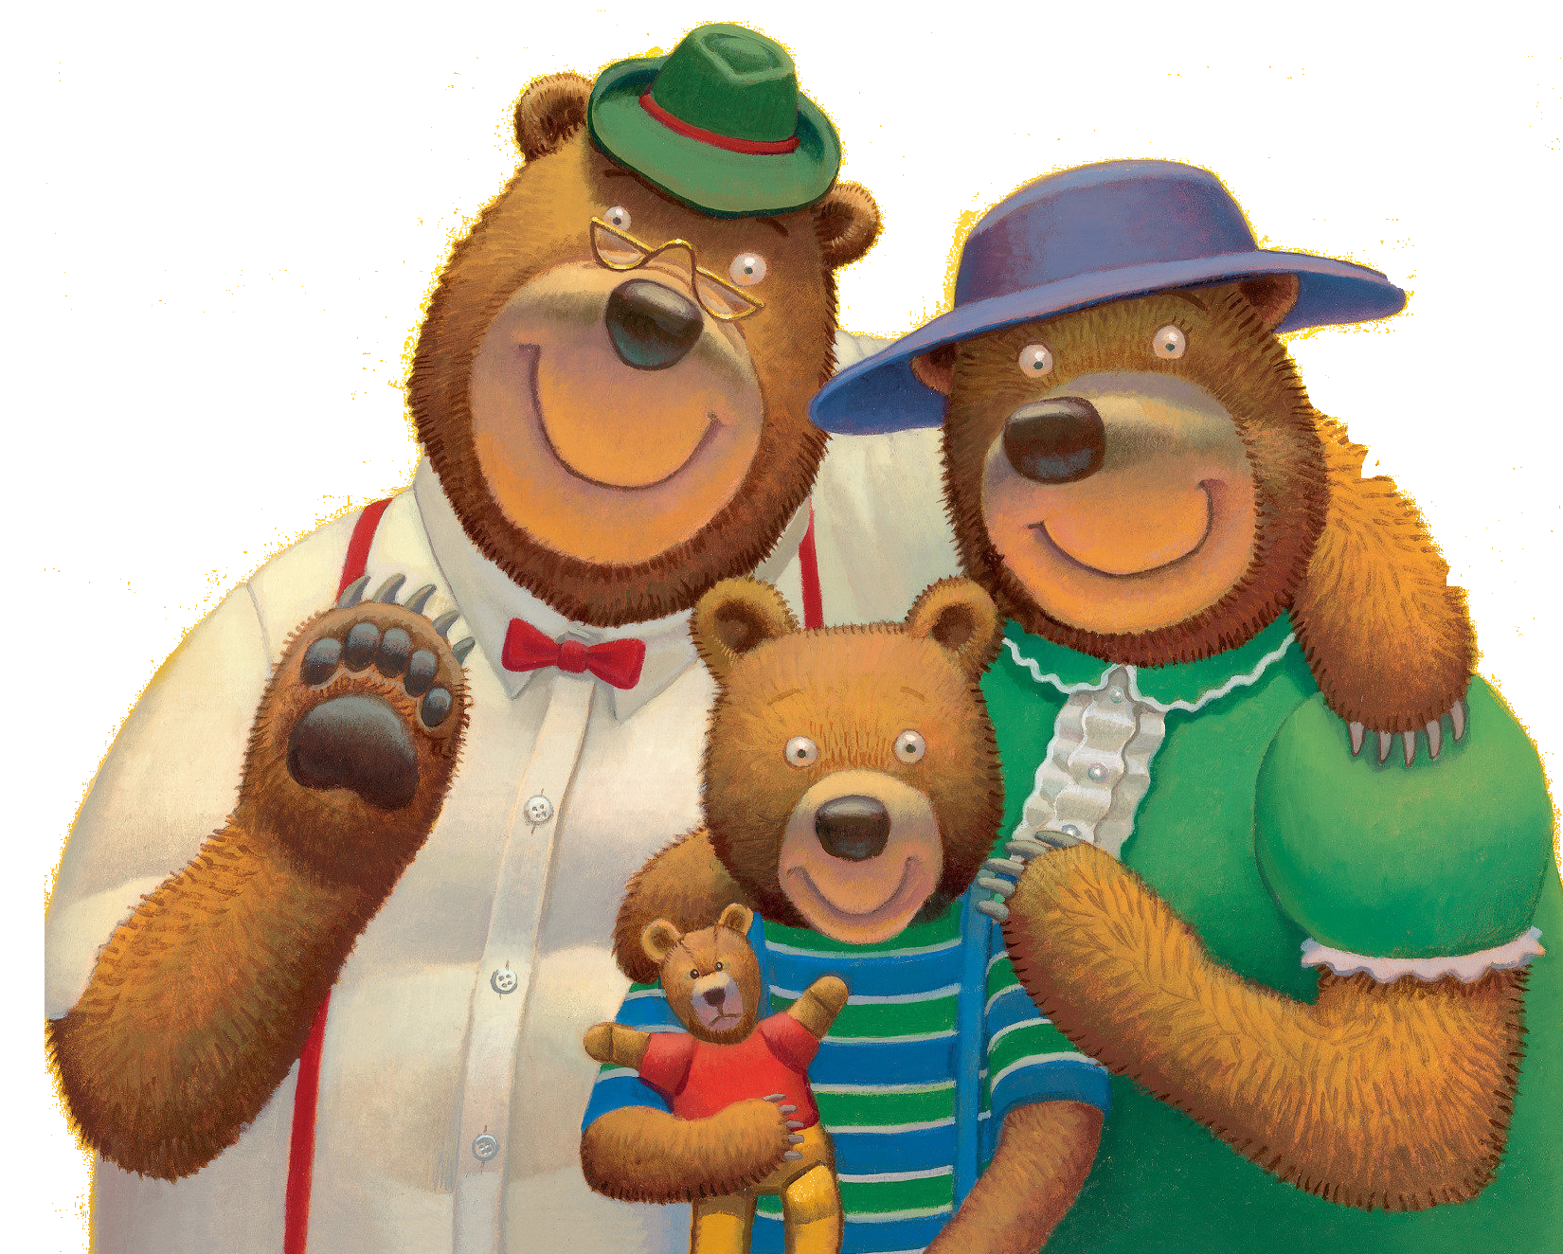
Goldilocks and the Three Bears

Slide 2

English Song

Slide 3

We are now going to listen to a song in English.
Please listen and enjoy.

Slide 4
我们现在要听一首英文歌。
请倾听和享受。

Slide 6
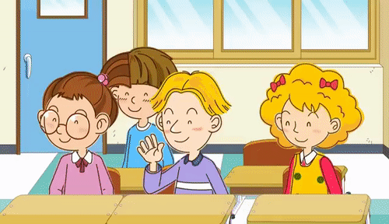
New Words

Slide 7
We are now going to learn new English words. Please practice with your teacher.

Slide 8
我们现在要学习新的英语单词。请和你的老师一起练习。

Slide 9

Bear
熊 (xióng)

Slide 10
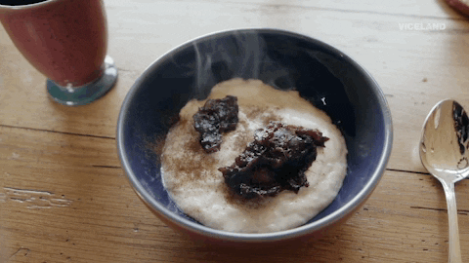
Porridge
粥 (zhōu)

Slide 11
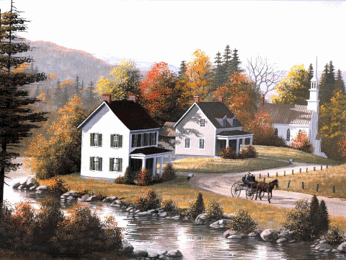
Village
村庄 (cūn zhuāng)

Slide 12
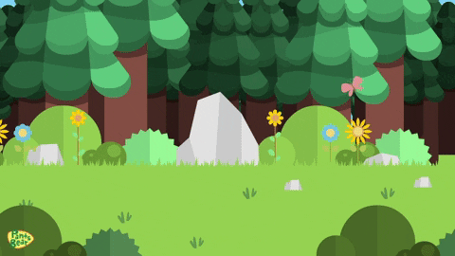
Forest
森林 (sēn lín)

Slide 13

House
房子

Slide 14
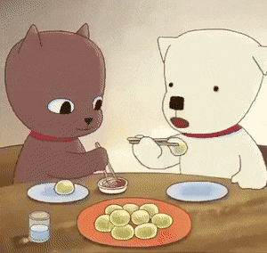
Taste
味道

Slide 15
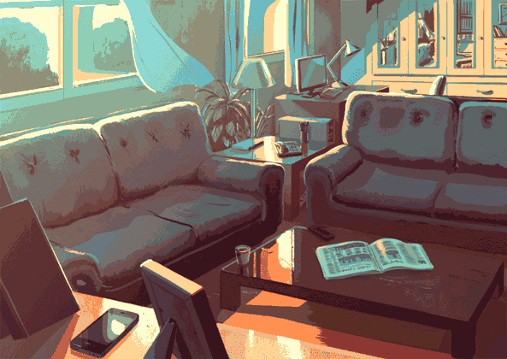
Living Room
客厅

Slide 16
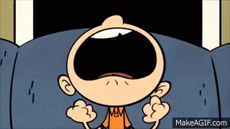
Yell
喊

Slide 17
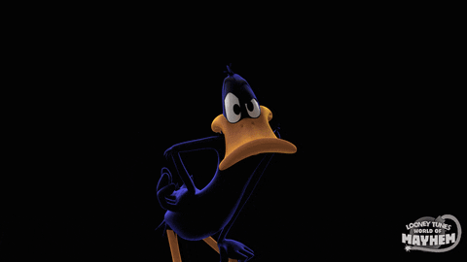
Knock
敲

