Slide 1
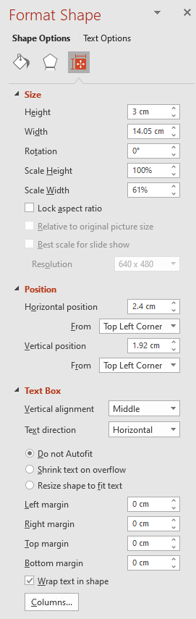
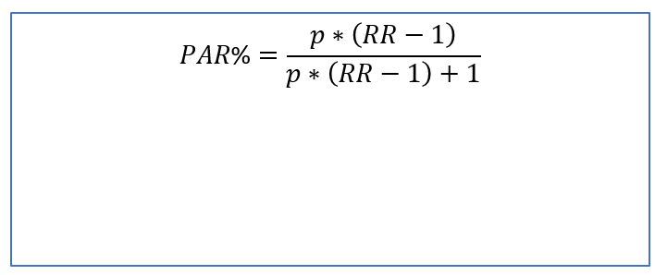
Formula size
$PAR\text{\%}=\frac{p∗\left(RR−1\right)}{p∗\left(RR−1\right)+1}$

