Slide 1
Introduction to Expedition and
The Countryside Code
EXP B-1 190204PF

Slide 2
Revision

Slide 3
Aims
To be able to identify and assess potential risks in order to be able to plan and prepare safe expeditions

Slide 4
Incentive
Plan and carry out expeditions safely
Avoid accidents
Avoid damage
Pass Basic level Expedition training

Slide 5
Scope
Carrying out an expedition – several stages:
Planning
The expedition itself
Review

Slide 6
Scope
Requires knowledge of:
Countryside Code/Moorland Code
Team Building
Expedition Equipment - survival
Load Carrying
Camp Site
Food/Cooking
Debrief

Slide 7
Scope
Also need elements of:
Navigation
First aid
Today we will look at the Countryside Code

Slide 8
The Countryside Code
Be safe – plan ahead and follow any signs
Leave gates and property as you find them
Protect plants and animals and take your litter home
Keep dogs under close control
Consider other people
Prevent uncontrolled moorland fires (Moorland Code)

Slide 9
The Countryside Code
Be safe – plan ahead and follow any signs
  Weather forecast
  Ground conditions – slippery/rocky
  Up to date maps and guidebooks
  The right equipment

Slide 10
The Countryside Code
Leave gates and property as you find them
  Don’t mess with machinery
  Leave gates as you found them
  Don’t damage walls, fences or historical monuments

Slide 11
The Countryside Code
Protect plants and animals and take your litter home
  Pick up your litter
  Do not pick or damage wildflowers or damage trees or shrubs
  Do not disturb animals or wildlife. If passing through a field with animals try to avoid them

Slide 12
The Countryside Code
Keep dogs under close control
  Dogs to be kept on lead when in the same area as wildlife or farm animals
  Pick up dog fouling
  Do not allow dogs to chase other people
  Cadets should not be taking dogs on expeditions.
  If a dog is chased by animals, in this case it is better to release it to run away.

Slide 13
The Countryside Code
Consider other people
  Avoid making unnecessary noise – particularly around residential areas, farms, animals and where other people are enjoying the countryside
  On a bike, slow down for horses and other wildlife
  Don’t obstruct gateways or get in the way of farm activities
  Stick to paths and signposted routes, where possible

Slide 14
The Countryside Code
Prevent uncontrolled fires
  Do not light fires where ground or surroundings can catch fire
  Don’t leave glass objects where the sun can make a concentrated beam through it.

Slide 15
The Countryside Code
Be safe – plan ahead and follow any signs
Leave gates and property as you find them
Protect plants and animals and take your litter home
Keep dogs under close control
Consider other people
Prevent uncontrolled moorland fires (Moorland Code)

Slide 17
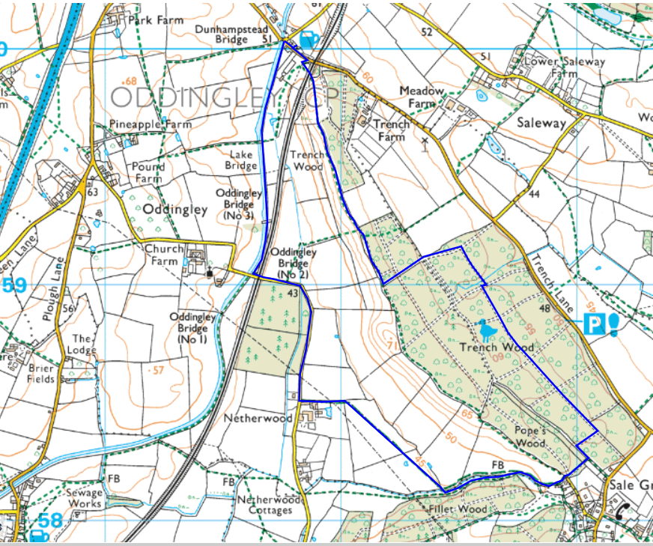
Virtual Expedition

Slide 18
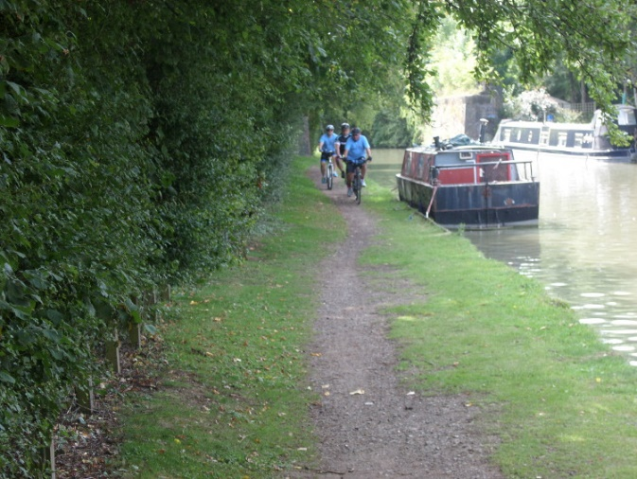

Virtual Expedition
Keep from edge
Respect other users
Leave no litter
No damage to wildlife

Slide 19
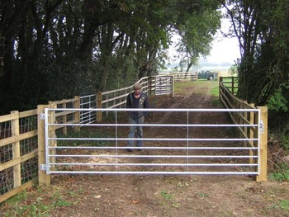
Virtual Expedition
Avoid blocking access
Leave open or closed – depending on how it is found
Avoid damage

Slide 20
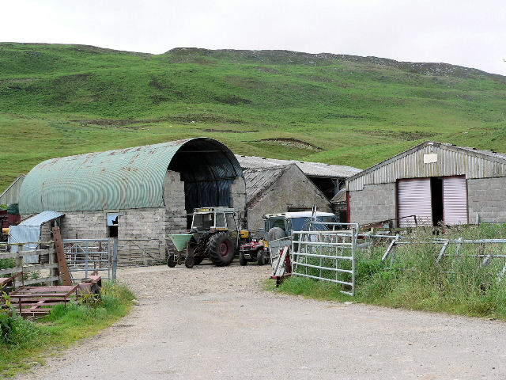
Virtual Expedition
Keep away from machinery
Watch out for farm activities
Keep away from livestock
Keep to footpath
Respect people living/working there

Slide 21
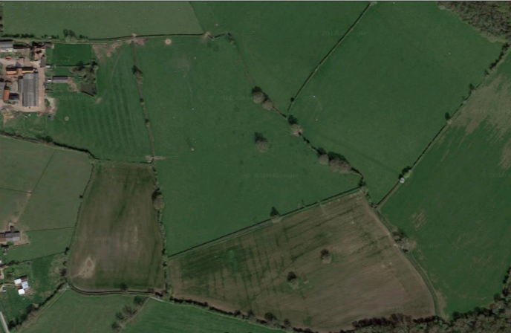
Virtual Expedition
Cross on clear path or follow field edge
Avoid disturbing livestock
Do not damage crops
Use designated stiles or gates

Slide 22
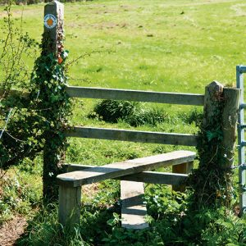
Virtual Expedition
Use designated stiles or gates
Observe direction indicators

Slide 23
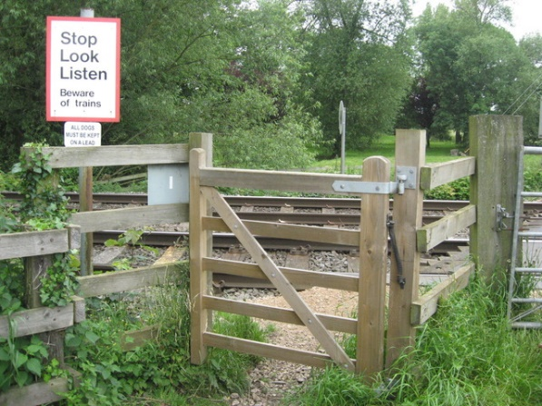
Virtual Expedition
Beware of approaching trains
Read posted advice
Close gates
Cross single file
Only cross at DESIGNATED crossing points

Slide 24
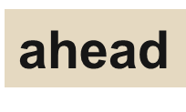



Summary
Be safe – plan _____ and follow any signs
Leave ____ and property as you find them
Protect plants and animals and take your ____ home
dogs
Keep ____ under close control
Consider other people
Prevent uncontrolled moorland ____ (Moorland Code)

Slide 26
Final Confirmation
Description
Right
Responsibility
Neither
Walking along a public footpath
P
Taking your rubbish home
P
Climbing over a fence rather than a stile
P
Following information on a sign
P
Picking wild flowers along a path through a wood
P
Cycling along a public bridleway
P
Being prepared for your countryside visit and letting someone know where you are going
P
Keeping your dog on a lead across a field with cattle in
P
Walking anywhere across access land
P
Clearing up after your dog
P
Riding a horse along a public footpath
P
Understanding the signs and symbols used in the countryside
P
Parking your car in a field gateway
P

Slide 27
Look Forward
This is the completion of the Basic APC syllabus for Expedition
Next expedition training is 1* - learning how to put together a great expedition team!

Slide 28

And Finally:

