Slide 1
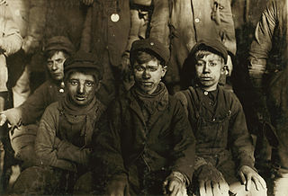
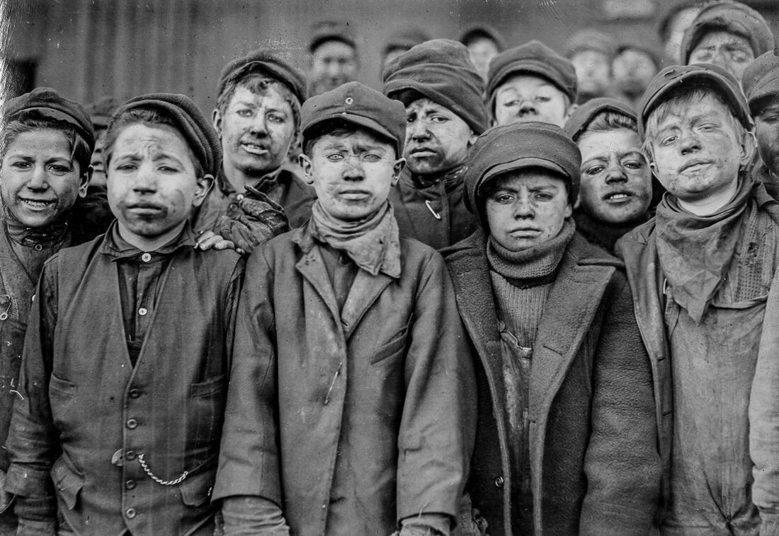
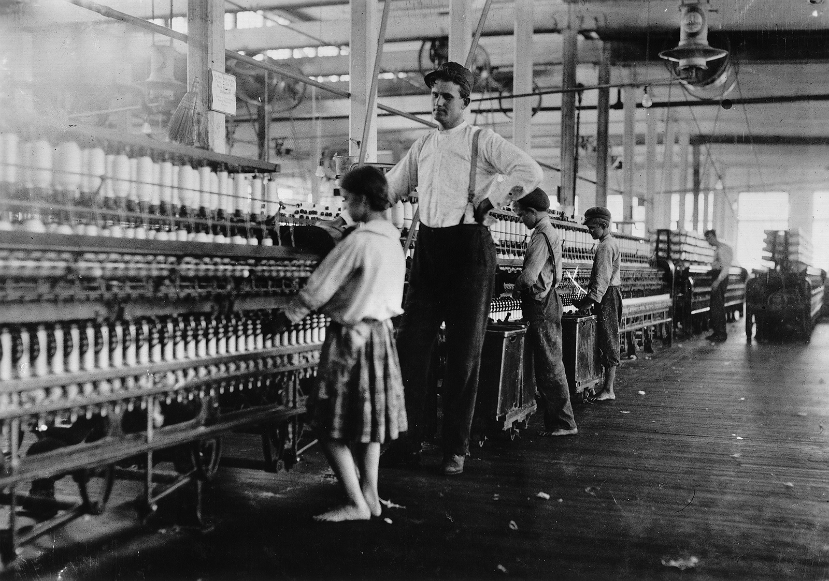
Child Labour in the Industrial Age

Slide 2
Last week we learnt all about working down the mines.
Thank you so much for uploading all your lovely, descriptive diary entries. We were very impressed with the quality and standard of your writing. We also loved all the living condition reports you submitted.
Let’s recap on last week’s work. What can you remember?

Slide 3
Complete the Quiz
In the early 1700s, what was the most common way to make items to sell?
What was made during the industrial revolution to power machines and tools?
What were the benefits of these machines?
What fuel did these machines need to power them?
Where was this fuel gathered?
What were the 3 main jobs for a child in a coal mine?
Why did people move to the cities?
What were the cities like?

Slide 4
Quiz Answers
In the early 1700s, what was the most common way to make items to sell? In a person’s home - this was called cottage industries.
What was made during the industrial revolution to power machines and tools? Steam engines
What were the benefits of these machines? Steam engines could work all the time; they didn’t need food, sleep or to be paid.
What fuel did these machines need to power them? Coal to burn the fire.
Where was this fuel gathered? By mining for coal
What were the 3 made jobs for a child in a coal mine? Trappers, Drawer and Pulley Operator.
Why did people move to the cities? They could find work in the factories.
What were the cities like during this time? No running water, overflowing toilets, no bins, damp, smelly, fleas, lice and rats, no sunlight because of narrow housing.

Slide 5
Working in the Textile Mills
This week we will be following a similar format to the work you completed last week but this time we are finding out what was it like for children working in the textile mills (factories) in the Industrial Age.

Slide 6
Key Vocabulary
Conditions - The conditions in which people live or work are the factors which affect their comfort, safety, or health
Textile Mills – large buildings where yarn is turned into fabric.
Factory - where items are made in large quantities
The Overlooker – a manager who oversees what is happening on the factory floor and punishes the children.
.
Mass production- the production of something in large amounts
Migrate – when people move to a new area or country in order to find work or better living conditions
Labour - productive work, especially physical work for wages.
Industrial Revolution- the transformation in the 18th and 19th centuries of Britain and other countries

Slide 7
Session 1a
What you need to know about working in textile mills (factories) in the Industrial Age.

Slide 8
Let’s Recap!
Living conditions in the towns and cities.

Slide 9
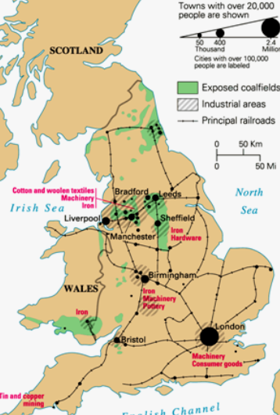
Why did people in the 1800s migrate away from the countryside to live in the towns and cities?

Slide 10
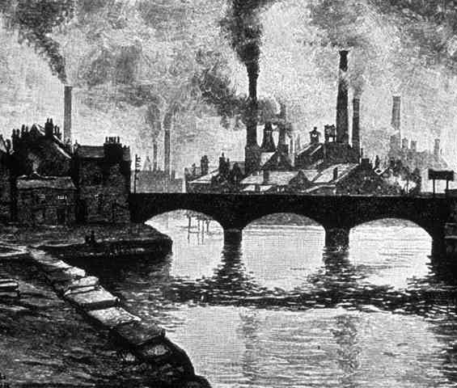
Think back to last week’s work on living conditions in towns and cities. What did you learn?

Slide 11
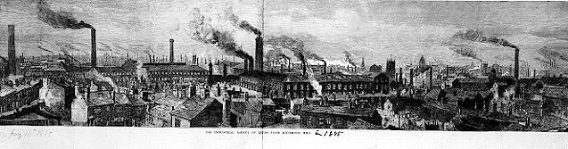

Slide 12
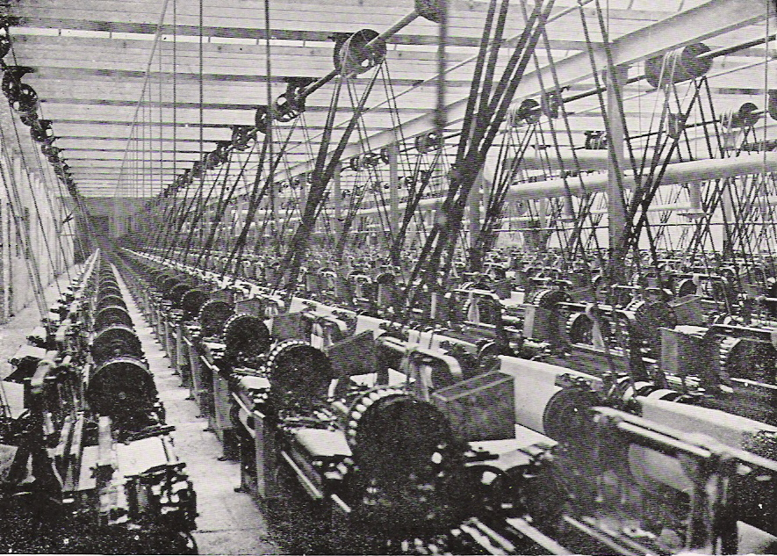
People from the countryside flocked to the towns and cities to find work, predominantly in the increasing numbers of textile mills.

Slide 13
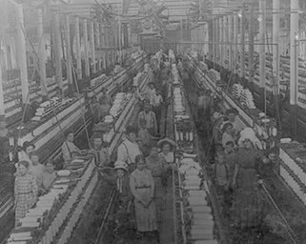
These huge mills produced cotton and woollen cloth, they needed a vast workforce which included children. The working hours were long and the mills were noisy, hot, dusty and dangerous places to work. Medical records from the time reveal that accidents and disease were common.

Slide 14
What was wrong with the working conditions for children during the Industrial Age?
Children worked very long hours with little breaks and no fresh air.
They often worked in very dangerous conditions resulting in injuries or even death.
Very young children were expected to work.
There was no education for the poor, so it was very unlikely they could get better paid jobs when they were older.
Children were exploited as they were paid very little money because they were younger.

Slide 15
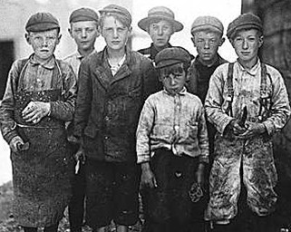
Why didn't children refuse to work?
Most children had no choice - they needed to work to help their families earn enough money to live.

Slide 16
What kind of jobs did children do?
The lucky children got apprenticed in a trade, the less lucky ones worked on farms or helped with the spinning.
When new types of work appeared with the development of industries and factories, it seemed perfectly natural to use children for work that adults couldn't do; crawling underneath machinery or sitting in coal mines to open and close the ventilation doors.

Slide 17
Now watch this BBC Bitesize clip
What was life like for children apprenticed in textile mills?
Can you answer the following questions:
Where did the apprentice children come from? And why did they work without pay?
What jobs did children do in the cotton factory, and how long did they work each day?
Children working in textile mills - KS2 History - BBC Bitesize

Slide 18
Task: What was it like for children working in a coal mine compared to in a factory (textile mill)? Can you list at least 3 similarities and differences in the table below:
Coal Mine
Textile Mill

Slide 19
Take a break Session 1b
What you need to know about working in textile mills (factories) in the Industrial Age.

Slide 20
To Summarise: Children would be apprenticed from the age of nine and were given lodgings, food and one hour of schooling each week.

Slide 21
Read this account of an apprentice boy from 1806: Each morning, Thomas Priestley would be roused early from his dormitory in the Apprentice House, along with the other boys and girls (nearly 100 children in total). After a breakfast of porridge, he would walk to work the cotton-mill spinning machines. He was used to the early start and the 13-hour day, and felt undaunted by the large building with its numerous floors in the Lancashire countryside: it reminded him of the workhouse from which he had come from. But it was hard to adjust to the incessant motion of the wheels and shafts that turned the machinery.
Thomas Priestley’s job that morning was routine: he had to look after one of the spinning machines. Brought north from a workhouse in Hackney, East London, when he was ten years old, he’d been at Quarry Bank Mill for three years. “My business was to supply these machines, to guide the thread occasionally and to twist them when they snapped,” he later recalled.
But then due to tiredness, he lost concentration and disaster followed. One of the wheels caught the forefinger of his left hand and tore it off. Luckily for Thomas, Quarry Bank Mill was one of the few to employ a doctor, and under his care Priestley recovered within six weeks. The way he expressed his shock and trauma was simply to say that he missed his mother. He was desperate to return to her in Hackney. He thought of running away, but was aware that by doing so he would be breaking the signed agreement he had with the mill owner, Samuel Greg. Like all apprentices, Thomas was contracted to work in the mill house until the age of 18. In return, the youngster had to pledge to serve and obey. There was no wage, just the prospect of a few shillings at the end of the apprenticeship, subject to his continuous good behaviour.
Notes:
Your child may need some help reading the text and support with some of the vocabulary e.g. roused, apprentice, incessant, desperate, trauma – they could look these words up in a dictionary.

Slide 22
Based on what you have just read, can you answer the following questions?
How long was Thomas’ working day?
What would he usually have for breakfast?
What does the word incessant mean? You might have to use a dictionary.
How old was Thomas when he was brought to Quarry Bank Mill? How old was he when the accident happened?
How did the accident happen and why?
Why does the account say he was lucky?
Whereabouts in London did Thomas come from?
Use your inference skills, why do you think Thomas had to take the apprentice job at Quarry Bank Mill?

Slide 23
End of Session 1
Can you summarise what have you found out?

Slide 24
Session 2 – Letter Home
Your task will be to write a letter home to one of your parents. You will be writing in the role of an apprentice working with machinery in a textile mill.
Notes:
The following sessions should be completed over 2 days.
Recap on what life was like working in a textile mill. Key Questions: What was it like working in the mill with all the machinery? Why was it so noisy and dusty? Why was it such a dangerous job for children?

Slide 25
Some ideas to help you with your letter…

Slide 26
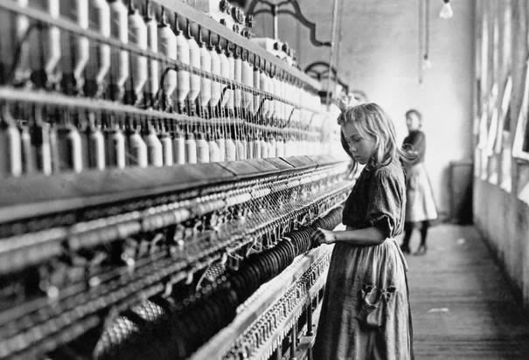
Girl aged 9
"I start work promptly at 5:00 in the morning and work all day till 9:00 at night. That’s 16 hours! We are not allowed to talk, sit or look out of the window whilst we work. The only day off from work I get is on Sundays, when we have to go to church."

Slide 27
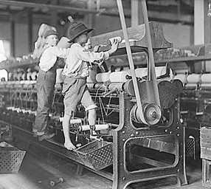
Accidents
In textile mills children were made to clean machines while the machines were kept running, as a result, there were many accidents. Many children lost fingers in the machinery and some were killed, crushed by the huge machines.

Slide 28
Punishments
Children who worked long hours in the textile mills became very tired and found it difficult to maintain the speed required by the Managers. Children were usually hit with a strap to make them work faster. They would also be punished if they talked to other children.

Slide 29
Ever wondered what it sounded like working in a textile mill? Listen to the sounds by clicking on the link below. Remember this would have been much louder in the factory room. Also the noise would have been constant.
Sounds of the machines in a textile mill

Slide 30

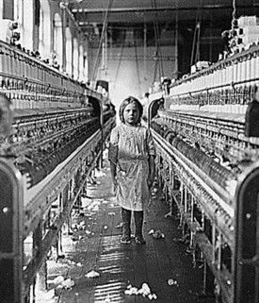
It is so loud in hear, my ears are ringing, my ears are hurting.
The cotton dust is everywhere. It is in my nose and mouth. I can’t stop coughing.
I’m so tired, I’ve been working since 6 this morning.
How much longer? I’m so hungry? When will I have a break? When will the day end?
The machines move so fast, I worry if I’m not quick enough I will lose my fingers or hand.
If I talk to my friend Nancy, we get beaten by a belt by the Overlooker.
Yesterday, a boy called Thomas lost his fingers, they were trapped in the machinery.
Notes:
This slide will help your child with ideas to include in their letter. The sound button is the sound of working machines in a textile mill.

Slide 31
A possible structure for your letter:
Paragraph 3:
Explain the job:
To clean and oil the machines whilst they are still running. They never stop unless there is a problem.
You worry that you might get injured by the heavy machines.
Talk about the accidents that have already happened to other children in the Mill.
As before use the Exciting Adjectives Word Bank (PDF) and the next few slides to help you.
Don’t forget to check your work against the checklist.
You could use the attached letter template to write or type on. If you are handwriting your letter, maybe draw lines on the page with a pencil and ruler to help you when writing.
Dear Mum or Dad,
Paragraph 1:
Ask after your family. Are they well? Do you have any brothers and sisters?
Explain how you are being treated at the apprentice home. Have you made friends? Are you happy? Do you miss home?
Paragraph 2:
What is your daily life like?. Things you can mention: You get up early, have breakfast and then walk to the mill to start your day’s work.

Slide 32
Word Bank of key words to use and refer to:
apprentice | accident
Textile mill | punishment
Machinery, machine | Thread
cotton | Tiredness, exhaustion
dust | hunger
Overlooker or Overseer | noise, incessant
Manager
Owner

Slide 33
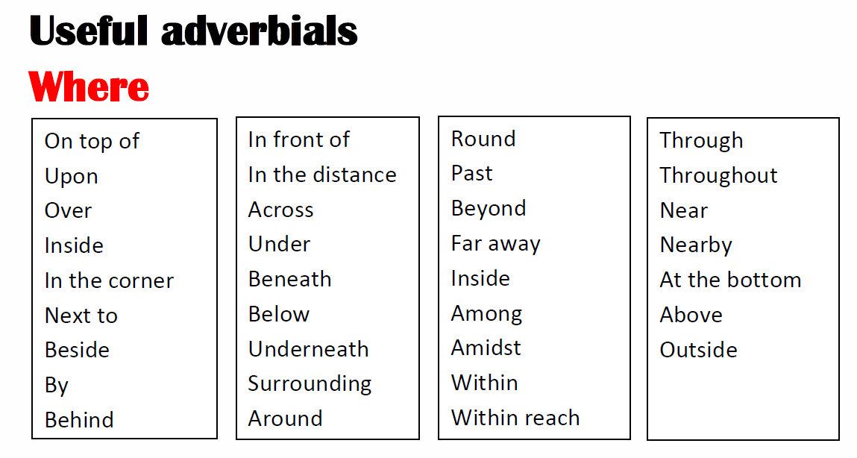
As always, think about the way you start your sentences. The following familiar slides will help you.

Slide 34
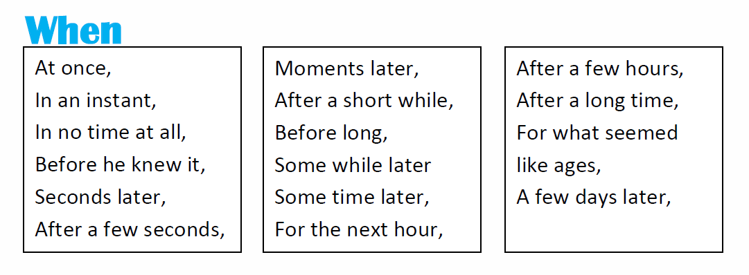
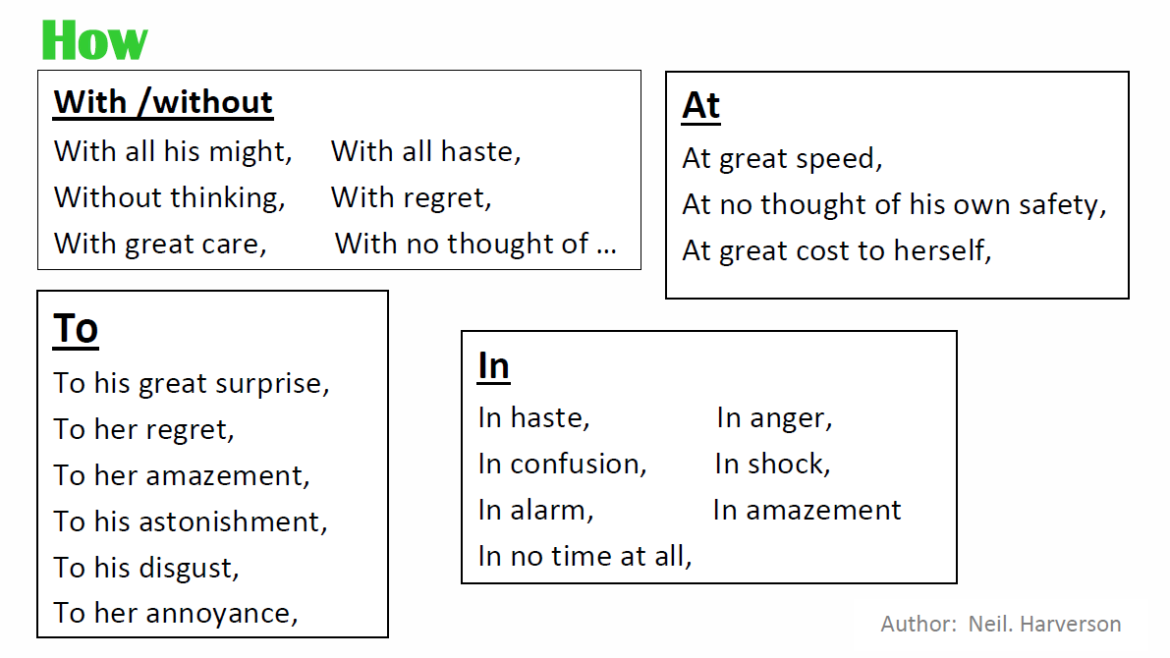

Slide 35
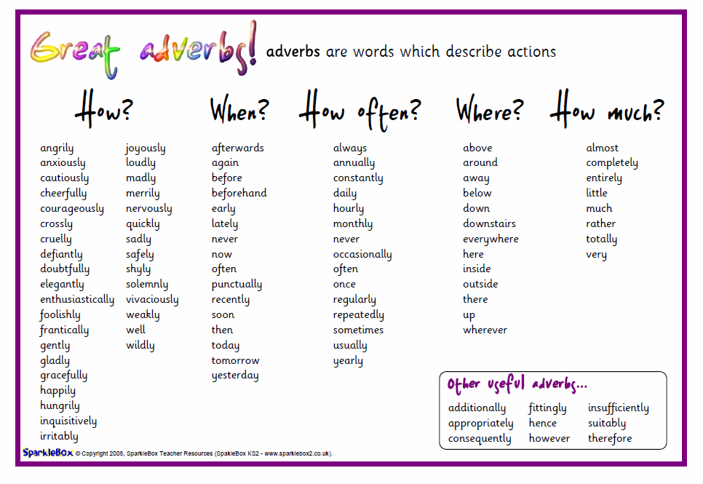

Slide 36
Session 2 – take a break
You are now over half way to completing your letter home.
For extra impact, can you add aspects of POAMS?

Slide 37
End the letter and sign off
As before use the Exciting Adjectives Word Bank (PDF) and the next few slides to help you.
Don’t forget to check your work against the checklist.
Paragraph 4:
Describe what working in the mill is like:
the loud noise
cotton dust everywhere
The Overlooker who punishes you when you talk.
Paragraph 5:
What happens at the end of the day? How tired are you? How long have you been working?

Slide 38
 | I have: | Self-Assess
Must | Included the key facts about working as an apprentice
 | Included thoughts and feelings
 | Asked about my family back at home
 | Written 5 paragraphs (beginning, middle and end)
 | Used a range of punctuation such as:. , ! ? ( ) ;
Should | Varied the way I have started my paragraphs and sentences – see the above slides
 | Used a range of conjunctions: although, because, despite, however, which, whilst, until, finally,
 | Written in chronological order about my day
 | Used a range of adjectives
Have you checked your work?

Slide 39

What do you like most about your letter? Ask someone else in your family to read it. What do they think?
What are your 2 successes? What one thing should you do next time?
Don’t forget to upload your finished letter so we can give you feedback.

Slide 40
Luckily for children like you, due to the work of reformers and campaigners, laws were passed to protect children’s rights, this was in the form of the following Factory Acts:
Date | Industry | Details of law
1833 | Textiles | No child workers under nine years. Reduced hours for children 9-13 years. Two hours schooling each day for children. Four factory inspectors were appointed to ensure these laws were adhered to.
1844 | Textiles | Children 8-13 years could work six half-hours a day. Reduced hours for women (12 hours) and no night work.
1847 | Textiles | Women and children under 18 years of age could not work more than ten hours a day.
1867 | All Industries | Previous rules applied to all factories if they employed more than five workers.
1901 | All Industries | Minimum working age raised to 12 years of age in all areas.

