Slide 1

Monthly EMS Review
For the month of - June’14
Date - 10/07/14

Slide 2
Minutes of Meeting – Status Update

Slide 3
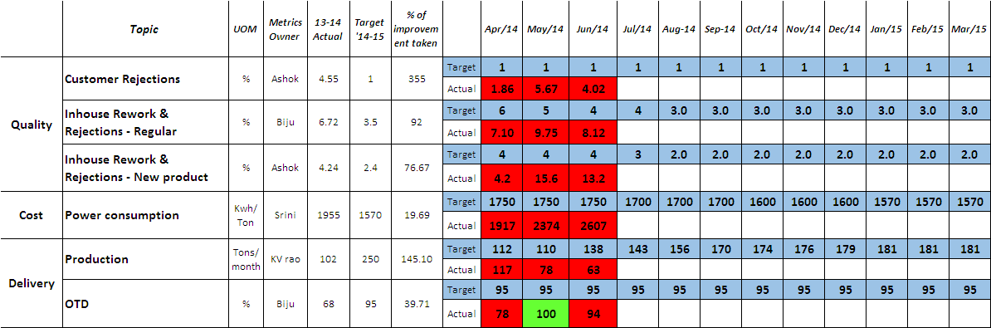
EMS Metrics - foundry

Slide 4
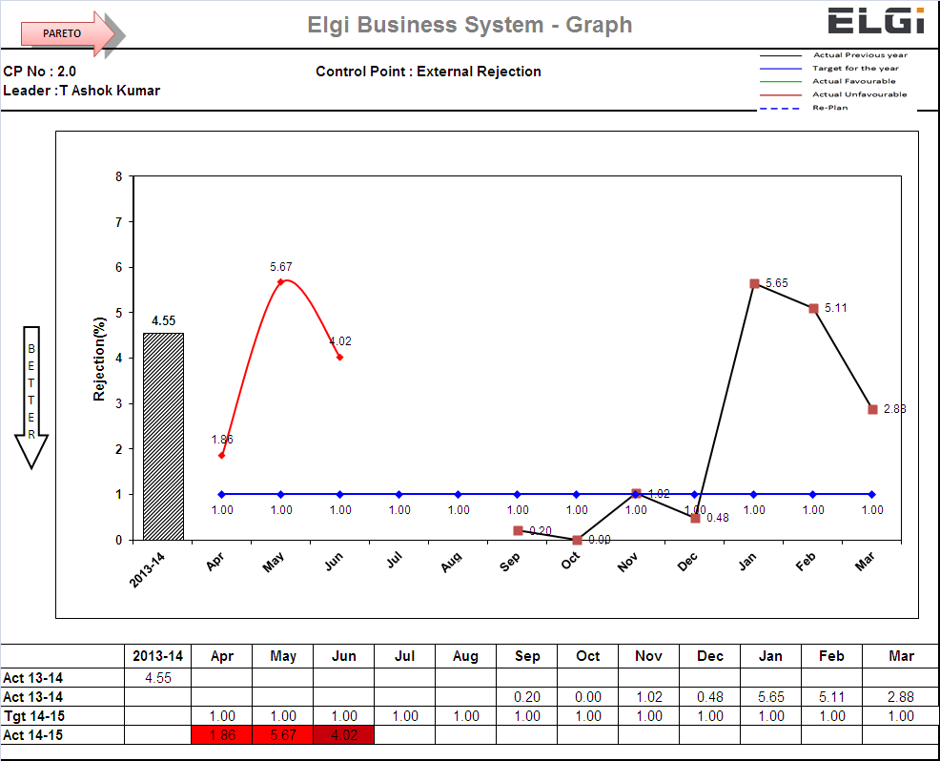
Customer Rejection

Slide 5
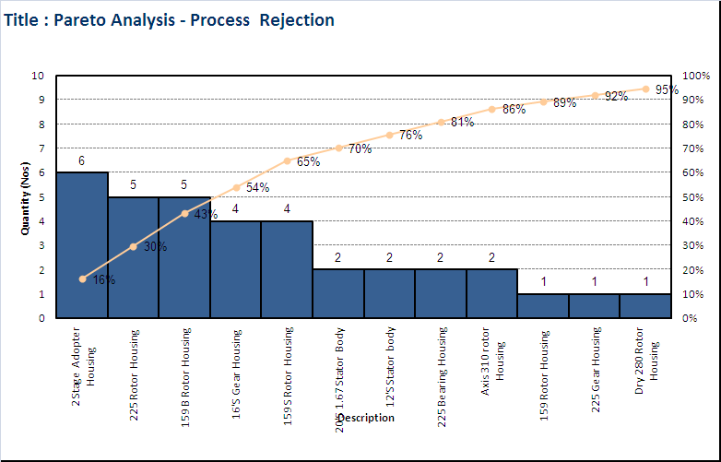
Customer Rejection - Pareto

Slide 6
Customer Rejection - CAPA

Slide 7
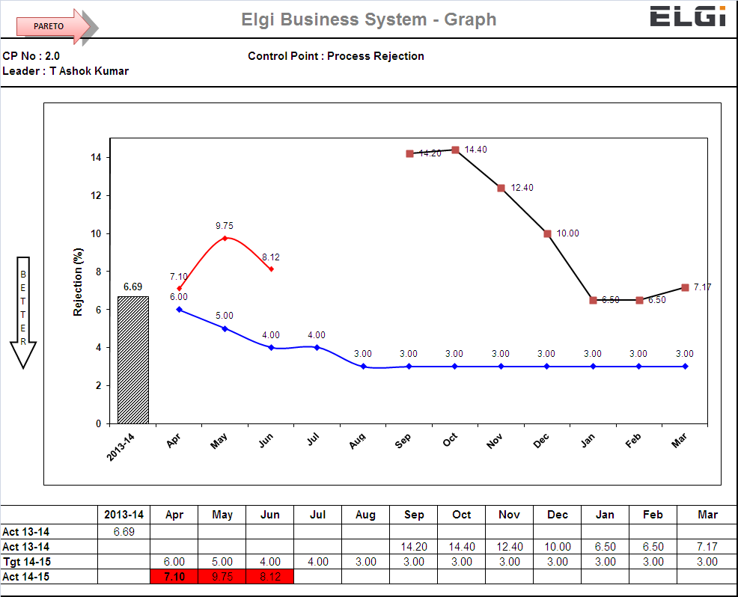
Inhouse Reworks & Rejection

Slide 8
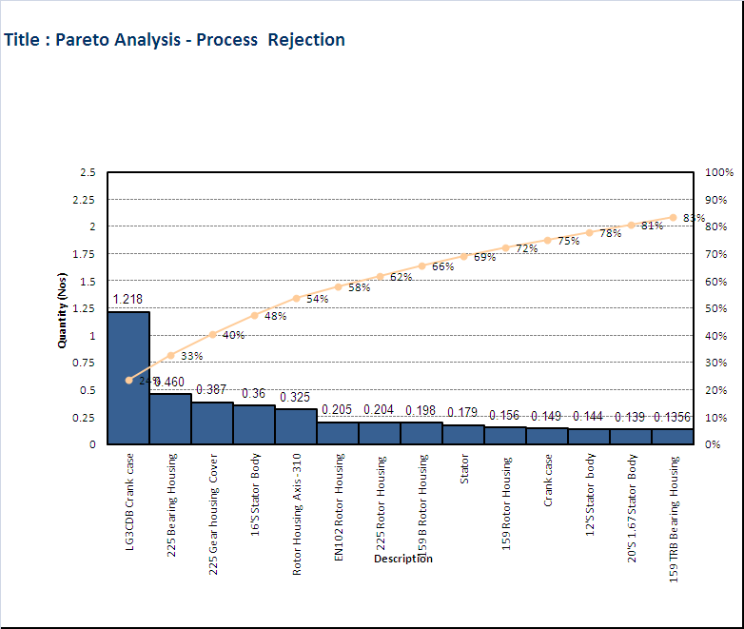
Inhouse Rework & Rejection - Pareto

Slide 9
Inhouse Rework & Rejection - CAPA

Slide 10
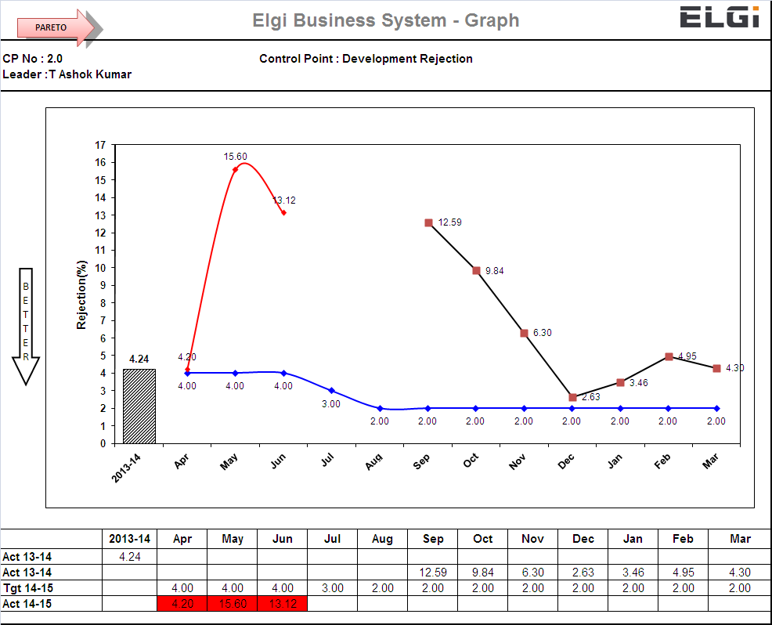
Inhouse Rework & Rejection – New Product

Slide 11
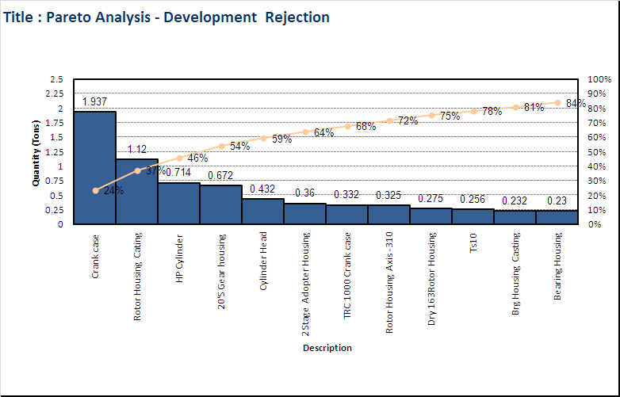
Inhouse Rework & Rejection – New Product Pareto

Slide 12
Inhouse Rework & Rejection – New Product CAPA

Slide 13
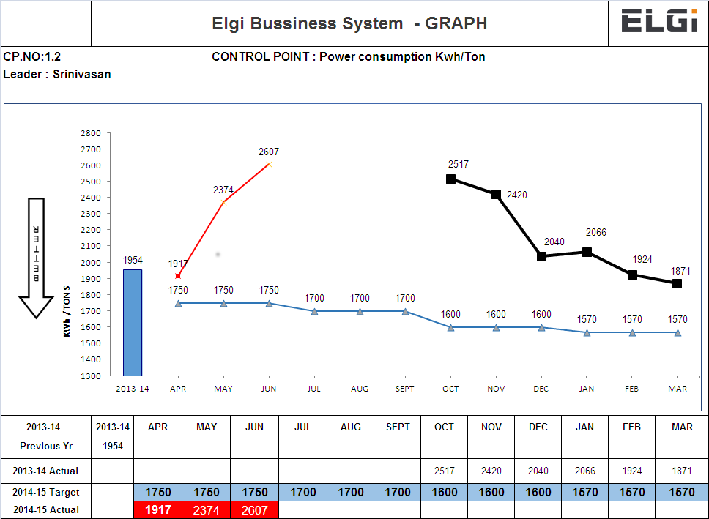
Power consumption

Slide 14
Power consumption - CAPA

Slide 15
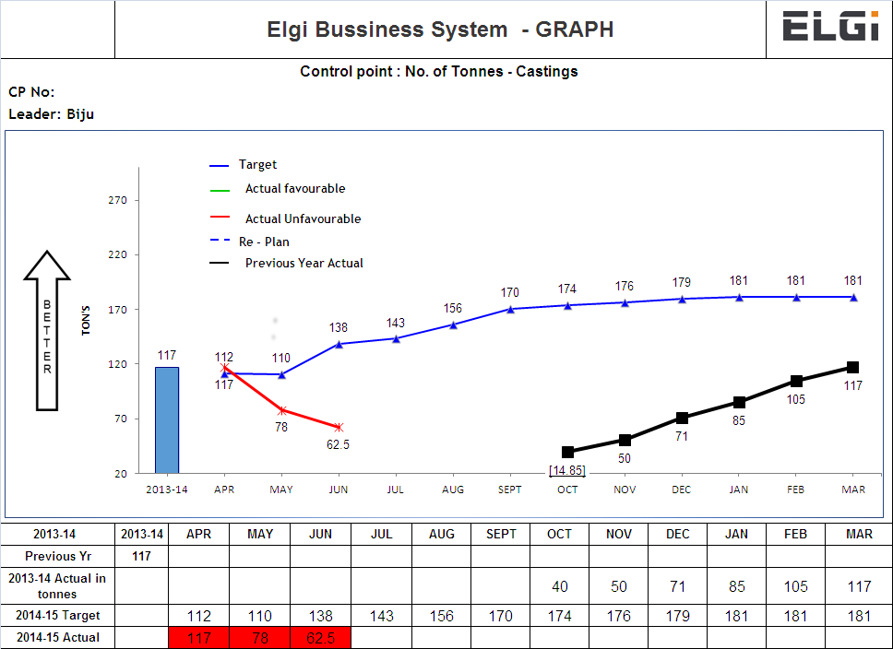
No. of Tonnes - Castings

Slide 16
No. of Tonnes Castings - CAPA

Slide 17
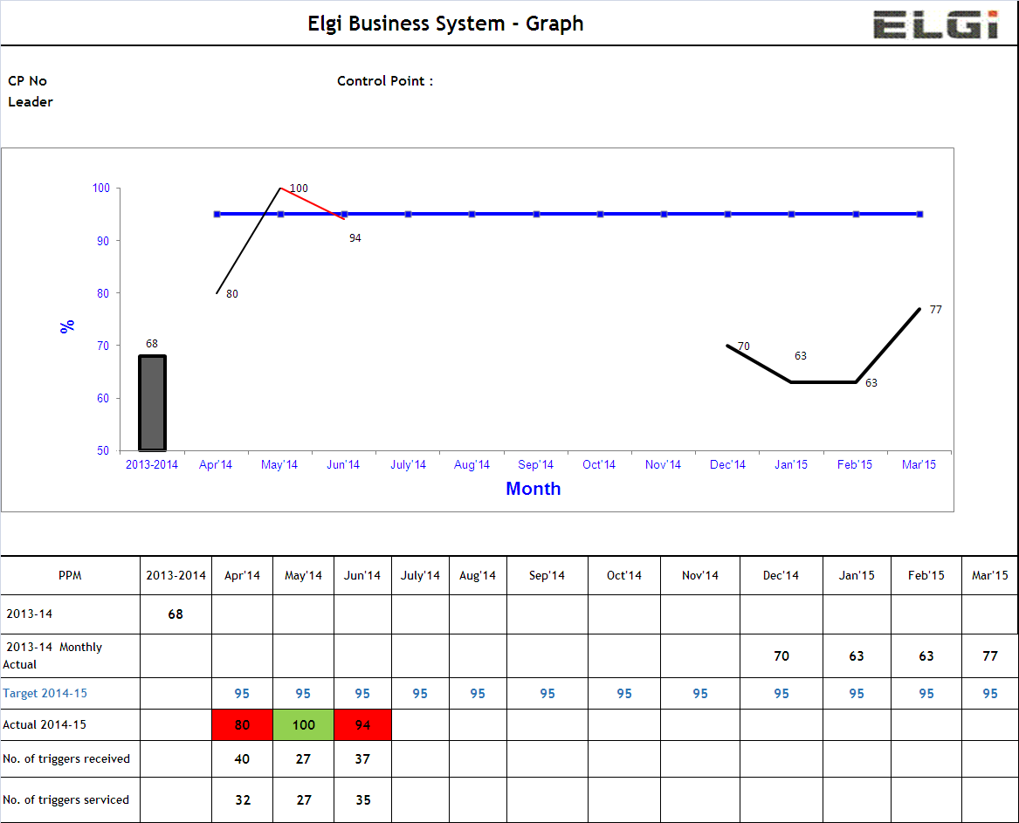
OTD

Slide 18
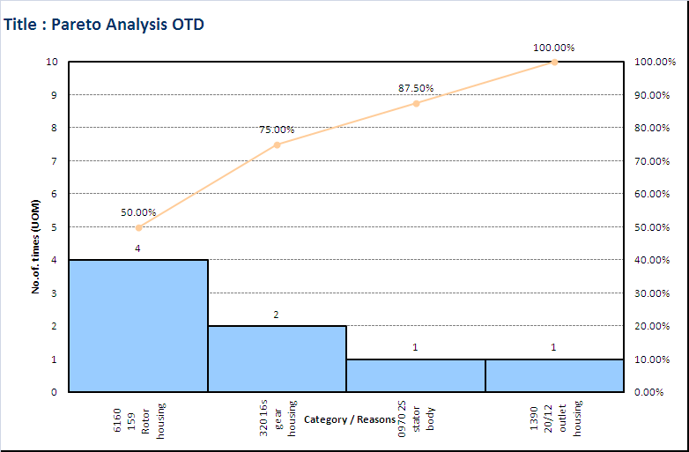
OTD- Pareto

Slide 19
OTD- CAPA

Slide 20
Thank you

