Slide 1
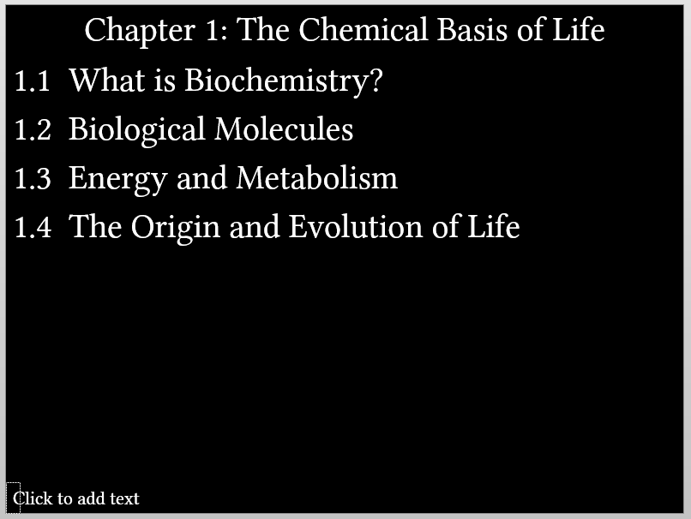
Chapter 1: The Chemical Basis of Life
1.1 What is Biochemistry?
1.2 Biological Molecules
1.3 Energy and Metabolism
1.4 The Origin and Evolution of Life
Notes:
The inserted picture shows what the page looks like during editing in PowerPoint. The shape is a “text placeholder” from the slide layout.

