Slide 1
Position: yellow 0%, blue 100%
Position: yellow 1%, blue 100%

Slide 2
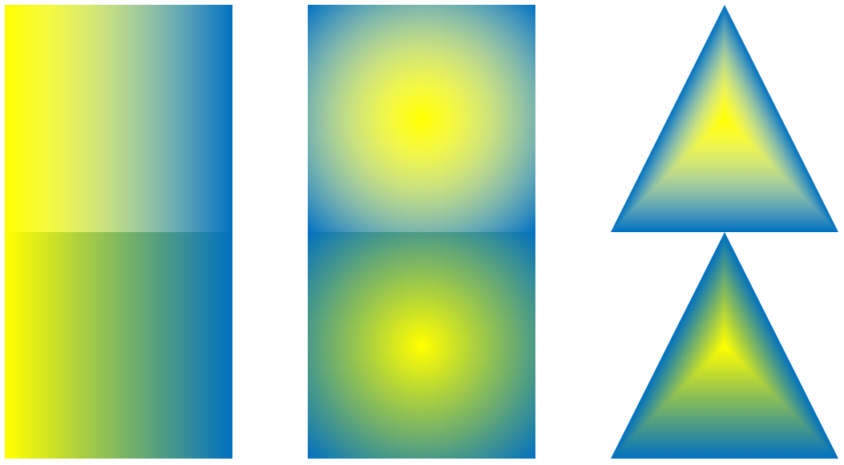
Screenshot

