Slide 1

$100k in 45 Minutes!
Effective NO-COST Strategies That Immediately Increase Sales and Profits
(Replace with your logo)

Slide 2

Today’s Agenda
I will Show you how exactly how we find a minimum of $100k of additional recurring revenue any business, without them spending an additional dollar on advertising or marketing; the focus of my first book.
Listen to your insights as an industry leader. Hear your thoughts about these strategies and the impact you believe they would have on businesses in your industry, during these challenging times.

Slide 3

Interview Process
I will present several of the profit acceleration strategies outlined in my first book.
I will share a case study that demonstrates the strategy in practice.
I’ll ask you to share your insights or opinions about the impact the strategy would have for businesses that implement it in your industry.

Slide 4
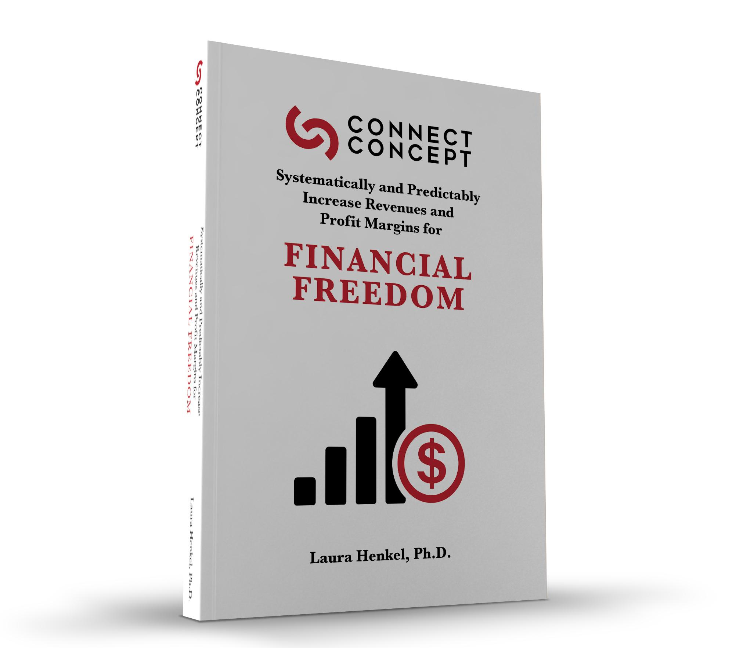
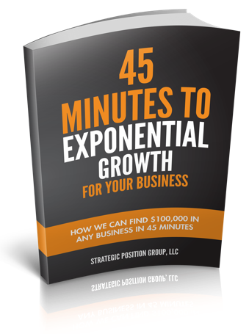
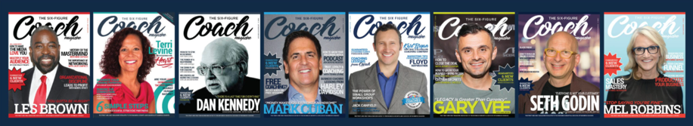
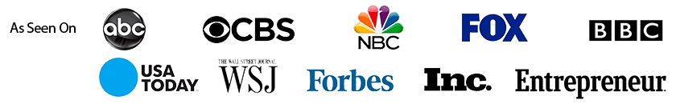
How I find $100K
In 45-minutes
Without additional Marketing
Or Advertising Dollars
Published Author
Magazine Contributor
Nationally Recognized Business Strategist

Slide 5

Basic Questions To Start…
What is your view of the current state of the industry in your market?
What do you see as the biggest growth opportunities for in your industry?
What do you feel are the biggest challenges facing your industry, right now?

Slide 6
The Focus of Successful Businesses
5
1
4
2
3

Slide 7
Strategy
Cut Costs
Bundling
Policies, Procedures
Upsell & Cross-Sell
Market Dominating Position
Increase Longevity of the Buying Relationship
Increase Price
Trust, Expertise, Education
Referral Systems
Sales Team
JVs & Alliances
Appointments
Additional Products & Services
Publicity & PR
Increase Frequency of Purchase
Direct Mail
Reactivate Former Customers
Digital Marketing
Downsell
Advertising
Drip Campaign
Compelling Offer
Follow-up Close Rates
Initial Close Rates
Scripts
Other

Slide 8
More Leads
Search Engine Marketing
(SEM)
Social Media
Facebook
Content
Twitter
Social Bookmarking
LinkedIn
Instagram
…and MANY more
Search Engine Optimization
(SEO)
Conversion Optimization
Copywriting
Digital Marketing
Ecommerce
Data Science & Analytics
Google Ads
Facebook Ads
Paid Advertising
(Pay-per-click, pay-per-view)
Retargeting
Reputation
Live Video and Audio
Sponsorship
Behavioral
Website
Video
Networks
(Exchanges, Community Management
Rich Media
Mobile
Banners
Affiliate
And MANY Others
Local
Blogging
Email
Link Sharing

Slide 9
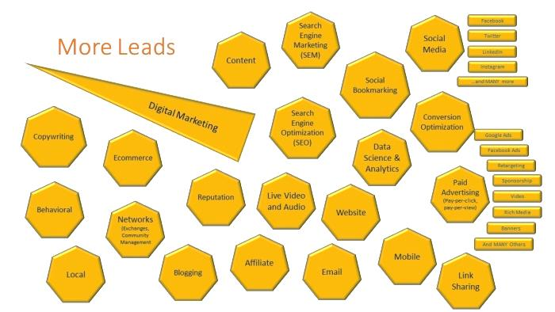
The Problem
Strategy
Cut Costs
Bundling
Policies, Procedures
Most “Marketing” companies start here
Upsell & Cross-Sell
Market Dominating Position
Increase Longevity of the Buying Relationship
Increase Price
Trust, Expertise, Education
Referral Systems
Sales Team
JVs & Alliances
Appointments
Additional Products & Services
Publicity & PR
Increase Frequency of Purchase
Direct Mail
Reactivate Former Customers
Digital Marketing
Downsell
Advertising
Follow-up Close Rates
Compelling Offer
Drip Campaign
Initial Close Rates
Scripts
Other

Slide 10

Seeing this, business owners can get overwhelmed…
How have you seen this affect business owners in your industry?
Are you familiar with 80/20 rule?

Slide 11

80% of your revenue, comes from 20% of what you doing in your business everyday.
20%
The crucial 20% for business revenue acceleration, can be broken down…
Into 5 Sure-fire Areas.

Slide 12



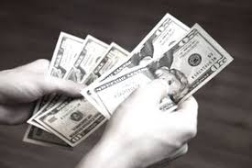

The Five Step Profit Formula
Higher Profits
More Leads
More Conversions
More Transactions
Higher Avg. Dollar per Sale
A predictable pathway to compounding,
Transformational revenue & Profit acceleration.

Slide 13
Profit Acceleration Strategies: Financial breakthroughs, can be predictably created by implementing 12 key strategies, in five areas. Income results are transformational, sustainable, and lead to triple digit profit increases for any business.
Market Dominating Position
Leads
Alliances and Joint Ventures
Digital Marketing
Compelling Offer
Drip Campaign
Down-sells
Additional Products & Services
Increase Prices
Upsell & Cross-sell
Bundling
Cut Costs
Notes:
Now, you have identified your ideal clients, Module 2: Decision Making Process will help you understand more about who your ideal clients are and what drives their decisions.
This module builds upon your research findings from Module 1 and introduces you to additional market research. Your report will begin to grow significantly after completing this module.
Polling question:
True or false… should you complete a “Gap Analysis” prior to creating your revenue plan?
(Answer… True)

Slide 14
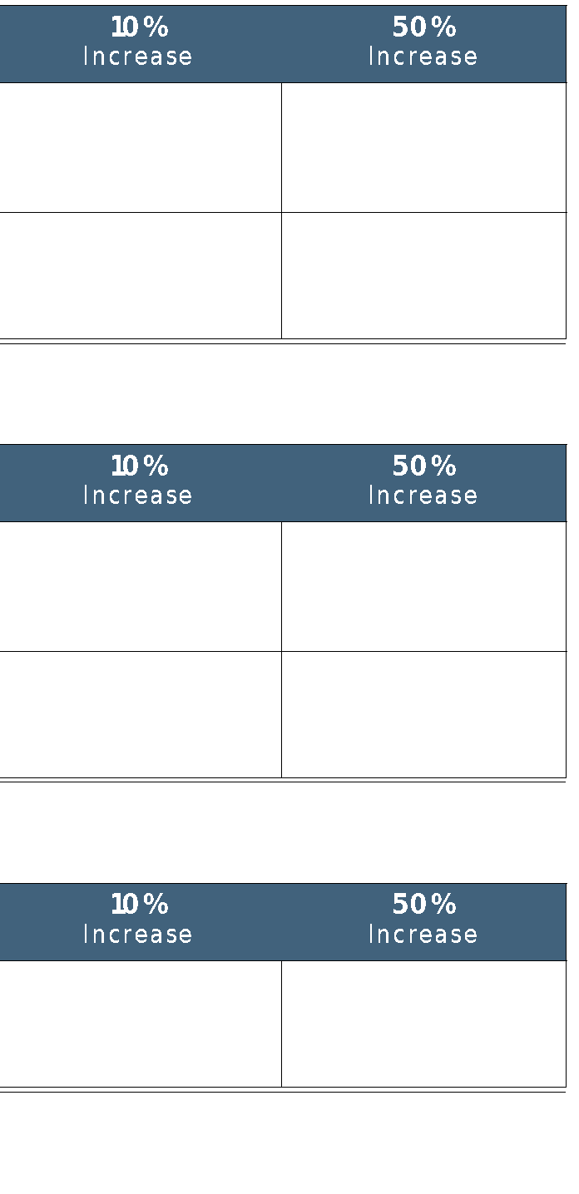
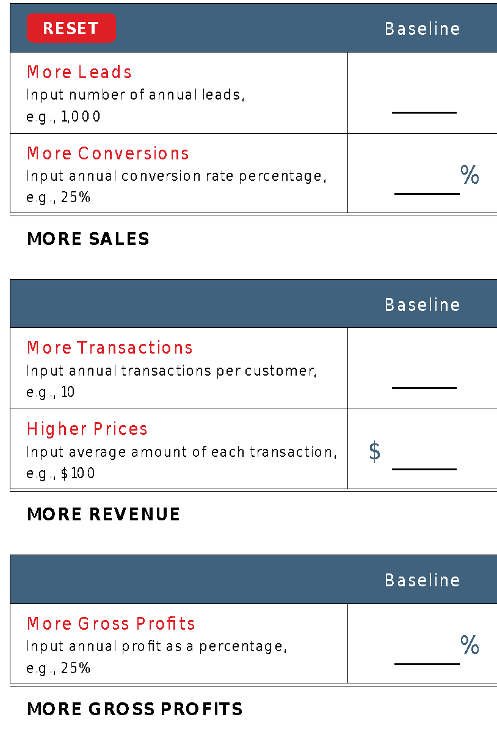
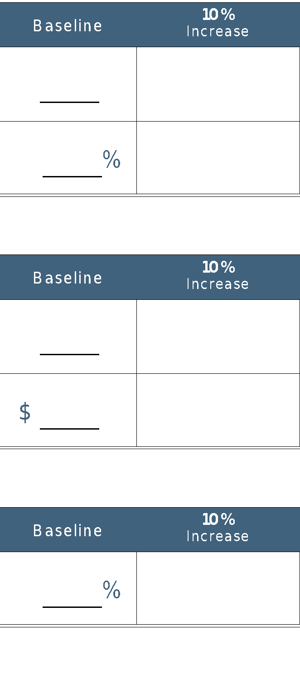
Profit Growth Calculator: Compound Growth
1,000
1,100
1,500
Small incremental improvements compound on each other.
The small gains in each area produce significantly greater, overall gains.
25
27.5
37.5
250
303
563
10
11
15
760%
100
$110
$150
$250,000
$366,025
$1,265,625
25
27.5
37.5
$62,500
$100,657
$474,609

Slide 15
Revenue Compounding:
Small Increases in 5 Areas Generate Massive Profits
1,000
1,100
1,500
A 50% gain in each of these five areas is child's play when effective strategies are deployed.
Achievable incremental improvements in these fundamental five areas, generate exponential growth…
25
27.5
37.5
250
303
563
10
11
15
100
$110
$150
Without spending additional dollars on Marketing & Advertising.
$250,000
$366,025
$1,265,625
25
27.5
37.5
$62,500
$100,657
$474,609

Slide 16

$100k In 45 Minutes
The Key to Successful Marketing
You MUST be able to enter the conversation taking place in the head of your prospects
Or another way to look at it is to be able to address the number one question on your prospects mind at just the right time

Slide 17
Entering the Conversation in the Buyers Mind
The conversation that’s taking place in EVERY Prospect’s mind revolves around two major emotional issues…
The Problem That They Have...
We all hate to be sold, but We love to buy.
That They Don’t Want.
All
Buying descisions are based on emotion. The buyer buys when they “FEEL” ready
The Solution That They Want...
and willing to do so....when they FEEL good about buying.
That They don’t Have.

Slide 18

The Conversion Equation:
INTERRUPT =
A headline that states the problem your prospect has and doesn’t want.
ENGAGE =
A sub-headline stating the promise of the solution they want but don’t have.
EDUCATE =
The information you provide either verbally or in writing that presents evidence to your prospects that you and your product or service are superior in every way to your competition.
OFFER =
An offer that MUST be so compelling and so irresistible your prospect
can’t turn it down.
.

Slide 19

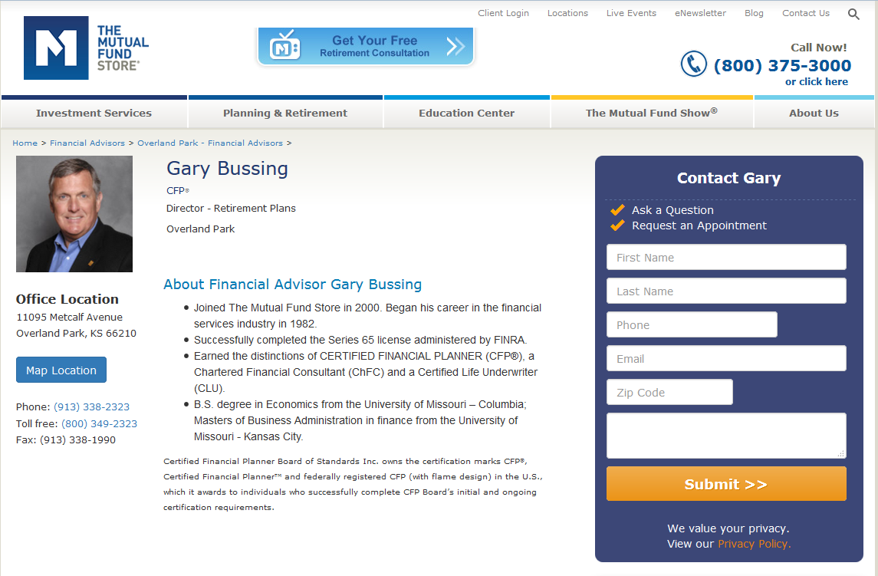


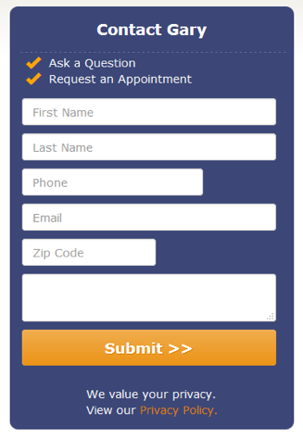


What’s The Offer?
Notes:
1 22

Slide 20


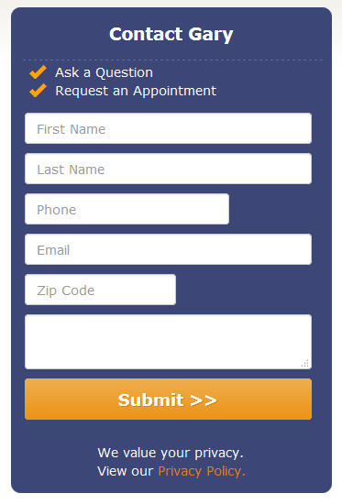

What’s The Offer?
Notes:
1 22

Slide 21
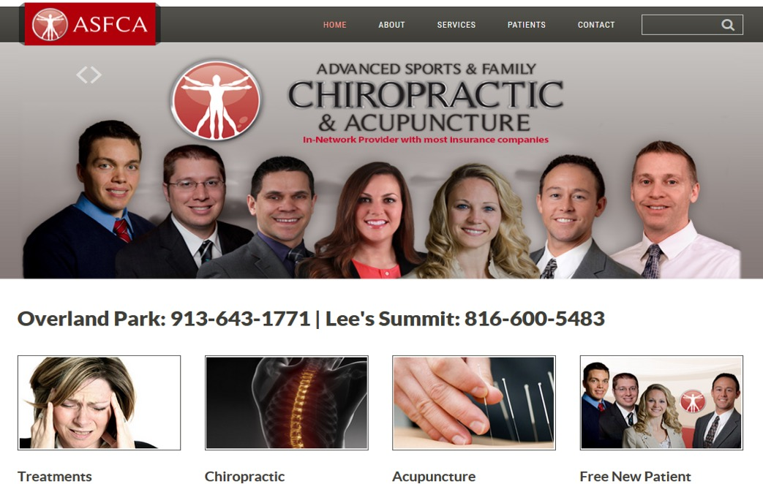
What’s The Offer?
Notes:
1 23

Slide 22
What’s The Offer?
Notes:
1 23

Slide 23
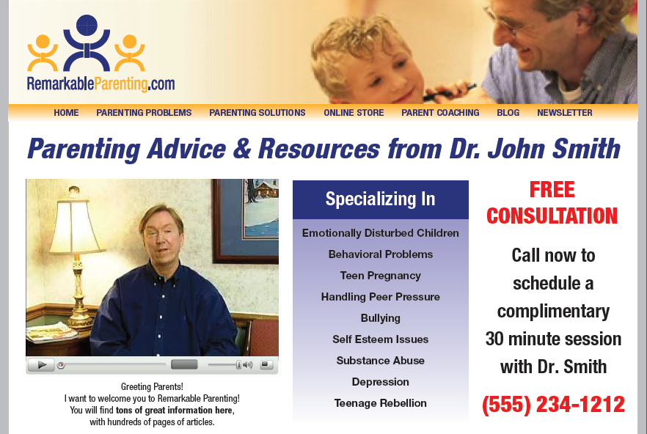



Slide 24


Slide 25


Slide 27
The Conversion Equation
The Doctor’s Video Script
INTERRUPT
“As a parent, are you struggling to gain control of your child's attitude and emotions?
Is your child yelling and screaming at you, while often displaying a belligerent and sometimes threatening tone that no matter what you do or try... you just can't seem to get under control?
My name is Dr. John Smith, and I help parents like you every day learn the techniques that will solve these frustrating and destructive behavioral patterns once and for all. In fact, let me prove it to you.
Enter your first name and email in the box to the right, and I'll send you a series of 60 second techniques that will immediately restore peace and quiet in your home.”
ENGAGE
EDUCATE
OFFER

Slide 28
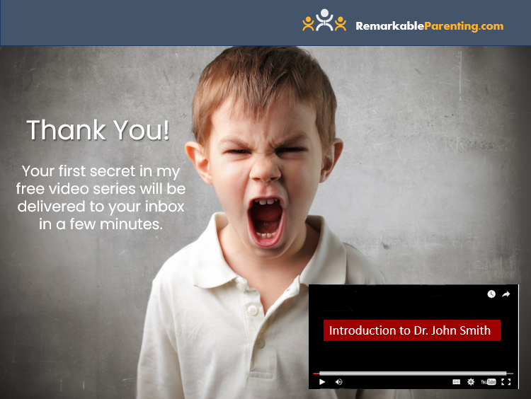

Slide 29
Conversion Equation
Avg. 300 leads per month
Avg. 30 (10%) call to ask about the consultation
Avg. 3 (10%) consent to the consultation, and all 3 become new patients.
This represents the typical 1% - 2% conversion rate for “Me Too” communication from businesses.

Slide 30
Conversion Equation
Avg. 300 leads per month
60 (20%) request offer
Avg. 6 (10%) consent to the consultation, and 6 become new patients.
Avg. sale value = $800
$2,400 per month increase
$28,000 annual revenue increase

Slide 31

The power of a Marketing Dominating Position
Case Study: Cosmetic Surgeon
Specialized in “Mommy Makeovers”
35 leads / month running Facebook PPC ($6k)
The doctor had NO market-dominating position that addressed the primary problem his ideal client faced
Notes:
Now, you have identified your ideal clients, Module 2: Decision Making Process will help you understand more about who your ideal clients are and what drives their decisions.
This module builds upon your research findings from Module 1 and introduces you to additional market research. Your report will begin to grow significantly after completing this module.
Polling question:
True or false… should you complete a “Gap Analysis” prior to creating your revenue plan?
(Answer… True)

Slide 32
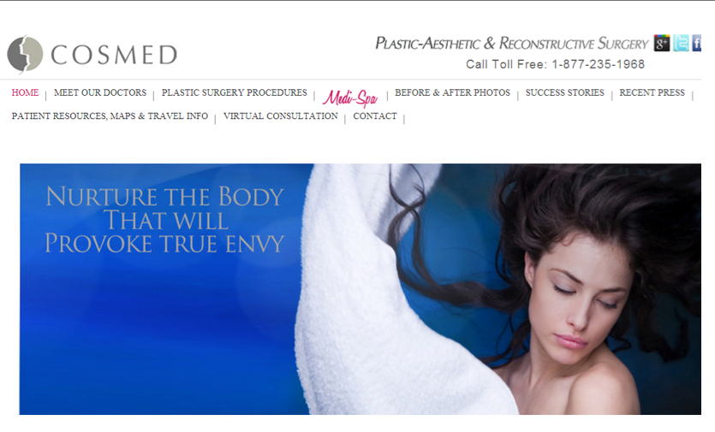
What is the Offer?
35 leads / month running Facebook PPC
His conversion rate was ZERO
He had NO compelling offer
Notes:
Now, you have identified your ideal clients, Module 2: Decision Making Process will help you understand more about who your ideal clients are and what drives their decisions.
This module builds upon your research findings from Module 1 and introduces you to additional market research. Your report will begin to grow significantly after completing this module.
Polling question:
True or false… should you complete a “Gap Analysis” prior to creating your revenue plan?
(Answer… True)

Slide 33

Case Study Cosmetic Surgeon:
Sent them to a “squeeze” page
NOT his website
At this early stage, prospects want “information”
Result: Generated 400 leads per month
1,143% LEAD INCREASE
Notes:
Now, you have identified your ideal clients, Module 2: Decision Making Process will help you understand more about who your ideal clients are and what drives their decisions.
This module builds upon your research findings from Module 1 and introduces you to additional market research. Your report will begin to grow significantly after completing this module.
Polling question:
True or false… should you complete a “Gap Analysis” prior to creating your revenue plan?
(Answer… True)

Slide 34
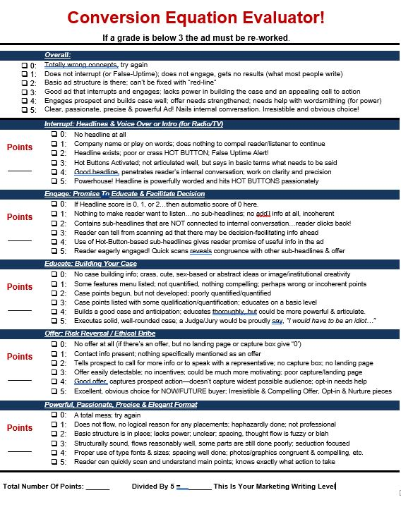
$100k In 50 Minutes

Slide 35

Marketing is Strategic
It’s been unduly simplified by
Business owners failure to implement
The Buyer’s Journey
This failure (the result of outdated business models and technology) requires more repetition (and more $$) to be minimally effective…
Here’s why…

Slide 36
The Buyer’s Journey
The buyer travels through perdictable internal & information gathering stages on the path to purchase.
Who should I buy from?
Vendor Selection
Who should I buy from?
The buyer becomes aware of the product or service
Awareness of Product / Service
Why shouldn’t I buy?
Objections to ownership
Why shouldn’t I buy?
Why should I buy?
Benefits of ownership
Buyer the right information at the right time on their journey
Exhaustive studies, in hundreds of industries confirm that only 3% - 9% of buyers are in market to buy at any moment in time.

Slide 37

ADVERTISING SATURATION The conversion equation reduces touch points
Today, it takes anywhere from 20 to more than 100 touch points before a prospect makes their buying decision.
Following the Conversion Equation reduces the touch points to somewhere between 5 to 12 points of direct contact to engage a client or customer along the buyer's journey to a sale.

Slide 38

Lead Nurturing
80% + of ALL sales occur between the 5th and the 12th direct point of contact between the business and the prospect.
Notes:
Now, you have identified your ideal clients, Module 2: Decision Making Process will help you understand more about who your ideal clients are and what drives their decisions.
This module builds upon your research findings from Module 1 and introduces you to additional market research. Your report will begin to grow significantly after completing this module.
Polling question:
True or false… should you complete a “Gap Analysis” prior to creating your revenue plan?
(Answer… True)

Slide 39

Drip Campaigns
A drip campaign is an automated sequence of “Value Add” communications, sent directly to the prospect client/customer/patient.
A drip campaign follows the buyer's journey and communicates with customers or prospects on a predetermined and scheduled basis that nurtures the relationship through the stages of education to purchase.
Notes:
Now, you have identified your ideal clients, Module 2: Decision Making Process will help you understand more about who your ideal clients are and what drives their decisions.
This module builds upon your research findings from Module 1 and introduces you to additional market research. Your report will begin to grow significantly after completing this module.
Polling question:
True or false… should you complete a “Gap Analysis” prior to creating your revenue plan?
(Answer… True)

Slide 40
Conversion Equation
Avg. 300 leads per month
60 (20%) request offer
Avg. 6 (10%) consent to the consultation, and 6 become new patients
Avg. sale value = $800
$2,400 per month increase
$28,000 annual revenue increase

Slide 41


300 Leads
This means that 54 qualified prospects did NOT engage his services…
YET!
60 opt-ins for free info offer
6 clients
Notes:
5 13

Slide 42
54 prospects
Those 54 prospects go into our “drip campaign.”
Let's assume that these numbers produce just 2 additional clients.
Drip campaign nurturing
2 clients
Notes:
5 14

Slide 43
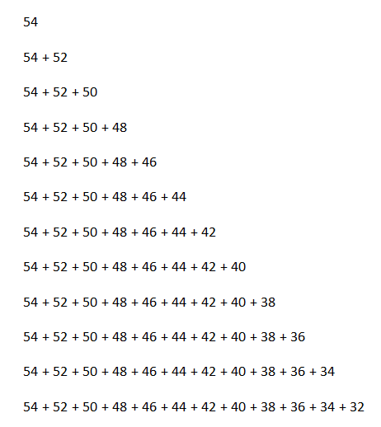
This is what it looks like over the course of one year!
Notes:
5 15

Slide 44
3600 prospects
4080 prospects
At the end of the first year, the squeeze page generated an additional 72 clients in 12 months.
Drip campaign nurturing
The drip campaign produced 156 NEW clients, generating $124,800 in additional revenue that would have NEVER converted without it.
156 clients
Notes:
5 16

Slide 45
By month 12 of year one, the doctor is generating 30 NEW patients every month.
Is that a number this doctor can handle logistically?
Notes:
5 17

Slide 46

Up / Down / Cross selling Drives additional revenue.
Up/Down/Cross Selling is a primary strategy for driving additional revenue and initiating longer life cycle revenue opportunities:
A full 34% of buyers will make an additional and or alternative purchase at the time of initial purchase if...they are simply asked!
DOWN SELL: Someone declines your product or service offering…so, you offer them an alternative at a lower price
The goal is to turn the prospect into a client, so you not only realize some short-term financial benefit... but you gain the opportunity to do business with them again in the future
Notes:
Now, you have identified your ideal clients, Module 2: Decision Making Process will help you understand more about who your ideal clients are and what drives their decisions.
This module builds upon your research findings from Module 1 and introduces you to additional market research. Your report will begin to grow significantly after completing this module.
Polling question:
True or false… should you complete a “Gap Analysis” prior to creating your revenue plan?
(Answer… True)

Slide 47

Down selling retains clients
Down-sell Example:
Health club - Sells a one-year Gold Membership Program
The prospect declines the membership.
The Sales associate offers the prospect low risk / low barrier to purchase options:
90 day “health makeover” membership
One week “trial” membership
Notes:
Now, you have identified your ideal clients, Module 2: Decision Making Process will help you understand more about who your ideal clients are and what drives their decisions.
This module builds upon your research findings from Module 1 and introduces you to additional market research. Your report will begin to grow significantly after completing this module.
Polling question:
True or false… should you complete a “Gap Analysis” prior to creating your revenue plan?
(Answer… True)

Slide 48

Down Selling
Down-sell Example:
Florist – sells a dozen roses for $50
Just ONE $25 alternative down-sell daily would net an additional $8,000 annually
That’s only one possible downsell opportunity - suppose they had floral alternatives for weddings, lower priced options for funerals and so on
Notes:
Now, you have identified your ideal clients, Module 2: Decision Making Process will help you understand more about who your ideal clients are and what drives their decisions.
This module builds upon your research findings from Module 1 and introduces you to additional market research. Your report will begin to grow significantly after completing this module.
Polling question:
True or false… should you complete a “Gap Analysis” prior to creating your revenue plan?
(Answer… True)

Slide 49

Up-selling & Cross-selling
Upselling means offering a higher grade or quality or size of the item that the customer may be interested in at the point when the customer is ready to buy.
Cross-selling means offering other products or services which complement the item the customer is interested in, at the point when the customer is ready to buy.
34% of prospects will buy additional products or services at the time of their original purchase IF they’re asked to do so.
Notes:
Now, you have identified your ideal clients, Module 2: Decision Making Process will help you understand more about who your ideal clients are and what drives their decisions.
This module builds upon your research findings from Module 1 and introduces you to additional market research. Your report will begin to grow significantly after completing this module.
Polling question:
True or false… should you complete a “Gap Analysis” prior to creating your revenue plan?
(Answer… True)

Slide 50

Up-selling & Down-selling Increase's revenue per sale
Upsell / Cross-sell Example:
A dentist offers basic dental services like exams and teeth cleaning… but that is NOT where they make their money
Most of their revenue comes from cosmetic services, root canals, crowns, fillings and braces
Notes:
Now, you have identified your ideal clients, Module 2: Decision Making Process will help you understand more about who your ideal clients are and what drives their decisions.
This module builds upon your research findings from Module 1 and introduces you to additional market research. Your report will begin to grow significantly after completing this module.
Polling question:
True or false… should you complete a “Gap Analysis” prior to creating your revenue plan?
(Answer… True)

Slide 51



Increase Revenues Per Sale
Upsell / Cross-sell:
What might convince someone to leave their dentist?
85% of the population have medical insurance
Less than 50% have dental insurance
Among those without dental insurance, 44% said that was the main reason they didn’t visit the dentist
Can you see an opportunity here if you’re a dentist?
Notes:
Now, you have identified your ideal clients, Module 2: Decision Making Process will help you understand more about who your ideal clients are and what drives their decisions.
This module builds upon your research findings from Module 1 and introduces you to additional market research. Your report will begin to grow significantly after completing this module.
Polling question:
True or false… should you complete a “Gap Analysis” prior to creating your revenue plan?
(Answer… True)

Slide 52

Target untapped markets
Upsell / Cross-sell: Case Sudy
The dentist, by offering a routine exam and cleaning for $25 (normal co-pay with insurance) covers their costs for the treatment
Then they create the upsell opportunity for additional services they need such as fillings, crowns, dentures, braces,
This is just like a low-cost oil change for your car, followed by wipers, and a brake repair.
Notes:
Now, you have identified your ideal clients, Module 2: Decision Making Process will help you understand more about who your ideal clients are and what drives their decisions.
This module builds upon your research findings from Module 1 and introduces you to additional market research. Your report will begin to grow significantly after completing this module.
Polling question:
True or false… should you complete a “Gap Analysis” prior to creating your revenue plan?
(Answer… True)

Slide 53

Joint Ventures
Notes:
3 1

Slide 54

Joint Ventures
Joint Ventures involve two or more businesses that decide to form a partnership to share markets or endorse a specific product or service to their customer base… usually under a revenue share arrangement.
The key to creating successful joint ventures is to find partners who service the exact same type of clients that need or want what you sell.
Notes:
3 2

Slide 55

Roadmap to Joint Ventures:
Event Chain Purchases
The wedding industry gives of an example of a typical “Event Chain” of vendors when someone is getting married.
Notes:
3 3

Slide 56


Consider the wedding industry:
This is the typical “event chain” of vendors when someone is getting married.
Jeweler (engagement ring)
Wedding planner
Church / chapel
Reception venue
Wedding dress
Florist
Wedding cake
Printer (invitations)
Everyone ABOVE the florist is perfectly positioned to refer business TO the florist.
Notes:
3 4

Slide 57
Consider the wedding industry:
This is the typical “event chain” of vendors when someone is getting married.
Jeweler (engagement ring)
Wedding planner
Church / chapel
Reception venue
Wedding dress
Florist
Wedding cake
Printer (invitations)
Everyone ABOVE the florist is perfectly positioned to refer business TO the florist.
Everyone BELOW the florist is perfectly positioned to receive referrals FROM them.
Notes:
3 5

Slide 58
Consider the wedding industry:
This is the typical “event chain” of vendors when someone is getting married.
Jeweler (engagement ring)
Wedding planner
Church / chapel
Reception venue
Wedding dress
Florist
Wedding cake
Printer (invitations)
Could the florist OBTAIN just one referral each month from just ONE of the businesses ABOVE them.
Next, could the florist SEND just one referral each month to EACH business BELOW them.
Notes:
3 6

Slide 59
Consider the wedding industry:
Let’s assume in the chain below your prospect is the florist…
Jeweler (engagement ring)
Wedding planner
Church / chapel
Reception venue
Wedding dress
Florist
Wedding cake
Printer (invitations)
If the average sales price for the florist’s wedding flowers is $3,000, then just a single referral per month produces an annual increase of $36,000.
Notes:
3 7

Slide 60
Consider the wedding industry:
Let’s assume in the chain below your prospect is the florist…
Jeweler (engagement ring)
Wedding planner
Church / chapel
Reception venue
Wedding dress
Florist
Wedding cake
Printer (invitations)
If the average sales price for a wedding cake is also $3,000, and the florist receives a 10% referral fee, then just a single referral per month produces an additional annual increase of $3,600.
Notes:
3 8

Slide 61
Consider the wedding industry:
Let’s assume in the chain below your prospect is the florist…
Jeweler (engagement ring)
Wedding planner
Church / chapel
Reception venue
Wedding dress
Florist
Wedding cake
Printer (invitations)
If the average sales price for printing is $1,000, and the florist receives a 10% referral fee, then just a single referral per month produces an additional annual increase of $1,200.
Notes:
3 9

Slide 62
Consider the wedding industry:
Let’s assume in the chain below your prospect is the florist…
Jeweler (engagement ring)
Wedding planner
Church / chapel
Reception venue
Wedding dress
Florist
Wedding cake
Printer (invitations)
Add it all up and the florist is now earning an additional $40,800 in annual revenue.
Using ULTRA-CONSERVATIVE numbers.
Notes:
3 10

Slide 63



“5 Things Every Bride Should Know to Avoid Disaster on their Wedding Day.”
Joint venture opportunities exist for each vendor in the wedding chain:
Imagine the impact on sales for every vendor in the wedding chain, if each of them gave a copy of this report to the bride and groom at each purchase on the road from proposal to honeymoon!
Notes:
3 11

Slide 64


843.655.5797
DOWNLOAD YOUR FREE BOOK

Slide 65

Up-Sell & Down-Sell
What do you think might happen if a dentist specifically targeted families without dental insurance and offered them virtually the exact same services as those with dental insurance…
…but without paying the expensive monthly premiums?
Notes:
Now, you have identified your ideal clients, Module 2: Decision Making Process will help you understand more about who your ideal clients are and what drives their decisions.
This module builds upon your research findings from Module 1 and introduces you to additional market research. Your report will begin to grow significantly after completing this module.
Polling question:
True or false… should you complete a “Gap Analysis” prior to creating your revenue plan?
(Answer… True)

Slide 66
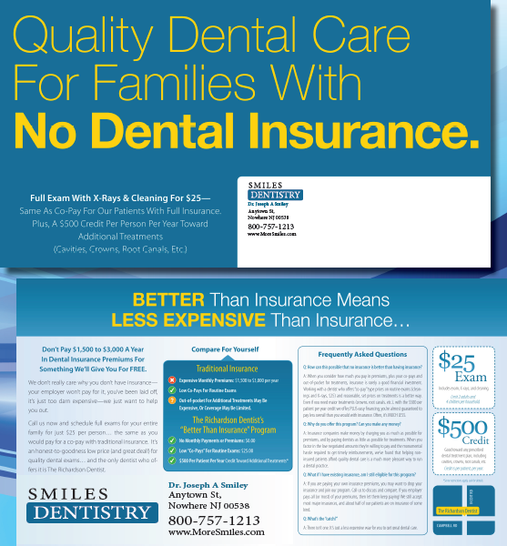


Notes:
Now, you have identified your ideal clients, Module 2: Decision Making Process will help you understand more about who your ideal clients are and what drives their decisions.
This module builds upon your research findings from Module 1 and introduces you to additional market research. Your report will begin to grow significantly after completing this module.
Polling question:
True or false… should you complete a “Gap Analysis” prior to creating your revenue plan?
(Answer… True)

Slide 67

Case Study: Cosmetic Surgeon
The Surgeon’s ad:
“Nurture The Body That Will Provoke True Envy”
(Enter the conversation taking place in the head of your prospect)
Notes:
Now, you have identified your ideal clients, Module 2: Decision Making Process will help you understand more about who your ideal clients are and what drives their decisions.
This module builds upon your research findings from Module 1 and introduces you to additional market research. Your report will begin to grow significantly after completing this module.
Polling question:
True or false… should you complete a “Gap Analysis” prior to creating your revenue plan?
(Answer… True)

Slide 68

Case Study Cosmetic Surgeon:
BEFORE conversion rate: 0%
AFTER conversion rate:
Report opt-in rate: 67%
Patient conversion rate: 12%
RESULTS AFTER IMPROVING TWO AREAS
His ad generated 400 prospects per month
His 67% opt-in rate generated 268 new leads
His 12% conversion rate generated 32 new patients
Approximately $125,000 in monthly revenue
Notes:
Now, you have identified your ideal clients, Module 2: Decision Making Process will help you understand more about who your ideal clients are and what drives their decisions.
This module builds upon your research findings from Module 1 and introduces you to additional market research. Your report will begin to grow significantly after completing this module.
Polling question:
True or false… should you complete a “Gap Analysis” prior to creating your revenue plan?
(Answer… True)

Slide 69
80/20 Rule
Immediate, compound growth can be broken down into just 5 areas!
When you make small incremental increases in these 5 key areas, revenue & profit growth is transformational.
This is NOT DONE by spending more money on ads & marketing…
But by focusing on the most powerful strategies that generate exponential revenue & profit growth.

