Slide 1
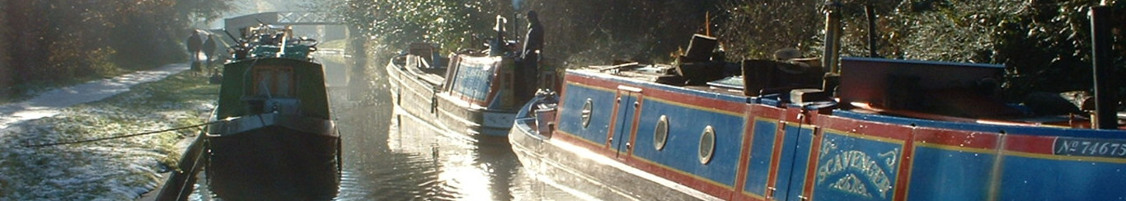


Presentation 8th June 2021 to the
All Party Parliamentary Group – Waterways
“Living on the Water”
NBTA: Supporting Itinerant Boat-dwellers
W: www.bargee-traveller.org.uk
E: secretariat@bargee-traveller.org.uk
Nick Brown – Secretary
National Bargee Travellers Association

Slide 2
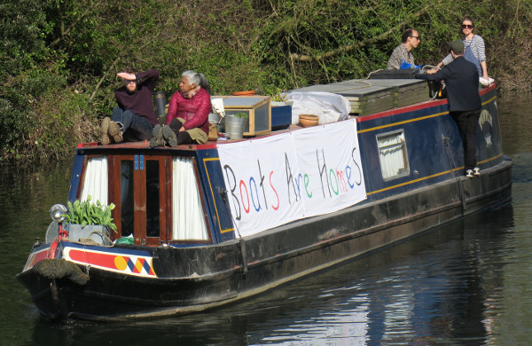
> What We Want
- Non-CRT: 56-day moorings
- CRT: no 20-mile range spec
(unlawful)
- CRT: <14-day restrictions
to end
- recognition IN LAW of our right to live on our boats
(new legislation) irrespective of jurisdiction
- this right to subordinate recreational use
National Bargee Travellers Association

Slide 3
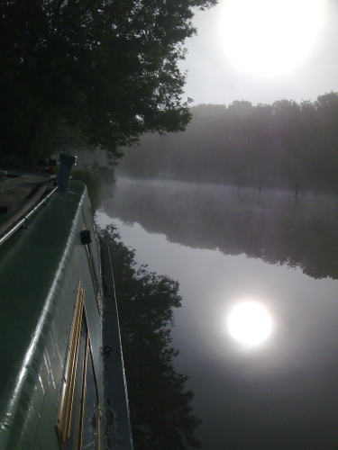
> Why be an Itinerant Boat-Dweller?
- Increase in population driven
by housing crisis
- Serenity, peace, movement in a
troubled world
- Culture, strong and supportive
community
- It is a challenge, it is fun:
“They’ll take me off my boat in a box”
“Once a boater always a boater”
a boater”
National Bargee Travellers Association

Slide 4
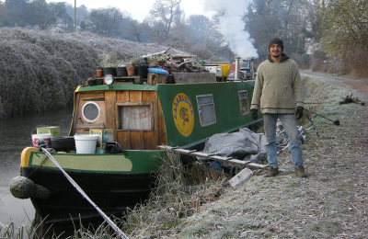
> What Entitles us to Live on Boats?
- Natural rivers:
public right of navigation
- Since time immemorial
Magna Carta, no distance
or times specified
- No law preventing nomadic living
- BUT Police, Crime,
Sentencing and Courts Bill 2021
- CRT: s.17(3)(c)(ii) BW Act 1995
National Bargee Travellers Association

Slide 5
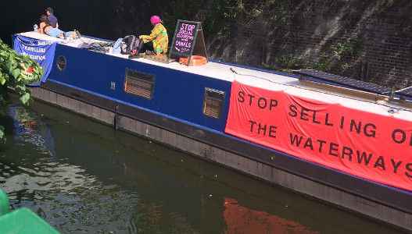
> What is all the Fuss About??
- Recreational use subordinate to residential use:
s.8 Human Rights Act
BUT...
- Constant encroachment on these rights by:
CRT, other Navigation Authorities,
other state actors, some private landowners
- “We are in the way” of recreational use
– trying to “get rid”
We need stronger protection
National Bargee Travellers Association

Slide 6
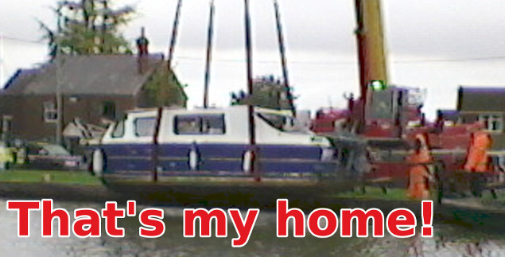
> Casework:
the Numbers
The NBTA provides casework support and advocacy
2016 | 2016 | 2017 | 2018 | 2019 | 2020 | 2021
Litigation Others Total | 11 49 60 | 14 77 91 | 10 53 63 | 9 53 62 | 7 28 35 | 12 19 31
National Bargee Travellers Association

Slide 7

Public Inquiry into conduct of all Navigation Authorities and public sector riparians
> What
Next?
National Bargee Travellers Association

Slide 8
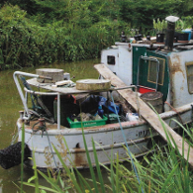
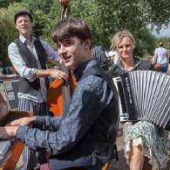
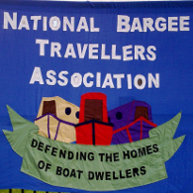
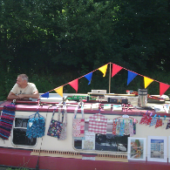
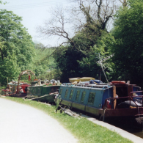
Questions….
National Bargee Travellers Association
Supporting Itinerant Boat-dwellers
W: www.bargee-traveller.org.uk
E: secretariat@bargee-traveller.org.uk
National Bargee Travellers Association

