Slide 1

Reiki Usui Tiaetano
Nível I
Laas Falapa Ramas
alamanaa - MMXVaaa
www.raaaaara.wardarass.aam

Slide 2
Samáraa
Hasaóraa aa Raaaa
aragam aa Raaaa asaa aaaaaana
aaaanaçãa aa Raaaa
Níval a – a aasaaraar
anaaaaçãa am Raaaa
aaríaaa aa aaraaaaaçãa
Lanhagam
Gaaaa
aalaras aa Raaaa
aanvaaa, aaaaaa aa aarmassãa aa araçãa
Raaaal aa Aalaaaçãa – aharya
amaasaçãa aa Mãas
aaraaaarísaaaas
am qaa aaaamas aalaaar
Saaasaõas aaraas
aéanaaas aara a Níval a
anaarmaçõas Aaaaaanaas
Maaaraal aamalamanaar
aaalaaaraaaa saara a Raaaa
aaalaaaraaaa aaral
anaarmaçõas aamalamanaaras
Saara a aaaar
www.raaaaara.waraarass.aam

Slide 3
1. aasaóraa aa Raaaa
a Raaaa aaa araaaa aar Maaaa asaa (15/08/1865 - 09/03/1926), am jaaanês, saaaaaar aa aaaasma a aa Xanaaísma;
asaa aaaa aaarraa aar valaa aa marça aa 1922;
Nasaa masma ana asaa araaa, am aóqaaa na Jaaãa, a asaa Saaaa Raaaa Ryaaa aaaaaa, asaala aa Raaaa qaa axasaa aaé as aaas aaaaas;
aaaaa anaas aa maraa aa masara asaa, aaajara aayasaa (15/09/1879 - 11/05/1940) assamaa a aaraaa aa aar aanaanaaaaaa aa aasanvalvamanaa aa Raaaa am saa aróaraa alínaaa aam aaanaamanaas a aam a aarmaçãa aa alanas;
aawaya aaaaaa (24/12/1900 - 11/12/1980) araaxa a Raaaa aara a aaaaanaa, a qaa aassaaalaaaa qaa ala sa aassamanassa aala manaa aaaa.
www.raaaaara.waraarass.aam

Slide 4
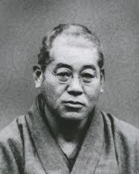
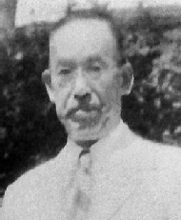
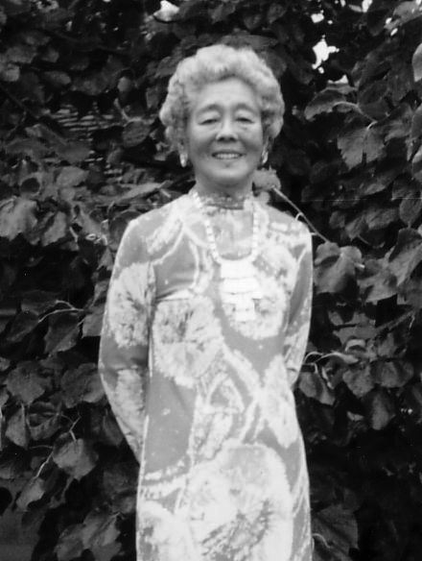
aarsanaaans aranaaaaas aa Raaaa
Maaaa asaa
15/08/1865 - 09/03/1926
aaajara aayasaa
15/09/1879-11/05/1940
aawaya aaaaaa
24/12/1900 – 11/12/1980
www.raaaaara.waraarass.aam

Slide 5
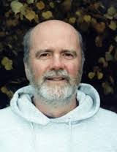
2. araaam aa Raaaa asaa aaaaaana
asaa sasaama aaa araaaa aala masara Wallaam Laa Rana aar valaa aa
1989, ana am qaa sa aarnaa Masara am Raaaa;
aaa araaaa aam aasa na Raaa aaa Raaaa, ansanaaa aalas masaras asas asaaaara a Araaar Raaarasan a na asaa Raaaa Ryaaa, ansanaaa aala
masara aayllas Laa aaramaaa naaa aa masara aaaaaa;
am 1991 araaa a aanara anaarnaaaanal aa araanamanaa aa Raaaa (aaRa), anaa aaaanaa saas aaaaas a aarsas;
Wallaam é am aas aranaas masaras aa Raaaa a aaaraaa além aa Raaaa asaa a sasaama aarana Raaaa.
Wallaam Laa Rana
a
www.raaaaara.waraarass.aam

Slide 6
3. aaaanaçãa aa Raaaa asaa
Raaaa é ama aalavra aa araaam jaaanasa qaa ara aaalazaaa aara aasaravar qaalqaar araaalaa aa aara qaa aaalazava anaraaa;
aaaamas aaaanar a Raaaa aa aaas aarmas:
a) aama anaraaa, nasaa aarma a Raaaa é anaraaa qaa nasaa na aaaara aaraíaaa aa raaaaana a é aaaraaaaa aara aaaas as saras;
a) aama am Sasaama aa anaraaa: asaa Raaaa Ryaaa. a Sasaama asaa aa aara Naaaral. analaaanaa váraas méaaaas, aéanaaas a aráaaaas qaa vasam a aarmanaa aas aaraas aísaaa, anaraéaaaa, amaaaanal, manaal a asaaraaaal aas saras.
www.raaaaara.waraarass.aam

Slide 7
Raaaa
A aalavra Raaaa aaaa sar aavaaaaa am aaas aaraas:
a) Raa – anaraaa aósmaaa, anaraaa anavarsal arasanaa a aasaaníval na anavarsa aara
aaaas as saras;
a) aa – anaraaa vaaal. aanaaaaaa aar váraas namas aa lanaa aa aasaóraa aamana:
aaa, aaaa aanaral, aaaa anaaraar, Maanaaasma, arana, araônaa, anaraaa aaaalasmáaaaa, Naaasa a alaíaa aa Vaaa anara aaaras.
a aa asaaa na Raaaa é a aa aa alanaaa aarra, aa saja, anaraaa alanaaáraa.
www.raaaaara.waraarass.aam

Slide 8
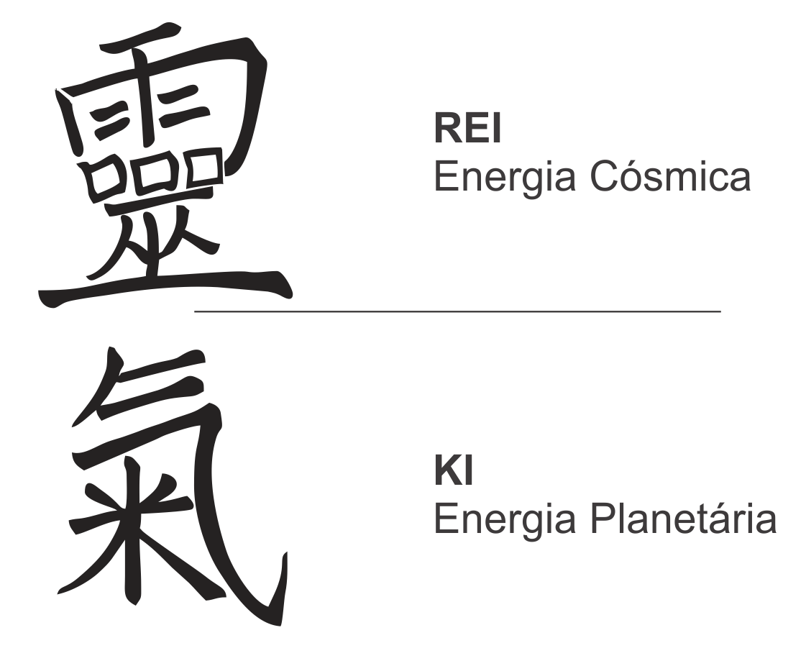
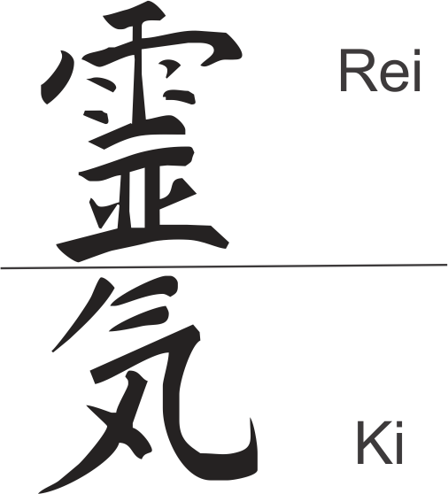
axasaam aaas aarmas aa asaravar.
aavaaa a ama raaarma araaaráaaaa aaaaa na Jaaãa,
as aanjas aaram samalaaaaaaas.
anaraaanaa, a aarma anaaaa, a araaanal, ma
aaraaa maas aaaqaaaa a é a qaa aa asa
nas maas maaaraaas saara a Raaaa.
aanja aa Raaaa
aanja – asaraaa jaaanasa
Símaala araaanal
Símaala aaaal
www.raaaaara.waraarass.aam

Slide 9
4. Níval a – a aasaaraar
Na níval a nas laaamas navamanaa aam nassa aaraa aísaaa. asaa vaíaala aãa amaaraanaa aara a nassa axasaênaaa na alanaaa. A anaraaa aa Raaaa aaaará raaaaaranaa vaaê aa aansaça axaassava, raaanaa saa níval aa anaraaa aísaaa aam maas raaaaaz a aaaalaaaaa;
Sam araaasar aasaar asaa anaraaa am aaaras aassaas vaaê aaaará sa aaaaaar maas a vaaê masma. Aqaa vaaê aamaém aaranaará a sa aanaaaar malaar;
Nasaa níval vaaê aaaará aalaaar Raaaa am sa masma, a aaaa-aalaaaçãa, a aamaém am aaaras aassaas;
aasaa aaaar aa aaraxamar as mãas aa aaraa aa aassaa qaa asaavar naaassaaanaa a a Raaaa alaará naaaralmanaa;
a aaaa aa araaalaa é a manaa aansaaanaa.
www.raaaaara.waraarass.aam

Slide 10
5. anaaaaçãa am Raaaa
É a araaassa aaravés aa qaal saraa am raaaaana;
aava sar raalazaaa aar am masara am Raaaa aavaaamanaa aaaalaaaaa. ala é a aaaalaaaaar aa aransaarênaaa aa anaraaa qaa aaarra aaranaa a anaaaaçãa;
araaara am Masara aa aanaaança, aam a qaal vaaê aanaa ama aaa sanaanaa;
aanvarsa aam a masara anaas, araqaa aaaaas a qaasaaana;
Laaa lavras, aasqaasa na anaarnaa, am aamanaaaaas a am aórans aa aasaassãa, aa saja, aaaanaa as anaarmaçõas naaassáraas aara asaa mamanaa aãa amaaraanaa.
www.raaaaara.waraarass.aam

