Slide 1
Bangladesh army university of engineering and technology
Course code :1151
Course tittle : Bangladesh Studies- History & Culture

Slide 2

PARTITION OF BENGAL 1905
PRESENTED BY
Maksura Mahjabin
I’D-0812310105101022
Department of CSE

Slide 3



INDEX
* BASIC INFO
* ORIGIN OF THE PARTITION
* REASONS BEHIND THE PARTITION
* SIGNIFICANCE OF THE MOVEMENT
* REUNITED OF BENGAL
* DISCUSSION

Slide 4

Basic info about Bengal partition
The first partition of Bengal was a territorial reorganization of the Bengal presidency implemented by the authorities of the British raj . The partition was announced on July 1905 by Loard Curzon

Slide 5

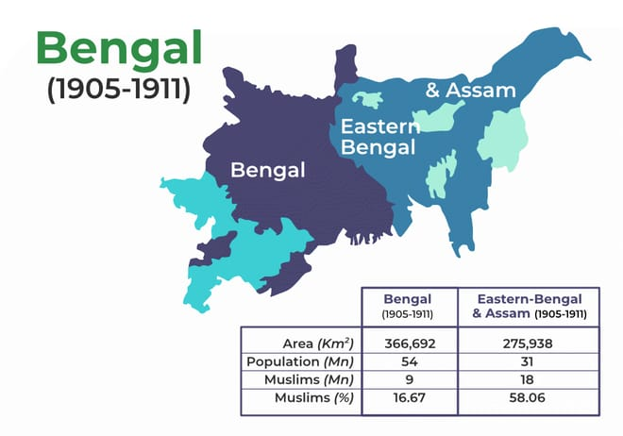

Origin of the partition
The partition of Bengal was based on the religion . The partition divides the province between West Bengal and East Bengal whose majority was Hindu and Muslims. As the Muslims were in favour of the partition they would have their own province and on the other hand the Hindus opposed it.

Slide 6
Reasons behind the partition
Vastness of province.
Limited source of communication.
Differences of language.
Need of the time.
To restor the efficiency of the government.
To curb the radical Bengali nationalists and to weaken the nationalists movement.

Slide 7
significance of the movement
Increased the demand for separate Muslim and Hindu province.
In Bengal the Hindus was roaring against it .
Increased terrorism in Bengal in the name of religion .
The economy of both country suffered and faced a downfall.
The fate of the people of East Bengal was opened .
People were forced to migrated from one state to another .
The aftermath of the partition was marked by ongoing conflict between India and Pakistan.
Partition triggered riots , mass casualties and a colossal wave of migration.

Slide 8

Reunited of bengal
The annulment or reunitation of Bengal was in 1911. with the emergence of strong ,violent terrorist opposition by the Hindu community,the Hindu-Muslims relations severely deteriorated, Communal riots occurred in different places, which resulted in political changes of magnitude in the government of India’s policies. In the face of rising opposition to colonial rule the British ended the division and the partition had to be annulled.

Slide 9
discussion
The partition of Bengal was one of the biggest issue for the birth of today’s Bangladesh . The agreement for divide the Bengal took place in 16th October in 1905 .and due to many causes it had to be annulled in 1911.the main cause behind the partition was Hindu-Muslims relation .from the division Muslims were gel benifited and the hindus were facing many difficulties. Considering all effects of that,the partition of Bengal was annulled in 1911. And once again Bengal was reunited.

Slide 10
thank you everyone for your valuable time

