Slide 1
Xcelerator
focus on Xecution

Slide 2
Accelerate the development and execution of management sponsored business ideas
Selection/screening and development/execution of employee proposed ideas
Internal intelligence unit for business trends
Build innovation throughout the ranks of commercial and non-commercial employees
Function:

Slide 3
Management Committee
Execution Team
Manageco
Manageco
Manageco
Manageco
Newco
Newco
Spinco
Marketing
Comm.
Legal
Technical
Finance &
Accounting
Foresight &
Intelligence
(FIG)

Slide 4
Propose
Graduate
Employees
New Units
Management
Existing Businesses
External
Spun Out
Evaluate
Foresight and intelligence group will perform a complete evaluation
Approve
Management committee will approve deals following positive evaluation
Develop
Sponsor assembles team to fully build out and implement business plan
Execute
Dynamic team executes business plan and deliverables

Slide 5
Manageco
Newco
Spinco
Management Sponsor
Business Team
Support as needed
Dynamic
Team
Static
Team

Slide 6
Dynamic
Team
Team assigned to a particular deal or business
Ultimately moves out from Xcelerator
Static
Team
Team assigned to a function within the Xcelerator
Builds the experience base that remains with the Xcelerator

Slide 7
Execution Tools:
Marketing/
Communication
Develop marketing and communication plan
Legal
Prelim review of execution plans, IP issues, contracts, and tax strategy
Technical
Execute technology aspects for relevant new businesses
Finance &
Accounting
Develop financial model, tax strategy, comply with ENE accounting standards

Slide 8
Analysis:
Focus on producing analyses/recommendations that are, insightful, well founded, and actionable
Foresight &
Intelligence
(FIG)
Analyze the competitive environment in which the business would reside
Identify emerging trends and technologies impacting the business’ environment
Future outlook
Analysis
Framework
Porter 5
Second one
Third one
Fourth one
Fifth one
Sixth one

Slide 9
Timeline:
Jan’01 Feb’01 Mar’01 Apr’01 May’01 Jun’01
Staff
6
13
19
24
30
36
Manageco
1
1
2
2
3
Newco/
Spinco
1
1

Slide 10
Staffing:
5 Directors includes legal/business developers
6 Managers foundation for support functions
12 Associates core dynamic team (3rd rotation)
6 Analysts core static team – analysis
7 Assistants including 1 legal assistant
Initial six months

Slide 11
Budget:
Salaries and wages $1,465,000
Outside services $ 500,000
Miscellaneous employee expenses $ 192,000
Rent, benefits, and taxes $ 288,000
Total $2,445,000
Initial six months

Slide 12
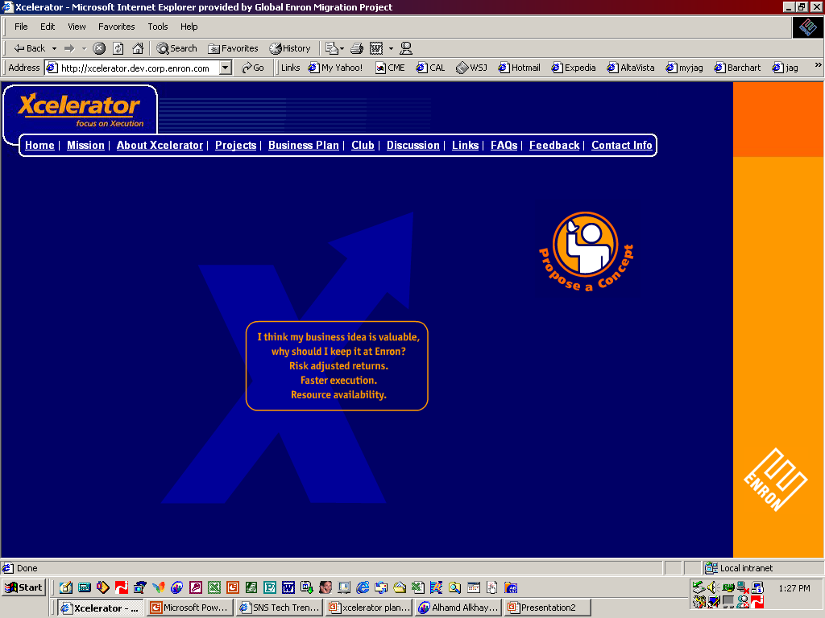
Enriching:
myxcelerator.com web participation environment
Online education teaching everyone to build a business
Club Xcel informal setting to share innovation

Slide 13
Action Plan:
Concept development phase

Slide 14
X

