Slide 1
ENRON CENTRAL DESK
Hunter Shively
Fletch Sturm
Jason Williams

Slide 2
Overview
Peoples Supply Deal
Central Desk Organization Structure
Using Information to make markets and money

Slide 3
Role of Jason Williams
Monthly Setup
  Supply Quantities
  Transportation
  Pricing
Manage Daily Activities
  SIQ,, DIQ Input
  Variable Transport
Liaison Between Trading and Logistics
Facilitate Smooth Communication Between Peoples and Enron
  Volumes, Constraints
  Changes, Cuts
Gather Key Information
  Storage, Flows, Weather

Slide 4
Items Involved In Managing Deal
Deal Booking
  Risk Group, Validation, Contracts
Morning Reports
  Information Gathering, Pipeline Summaries
Daily Activities And Flows
  Variable Transportion Costs, Economics
Scheduling
  Support Function, Tracking Actuals
Pinpointing And Solving Issues
  Cuts, Constraints, Weather, Human Error
Accounting
  Pricing, Pipeline Report Comparison

Slide 5
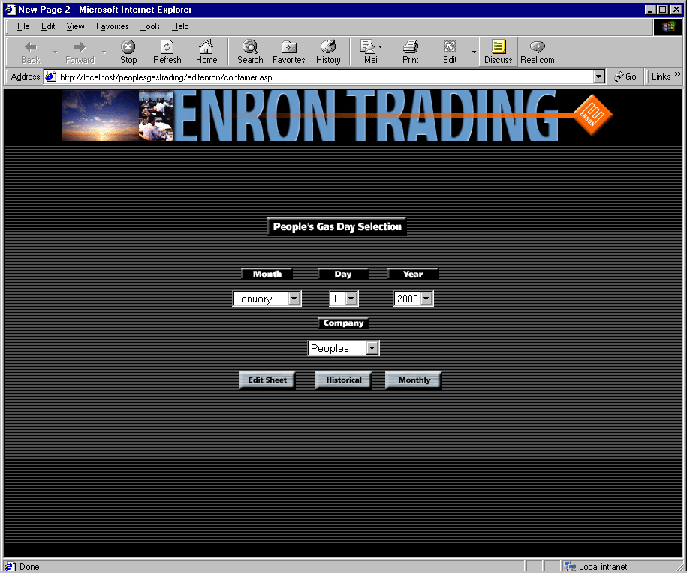
Peoples - Enron Website

Slide 6
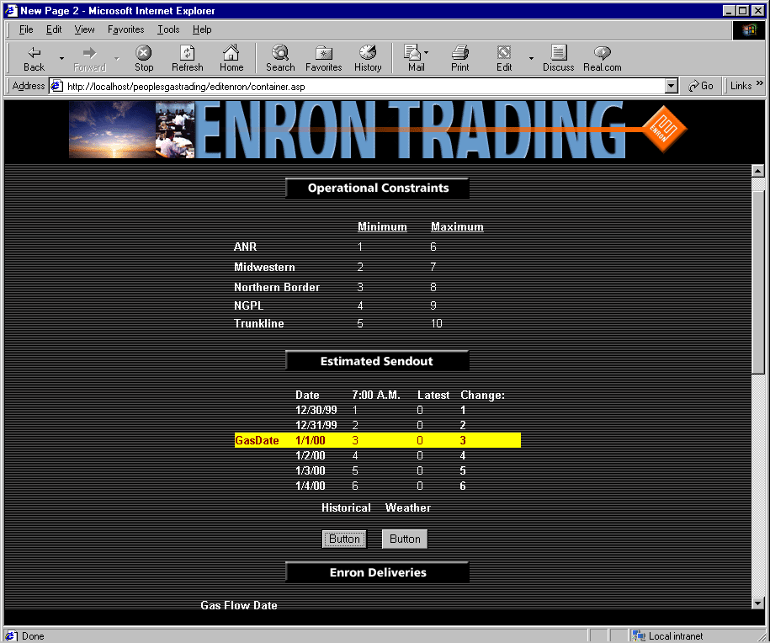
Top Half Of Edit Sheet (Enron View)

Slide 7
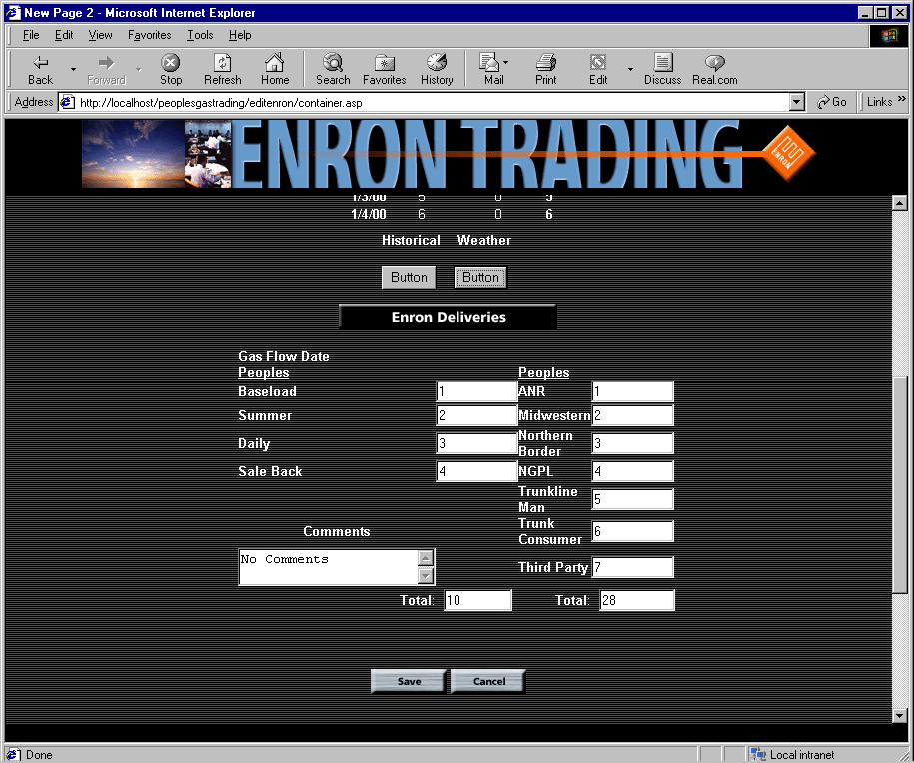
Bottom Half Of Edit Sheet (Enron View)

Slide 8
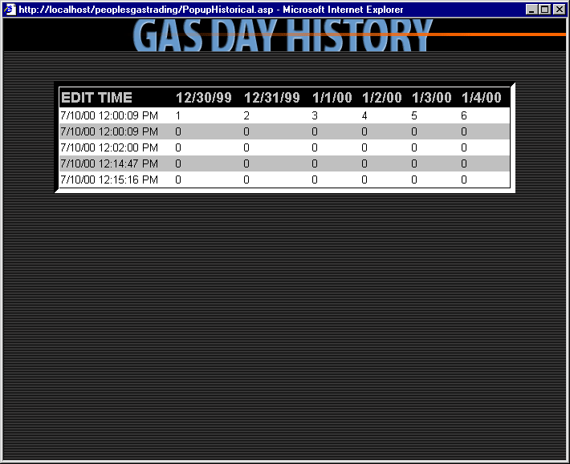
Historical Pop-Up Screen

Slide 9
Historical Weather Pop-Up Screen

Slide 10
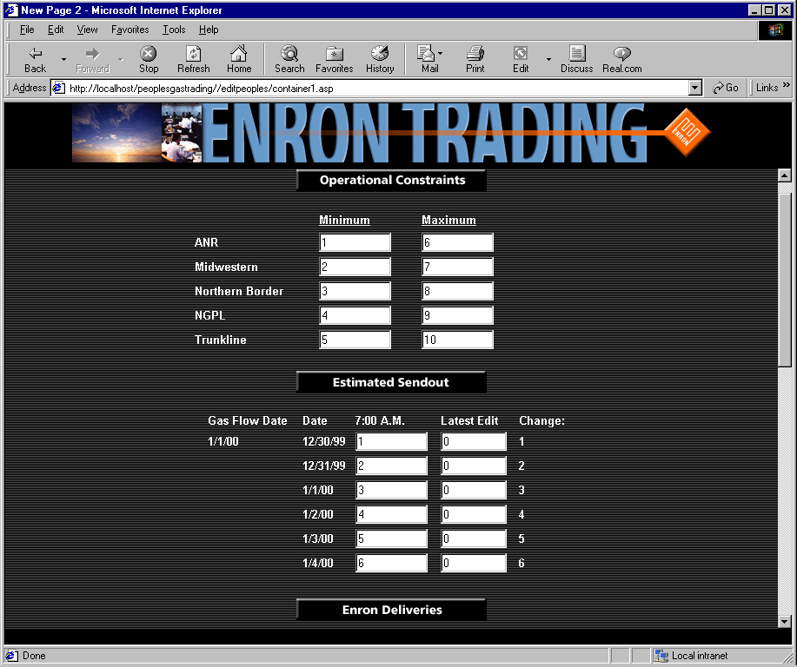
Top Half Of Edit Sheet (Peoples View)

Slide 11
Bottom Half of Edit Sheet (Peoples View)

Slide 12
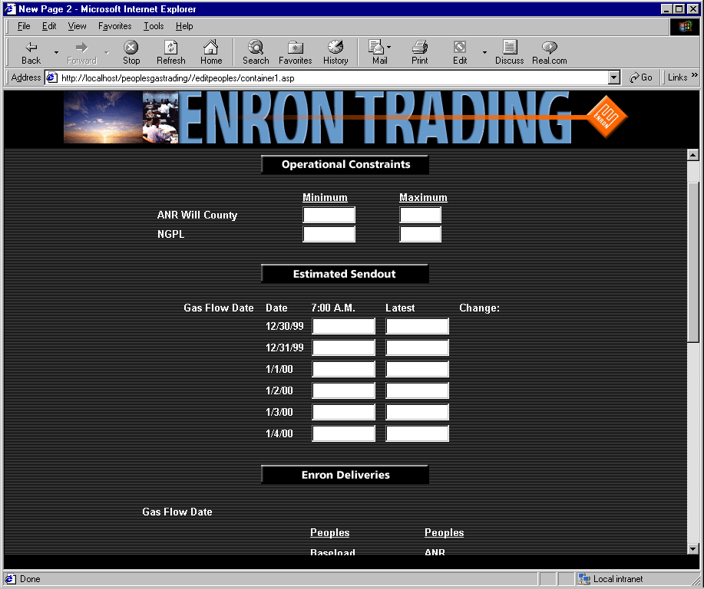
North Shore Sendout

Slide 13
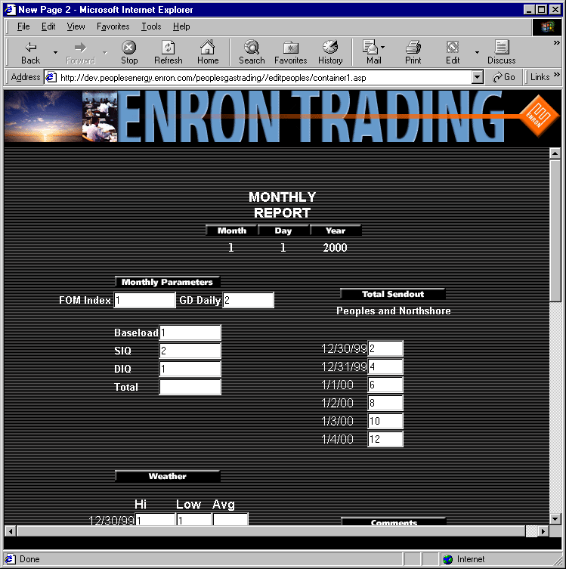
Monthly Setup and Quick View (Top)

Slide 14
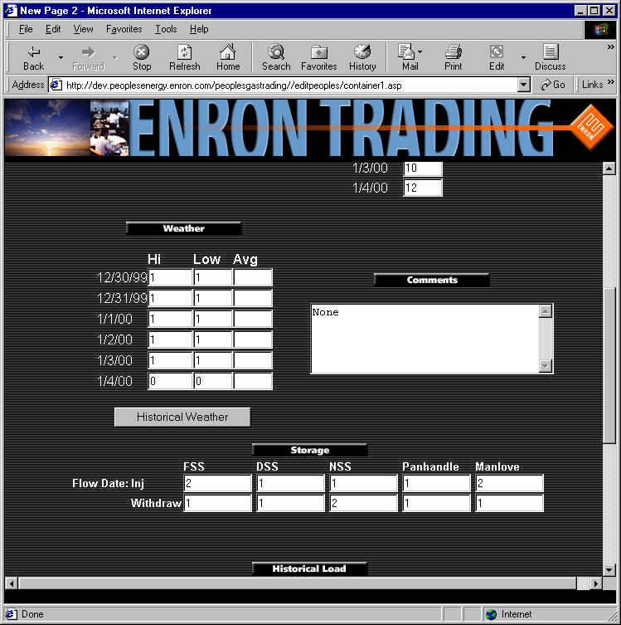
Monthly Setup and Quick (Mid)

Slide 15
Monthly Setup and Quick View (Bottom)

Slide 16
Past, Present And Future
The Beginning
Exciting Days Early On
Analyze Opportunities
Moving Towards EDI
Work On Confirmation Process
Originate New Ideas
Regularly Evaluate Progress
Keep Communication Lines Flowing

Slide 17
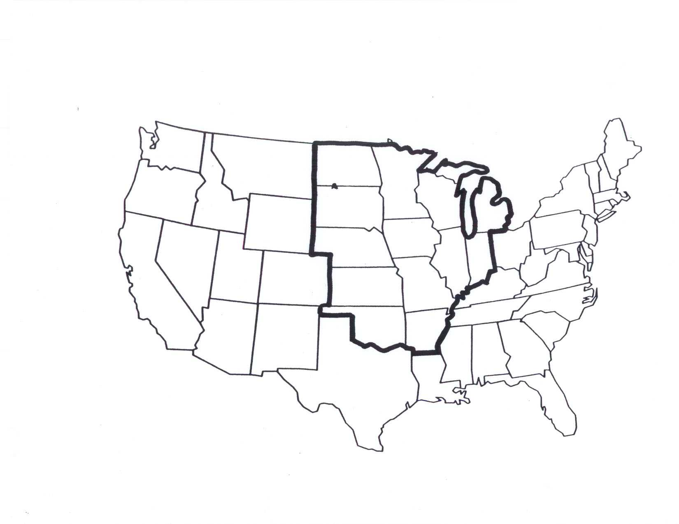
Central Desk

Slide 18
Reasons for having expertise in North America
Gas grid is constantly changing
The pipeline grid allows for gas to flow where it is most needed
Goal of the desk is to make money and expand knowledge of the region

Slide 19
Central Desk Statistics
The desk moves 4.5BCF/day of physical gas through the region
The traders execute an average of 480 physical trades per day
The desk makes markets in 17 different physical locations

Slide 20
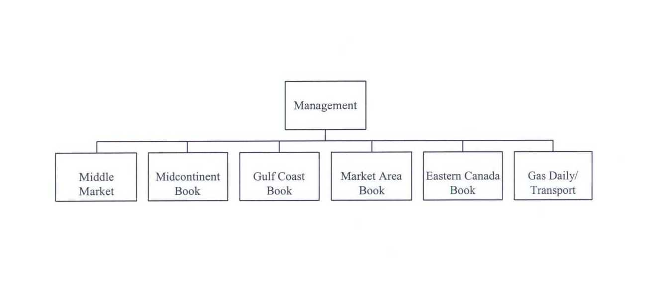
Organization Structure

Slide 21
Market Area Book
LDC markets on EOL
PGL&C
Nicor
Nipsco
Consumers
Michcon

Slide 22
Liquidity at PGL&C
Advantages
Pooling Concept
Good connection with incoming pipes
Midwest Hub (Online Marketing)
Disadvantages
Nicor’s has greater gas requirements

Slide 23
Gulf Coast Book
Pipelines
ANR-SE
NGPL Gulf Leg
Trunkline
Book attempts to capture intra-gulf spreads

Slide 24
Midcon Book
Pipelines
ANR-SW
NGPL - Midcon Leg
Noram
NNG
Oklahoma Intra-state
PEPL

Slide 25
Eastern Canada
Pipelines
TCPL
Great Lakes
Major trading points
Dawn
Niagara

Slide 26
Job Function of Traders
Each trader makes a market in a physical location and is responsible for the profit or loss associated with market making
Service customers
Make speculative market decisions
Gather information about the market that gives the desk an edge in trading

Slide 27

Traders do not make money by Gambling

Slide 28
Translating Information Into Trading Strategies
Fletcher J. Sturm

Slide 29
What type of Information do we receive?
Pricing
  natgas, oil, power, resid
Fundamentals
  AGA, weather services
Customer transactions
  RFP’s, market trades
News
  generation, production, transport, demand

Slide 30
Which term is relevant?
Short
    present to 1 week
Medium
    1 week to 1 month
Long
    1 month +

Slide 31
Which risk will be impacted most?
Price
Basis
Spread
  index, seasonal

Slide 32
How do we enter into the right trade?
Mental checklist:
  Is information bullish or bearish?
  Which term(s) will be impacted?
  Which location(s) will be impacted?
  Which risk(s) is affected?
Buy or Sell relevant product for location and term

Slide 33
How do we “Manage” the position?
Continue to gather new information
  see above
React to any new information which affects position
  Increase, decrease, spread, or close position
Follow risk management policy guidelines
  Properly report position and profit/loss
  Maintain position and VAR limits

