Slide 1
Project Eureka: Risk Management Strategies
Project Eureka Overview
Dan Allegretti
US/Canada Government Affairs
February 1, 2000
ENA Confidential & Proprietary
Notes:
<number>
<footer>
<header>
<date/time>

Slide 2
Project Summary
Enron to Supply Full Requirements Service for The United Illuminating Company’s Standard Offer Customers (Residential, Commercial, Industrial, Municipal Loads) and Special Contract Customers (Industrials With High Load Factors)
UI Serves 310,000 Customers, Representing 20% of Connecticut Load, 5% of NEPOOL Load
Position: 21,884,530 PV Mwh Short With 55% Load Factor 7,583,080 PV Mwh Long Hedge (Primarily in 2000) 14,301,451 PV Mwh Net Short (Primarily in 2001-2003)
Term: 1/1/00 Through 12/31/03 for Standard Offer 1/1/00 Through 12/31/07 for Special Contracts
Notes:
<number>
<footer>
<header>
<date/time>

Slide 3
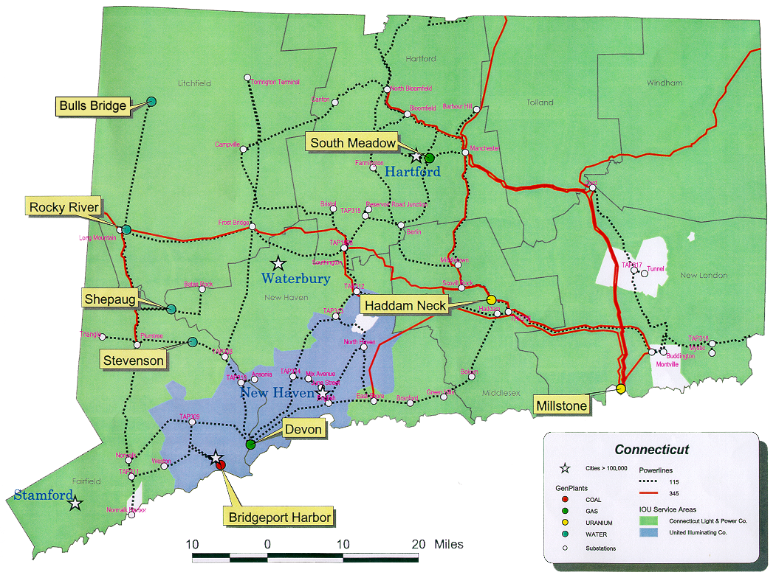
UI Statistics
310,000 Customers, 20% of Connecticut Load, 5% of NEPOOL load
Summer Peak of 1,200 MW with approx. 650 MW average load
Sales of 5.6 TWh/year
Member of NEPOOL and ISO-New England which has installed capacity of 25,000 MW with 24,000 MW of announced projects for 22,000 MW of load

Slide 4
Reasons for Entering into Transaction
Right Side of Trade in the Right Market
Reasons
Right Position
Right Location
Right Power Pool
Comments
Short position in overbuilt market
New England -- deregulating market with established ISO and power exchange
ISO is responsible for generation dispatch, transmission system reliability and meeting Pool load
This transaction is a Strategic Business Builder that allows ENA to continue developing the skill set necessary to excel in the power marketing business.

Slide 5
Trade Rationale
NEPOOL Characteristics
Construction Within NEPOOL Will Realistically Add 7,250 MW of New Generation by the End of 2004 (30,000 MW Proposed).
NEPOOL Is Already an Over-supplied Market With Limited Export Capability.
Historical and Projected Load Growth Does Not Support the Construction Activity.
NEPOOL Is in Advanced Stages of Deregulation Which Include ISO, Power Exchange, and Asset Divestitures to Dilute Market Power by Incumbents.
Asset Divestitures Have Brought New Generation Players Into NEPOOL.
Conclusions
NEPOOL Energy and Capacity Prices Will Decline Towards the Marginal Cost As New Generation Inundates the Market and Before Older, Less-efficient Generators Are Forced to Shut Down.
During This Transition Period, a Short Position Should Enjoy the Benefits of Energy and Capacity Prices Below the Fully-weighted Cost of Generation.

Slide 6
United Illuminating Standard Offer Rate Structure
Energy & Competitive Transition Assessment (CTA)
The Standard Offer Rate is capped at a 10% discount to UI’s 1996 tariff.
System Benefits
Conservation & Renewables
Transmission & Distribution

Slide 7
Commercial Risk Mitigation Strategy
Continue procuring long position at break-even type prices for July - September 2000, thus removing the liquidation risk in the first year and preserving back-end view and related up-side
Option and permit sites in NEPOOL that will allow construction of peaking generation if needed
Potential to build 270 MW of simple cycle generation by 2001

Slide 8
Regulatory Risks Overcome
GAMING OPPORTUNITIES
Ability Of Standard Offer Customers To Return Any Time Creates A Risk Of Seasonal Gaming
INCREASED SHOPPING CREDITS
Increase In Shopping Credits Upset ENA Migration Assumptions Necessitating A Price Increase
SPECIAL CONTRACTS
Decision To Allow Contract Customers To Migrate Without Penalty Threatened Transaction Economics At Eleventh Hour

Slide 9
Regulatory Changes
Recent
ISO authority to intervene in markets to set the Clearing Price to correct market design flaws
Correction to Pumped Storage Dispatch
Correction for ISO Emergency Sales
Cascading Reserves Policy
OpCap price caps
Year 2000
Consolidation/Elimination of Capacity Markets
Consolidation/Elimination of Reserve Markets
2001-2003
Multi Settlement System
Demand Bidding
Congestion Pricing - FCRs to standard offer load

Slide 10
Migration Risks
Customers may leave Standard Offer any time and may return. Returning customers can not leave again for 12 months.
Connecticut imposes some of the most severe supplier requirements in the region. These do not apply to Enron or to UI.
The Massachusetts shopping credit of $43/MWh has spurred minimal migration.

Slide 11
Supplier Licensing
Environmental
Two Green Power Portfolio Mandates
Fuel and Emissions Label Requirements
CT Emissions Standards for Owned Generation and Long-term Contracts
Security
5% of Estimated Gross Revenues up to $250,000
Liability
Must Demonstrate Compliance With NLRA and Unfair Trade Practice Laws
Subject to DPUC Complaint Enforcement
Subject to DPUC Information and Reporting Requirements
Other
Distribution Companies Must Offer “Do Not Call” Lists. UI Response to Date Has Been Very Strong.

Slide 12
Political Risk
STATE
Renewable Power Requirements
Change in Commissioners
FEDERAL
New FERC Commission
FERC Rejection of NEPOOL Reforms

Slide 13
Final Observations
As We Transition From Opening New Markets to a Commercial Support Function It Will Become Essential to Integrate Ourselves Into Cross-functional Teams With Business Units, Legal, Etc. to Develop and Risk Manage Positions
Our Knowledge and Information Often Puts Us in a Better Position to Identify Regulatory or Political Political Problems and Solutions Than the Business Units.

