Slide 1
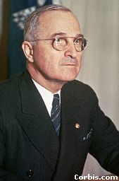
Truman to Run for Senate in 2002
“With how long Harry has been dead, he should win in a landslide.”
Quickly following the victory of Mel Carnahan, the Missouri Democratic Committee has announced their choice for Senate in 2002, the late President Harry S. Truman. “The people have spoken, and we are here to support the people, no matter how silly it might seem.”
The Republican Party was unprepared to announce their candidate, but stated that they are, “Searching the cemeteries with a fine tooth comb. The choice of which dead guy (or gal) to represent the people of Missouri is not to be taken lightly.”
In related news, a circuit court judge has ordered that people buried in the city of St. Louis will be allowed to vote in the next election, and the polls will remain open late to accommodate their needs. “The Fifteenth Amendment to the Constitution protects the right of everyone to vote, not just the living. If the dead can win, then the dead should vote!”
Senator elect Hillary Clinton applauded Missouri for its progressive thinking, stating that she plans to run for Senate in Missouri once she is dead. She also hinted at being a big Cardinal’s fan.

