Slide 1
Realizing Savings From The Texas Deregulating Energy Market
Enron Energy Services
December 7, 2000
®

Slide 2
Meeting Objectives
Overview
Enron Texas Electric Offer
Enron Account & Delivery Management
Summary
Questions

Slide 3
Why Enron?

Slide 4



Slide 5
Common Company Goals
Quality service
Customer loyalty
Brand recognition
Product enhancement

Slide 6

Enron Corp.
Fortune’s Most Admired Companies
Revenue - $60 Billion, 3Q 2000
Revenue - $40 Billion, 1999
Assets - $33.4 Billion, 1999
Largest Marketer of Natural Gas and Electricity in North America
Ranked #18 on Fortune 500
INNOVATIVENESS
PEER GROUP
1. Enron
2. Charles Schwab
3. Herman Miller
1. Enron
2. Williams
3. El Paso
#1 for 5 years in a row
#1 for 7 years in a row
#24 on Fortune’s 100 Best Companies to Work For in America
Transportation
&
Distribution
Wholesale
Energy
Retail
Energy
Broadband
Services
Natural gas transportation
Electric distribution
Marketing and delivery of energy products worldwide
Energy outsourcing to commercial and industrial customers
Bandwidth management and broadband delivery services

Slide 7
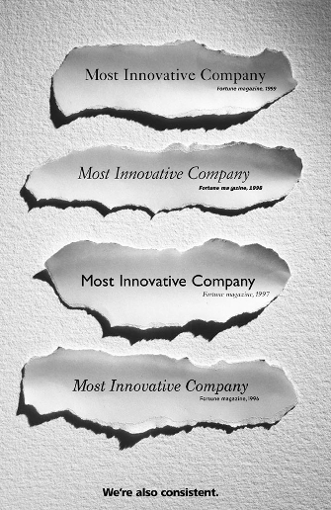
Enron Consistently Demonstrates Leadership
FORBES
Top Power Company in the World
(Forbes Global Business, January 1999)
FORTUNE Magazine
Most Admired Companies in America
(#22 of 500 Companies Ranked, July 1998)
FORTUNE Magazine
America’s Most Innovative Company
#1 for 4 years in a Row: 1996, 1997, 1998, 1999
1998
1. Enron 9.18
2. Intel 8.66
3. Nike 8.54
1999
1. Enron 8.93
2. Mirage Resorts 8.50
3. Herman Miller 8.43
FORTUNE Magazine
America’s Most Innovative Pipeline Company
#1 for 6 years in a Row: 1994 - 1999

Slide 8

Retail Energy Industry Structure
Natural Gas
Enron Wholesale
Enron Energy Services
Producer
Pipeline
LDC
Electricity
TM
Generation
Transmission
Distribution
Wholesale
End User

Slide 9
“Our success is measured by the success of our customers.” Jeff Skilling

Slide 10



















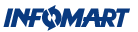




























Representative Retail Customers

Slide 11
Enron Texas Electric Offer

Slide 12
Price Offering Fixed Discount Off Tariff
Fixed discount off the frozen tariff rate
Discount reflected on monthly utility bill
Customer receives one bill from Enron
Protection from price volatility

Slide 13
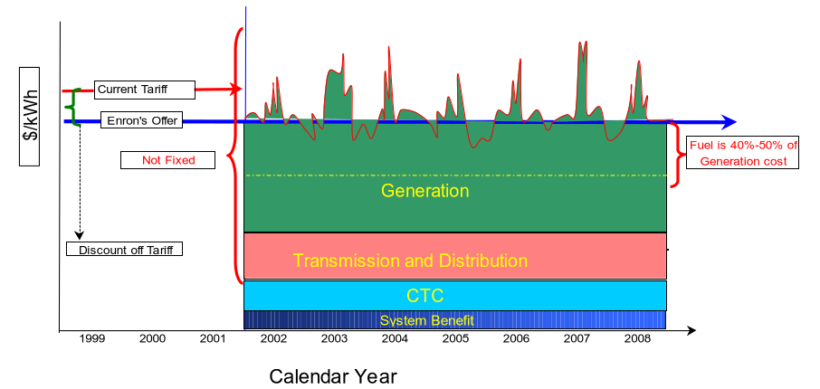
The Unbundled Market

Slide 14
It’s Time for “Choice”
Why a Great Deal:
Guaranteed savings off tariff
Immediate rate reduction
If fuel prices increase or electricity shortages occur, your cost will not increase
One bill
Ease of transition
Dedicated Account Manager
800 telephone line with dedicated customer representatives
Best in class customer service

Slide 15
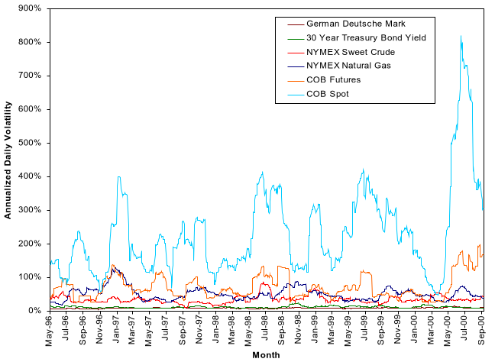
Historical Volatility of Commodities 1996 - 2000

Slide 16
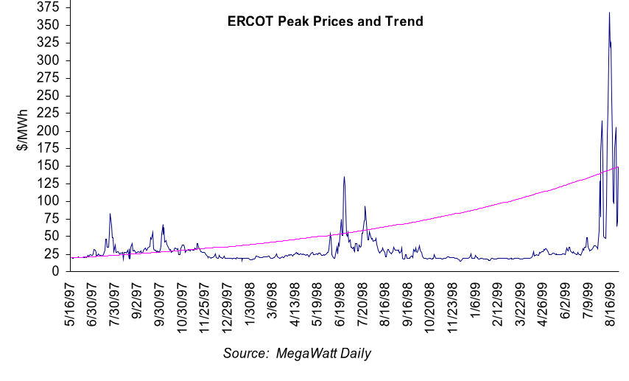
Taking No Action is Accepting Price Risk

Slide 17
Enron is the Smart Choice
Enron moves deregulation benefits to today’s market
Enron stands behind its offer as a reputable, solid financial partner
Immediate savings realized today
Enron provides a dedicated Account Manager
Enron provides dedicated telephone reps

Slide 18
Account & Delivery Management

Slide 19
Transition Timeline
Phases
Planning Transition Implementation
Timeline
Contract Signed
Services Commencement Date
Activities
Pre-Contract Schedule
Develop & Manage
Transition Support Schedule
Coordinate and Plan
Full Scope of Work
Execute Transition Plan
Designate Account
Manager
Manage Transition Schedule
Coordinate and Plan
Post Service
Commencement Date
Activities
Account Manager Handoff Completed
Execute Implementation Plan
Lessons Learned
Commodity
Bill Mgmt
Projects
O&M
Baseline
Other
Deliverables
Transition Plan
Implementation of Plan
Contract Execution & Compliance
Key Milestones
1. Customer Presentation
2. District Designations
3. AM Costs
4. Internal Kick-off (Implementation Team)
5. Contract Signing
6. ATP Complete
7. AM “On Boarding”
8. Hand Off (Deal team to Transition Team)
9. Customer Kick-off
10. Service Commencement Date
11. Handover to AM
12. Business Plan
13. Continual Improvement Process

Slide 20
Transition Plan
The Transition Plan will be jointly agreed upon immediately following the Effective Date to ensure services are initiated by the Services Commencement date
The Plan details major tasks required by both Parties to initiate services according to schedule
Goals of the Transition Plan are to:
Generate mutual understanding of priorities and processes for the implementation of services
Define the schedule and milestone dates required to accomplish them within a mutually agreeable time frame
Define and designate the appropriate resources to accomplish timely and cost effective execution of the agreement

Slide 21
Account Management
Enron is committed to:
The most efficient and effective execution
Driven by activity downstream of contract signing
Providing world-class customer satisfaction
Enron account management team is:
Responsible for execution
Responsible for delivery - consistent, effective, effective, efficient global platform
Responsible for total customer management and satisfaction
The single point of contact for our customer
Manages the relationship
Oversees all account & delivery activity to ensure contract compliance & performance

Slide 22
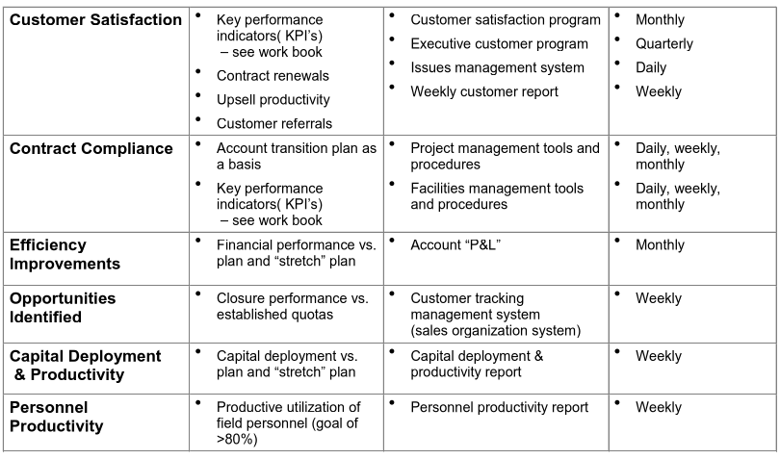
Metrics/Measurements
Metric Measurement Management Measurement
Tools Frequency

Slide 23
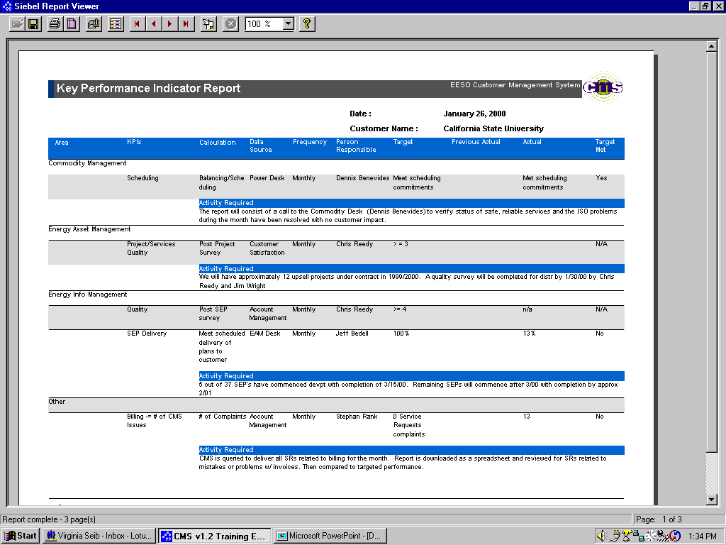
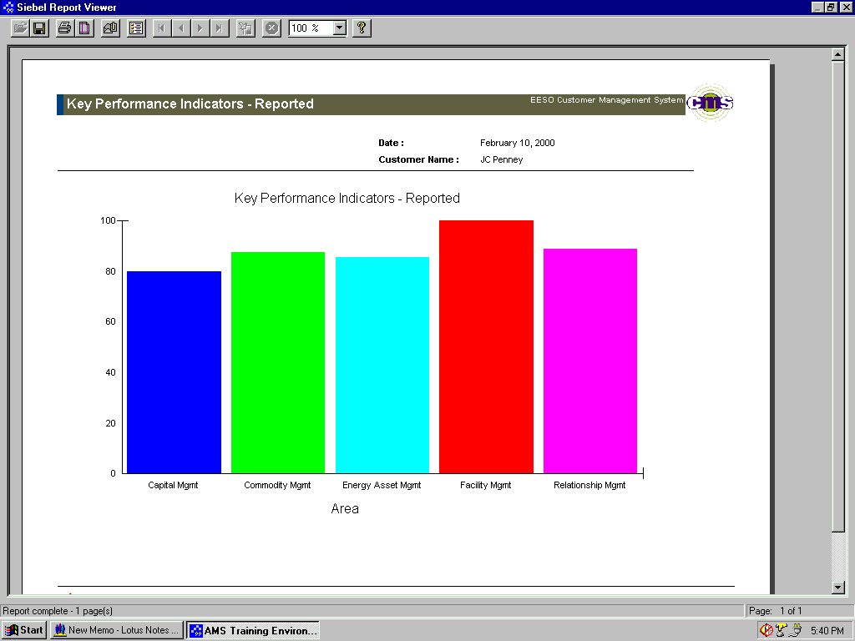
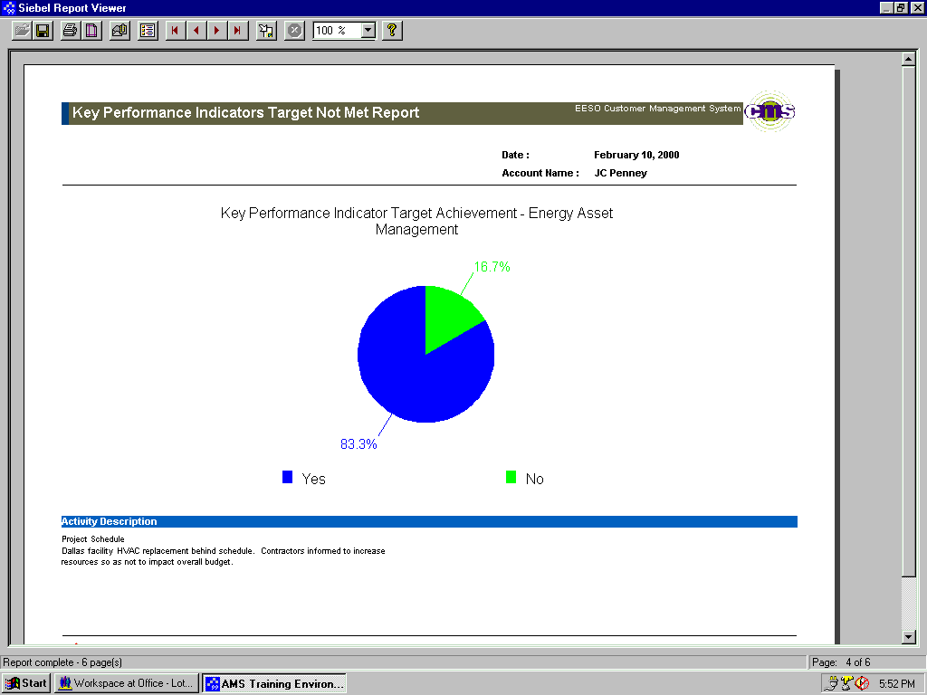


Performance Management Key Performance Indicators
To ensure internal performance, our Customer Management System provides an assessment of our delivery commitments and pre-established Key Performance Indicators by department.
<number>
Confidential and Proprietary Data

Slide 24
Customer Satisfaction Approach
Our Customer Satisfaction approach focuses on three areas: Performance, Relationship and Value.
Delivery Performance Measurement - KPIs
Performance
Satisfaction
Value
Relationship
Ongoing customer assessment - Surveys, “Voice of the Customer”
Pro-active Account Management - External Performance Management

Slide 25
Summary

Slide 26
Enron Energy Services Tricon Accounts
Since 1996 Enron has provided energy services to Tricon restaurants
Enron currently serves the following sites:
500 California electric accounts
940 natural gas accounts
45 New Jersey electric accounts
42 Ohio electric accounts
250 California and Ohio franchise sites

Slide 27
Summary
Reliable service
Guaranteed savings from Tariff
Price protection
Easy to switch
Dedicated Account Managers
Best in class customer service

Slide 28
Enron Energy Services Contact List
Michelle Robichaux
Account Manager
Telephone: 713-853-5976
email: mrobicha@enron.com
Mary Jo Johnson
Mid-Market Manager
Telephone: 713-853-5797
email: mary.jo.johnson@enron.com
Peter Vint
Director of Account Implementation Planning
Telephone: 713-853-7901
email: pvint@enron.com

Slide 29
Questions and Answers

