Slide 1
Tracking Enron Deregulation Messages

Slide 2
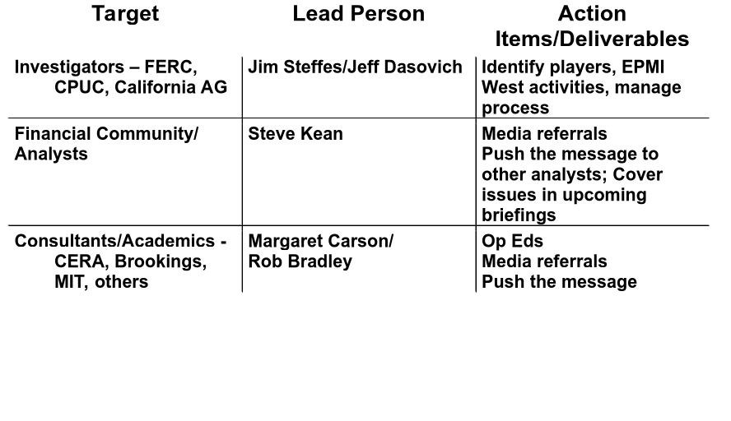
Tracking Enron Deregulation Messages
cont.

Slide 3
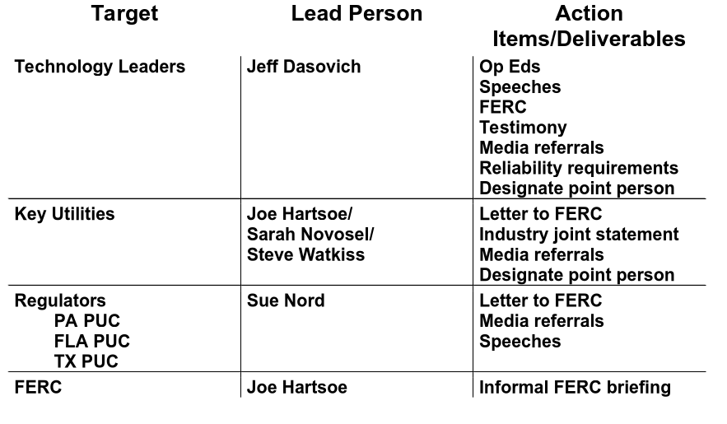
Tracking Enron Deregulation Messages
cont.
Enron Government Affairs
12/14/00 M. Carson

