Slide 1
Project Ice
Transammonia Inc.
CONFIDENTIAL
September 27, 2025

Slide 2
Project Ice
Fertilizer Products: Market Characteristics
FAVORABLE
Large numbers of international buyers and sellers
Existence of intermediaries
High price volatility
Poor price discovery
Commoditized / standardized product
Largely a wholesale product
Gas represents up to 80% of input costs
UNFAVORABLE
Sovereign and counterparty risk
Potential for government supply influence / interference
CONFIDENTIAL

Slide 3
Project Ice
World Market Size
(≈ $35B)
^ Denotes Ammonia and Urea markets only
# Defined as only the petrochemical products that Enron is considering: monomers, aromatics, and polymers.
* Defined as only the refined products that Enron is considering: gasoline, distillates, residuals, and jet fuel.
Sources: Lehman Brothers, Energy Information Administration (EIA), and United Nations Statistics Division Homepage
CONFIDENTIAL

Slide 4
Project Ice
Transammonia, Inc. Overview
A leading international physical trader, distributor, and transporter of ammonia and other fertilizer products, LPG, petrochemicals and methanol
Privately held with 100% of stock owned by the Stanton family
Headquartered in New York. Employs 230 people in 26 cities worldwide
2000 sales of over 17.2 million tons of all products, with revenues of $2.4 billion
Owns or leases several terminal, tanks and warehouses in various parts of the world
Ammonia
Other Fertilizers
LPG’s
Petrochemicals & MTBE
World’s leading independent marketer and transporter of anhydrous ammonia
In 2000 traded 11.6 million metric tons of fertilizer
Broad base of supply and sales in over 57 countries
Strong domestic presence with product available along the Gulf Central ammonia pipeline system
Imports or trades to the US market through direct purchase, swaps and other trading arrangements
Its wholly-owned 36,000 short ton Meredosia facility is a big factor in the domestic business
Sold over 2.8 million metric tons of urea worldwide in 2000
Has been appointed exclusive marketer of 500,000 metric tons of granular urea produced in Bangladesh by Karnaphuli Fertilizer Company, Ltd.
Sells about 1.1 million metric tons of other nitrogenous fertilizers around the world
Sales of sulfur exceeded 1.8 million metric tons
Phosphatic fertilizer sales above 1 million metric tons
Sulfuric acid trading of over 660,000 metric tons in 2000
Sales of around 600,000 metric tons of potash to worldwide markets
In 1995, Transammonia started the TrammoGas Division, located in Houston, Texas trading LPG in the US. 2000 volume reached 1.7 million metric tons. Majority of the volume is propane but also includes ethane, butane, iso-butane, and natural gasoline
Sea-3, an operating unit, owns LPG terminals in NH and FL. It is the largest importer of LPG into the north-east and Florida providing interesting arbitrage opportunities between MT Bellevue and world LPG prices
Sea-3 also participates in gas marketing on the Gulf Coast and other parts of the US. Annual volume is about 300,000 metric tons
The TrammoChem Division is active in all significant petrochemicals markets around the world with sales of about 3.8 million metric tons
A trader of MTBE worldwide and a major exporter of petrochemicals from China
Started with an emphasis on trading aromatics: Benzene, Toluene, Xylene, etc. Methanol and MTBE have become the largest volume products over the years. Recently, Trammochem started trading Propylene, Ethylene and Butadiene
CONFIDENTIAL

Slide 5
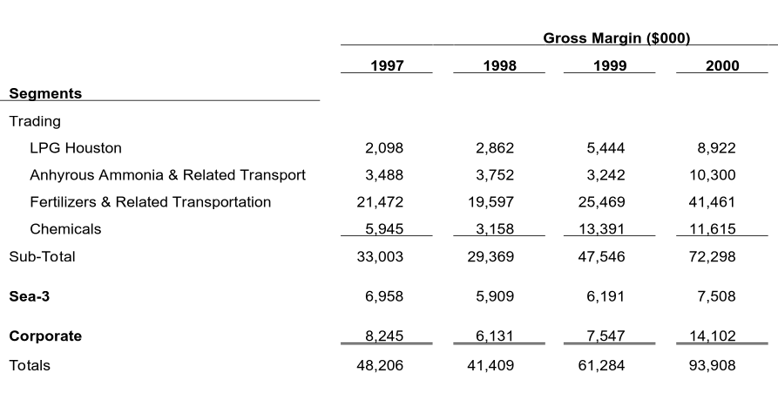
Project Ice
Transammonia Breakdown by Segment
Included deductions for interest, taxes and depreciation of $4,942, $6,730 and $13,681 in ‘98, ‘99, ‘00 respectively
Deductions for ‘97 are also included but the exact number is not available
Corporate income is the interest rate spread charged to trading and paid to banks.
Sea-3 business includes the 2 LPG terminals.
CONFIDENTIAL

Slide 6
Project Ice
Sources By Country - All Products
Year 2000 Tonnage - 11,411,804 MT
CONFIDENTIAL
Notes:
7

Slide 7
Project Ice
Sales By Country - All Products
Year 2000 Tonnage - 11,411,804 MT
CONFIDENTIAL
Notes:
7

Slide 8
Project Ice
Transaction Issues
Credit Exposure
Sovereign risk (China, Russia, Ukraine, Turkey)
Counterparty risk in 3rd world countries
Integration
ENE must retain and incentivize traders and key personnel *
Review of international business methods
* Head of fertilizers is highly compensated. Without him, deal has questionable merit
CONFIDENTIAL

Slide 9
Project Ice
Supplemental Financial Data
CONFIDENTIAL

