Slide 1

Capacity Trading on EnronOnline
Presentation to Natural Gas Pipeline Co.
February 23, 2001
Providing Access to the World’s largest online gas market

Slide 2

Agenda
Introduction
What is EnronOnline?
What has EnronOnline done for Enron?
What can EnronOnline do for NGPL?
The EnronOnline Solution

Slide 3
What is EnronOnline?
Capacity Trading on EnronOnline

Slide 4
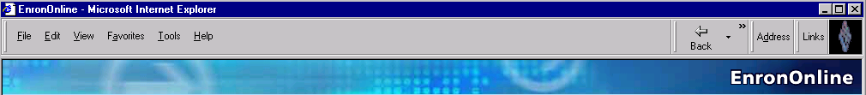
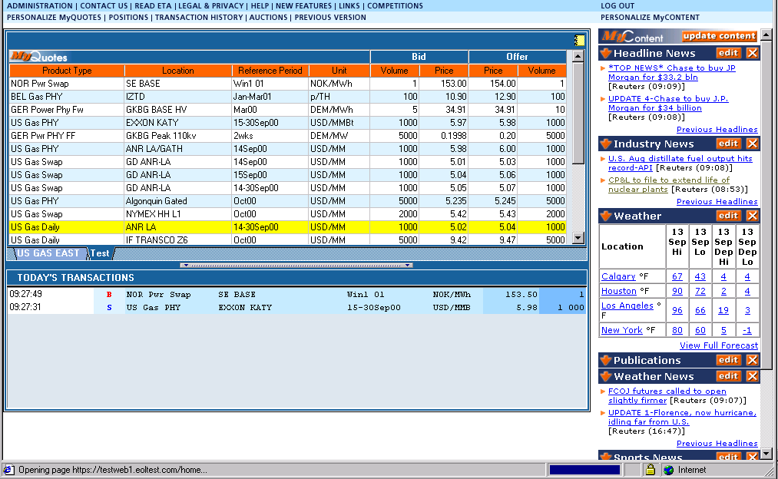
What is EnronOnline?
A Internet-based, Global Transaction System Managed by Enron Net Works, an independent subsidiary of Enron Corporation.
EnronOnline Allows Customers to View Real Time Prices and Transact Instantly Online

Slide 5


Benefits of EnronOnline to Customers
Reliable
Real-Time Transactions
Faster than Traditional Channels
Simple Access via the Internet
Easy to Use
Secure Execution
Market News and Quotes

Slide 6


Benefits of EnronOnline to Customers
Price Limit Orders
Industry Publications
Weather Information
Advanced Customization
Floating Windows

Slide 7
Markets Available on EnronOnline Today
Commodity Types
Argentine Natural Gas
Asian Crude & Products
Australian & Japanese Weather
Australian Power
Austrian Power
Bandwidth
Belgian Natural Gas
Canadian Natural Gas
Credit Derivatives
Dutch Power
Emissions
European Coal
European Weather
German Power
International Coal
Japanese Aluminum
LME Metals Contracts
LPG
Nordic Power
Oil & Refined Products
Petrochemicals
Pipeline Capacity
Plastics
Pulp & Paper
Sea Freight
Spanish Power
Swiss Power
UK Metals
UK Natural Gas
UK Power
US Gas Pipeline Capacity
US Lumber
US Metals
US Natural Gas
US Natural Gas Options
US Power
US Steel
US Weather

Slide 8
Deal Types Available on EnronOnline
Physical
Financial
Basis
Index
Options
Swaptions
Spreads
Swings

Slide 9
What has EnronOnline done for Enron?
Capacity Trading on EnronOnline

Slide 10
What has EnronOnline done for Enron?
Since its launch in November 1999, EnronOnline has revolutionized business at Enron:
Total Life to Date Transactions > 600,000
Average Daily Transactions > 3,750
Life to Date Notional Value of Transactions > $365 billion
Daily Notional Value Approximately $2.6 billion

Slide 11
What has EnronOnline done for Enron?

Slide 12
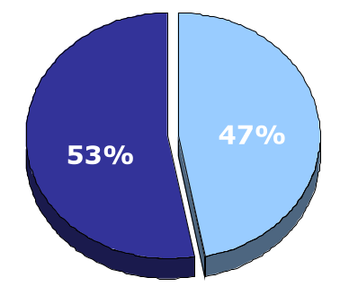
EnronOnline vs. Traditional Channels
Transactions
Daily % (30-day trailing average)
Traditional Channels
EnronOnline

Slide 13
Transactions via EnronOnline
Quarterly

Slide 14
What can EnronOnline do for NGPL?
Capacity Trading on EnronOnline

Slide 15
What can EnronOnline do for NGPL?
Increase number of transactions
Increase Short Term sales
Increase % of Pipeline utilization
Mitigate Turnback risk for future expiring Long Term contracts
Reduce Operational & Administrative costs
Provide value added services for your existing customers
Increase your customer base

Slide 16
Benefits of EnronOnline
EnronOnline is a true business solution, not just a software tool.
Proven track record
Short Time to market - minimum development time required
Scalability - Flexible Products structure is designed to grow as your needs change

Slide 17
The EnronOnline Solution
Capacity Trading on EnronOnline

Slide 18
The EnronOnline Trading Solution
EnronOnline Website
Highest concentration of natural gas traffic/transactions.
Best liquidity in hundreds of US Natural Gas Products.
EnronOnline Stack Manager
Used by Enron traders to provide liquidity to the EnronOnline Website.
Enabled to work for non-Enron companies
Provides tools to quickly construct “stacks” of prices and volumes and efficiently manage multiple products.

Slide 19
The EnronOnline Trading Solution
EnronOnline Support
Proven skills and processes supporting your business
IT Support
24 Hours/7 Days, 100 languages Help Desk
Product Development support
Training - on site with reference manuals
E-commerce advice -legal, tax, credit, risk
Contracts/Documentation - PA, ETA, GTC
Marketing Support - presentation materials, press releases, ticker text, demo CD’s, Industry Trade Fairs.

Slide 20
Providing Access to the World’s largest online gas market
Capacity Trading on EnronOnline

Slide 21
Appendix
Capacity Trading on EnronOnline

Slide 22
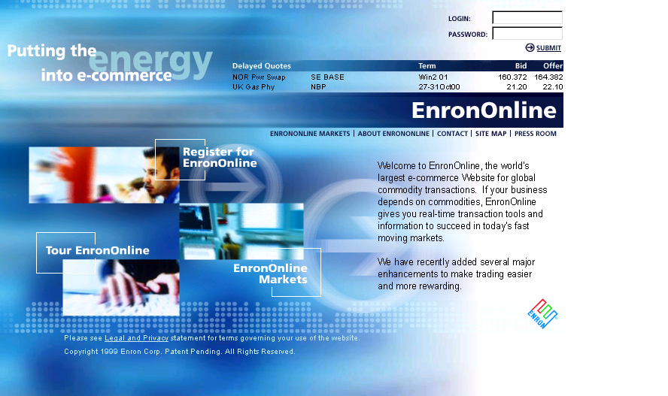
www.EnronOnline.com

Slide 23
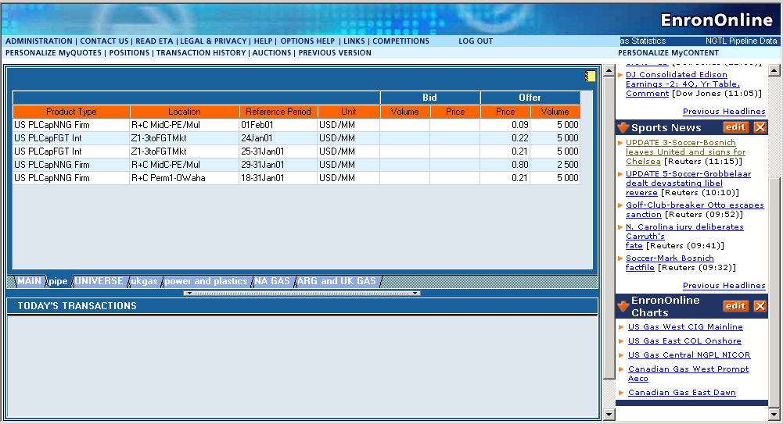
Functionality of EnronOnline

Slide 24
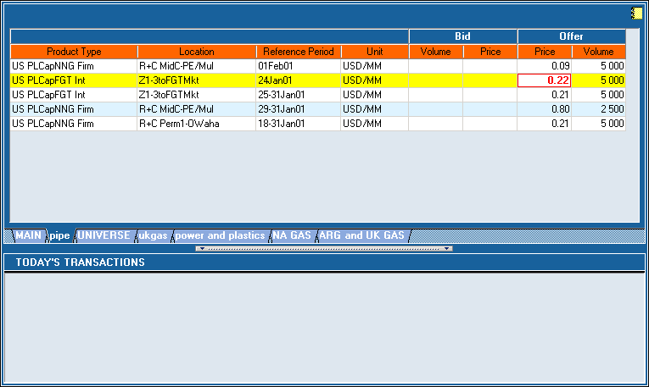
Click On Offer Price

Slide 25
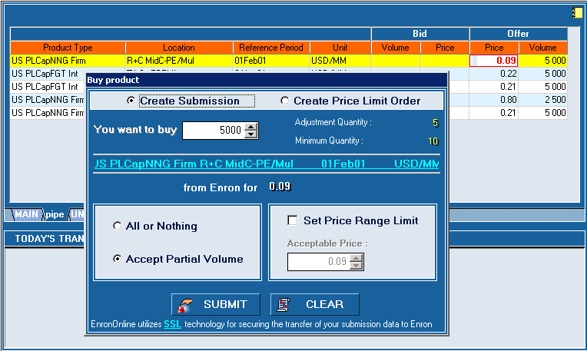
Submission Screen

Slide 26
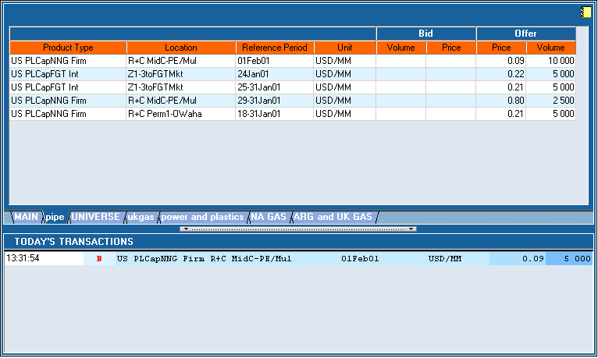
Successful Transaction

Slide 27
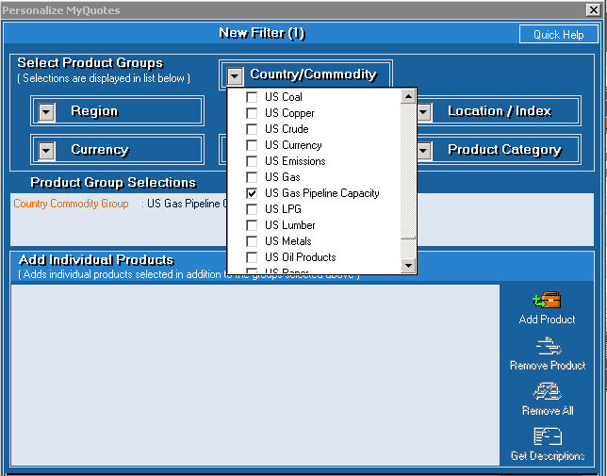
Customized Quotes
Customize by:
Country
Commodity
Region
Currency
Location/Index
Product Category
Deal Type

Slide 28
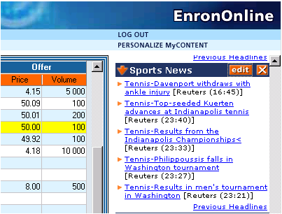
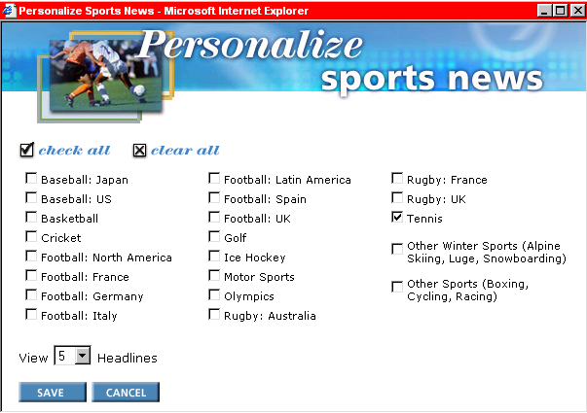
Customized Content

Slide 29
The EnronOnline Trading Solution
EnronOnline Website
Capacity Trade Screen - accessed through EnronOnline
Capacity Markets Vertical - market information, presentations, library, news, marketing contacts.
EnronOnline Internal Trading Applications
Stack Manager
is the tool Enron’s traders use to “make markets”
provides the ability to manage “stack depth”
ability to change volumes and prices in real-time
allows you to determine the product suite which will be displayed to the market

Slide 30
Functions of Stack Manager
Activate and Manage Products on EnronOnline
Add, Edit or Delete Offers
Modify Volume
Modify Prices
Activate, Inactivate, or Suspend Products
Price and volume controls
Set Price and Volume increments
Checks against inaccurate price and volume entries

Slide 31
Functions of Stack Manager
Manage Price Defaults
Assign Trading hours for each Product
Track Completed Transactions
Time Stamp
Counterparty
Volume
Price

Slide 32
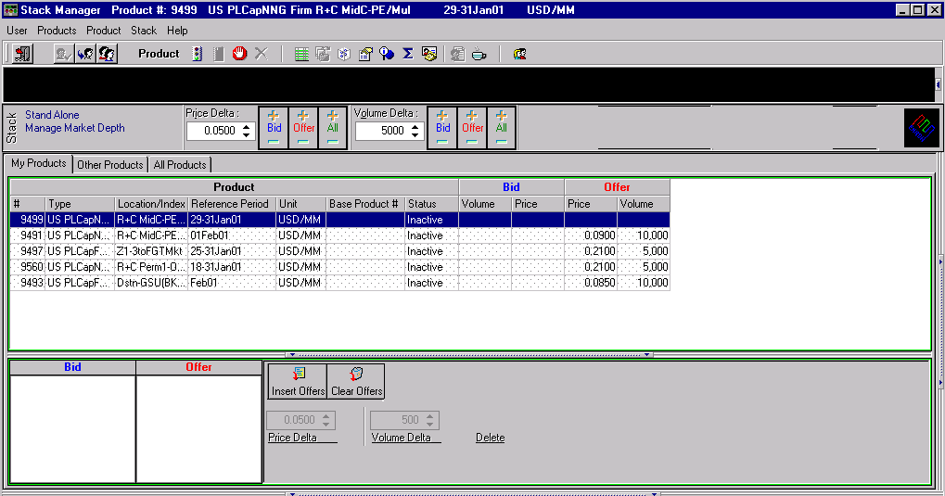
Stack Manager

Slide 33
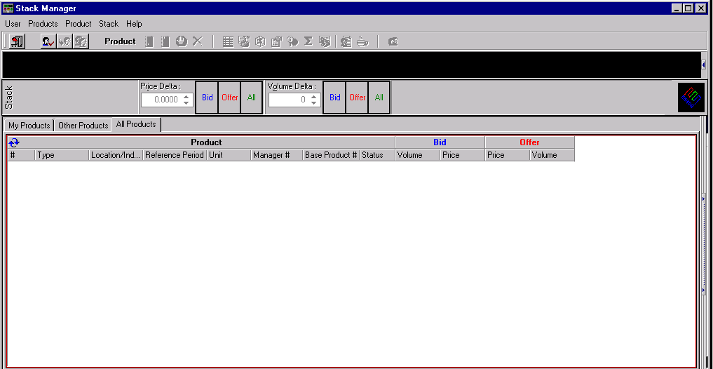
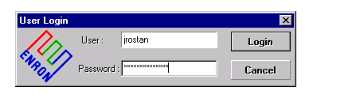
Log On to Stack Manger

Slide 34
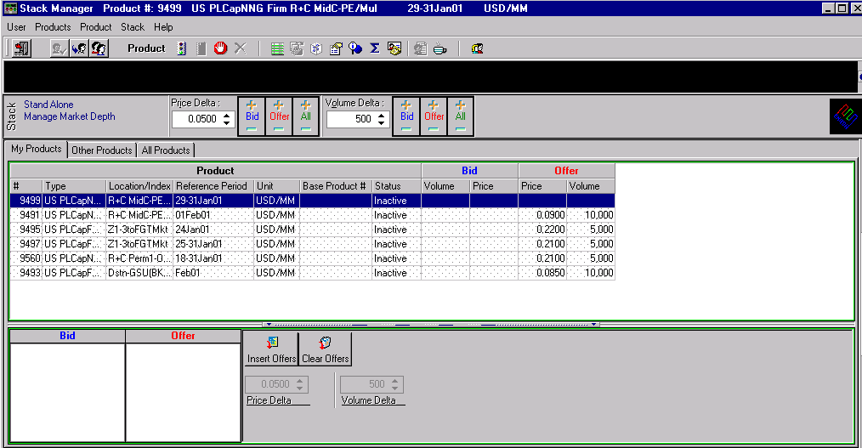
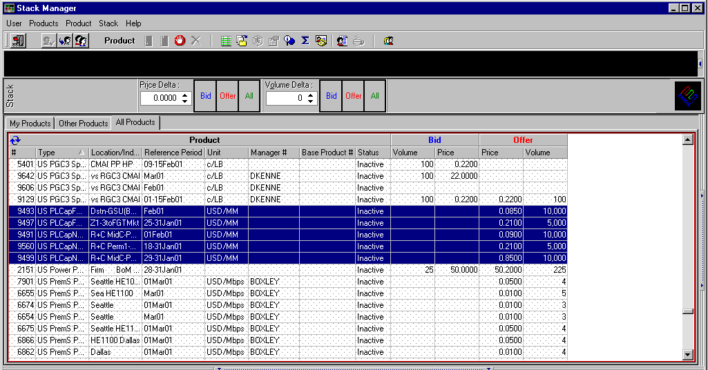
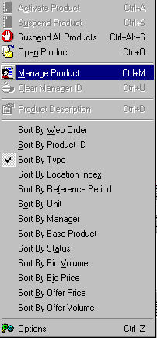

Select Products to Manage

Slide 35
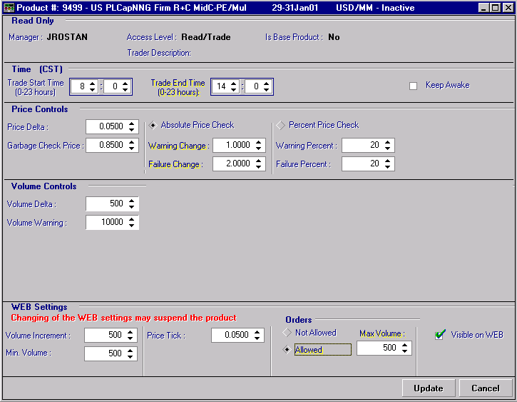
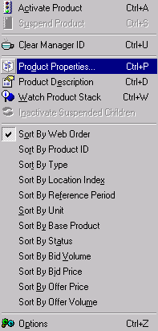
Selecting Product Properties
Control the tick size at which prices maybe changed
Checks the price inputs to reduce erroneous price changes
Control the tick size at volumes maybe set
Turn Price Limit Order Function on and off.
Control the price tick size at which orders maybe set
Enter Max Price Limit Order volume allowed

Slide 36
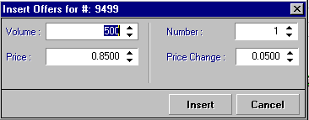
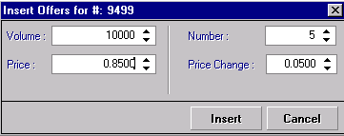

Insert Offer Prices and Volumes

Slide 37
Q&A
Capacity Trading on EnronOnline

