Slide 1
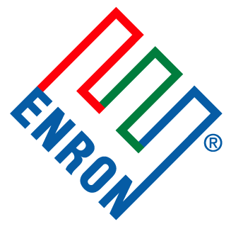
Project Sugarcane
November 2001

Slide 2
Overview
Strategy 1: Put in place an asset management structure (w/ Dynegy/Enron or a 3rd Party) to manage commodity risk and commercially optimize the asset:
Enron/Dynegy to provide asset management services if we can secure commercial control at an “acceptable” price – This should be easier to do with the merger.
Let a 3rd party provide asset management services if they are willing to pay a significant premium above what Enron/Dynegy would pay to manage the asset.
Bringing trading function closer to Dynegy/Enron “should” increase trading performance.
Strategy 2: Sell the accrual value of BHLP to an MLP who is willing to pay a premium for stable earnings:
MLP could be a Dynegy/Enron MLP (e.g. Northern Boarder), a Chev/Tex MLP or 3rd party MLP (e.g. KN or Enterprise).
Optimizes the capital structure of BHLP and removes capital position from Dynegy/Enron balance sheet (unless Dynegy/Enron MLP is used)
This step could be carried out independent of the asset management structure.

Slide 3
Current Structure
Dynegy
Chev/Tex
26% Equity Interest
ENA
40% Equity Interest
60 % Equity Interest
BHLP
Note:
Accrual value and commodity/commercial value are combined in BHLP.
Proceeds from BHLP are distributed based on % equity share
Equity capital is provided by corporate entities
ENA
Distribution
Chev/Tex
40% of Distributions
60% of Distributions
Banks
BHLP
Interest on revolver

Slide 4
Post Merger Asset Management Structure
Market
74% Equity Interest
26% Equity Interest
Chev/Tex
Dynegy
40% Equity Interest
60 % Equity Interest
Asset Mgmt Agmt
BHLP
Note:
Accrual value and commodity/commercial value are separated (Dynegy manages commodity risk)
Accrual proceeds from BHLP are distributed based on % equity share. Commodity trading proceeds are distributed based on performance
Equity capital is provided by corporate entities
40% of Accrual $
60% of Accrual $
Dynegy
Distribution
Chev/Tex
Asset management upside
Asset management fee
Banks
BHLP
Interest on revolver

Slide 5
Post Merger Asset Mgmt Structure w/ MLP
Market
74% Equity Interest
26% Equity Interest
Chev/Tex
Dynegy
MLP
Northern Boarder, Chev/Tex or 3rd Party
Market
Lower cost capital
100% Equity Interest
Note:
Accrual value and commodity/commercial value are separated (Dynegy manages commodity risk)
MLP pays a premium for “stable” BHLP accrual earnings. MLP could be Northern Boarder, Chev/Tex MLP or 3rd party MLP.
Dynegy provides commodity risk management and captures value in trading and asset optimization
Asset Mgmt Agmt
BHLP
100% of Accrual $
MLP
Chev/Tex or 3rd Party
Dynegy
Distribution
Asset management upside
Asset management fee
BHLP

