Slide 1

W
EST
P
OWER
F
UNDAMENTALS
B
RIEFING
9/25/01

Slide 2
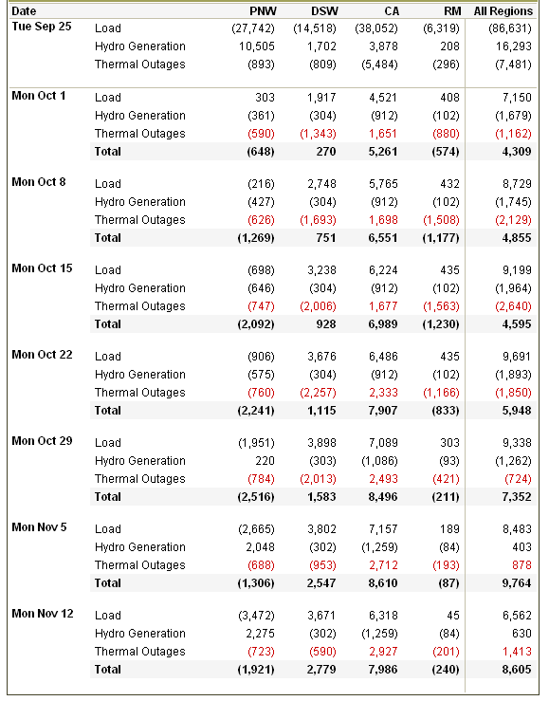
Load / Resource Balance
California loads down sharply with lower temperatures;
Pacific Northwest hydro now expected to rise in November
Fall maintenance outages peak in mid-October / current levels return in November

Slide 3
Updated L/R Adjustments
knelson:
The figures dropped by a max of ~1500mw. I account for this by new gen being cancelled/on hold and less conservation than originally forecasted.
Sept Oct Nov Dec
10,232 12,259 13,635 15,538

Slide 4
Timeline

Slide 5
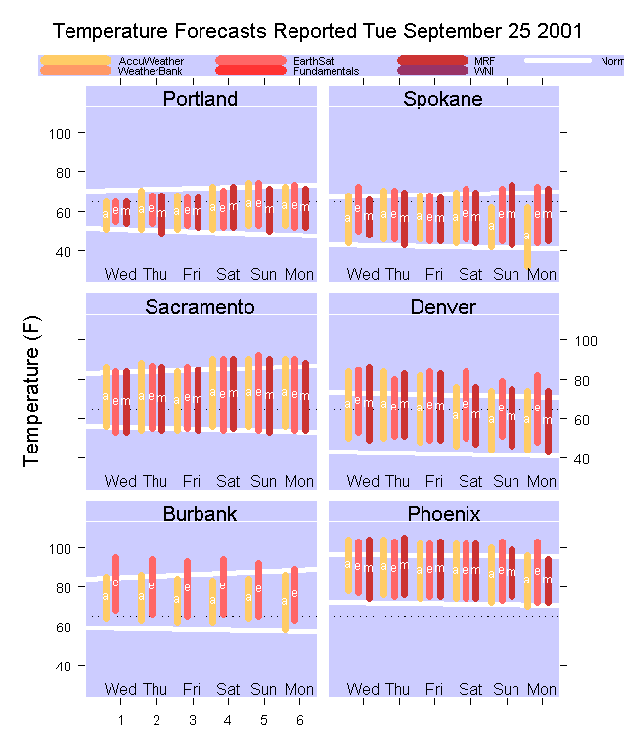

Slide 6
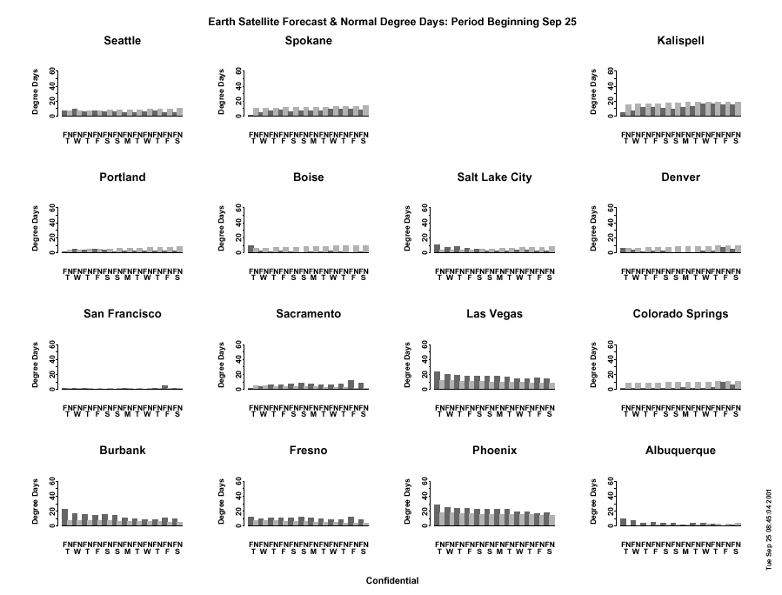

Slide 7
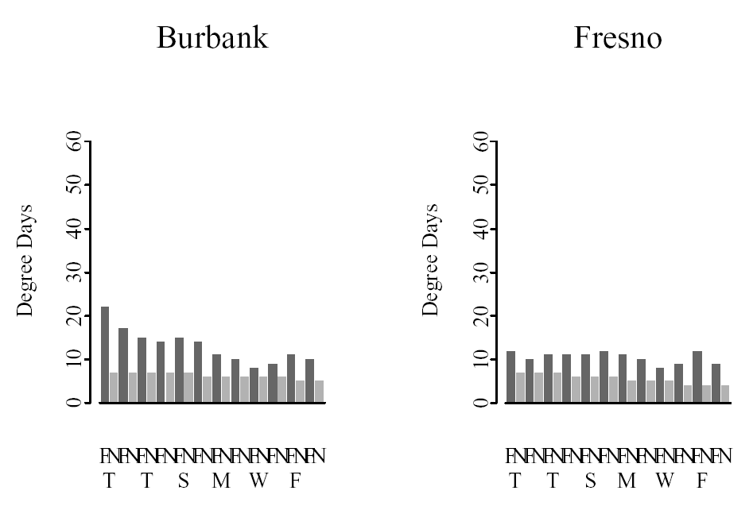

Slide 8
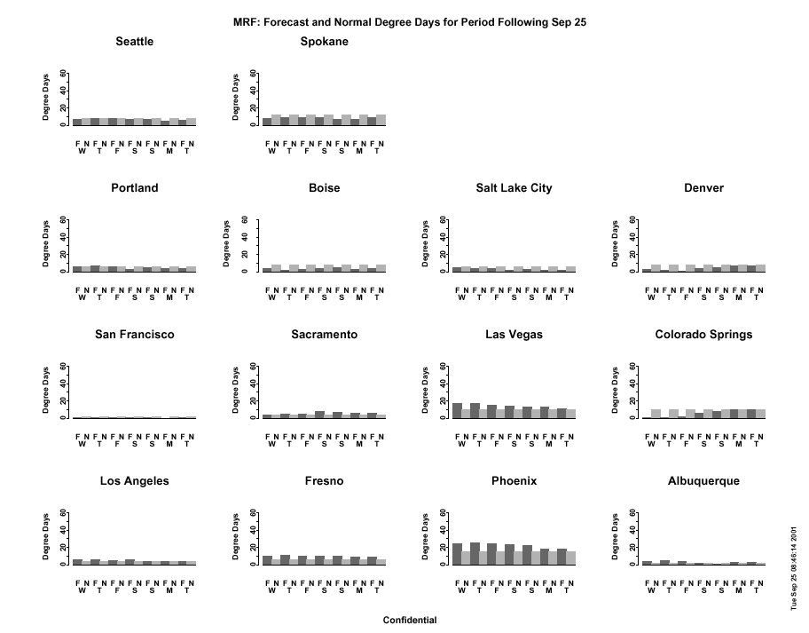

Slide 9
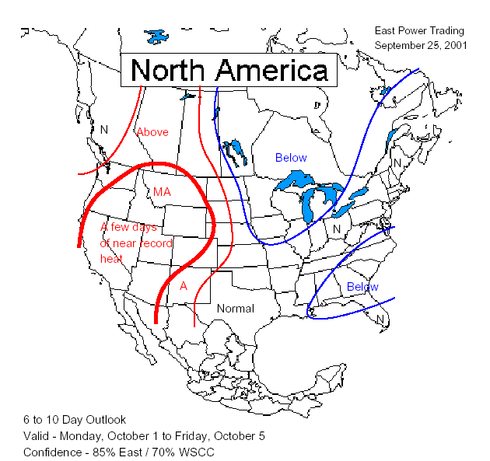
Houston 6 – 10 Day Outlook

Slide 10
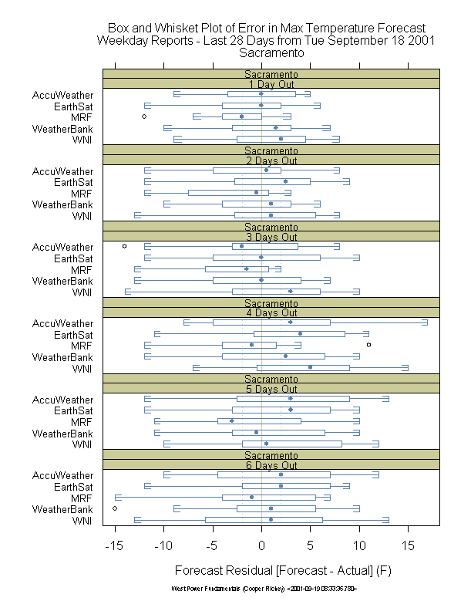
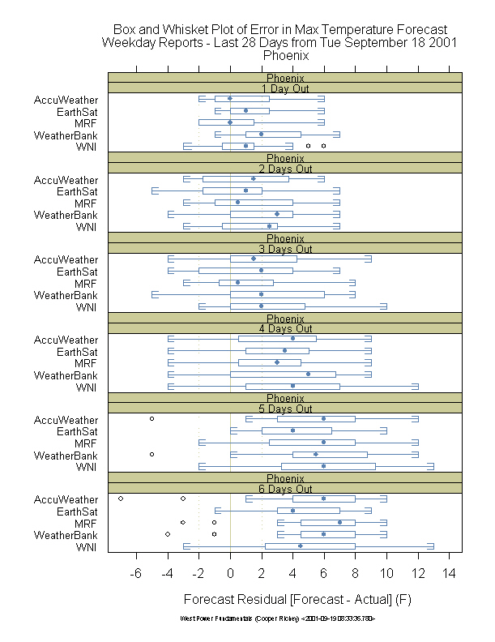
Temperature Forecast Error

Slide 11
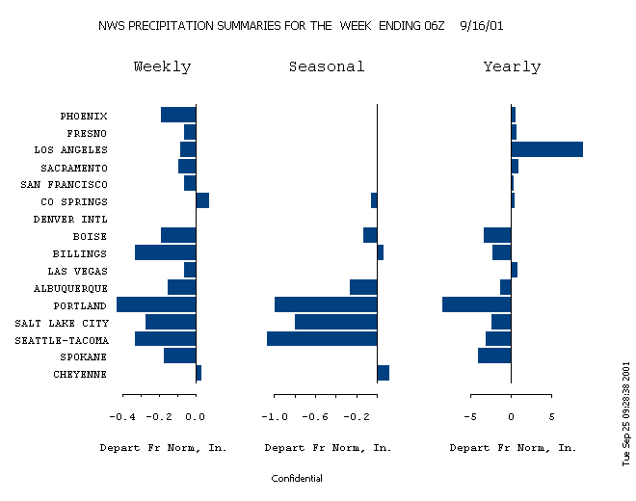
Precipitation History

Slide 12
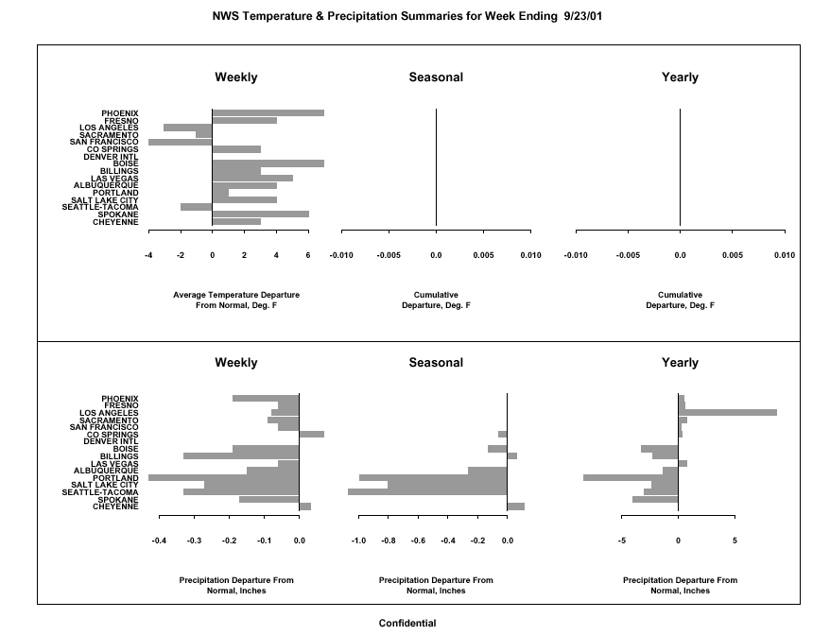

Slide 13
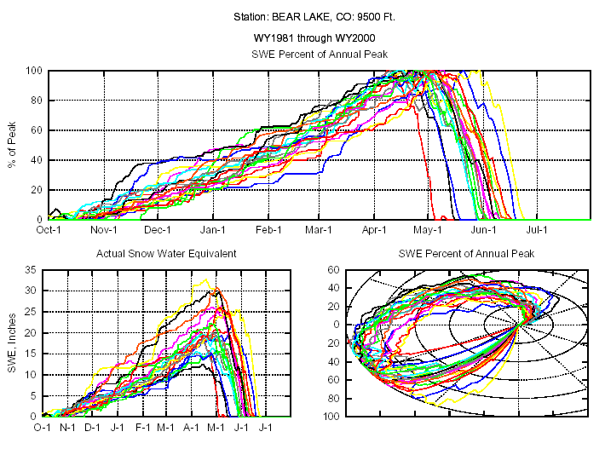
Snow Predictability: Good

Slide 14
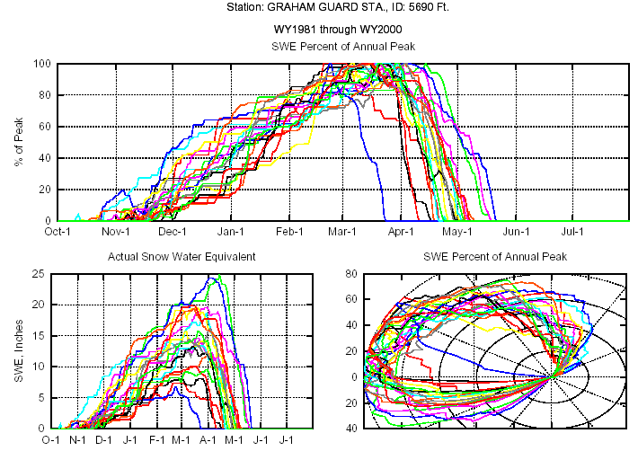
Snow Predictability: Bad

Slide 15
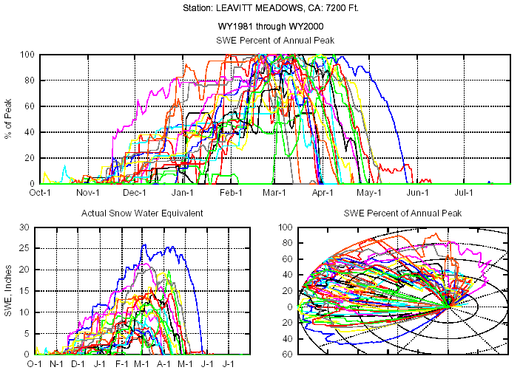
Snow Predictability: Ugly

Slide 16
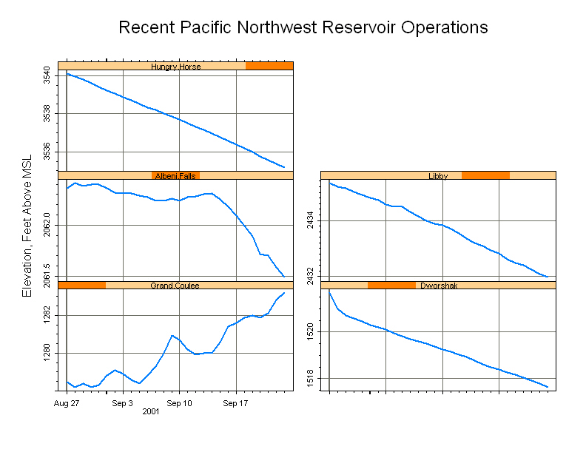
Northwest Reservoirs

Slide 17
McNary Actual & Forecast

Slide 18
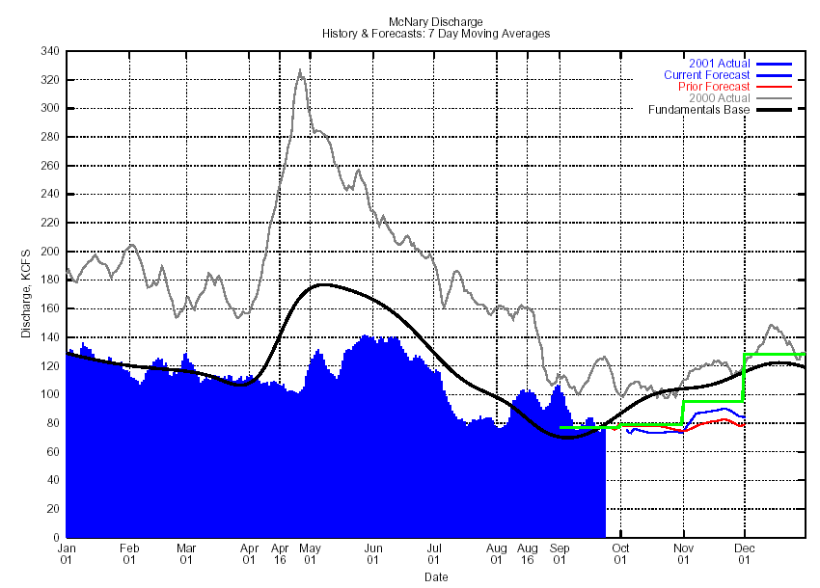

Slide 19
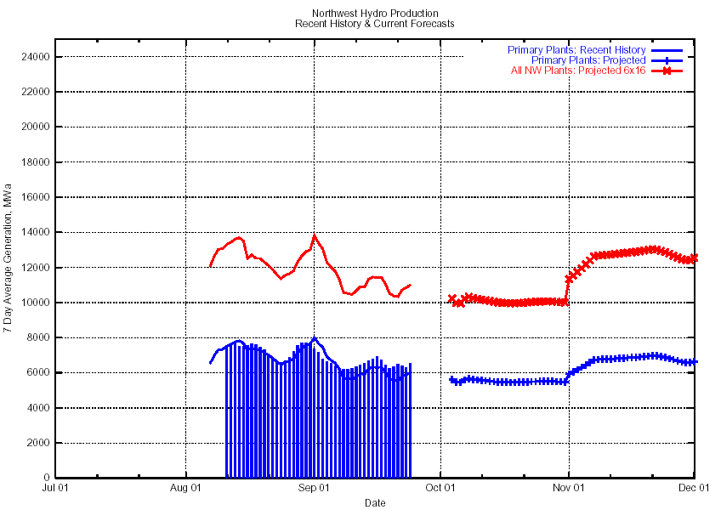

Slide 20
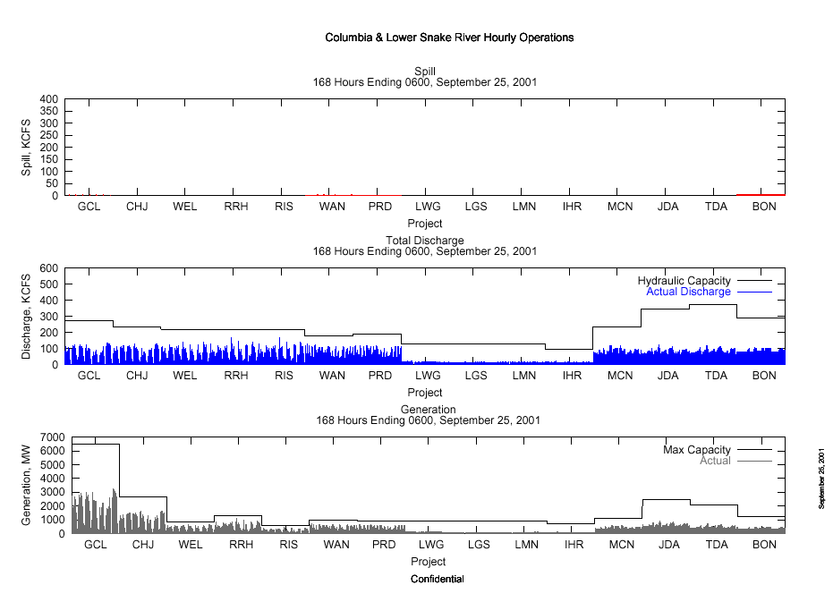

Slide 21
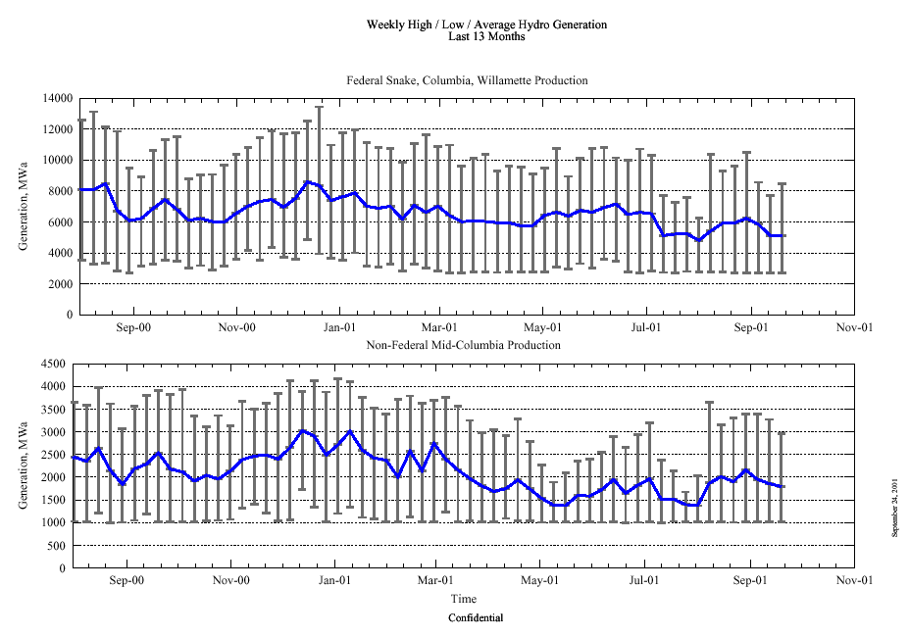

Slide 22
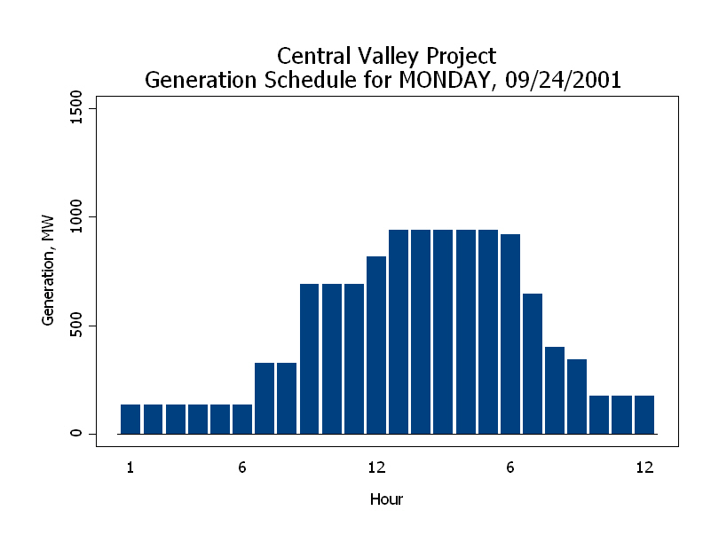

Slide 23
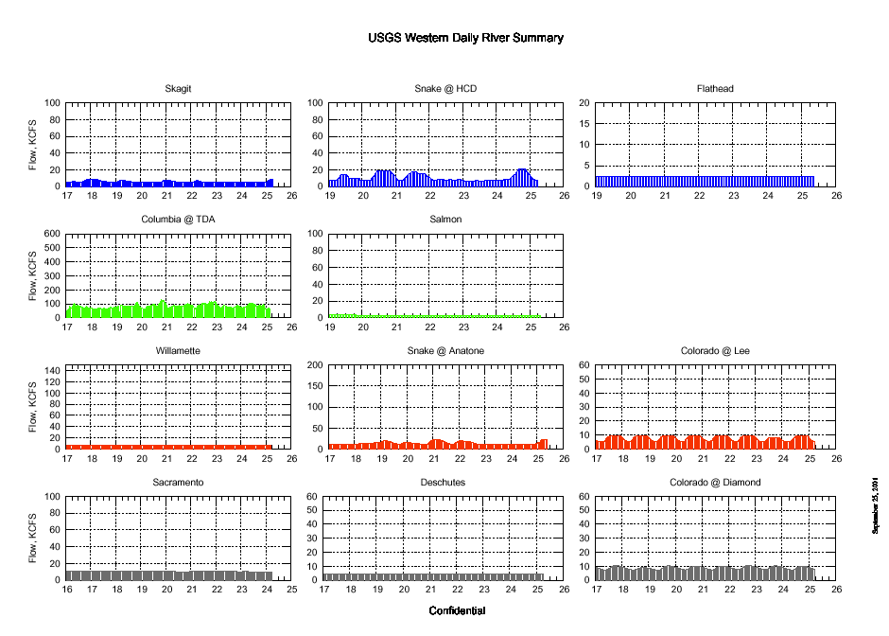

Slide 24
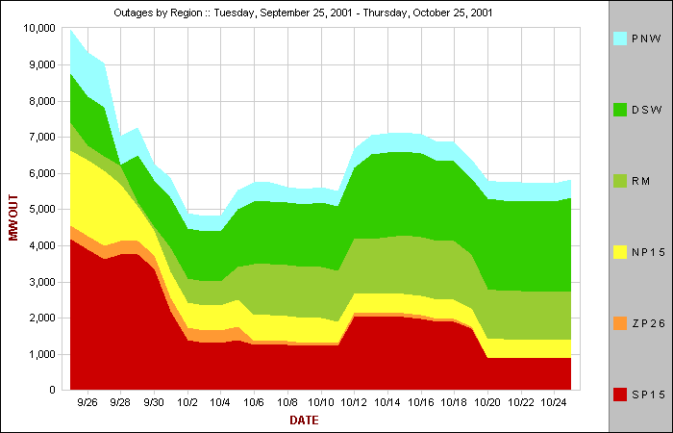

Slide 25
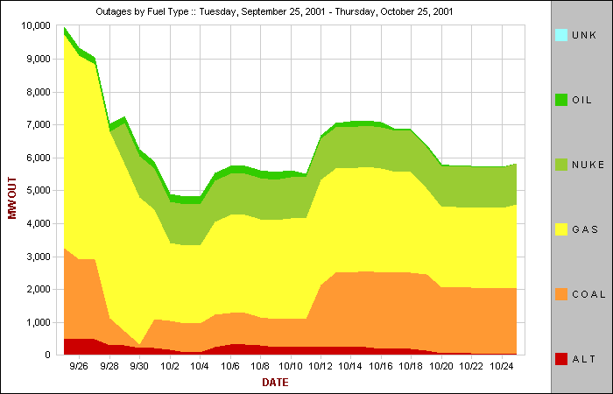

Slide 26
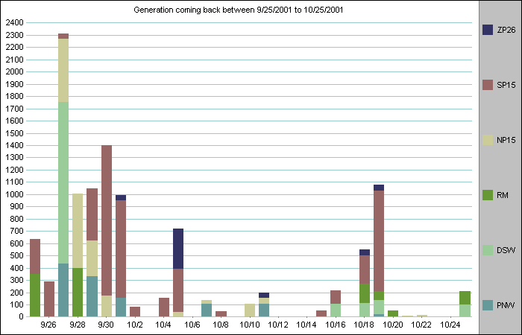

Slide 29
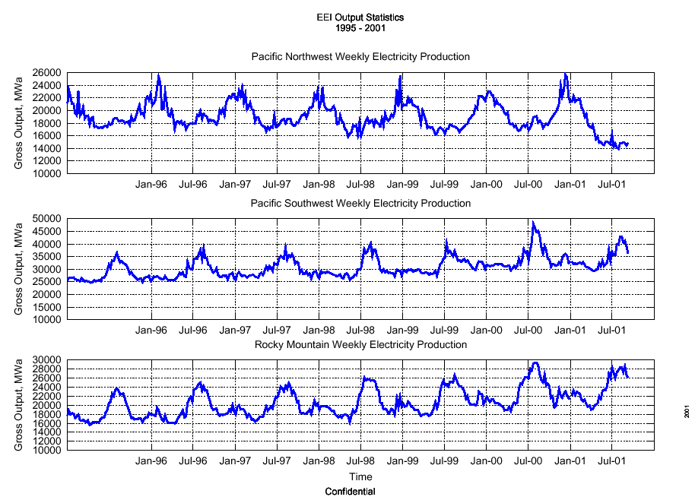

Slide 30
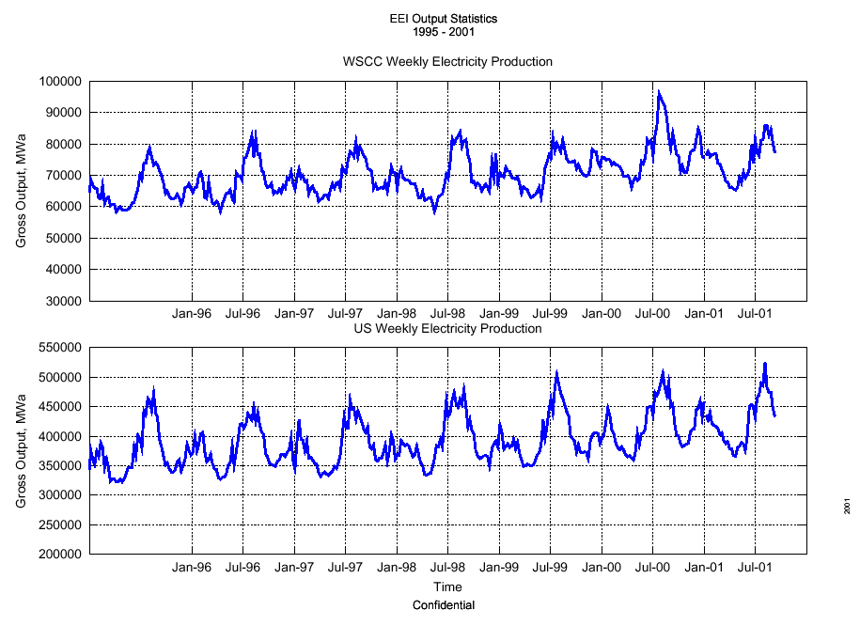

Slide 32
