Slide 1

W
EST
P
OWER
F
UNDAMENTALS
B
RIEFING
8/21/2001

Slide 2
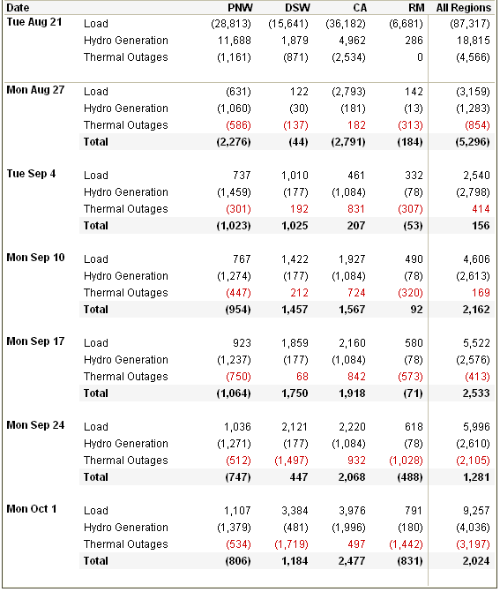
Load / Resource Balance
System 5000 MWa shorter next week with ramp from below normal temperatures to above normal
Sharp decrease in PNW hydro production as Dworshak draft ends
With assumed return to seasonal norms, week of Sept 4 like now

Slide 3
Updated L/R Adjustments
Sept Oct Nov Dec
11,618 14,096 15,090 15,221

Slide 4
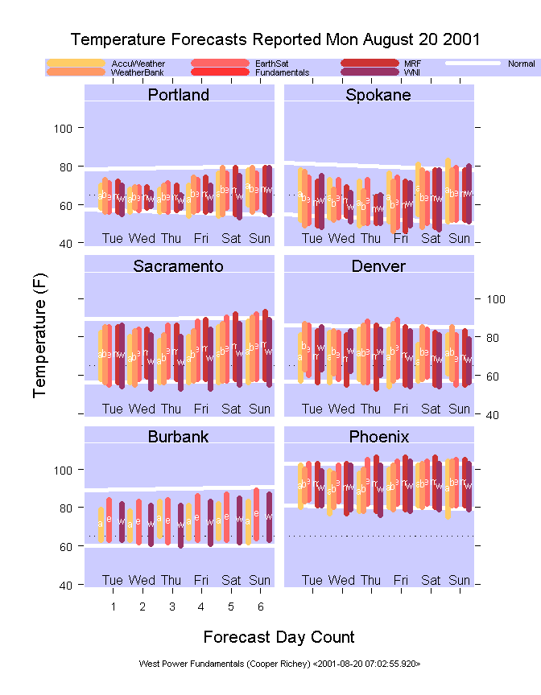
Yesterday’s Mid-Range Forecasts

Slide 5
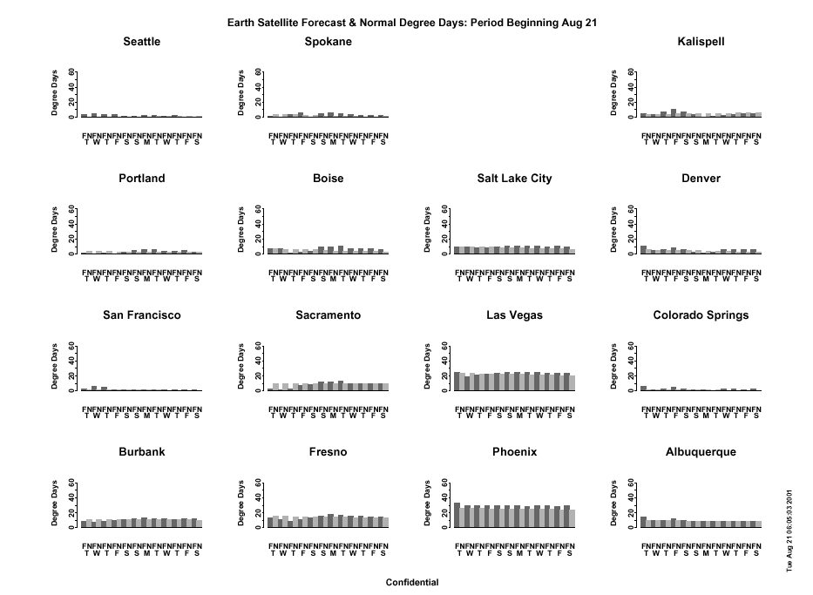

Slide 6
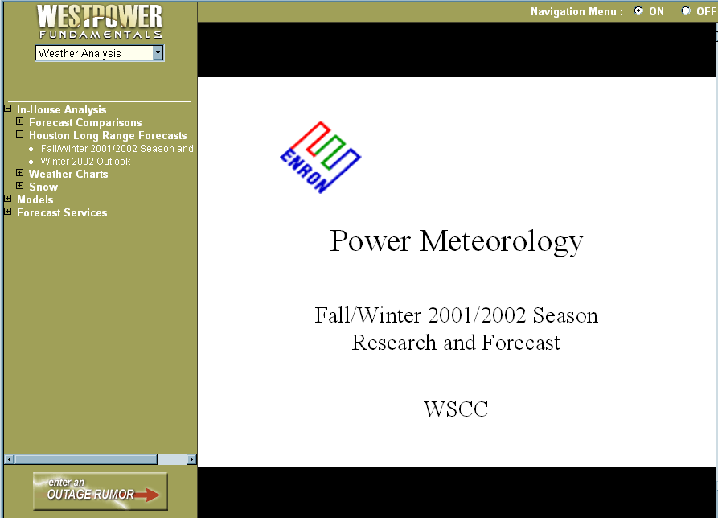
Houston Long Lead Forecasts Available

Slide 7
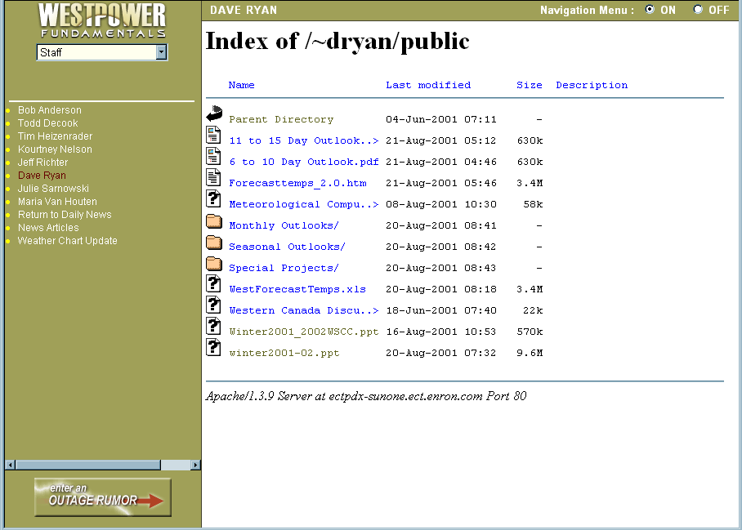
Daily Internal Weather Forecasts

Slide 8
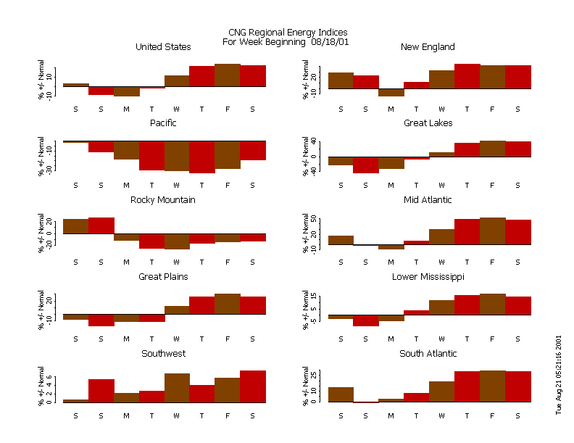

Slide 9
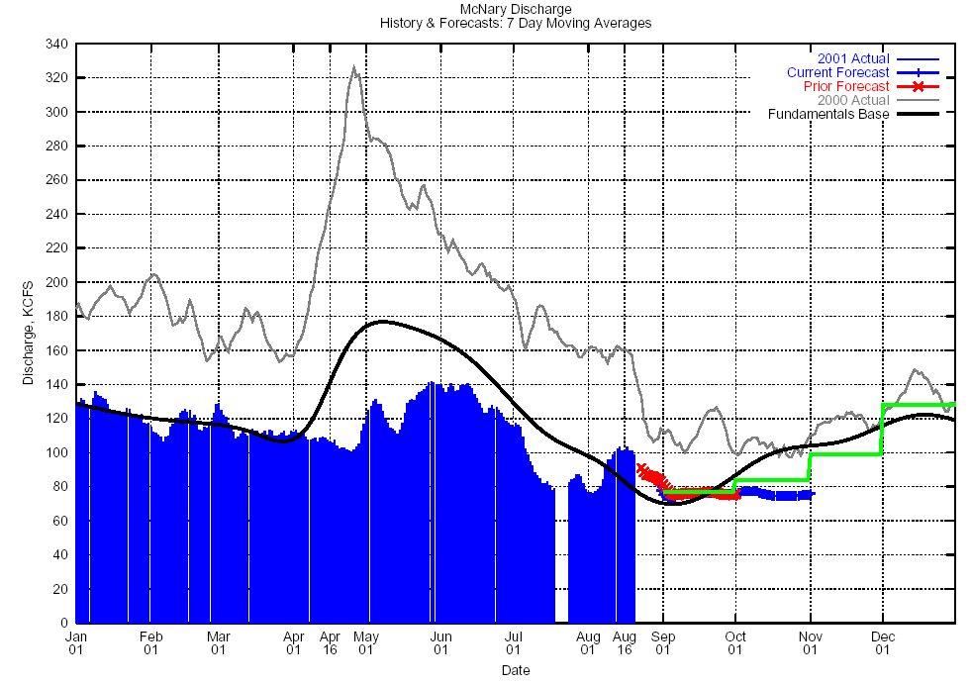
Actual Energy Regulation

Slide 10
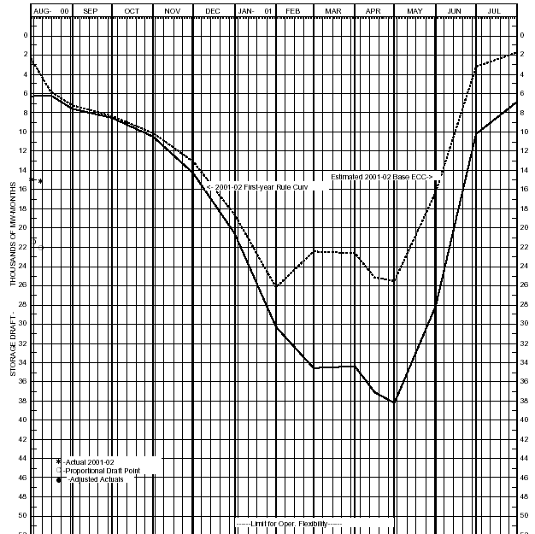

PNW Reservoir Status / Op Plan
Aug 8 Actual
BPA pre-Winter Minimum
Max Planned Draft, Starting Full, Until Volume Forecasts Indicate Sufficient Runoff

Slide 11
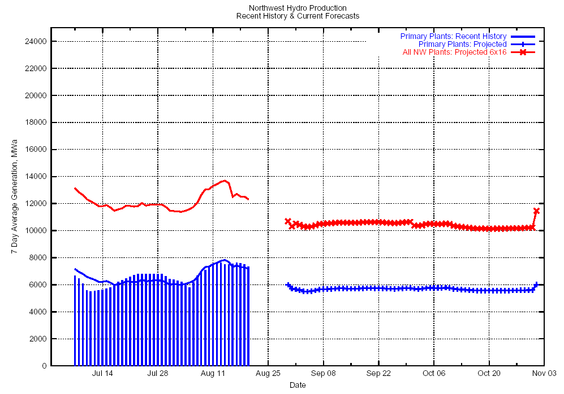

Slide 12
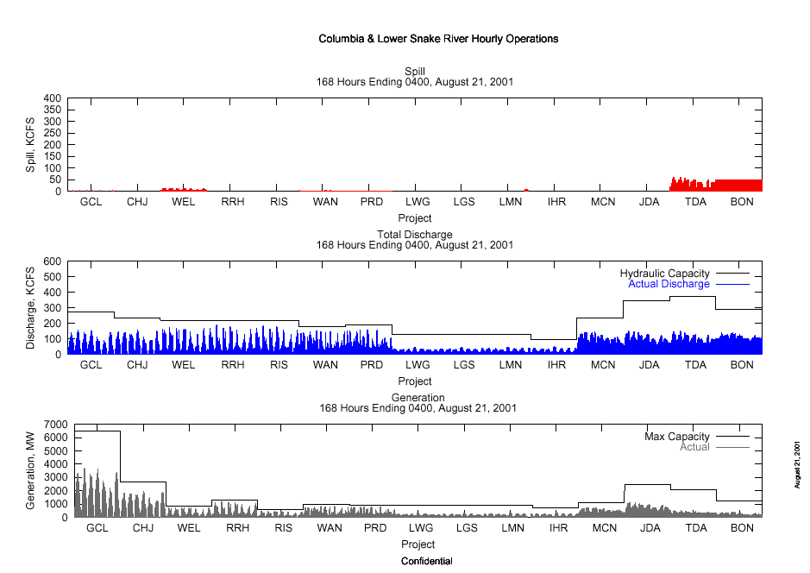

Slide 13
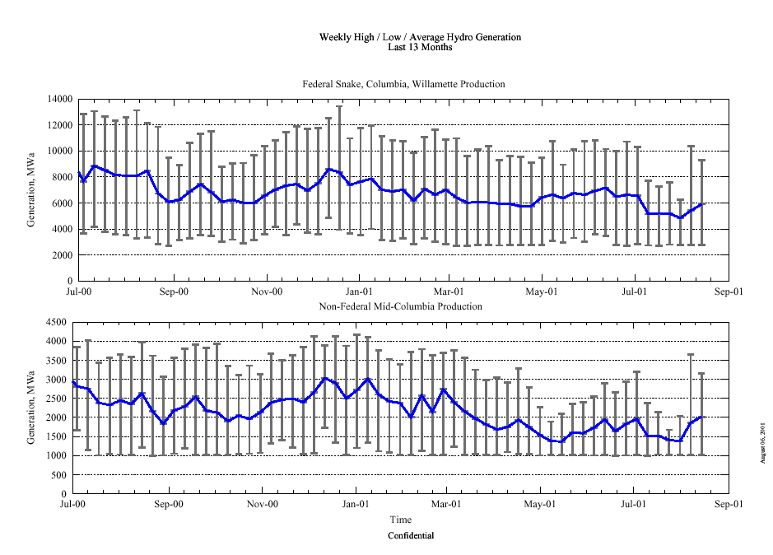

Slide 14
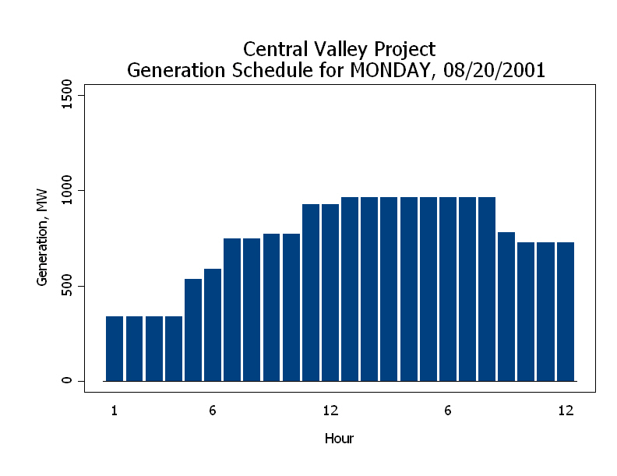

Slide 15
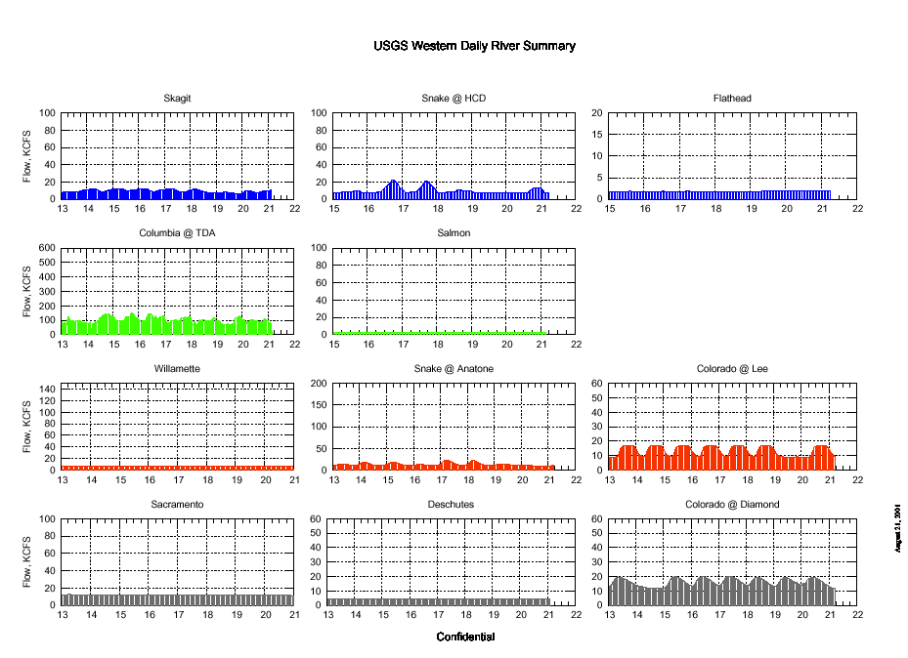

Slide 16
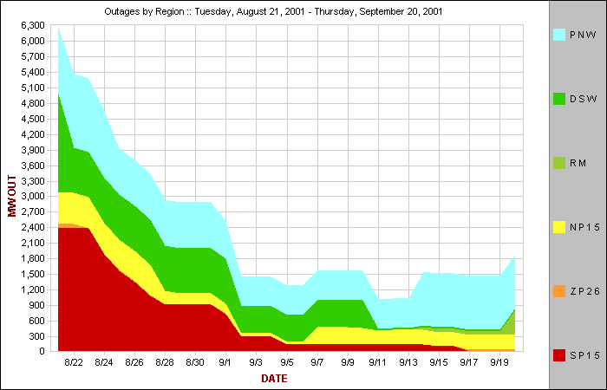

Slide 17
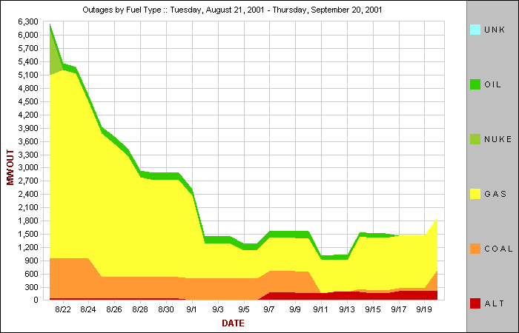

Slide 18
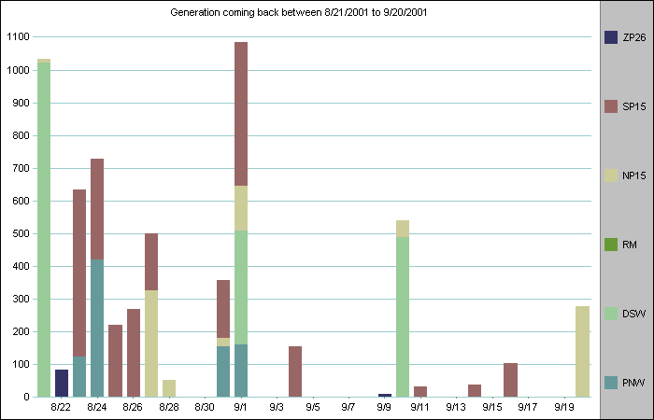
PV
New Gen
Etiwanda
Bonanza
San Juan
Pittsburgh

Slide 22
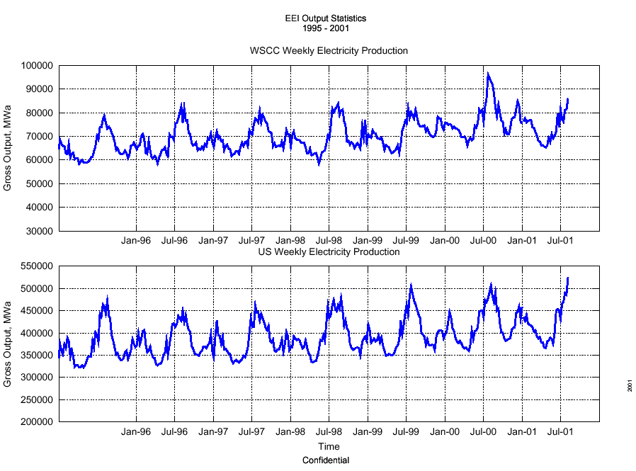

Slide 23
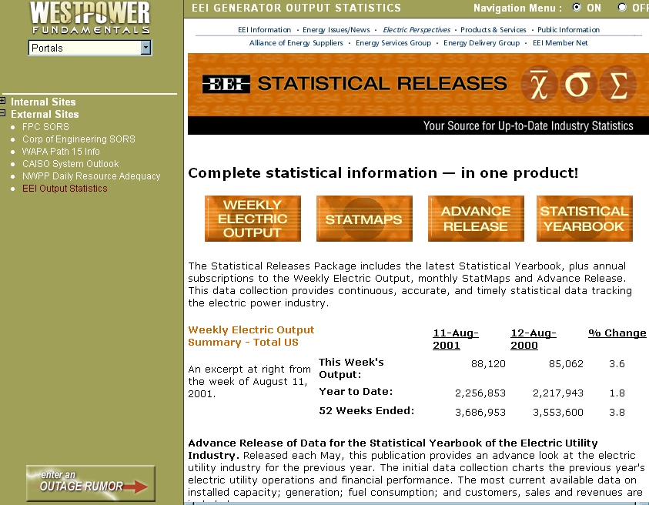
New Subscription to EEI Stats

Slide 24
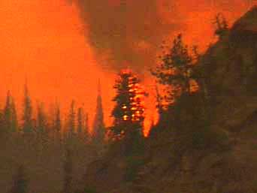

Slide 25
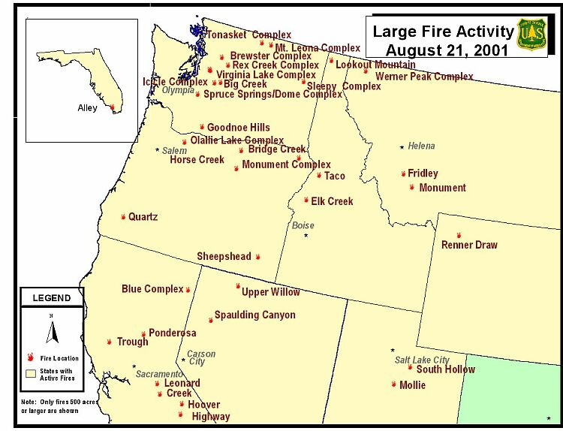

Slide 26
Statistics
Daily Statistics 8/21/01
Year-to-Date Statistics 1/1/01 - 8/21/01
Number of New Large Fires
8
Number of Fires
56,266
Number of Active Large Fires
42
10-Year Average
60,828
Acres from Active Fires
356,558
Number of Acres
2,829,192
Number of Fires Contained Yesterday
7
10-Year Average
2,749,141
States Currently Reporting Active Large Fires (see State-by-State Summaries for details)
California (9)
Florida (1)
Idaho (4)
Montana (4)
Nevada (2)
Oregon (6)
Texas (1)
Utah (5)
Washington (8)
Wyoming (2)
2000 Number of Fires
69,322
2000 Number of Acres
5,669,328
1999 Number of Fires
66,767
1999 Number of Acres
3,905,635

Slide 28
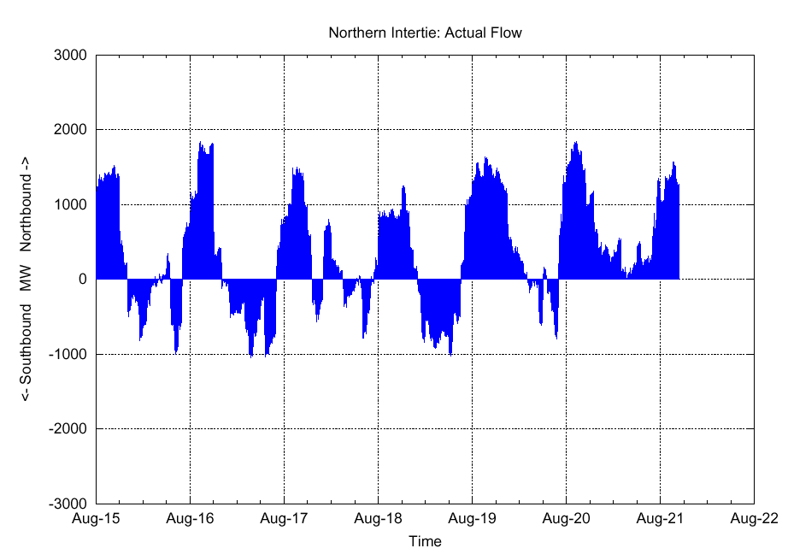

Slide 29
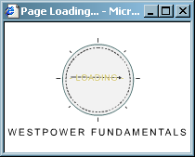
Development Status / Priorities
New Load / Resource balance in progress
Map interface to scheduling constraints next up

Slide 30
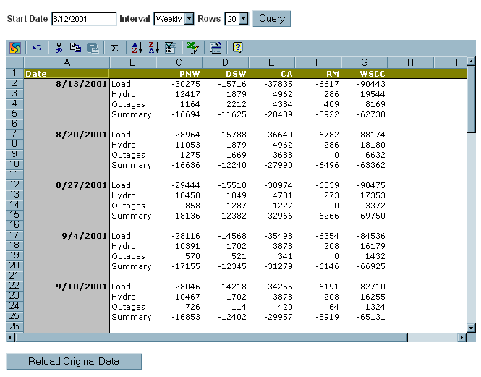
New L/R Balance Uses Web Components

