Slide 1

W
EST
P
OWER
F
UNDAMENTALS
B
RIEFING
7/31/2001

Slide 2
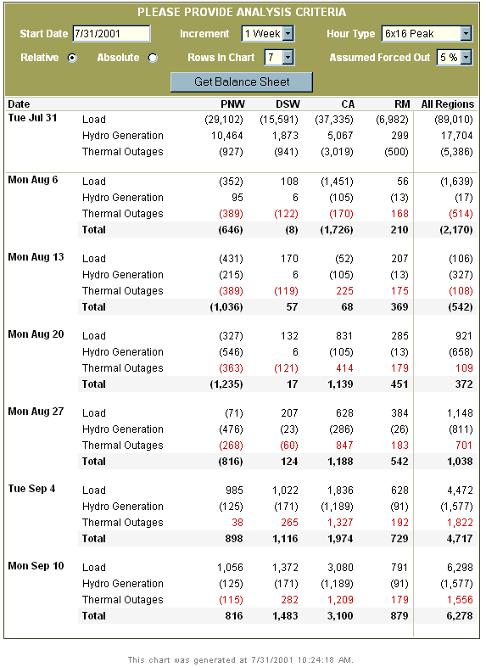
L/R Balance
Shortest Week of Season
Last Exposure to Extreme Heat

Slide 3
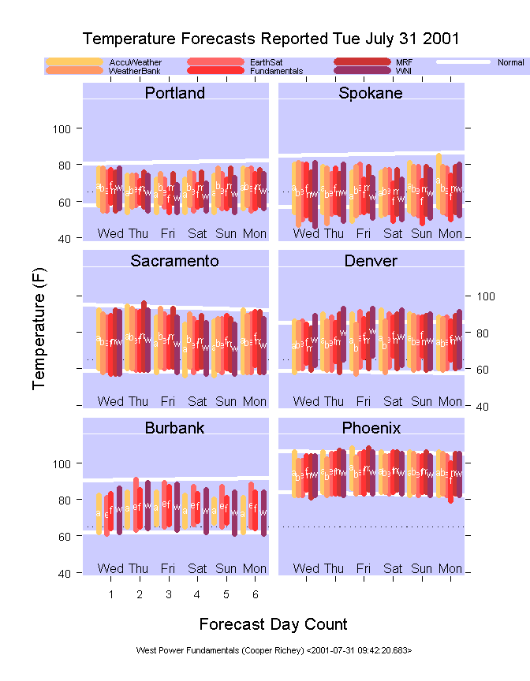
Forecast Comparison

Slide 4
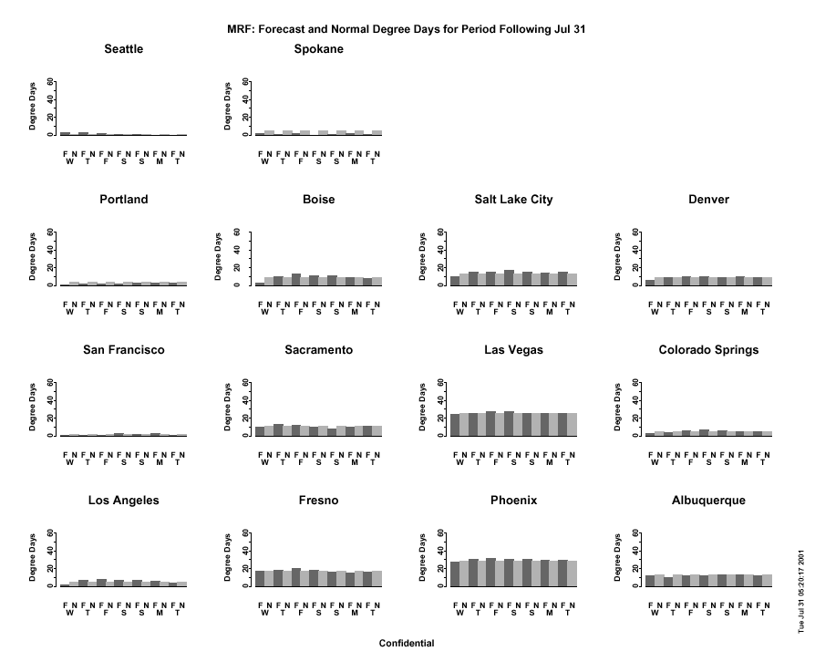

Slide 5
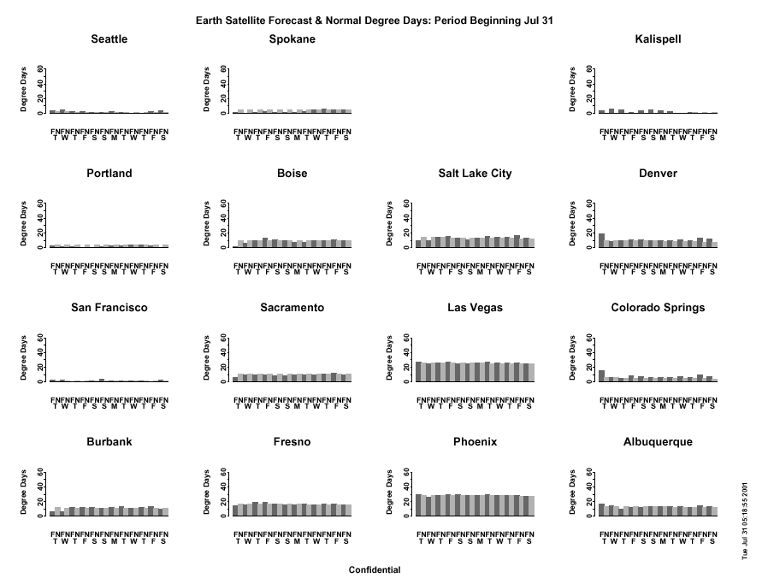

Slide 6
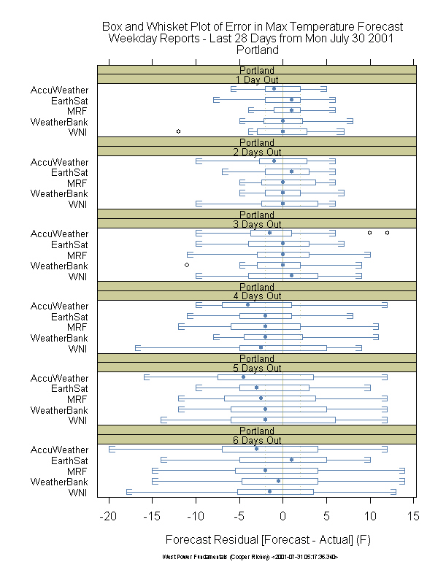
Recent Weather Forecast Skill Low More Than 3 Days Out

Slide 7
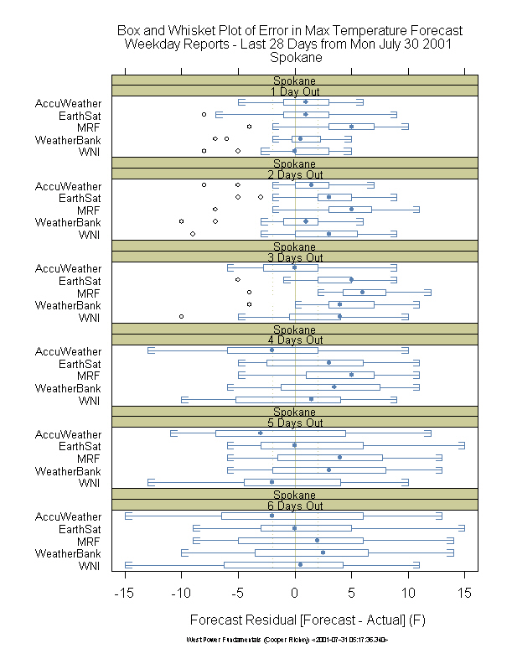
PNW Interior Error Patterns Inconsistent, Many Outliers…

Slide 8
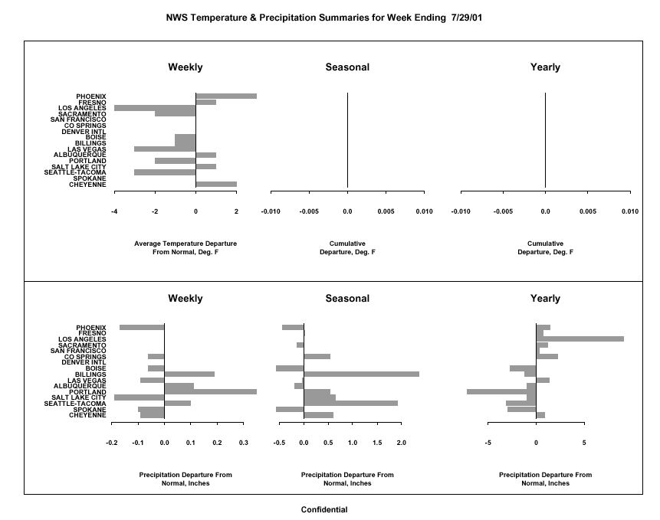

Slide 9
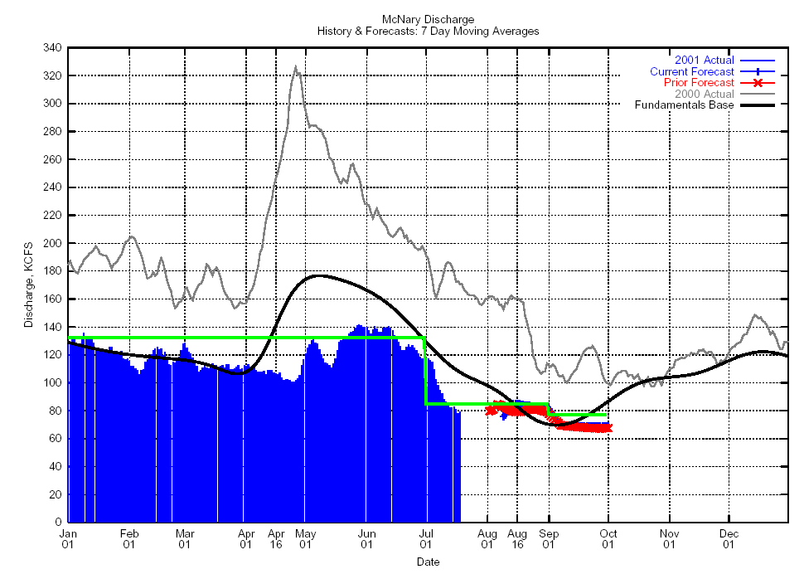
McNary Forecast
Recent Actuals

Slide 10
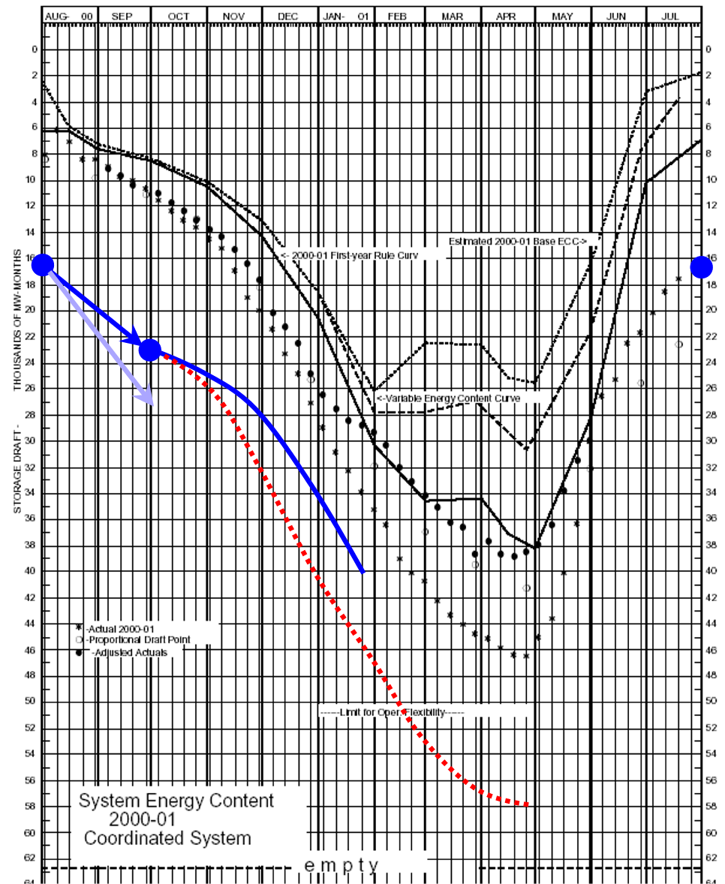
NWPP Composite Reservoir
ECC
Worst Case
Last Year

Slide 11
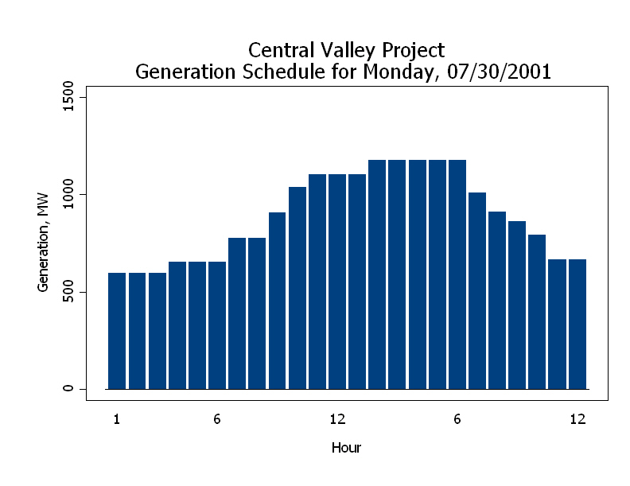

Slide 12
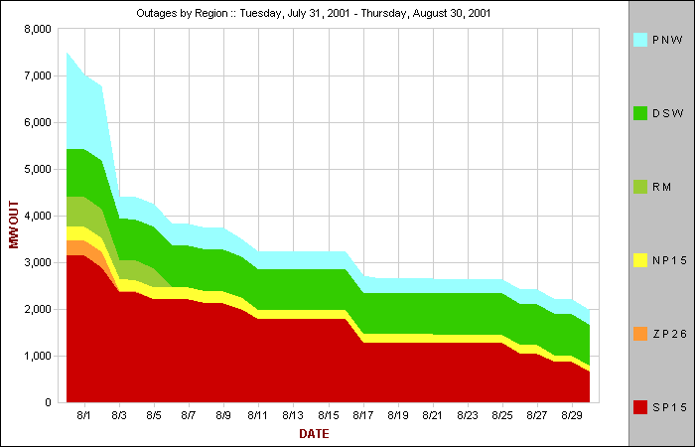

Slide 13
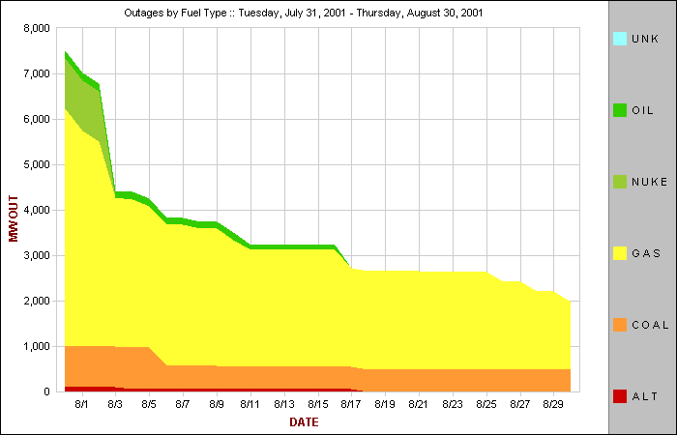

Slide 14
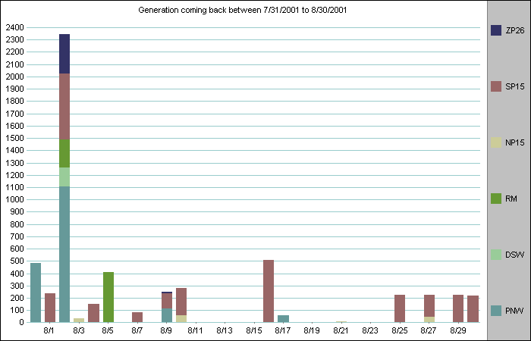
Alamitos
WNP

Slide 19
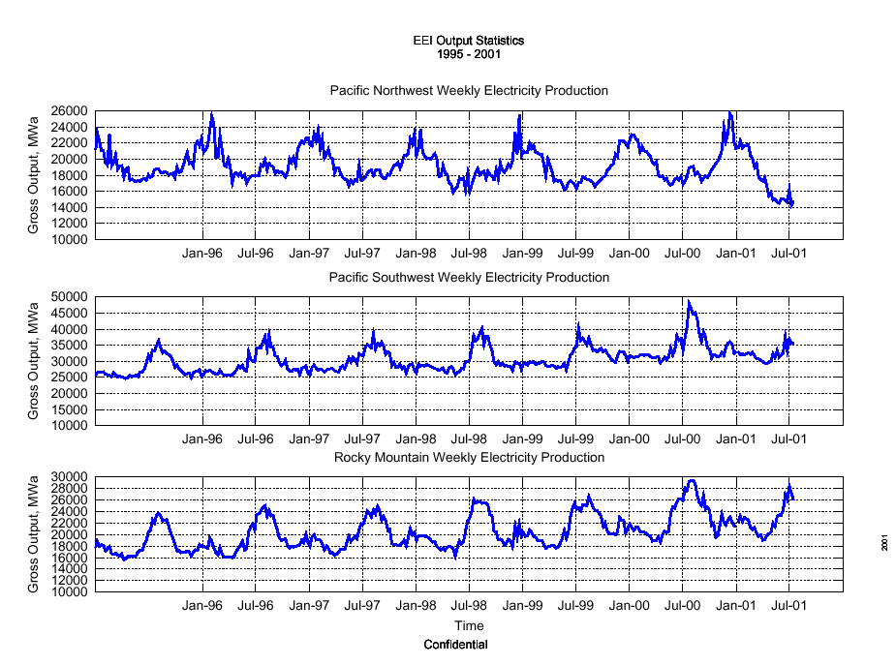

Slide 20
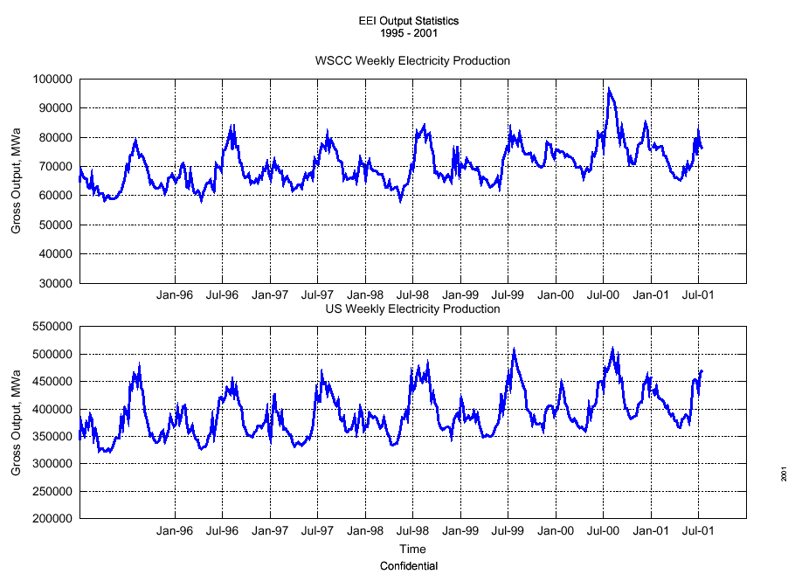

Slide 22
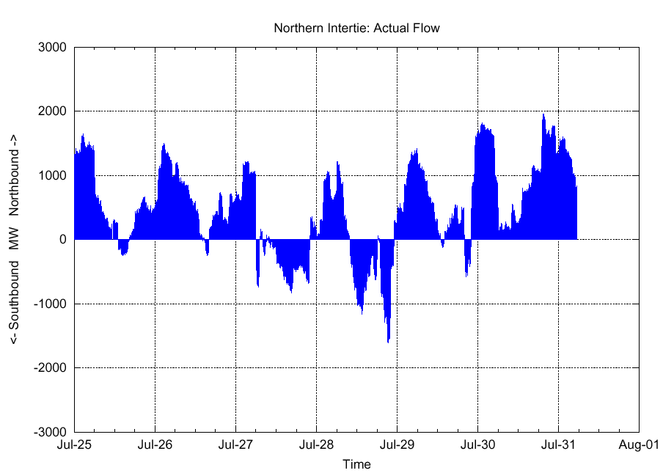

Slide 23
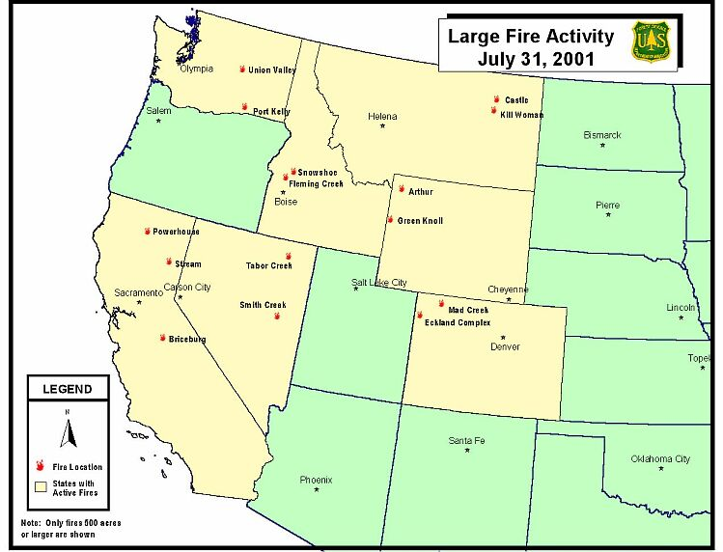

Slide 24
CALIFORNIA
Number of Fires: 2
Acres: 4,288
New Fires: 0
Fires Contained: 1
Stream (Plumas National Forest): 3,560 acres at 80 percent contained. Fire is 25 miles northeast of Quincy. Information: Call 530-283-7882, 7883, or 7884
Briceburg (CDF Madera-Mariposa-Merced Ranger Unit): 728 acres at 75 percent contained. Fire 15 miles east of Mariposa near Highway 140. Information: Visit the CDF web site or call 209-966-4784
COLORADO
Number of Fires: 3
Acres: 4,574
New Fires: 0
Fires Contained: 0
West Plateau (San Juan National Forest): 300 acres at 0 percent contained. Fire is 20 miles northeast of Dolores.
Mad Creek (Routt National Forest): 1,025 acres at 35 percent contained. Fire is 11 miles north of Steamboat Springs.
Ecklund Complex (BLM Little Snake Field Office): 3,249 acres at 0 percent contained. Fire is 50 miles east of Vernal. This fire is being monitored to benefit resources. Containment is expected by October 1.
IDAHO
Number of Fires: 1
Acres: 2,400
New Fires: 0
Fires Contained: 1
Snowshoe (Salmon-Challis National Forest): 2,400 acres at 0 percent contained. Fire is 25 miles northwest of Stanley. This fire will be managed to benefit resources. Containment is expected by late September. Information: Call 208-756-5177
MONTANA
Number of Fires: 1
Acres: 2,500
New Fires: 0
Fires Contained: 1
Castle (BLM Lewistown Field Office): 2,000 acres at 10 percent contained. Fire is 40 miles southwest of Glasgow

Slide 25
NEVADA
Number of Fires: 2
Acres: 8,597
New Fires: 0
Fires Contained: 0
Smith Creek (BLM Elko Field Office): 1,592 acres at 75 percent contained. Fire is 40 miles southwest of Ely. Containment is expected today.
Tabor Creek (BLM Elko Field Office): 7,005 acres at 90 percent contained. Fire is 13 miles north of Metropolis. Containment is expected today. Information: Call 505-768-6977
WASHINGTON
Number of Fires: 1
Acres: 4,000
New Fires: 0
Fires Contained: 1
Union Valley (Southeast Washington State): 4,000 acres at 20 percent contained. Fire is four miles north of Chelan. Residents in upper Union Valley and Washington Creek drainage have been evacuated and structure protection is being planned. Information: Call 509-682-7182
WYOMING
Number of Fires: 2
Acres: 5,470
New Fires: 0
Fires Contained: 0
Green Knoll (Bridger-Teton National Forest): 4,470 acres at 75 percent contained. Fire is six miles southwest of Jackson. Some residents were allowed to return home, but the Indian Paintbrush subdivision continues to be evacuated. Firefighters are making good progress and containment is expected by Thursday. Information: Call 307-739-5577 or visit this web site: www.tetonfires.com
Arthur (Yellowstone National Park): 1,000 acres at 0 percent contained. Fire is 55 miles west of Cody. A Park Service facility was evacuated at the east entrance and the East Entrance Road at Eagle Creek Campground was closed. Information: Visit the Yellowstone National Park web site or call 307-344-2013

Slide 26
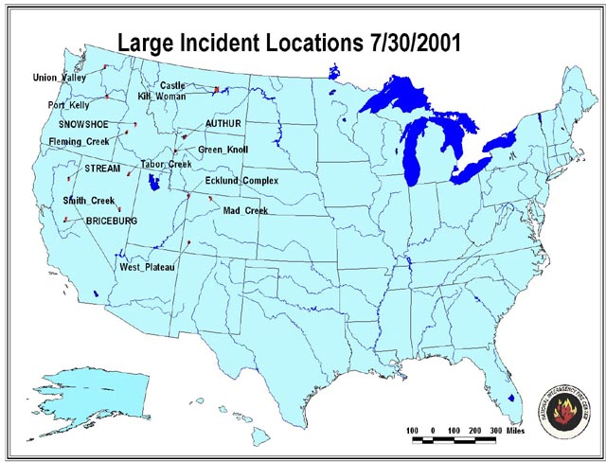

Slide 27
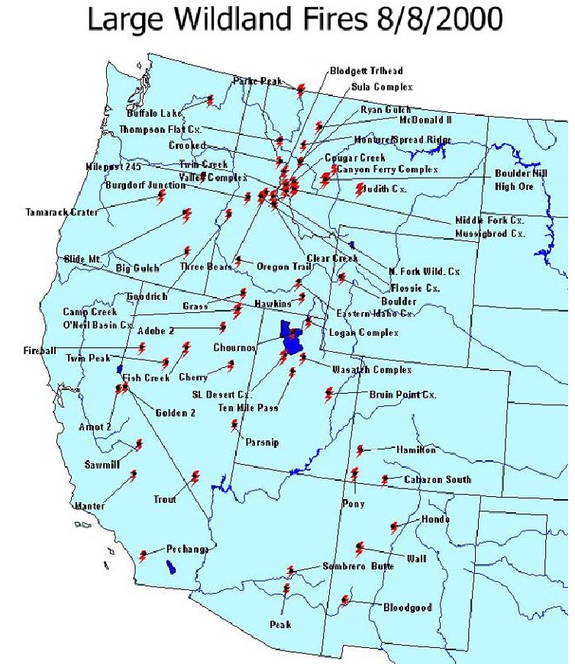
Last Year…

Slide 28
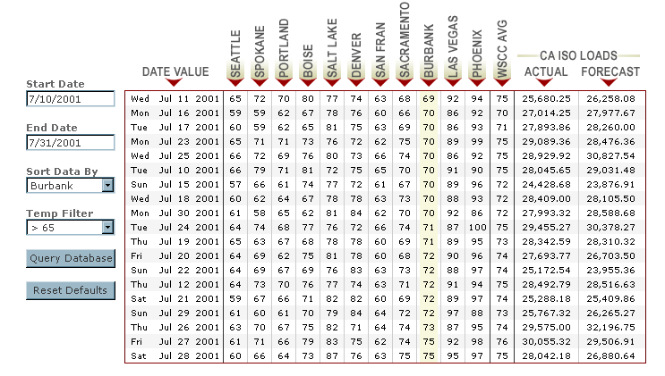
New Load / Temperature Display

