Slide 1

W
EST
P
OWER
F
UNDAMENTALS
B
RIEFING
6/5/2001

Slide 2
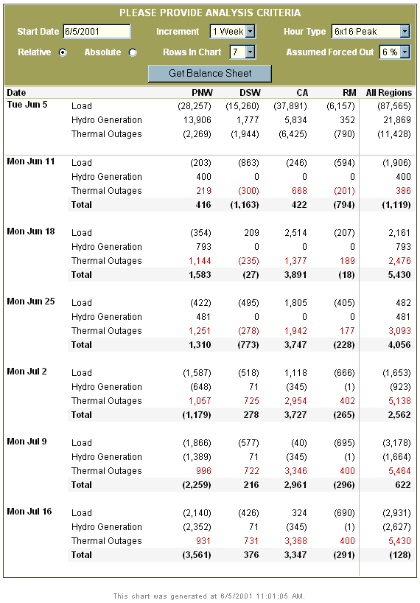
Minor hydro changes
Offsetting regional load changes
Scheduled maintenance season ends
Net L/R gains after next week

Slide 3
West normal to above next week

Slide 4
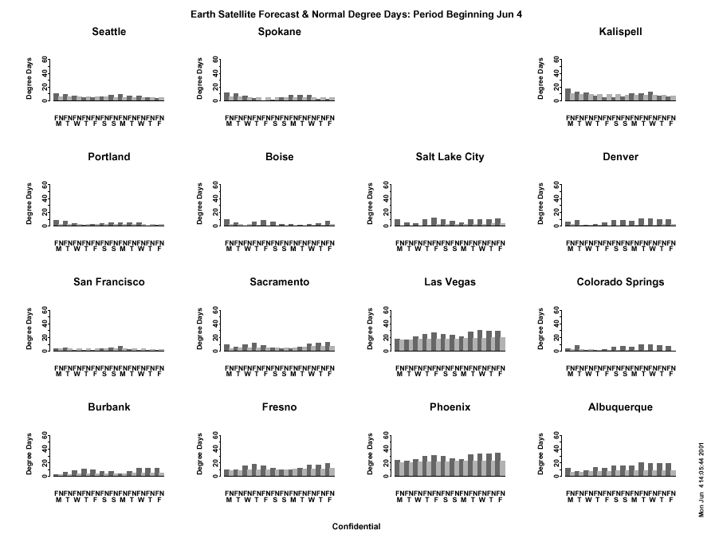

Slide 5
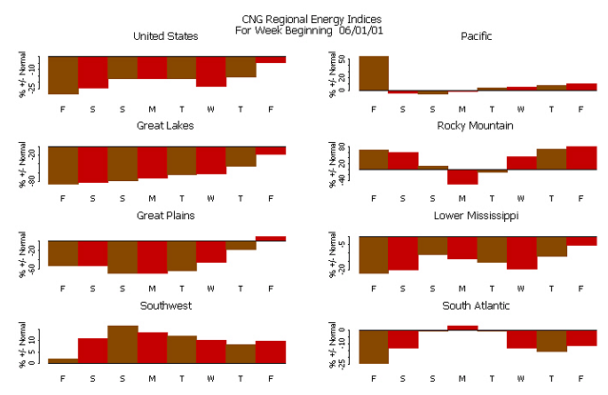

Slide 6
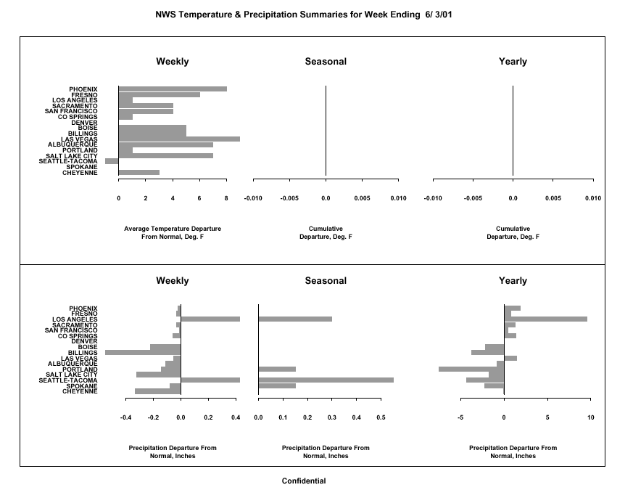

Slide 7
ISO Conservation Persists

Slide 8
Load reduction effects increasingly focused on peak

Slide 9
Light load penetration decreasing; behavior shift occurring?

Slide 10
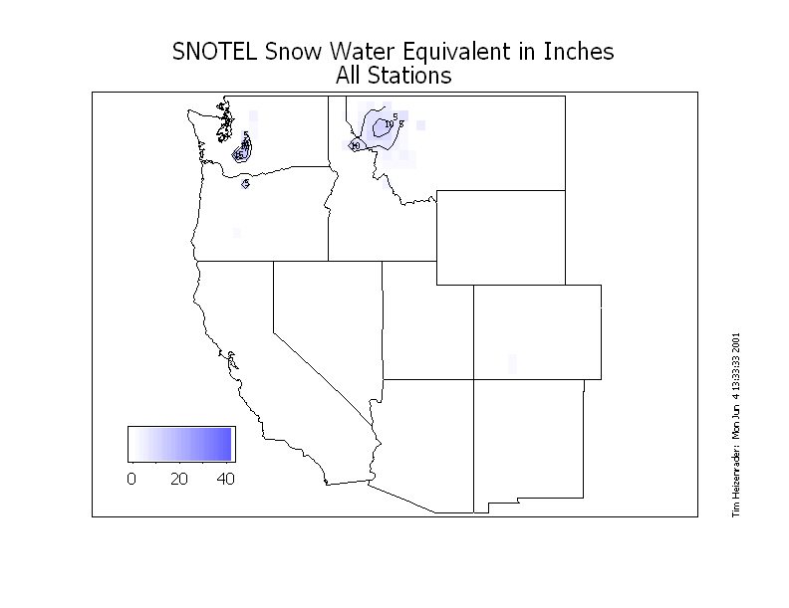

Slide 11
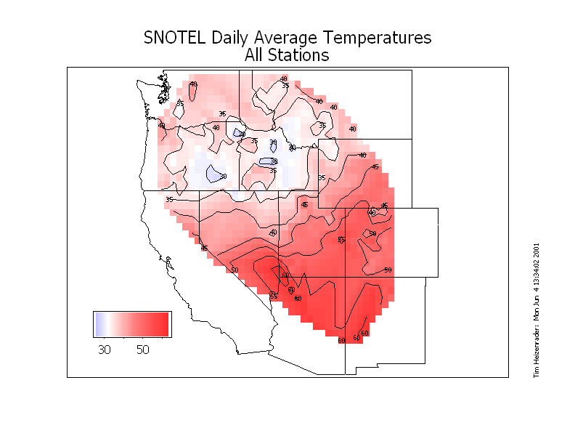

Slide 12
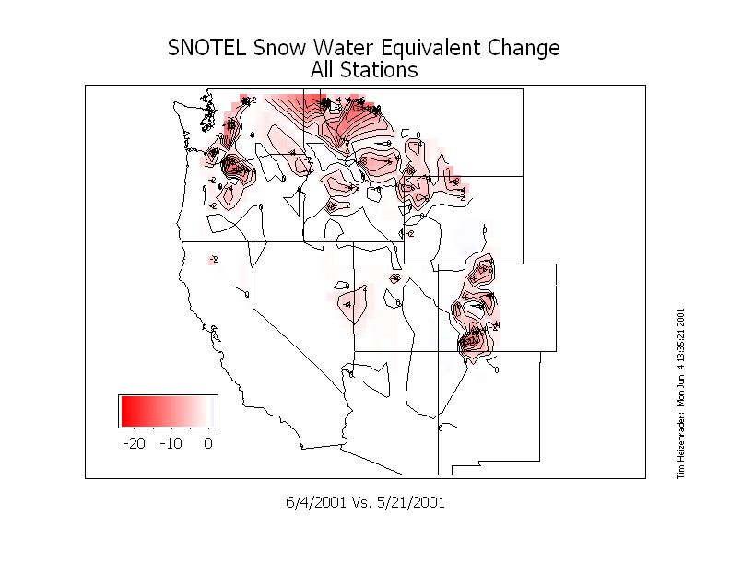

Slide 13
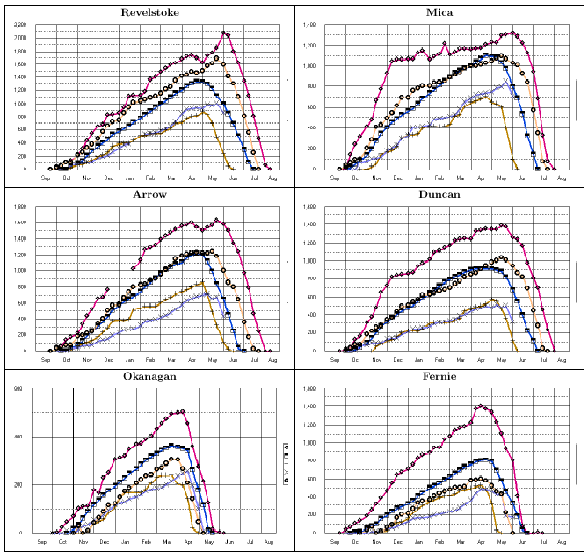
BC Courses bare by July 4

Slide 14
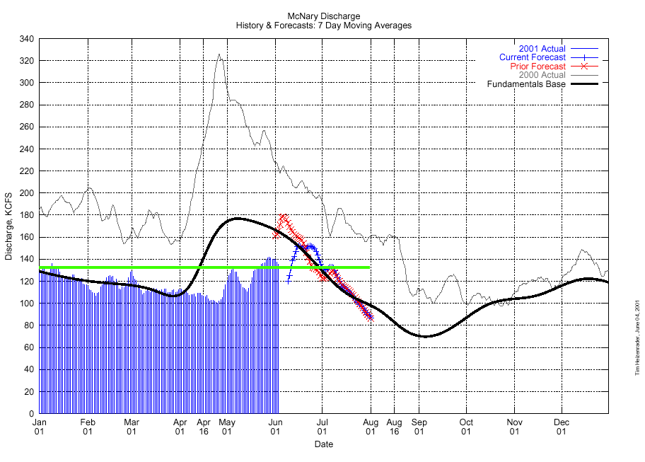

Slide 15
Short term hydro Jump?
You are here:
Snake River recession complete…

Slide 16
Upper mainstem recession at hand. Heat driven , short term rise possible but not forecast…
You are here:

Slide 17
Expect continued decline in lower Columbia natural flow
You are here:

Slide 18
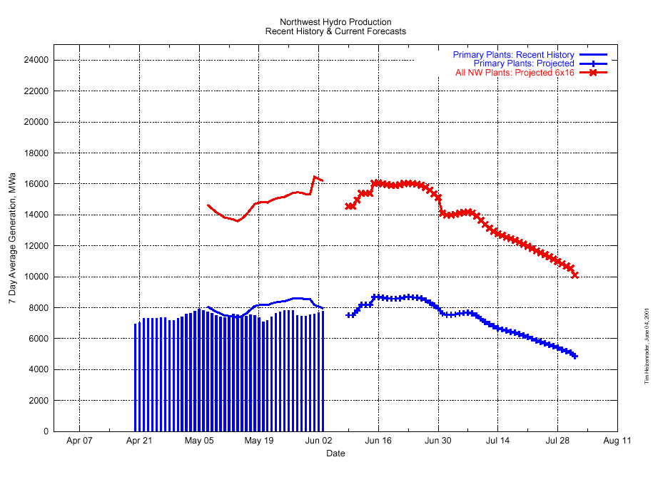

Slide 19
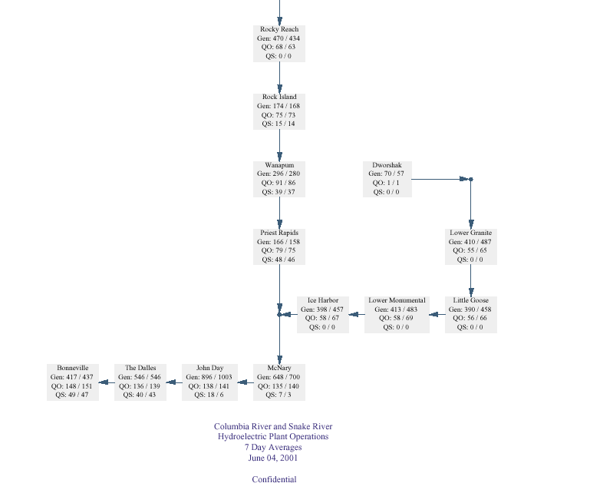
Federal spill extended “until further notice”; Mid Columbia decrease ok’d, but not implemented
Water over the dam(s)
40 MWa
240 MWa
290 MWa
220 MWa
240 MWa
135 MWa
35 MWa

Slide 20
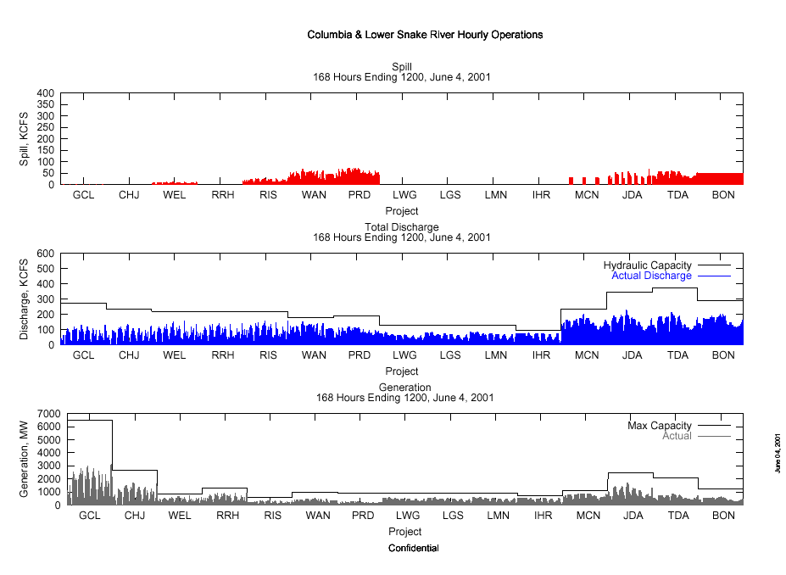

Slide 21
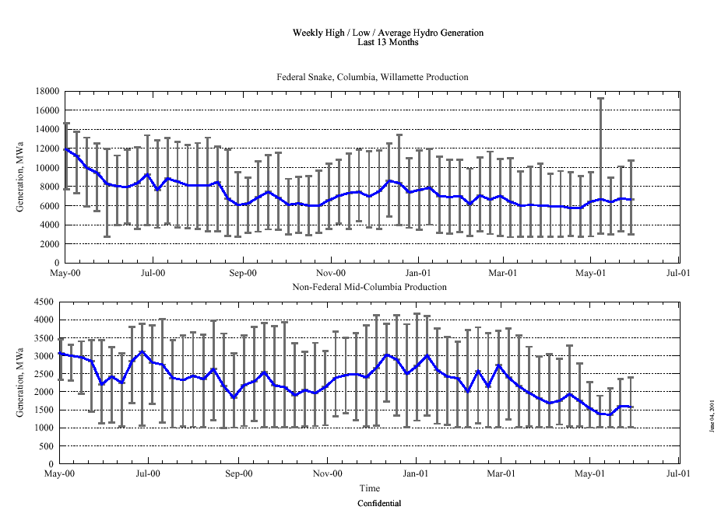

Slide 22
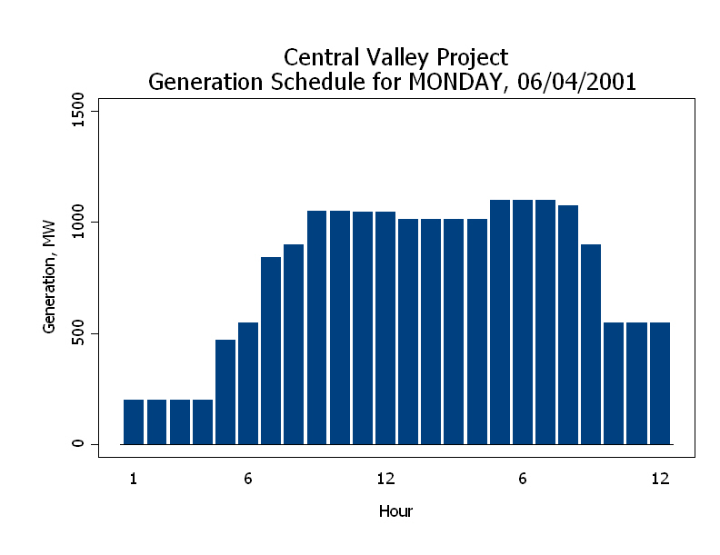

Slide 23
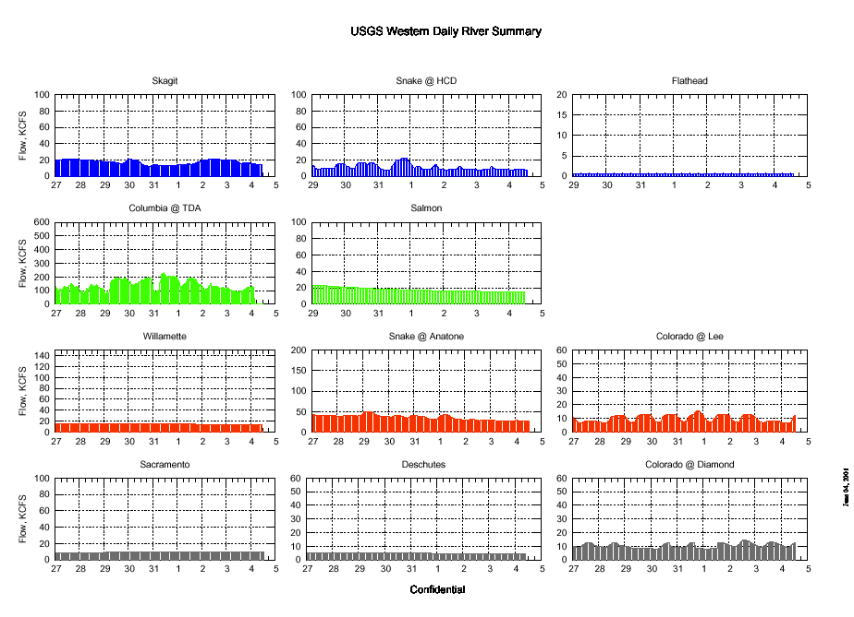

Slide 26
New Generation Added Over The Next 3 Months; now embedded in outage accounting
SP15 677 MW
NP15 1,175 MW
ZP26 320 MW
RM 240 MW
DSW 1,350 MW
PNW 160 MW
TOTAL 3,922 MW

Slide 29
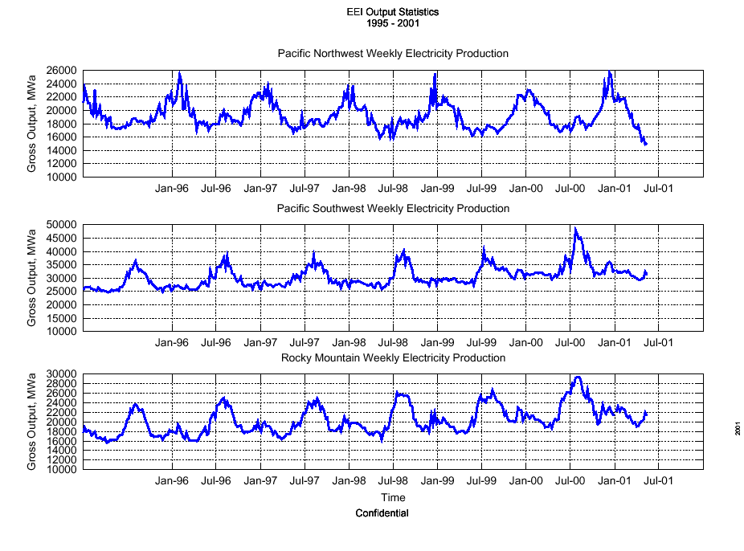
Through week of May 13

Slide 30
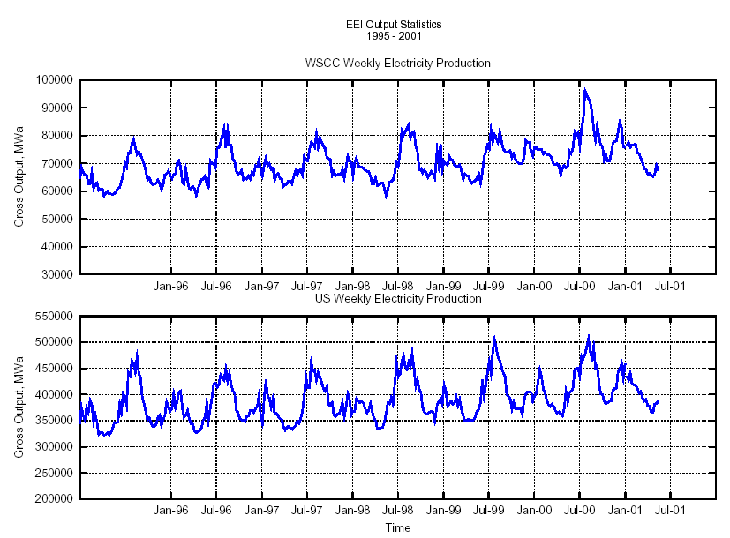
Temporary relief only?
Through week of May 13

Slide 32
