Slide 1

W
EST
P
OWER
F
UNDAMENTALS
B
RIEFING
5/22/2001

Slide 2
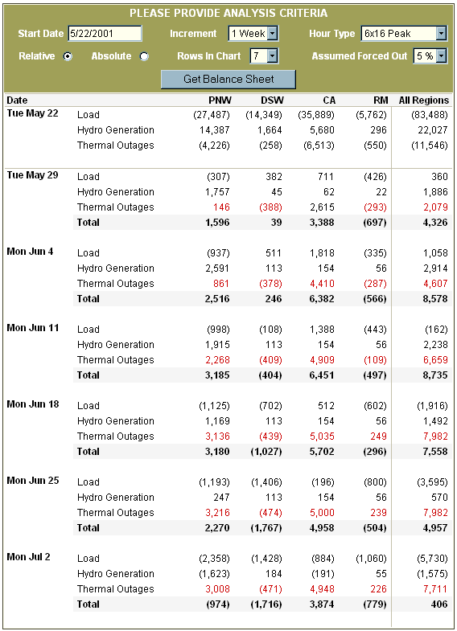

Slide 4
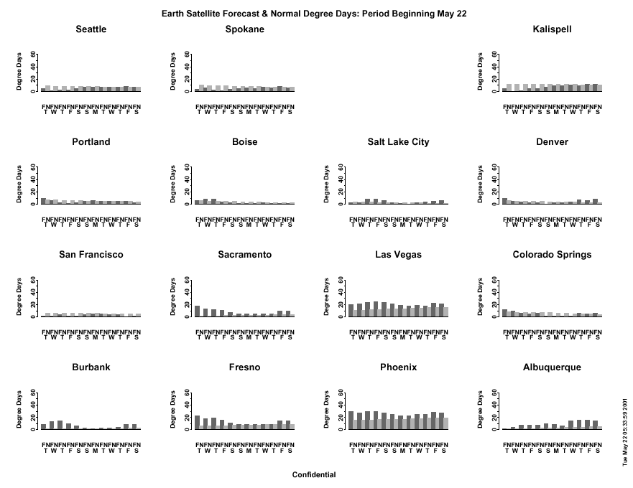

Slide 5
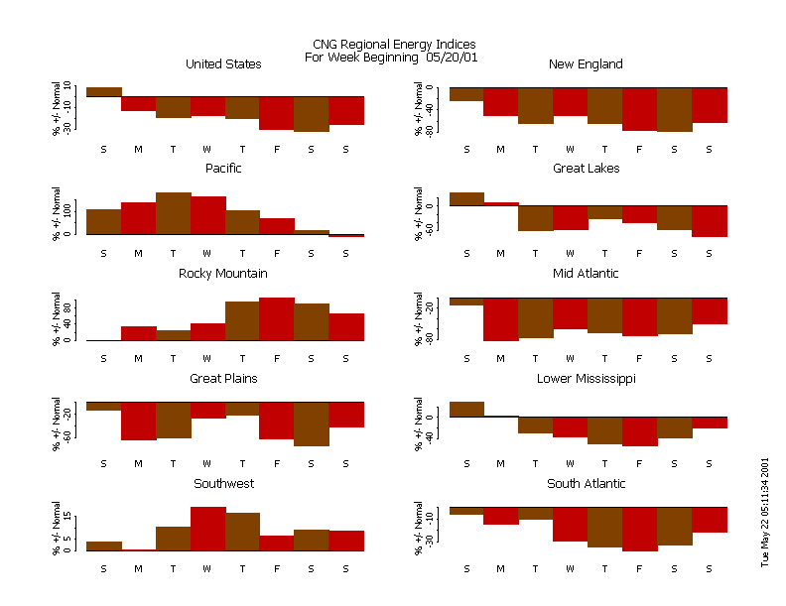

Slide 6
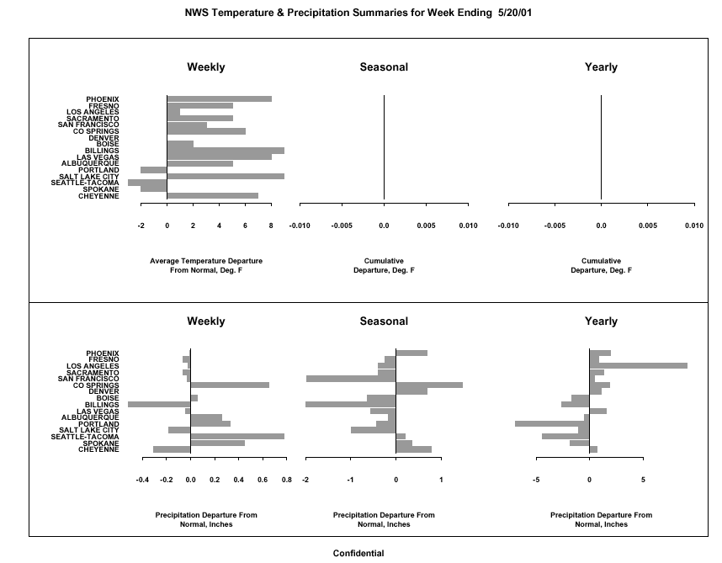

Slide 7
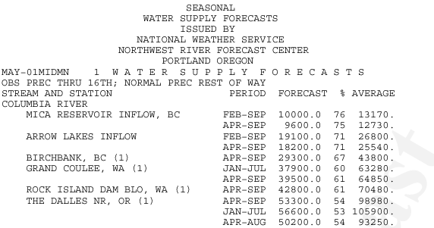

Slide 8
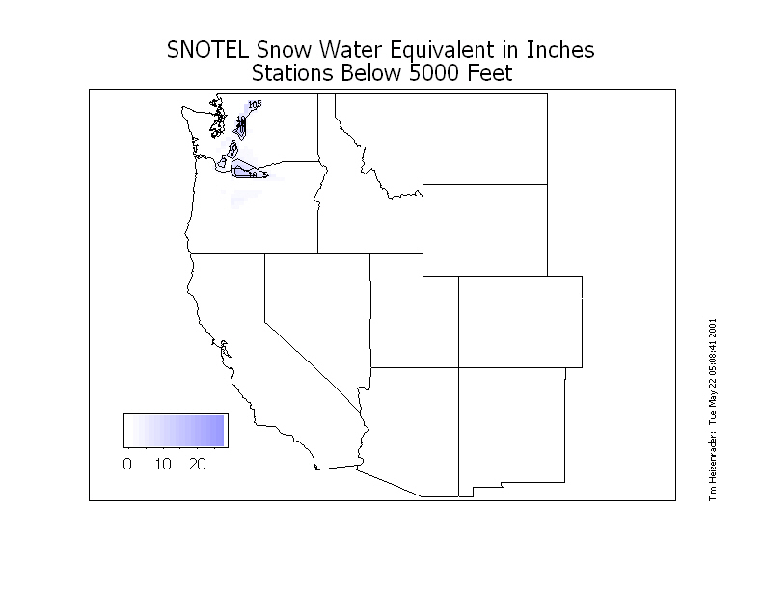
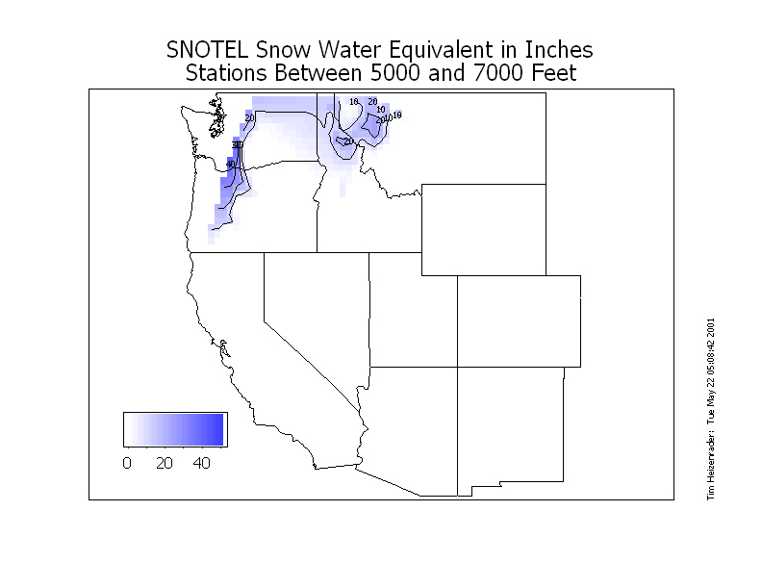
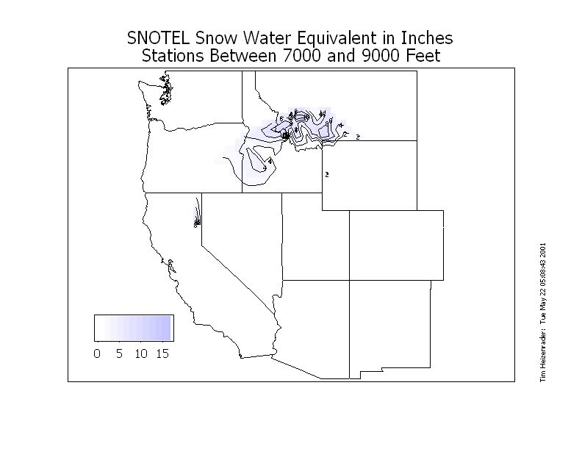
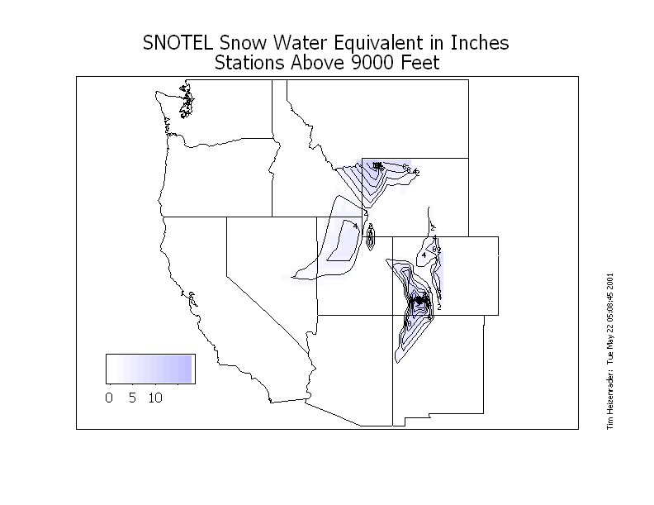
Remaining Snowpack
Only remaining prospect for forced rise in hydro production

Slide 9
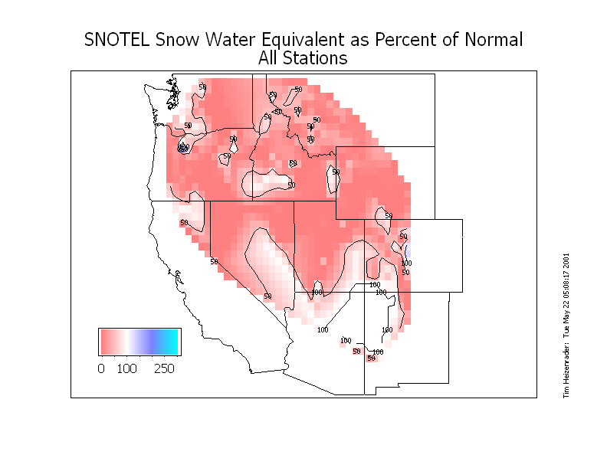

Slide 10
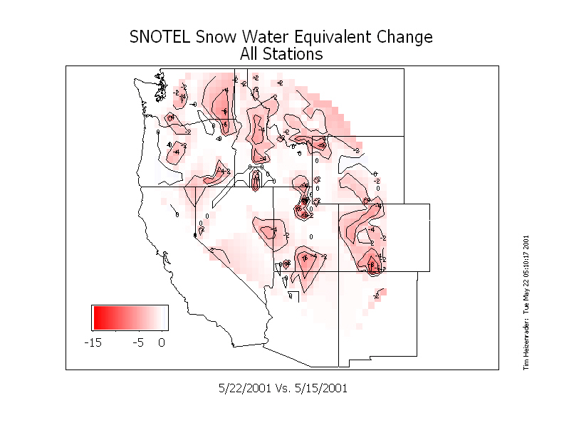

Slide 11
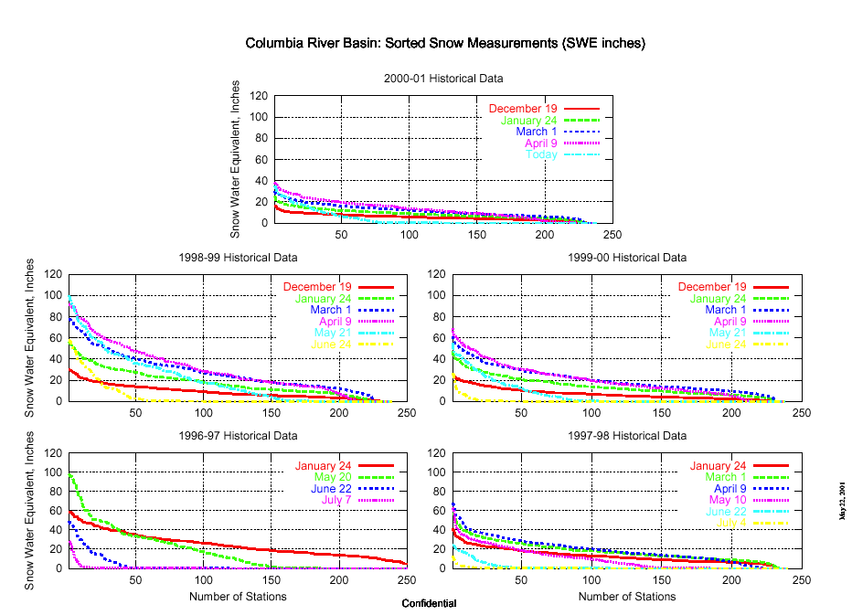
Fewer than half of basin gages reporting any snow

Slide 12
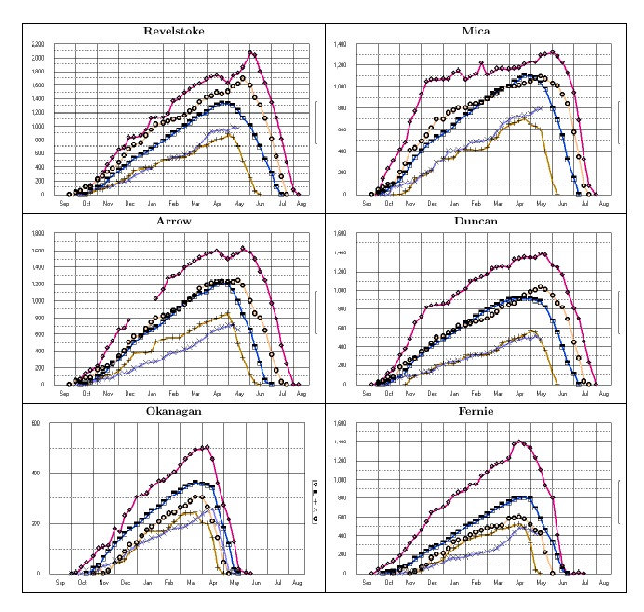

Slide 13
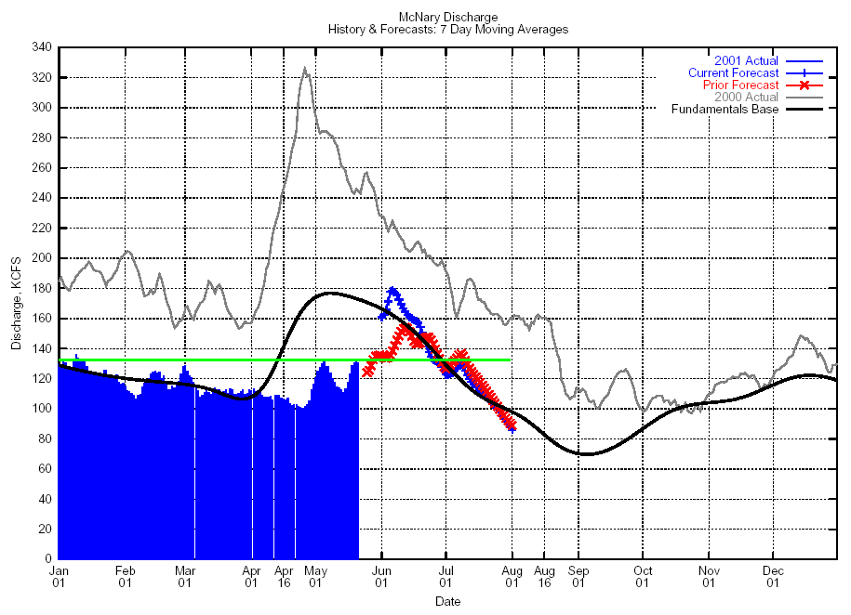
McNary Discharge Forecasts

Slide 14
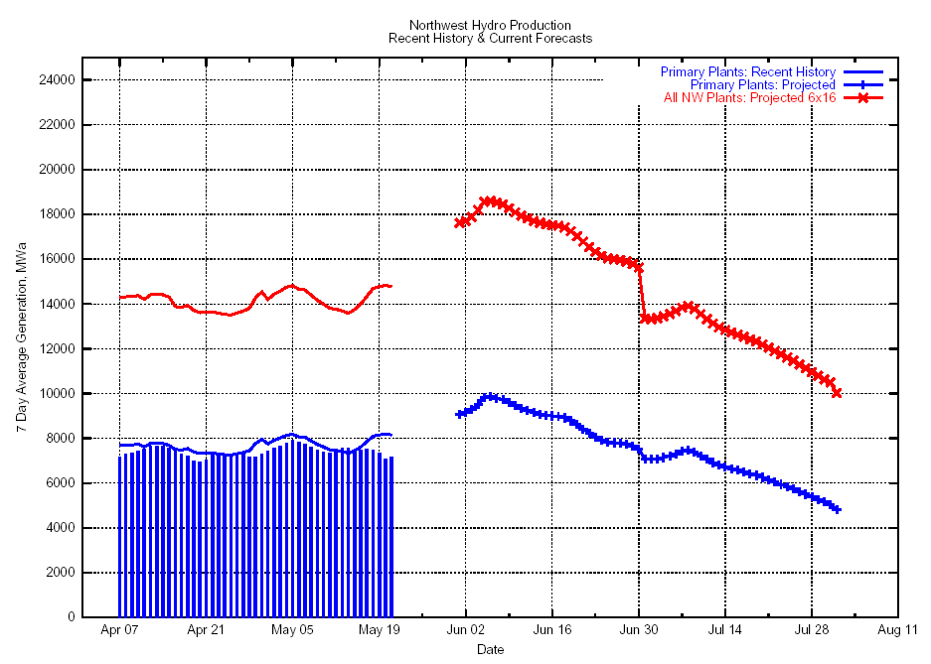
PNW Hydro Power Projection

Slide 15
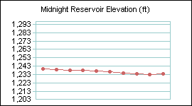
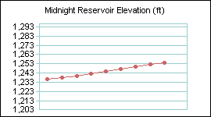
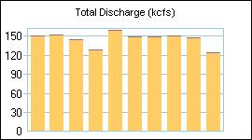
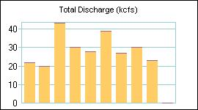
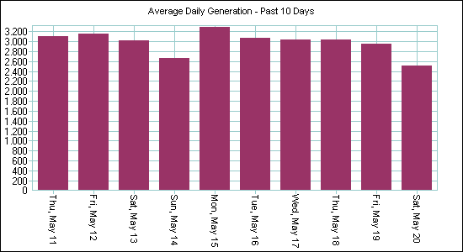
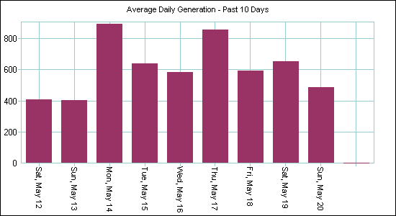
Grand Coulee Vs Year Ago
Y2K
Y2K+1
Reservoir refill 20 ft ahead of last year
Discharge cut below Hanford Reservation emergency minimum
Extended drawdown to provide spill, extra transport flow
2,938
Mwa/Week
545
Mwa/Week

Slide 16
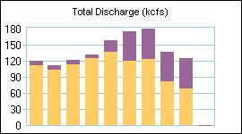
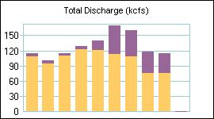
Special 2001 Federal Spill
Flat 230 MWa @ BON
Shaped 250 MWa @ TDA
300 MW-Mo supplies 19 days @ current rates
Likely ends June 4

Slide 17
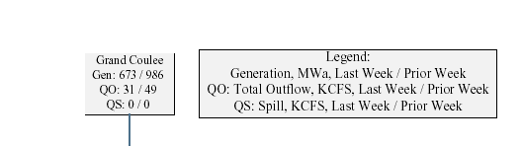
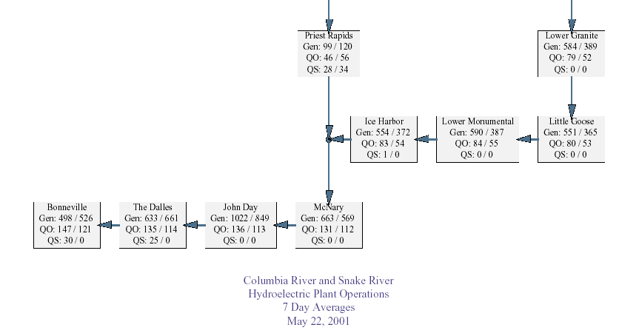

Slide 18
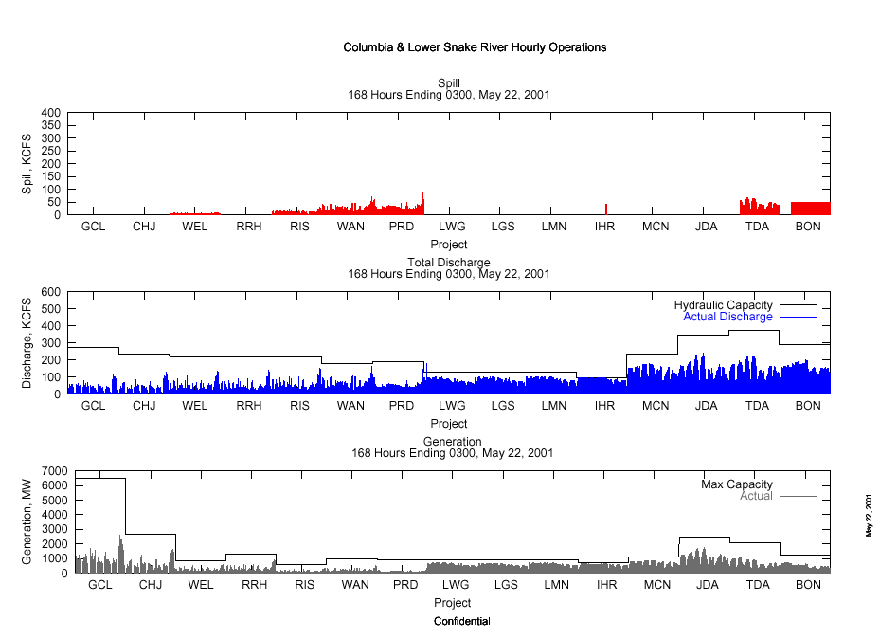

Slide 19
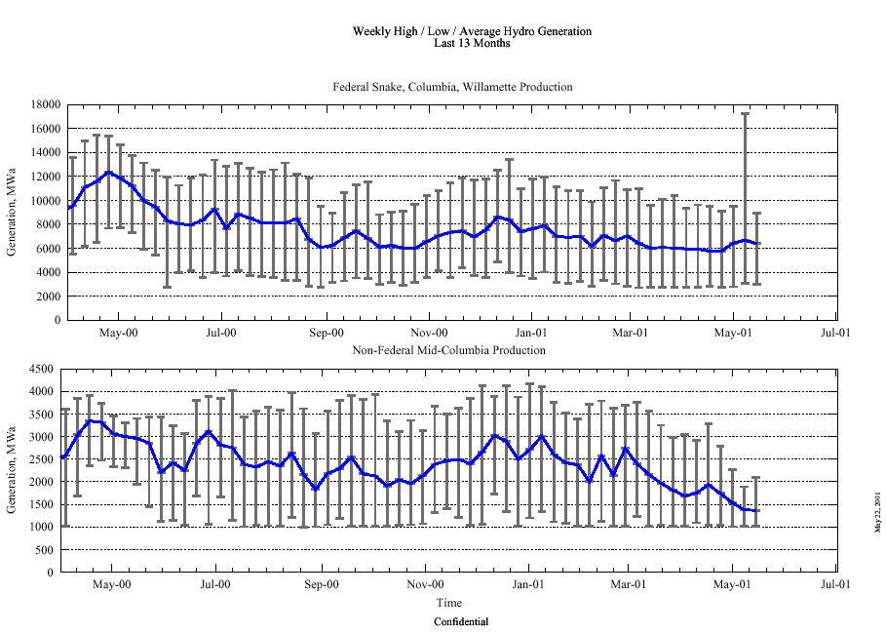

Slide 20
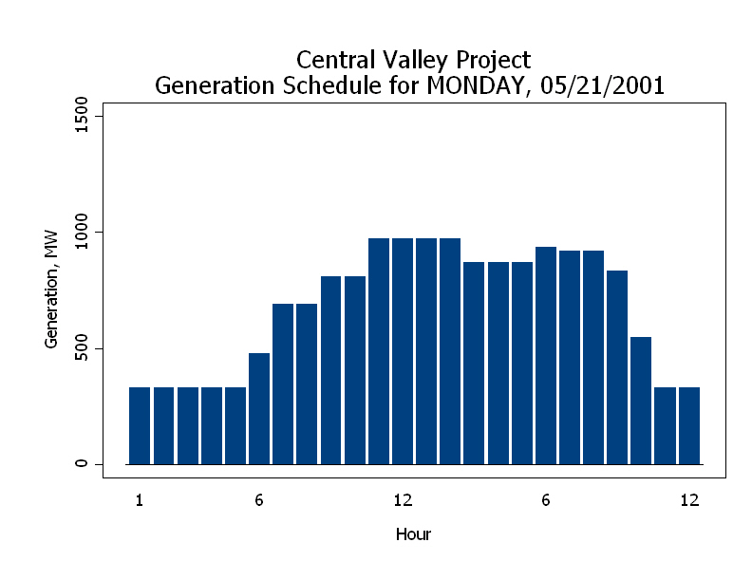

Slide 21
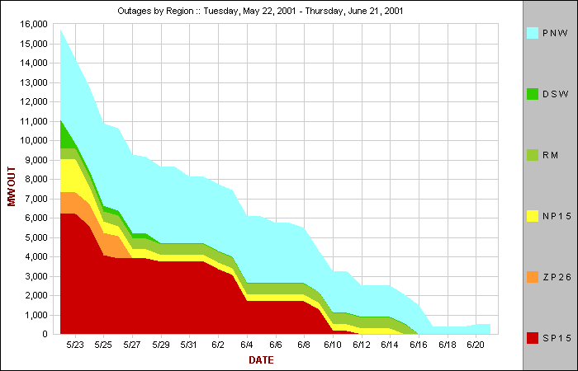

Slide 22
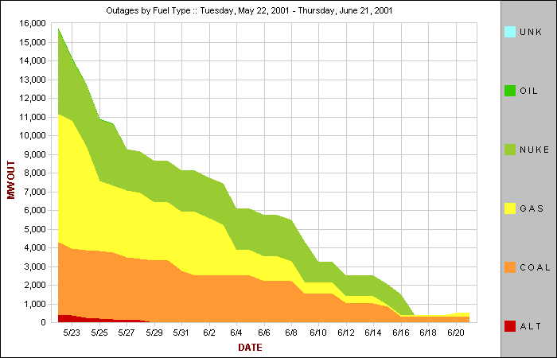

Slide 23
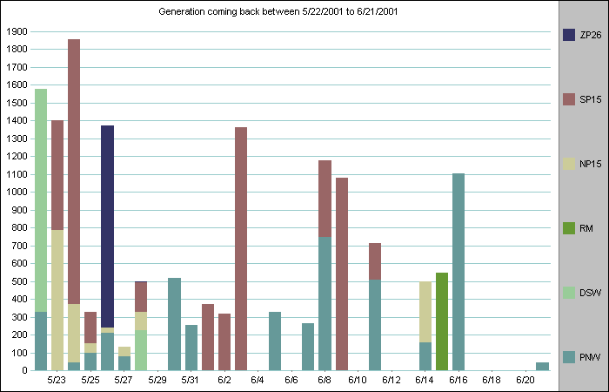

Slide 24
2001 Fire Tracking
Drought increases risk, extends season
Drug labs heighten risks
Oregon, Washington spared last year, at risk now
California declares season open today
New online systems help pinpoint sites
Kathy Sheppard monitoring all news, stats
Fundamentals will overlay transmission, notify traders

Slide 25
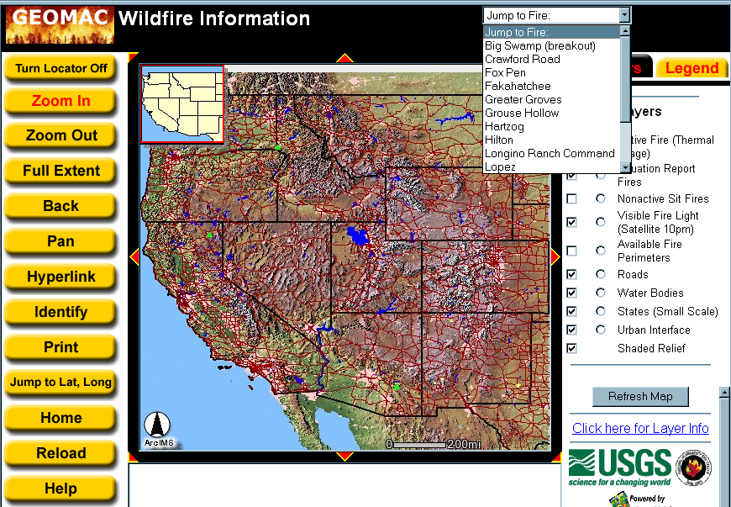
Improved Systems for 2001

Slide 29
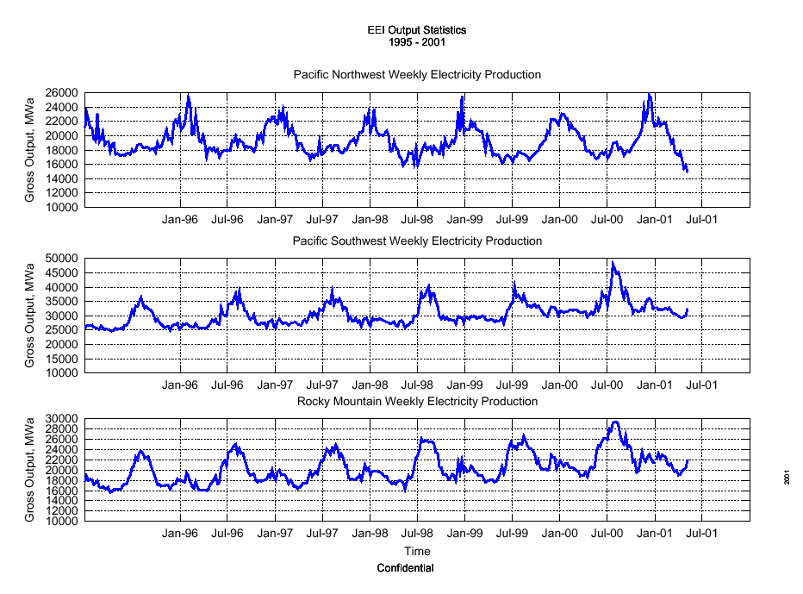
Through May 6
California & Rockies showing seasonal, production upturn, but Northwest still down; Northwest Power Pool control area stats have loads off 3,900 MWa from year ago.

Slide 30
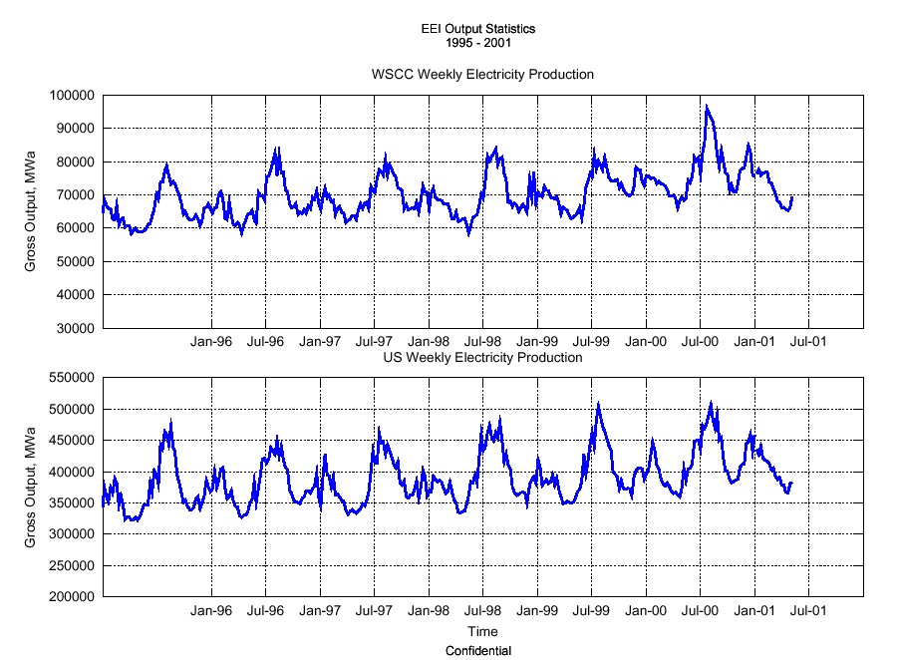
Through May 6

Slide 32
