Slide 1

W
EST
P
OWER
F
UNDAMENTALS
B
RIEFING
11/01/01

Slide 2
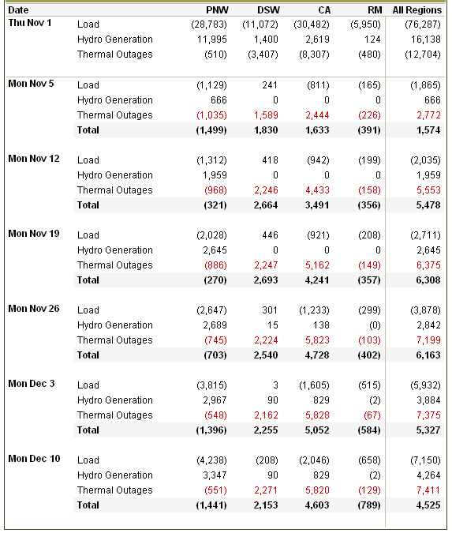
Load / Resource Balance

Slide 3
Load Growth Model
CAISO Annual Load Growth
Adjusted for Temperature and Time of Use
October 2001
*Weighted Average ALL Hours: -2.1%
*Weighted Average PEAK Hours: -2.0%

Slide 4
Updated L/R Adjustments
*Significant decrease in conservation

Slide 5
Timeline Locator

Slide 6
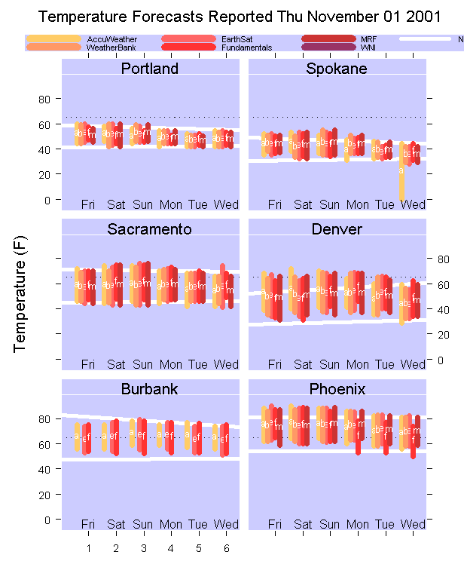
Temperature Forecast Comparison

Slide 7
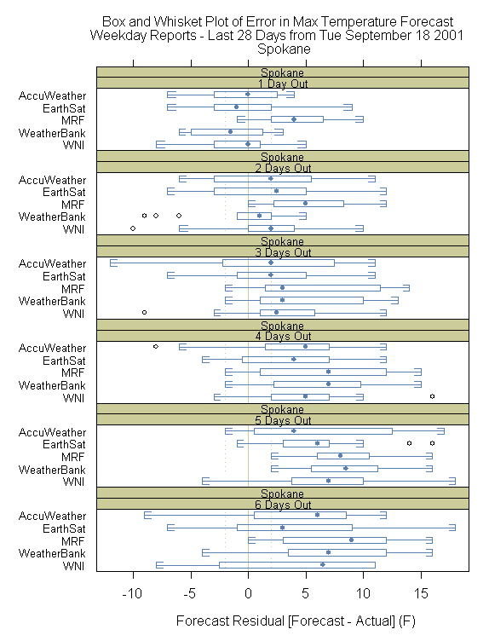
Warm Forecast Bias Persists

Slide 8
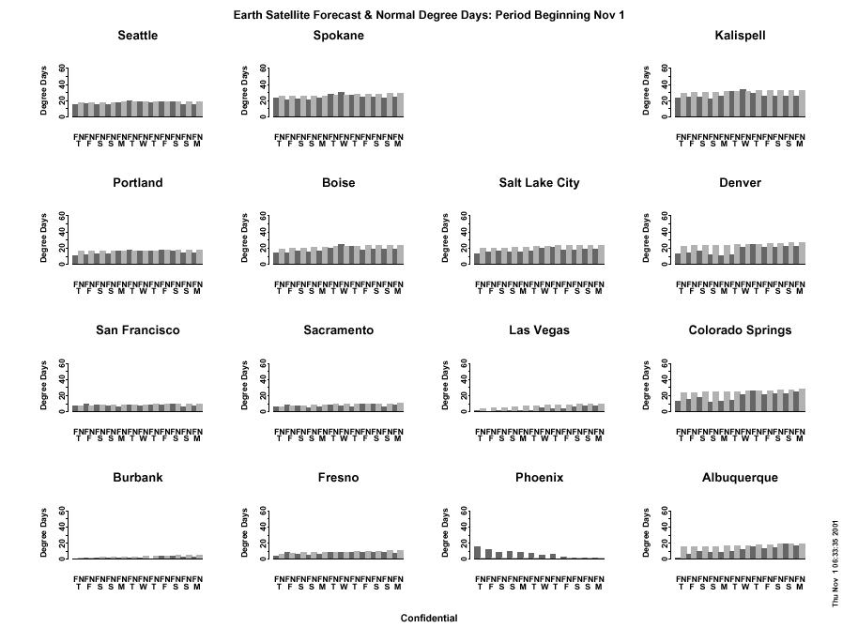
EarthSat Medium Range Forecast

Slide 9
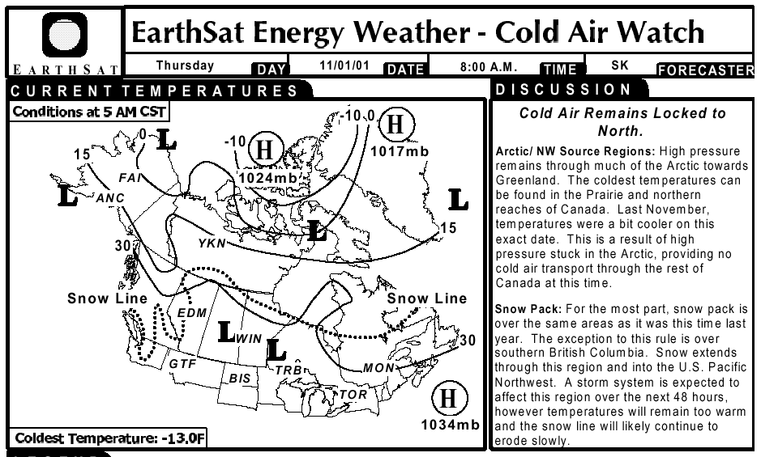
EarthSat Cold Air Watch Activated

Slide 10
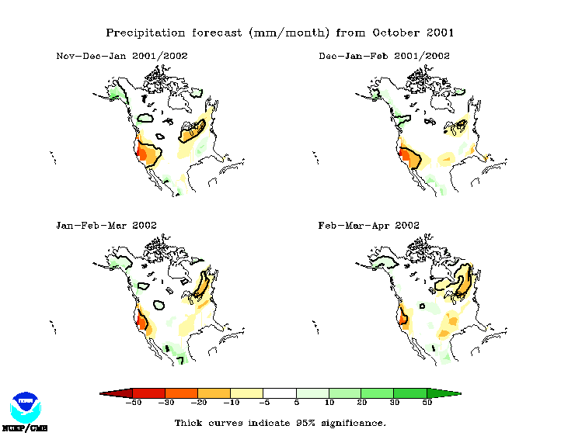
Global Climate (Super) Model
Columbia basin in BC slightly above normal first half of winter…
Very dry in California throughout winter…

Slide 11
Smith Barney 2001-02 Winter Outlook
PRECIPITATION
*Negative PDO + Neutral SST
Western Dry Bias
“Based on our analysis of SSTs and the PDO, we expect below-normal precipitation totals for most of the western portion of the U.S. and for southwest Canada between now and spring of 2002”
*Particularly in Southwestern US

Slide 12
Vs. The Dalles History..

Slide 13
Smith Barney 2001-02 Winter Outlook
SUMMARY
*Rank in coldest third of winters
*Very similar to last winter
*Temperature variability will occur
*1st half not extremely cold, 2nd half somewhat colder
*Last winter temperature rank 24 coldest of 106 winters
-This year’s rank: 20-30 range

Slide 14
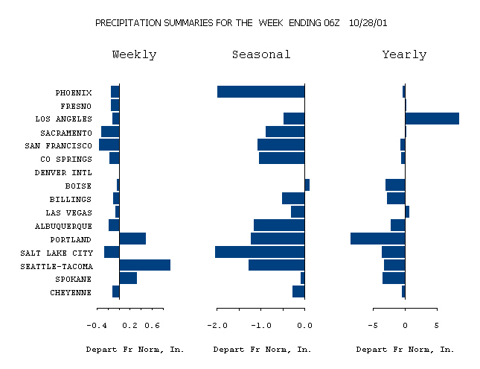
Precipitation Summary

Slide 15
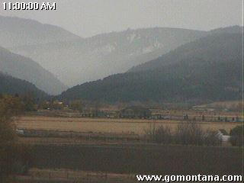
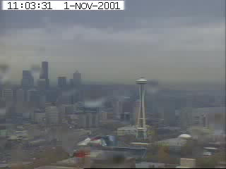
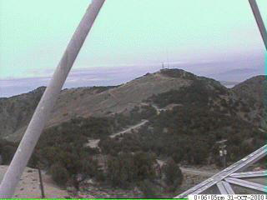
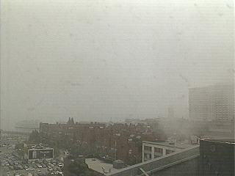
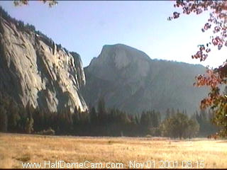
It’s now wet where the people are…
Bozeman, MT
…but dry in the interior.
Seattle, WA
Salt Lake City, UT
San Francisco, CA
Yosemite

Slide 16
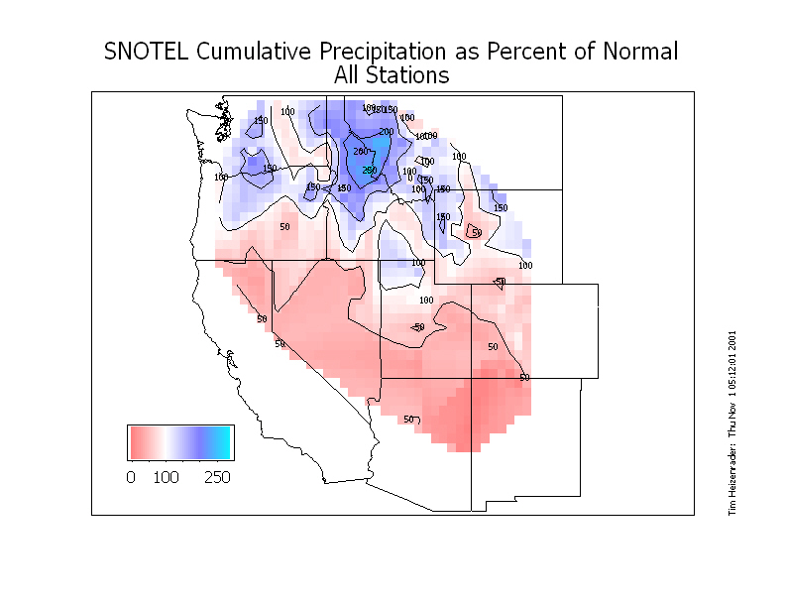
Early Precipitation Encouraging PNW

Slide 17
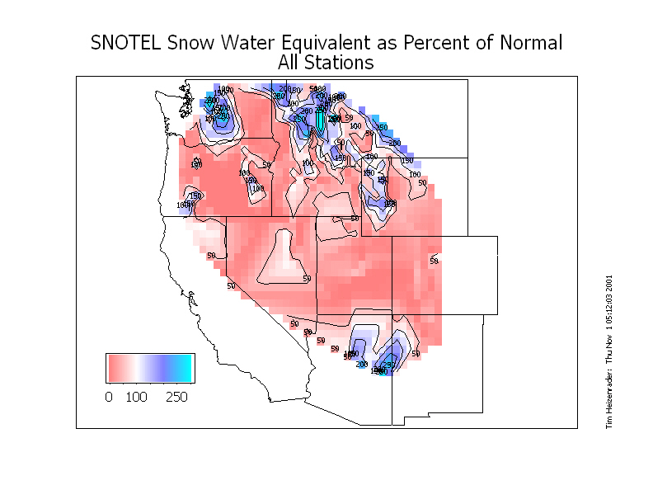
Snow Retention Variable By Subregion

Slide 18
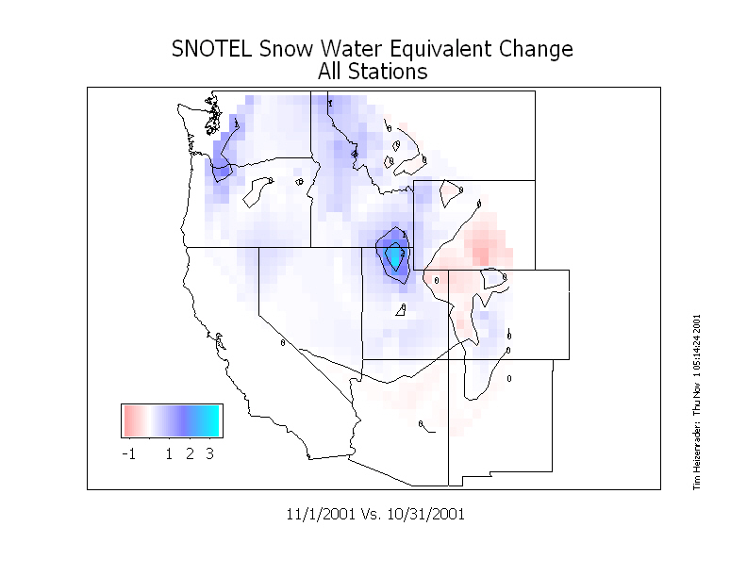
One Day Snowpack Changes

Slide 19
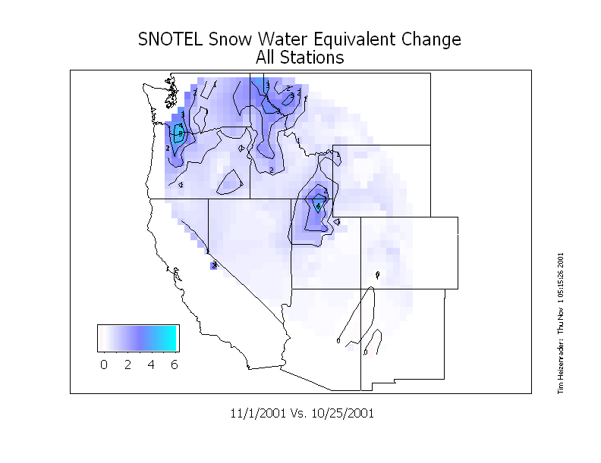
One Week Snowpack Changes

Slide 20
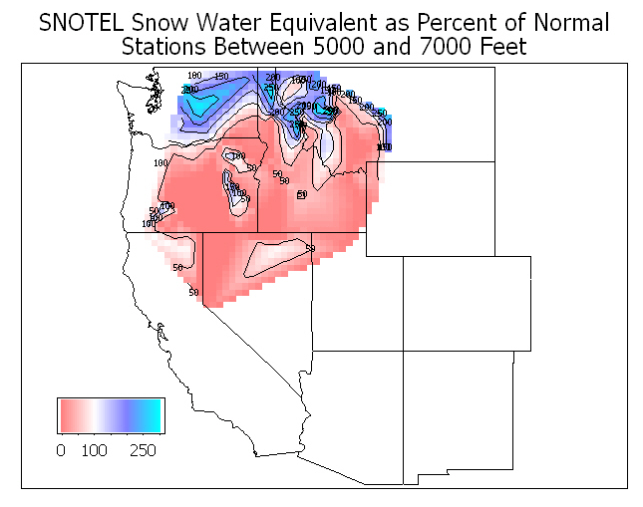
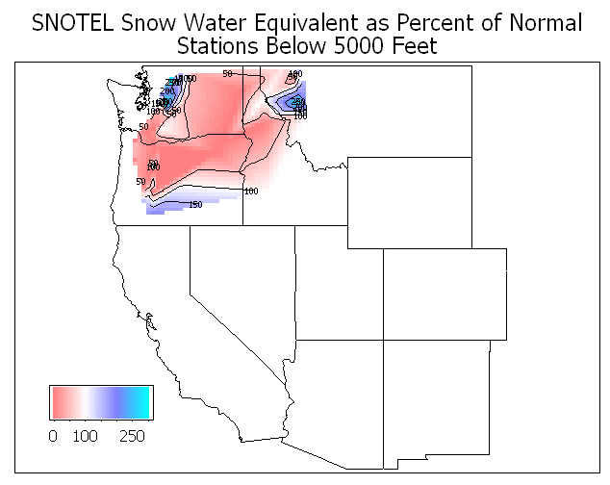
Early Snow Accumulation
Expect to lose 25% to 50% of snowpack in the 5000 to 7000 foot range by December 1
Expect to lose all snowpack below 5000 foot range by December 1

Slide 21
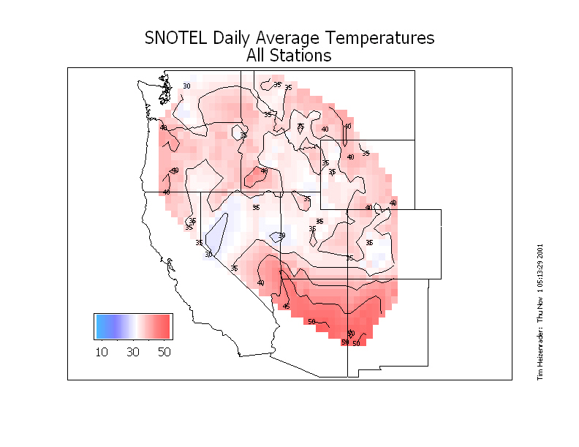
Warm Temperatures Continue Erosion

Slide 22
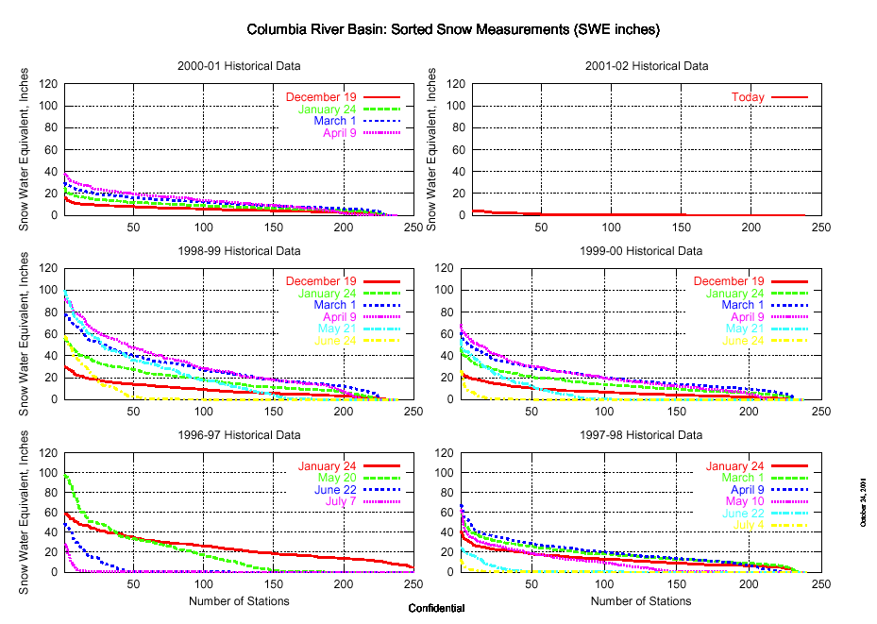
Sorted Columbia Snow Gages

Slide 23
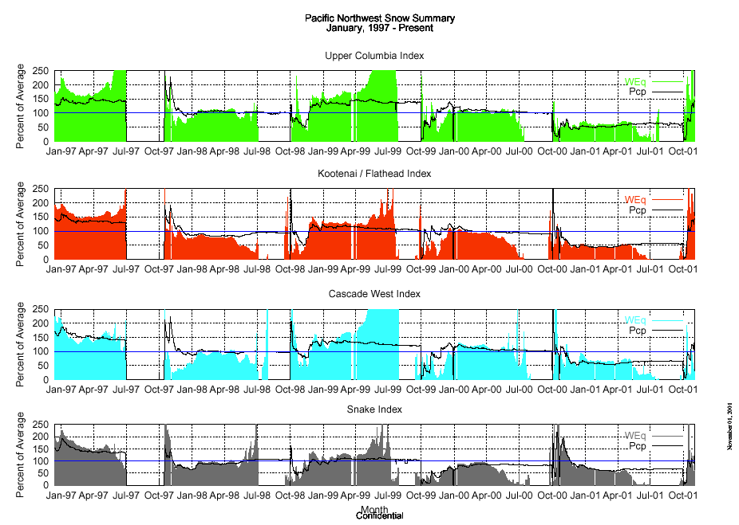
Columbia Basin Snow Indexes

Slide 24
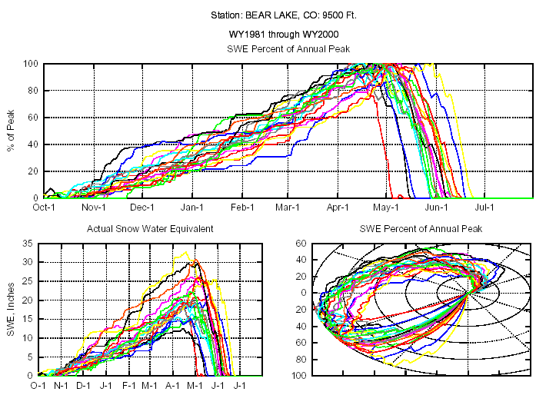
Snow Predictability: Good

Slide 25
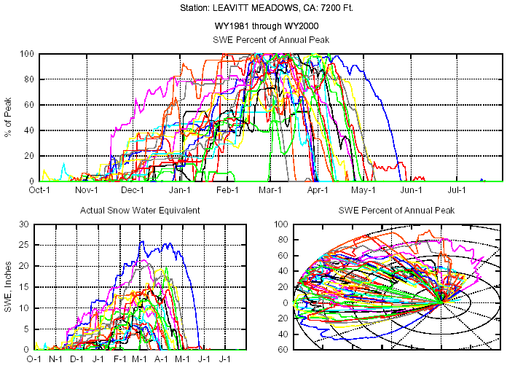
Snow Predictability: Ugly

Slide 26

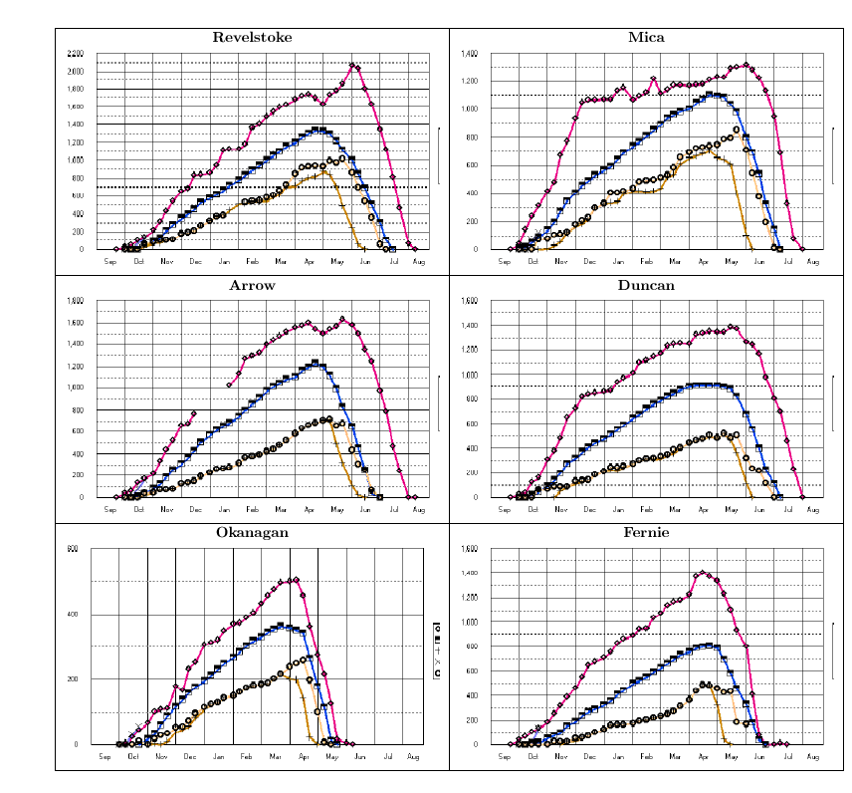
BC Snow Surveys

Slide 27
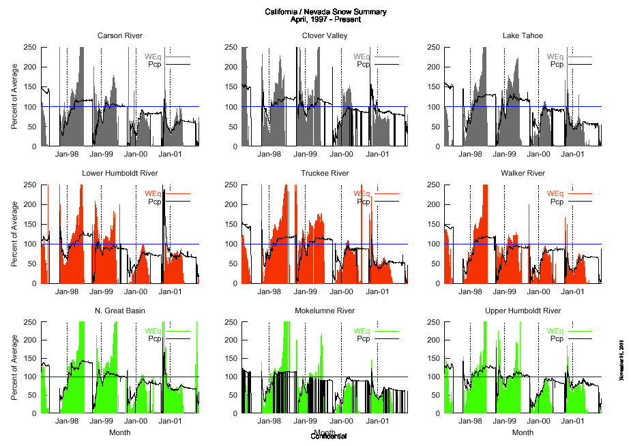
California Snow Survey

Slide 28
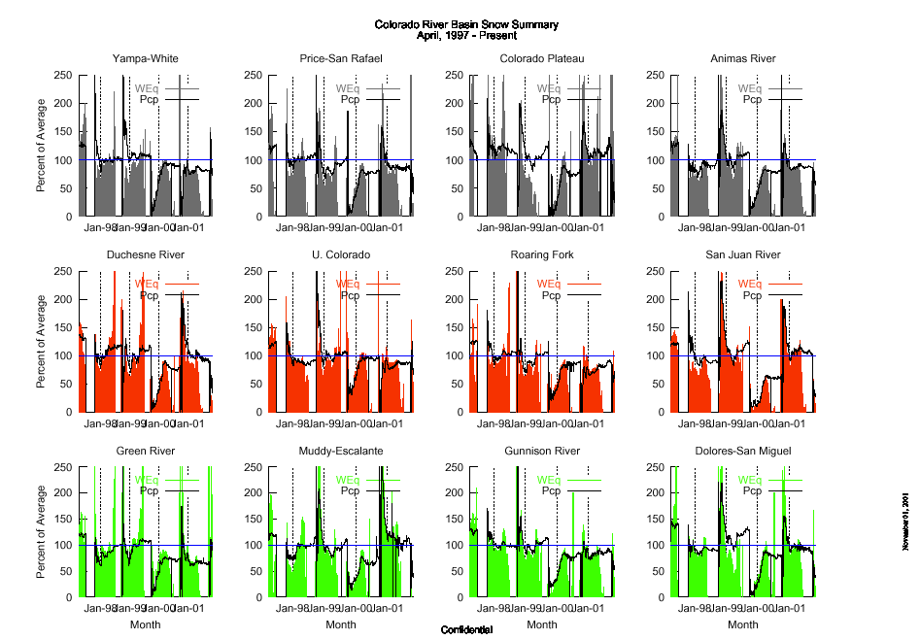
Colorado Snow Survey

Slide 29
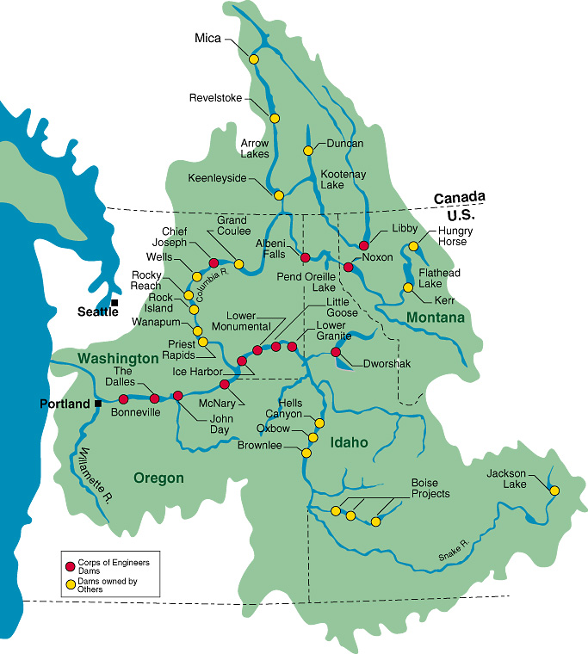
Primary PNW Hydro Generation
Lower Columbia Power Model Predictor
Mid Columbia Environmental Control Point
Lower Columbia Environmental Control Point

Slide 30
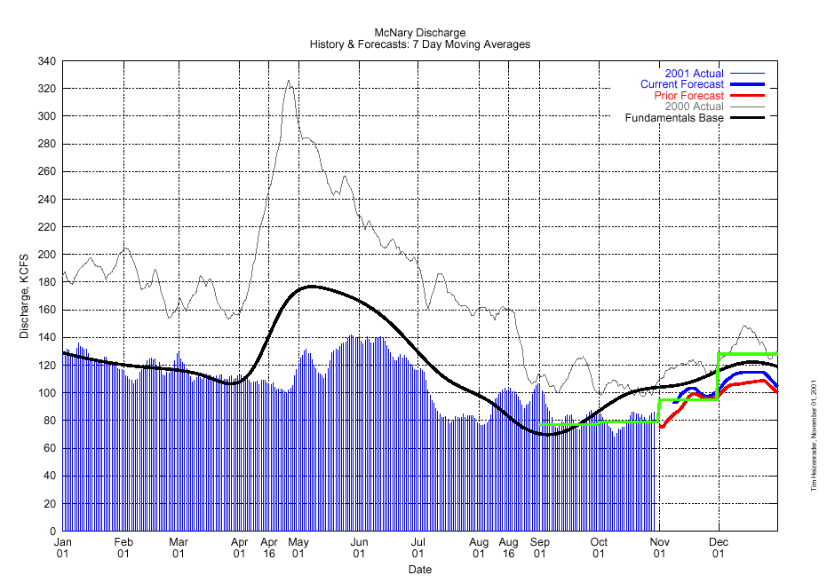
McNary Discharge Forecast

Slide 31
Special Autumn Hydro Operations

Slide 32
Pacific Northwest Hydro Index

Slide 33
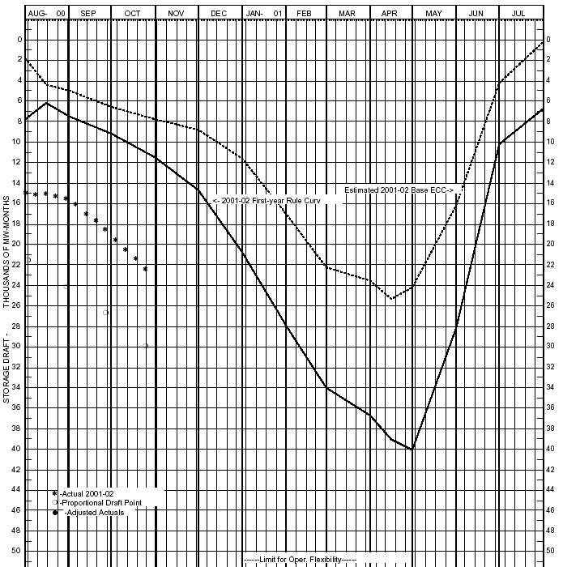

Current PNW Reservoir Status
AER Average Runoff Drawdown

Slide 34
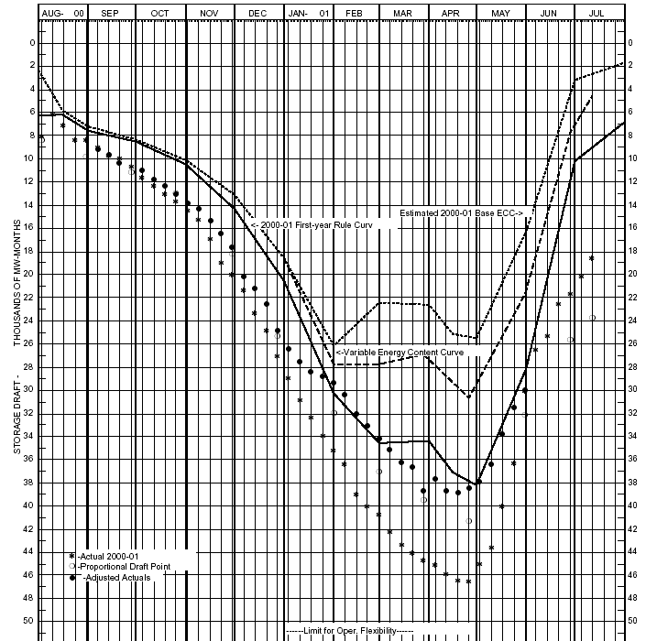

PNW Storage Operation Last Year

Slide 35
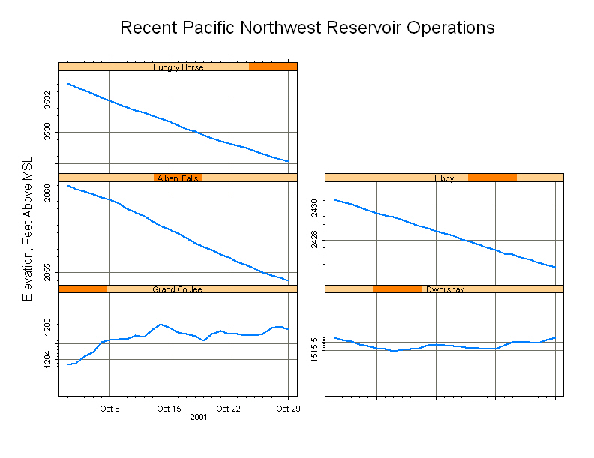
Recent Northwest Reservoir

Slide 36
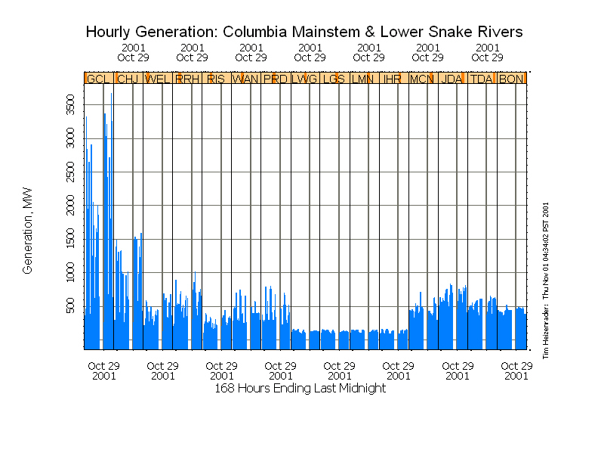
Hourly Columbia Generation

Slide 37
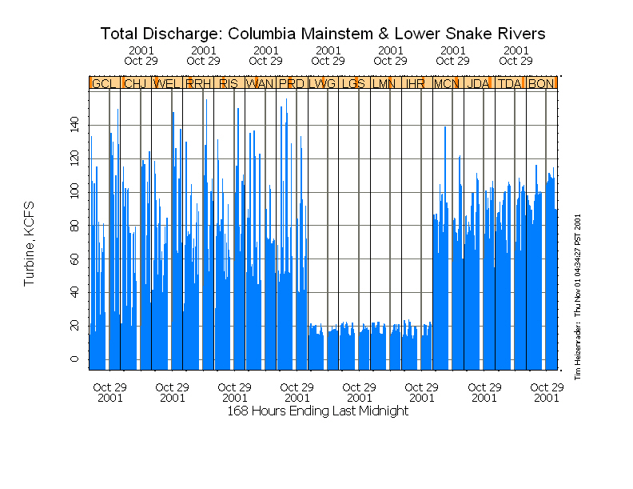
Hourly Columbia Discharge

Slide 38
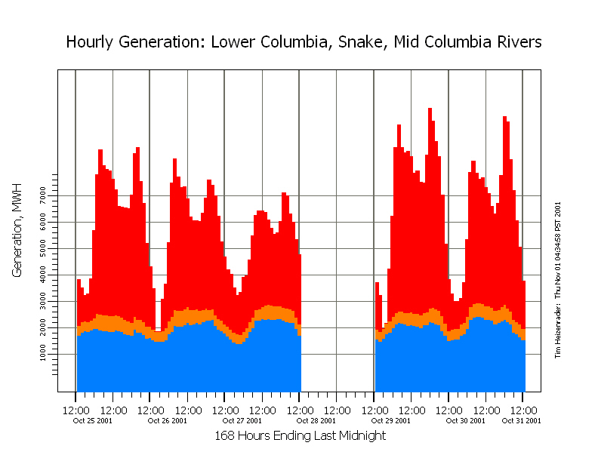
Total Primary Plant Generation

Slide 39
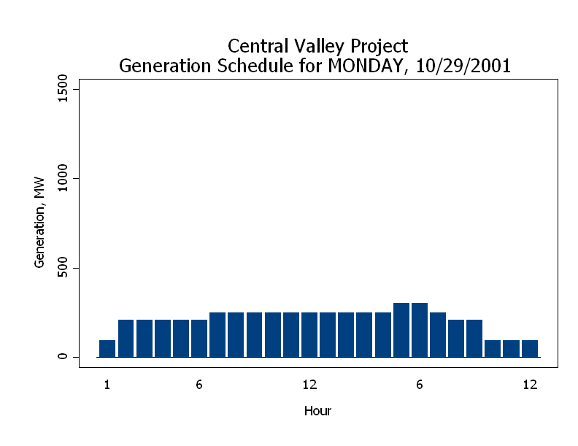
CVP Hourly Schedules

Slide 40
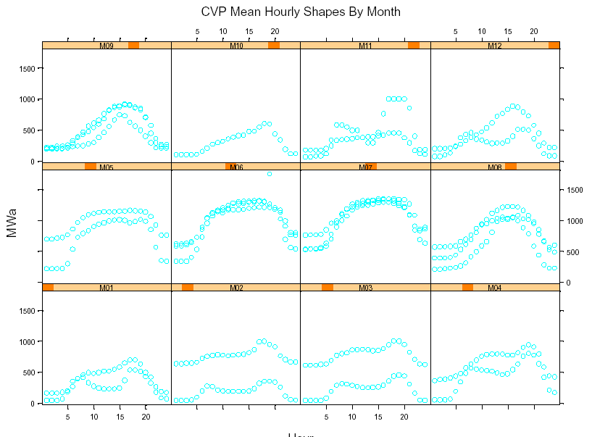
Historical CVP Hourly Generation

Slide 41
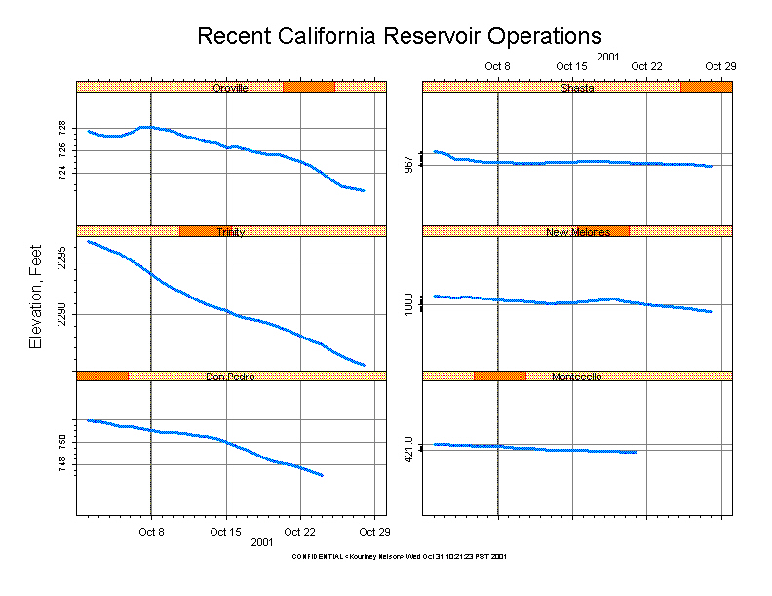
California Reservoir Status

Slide 42
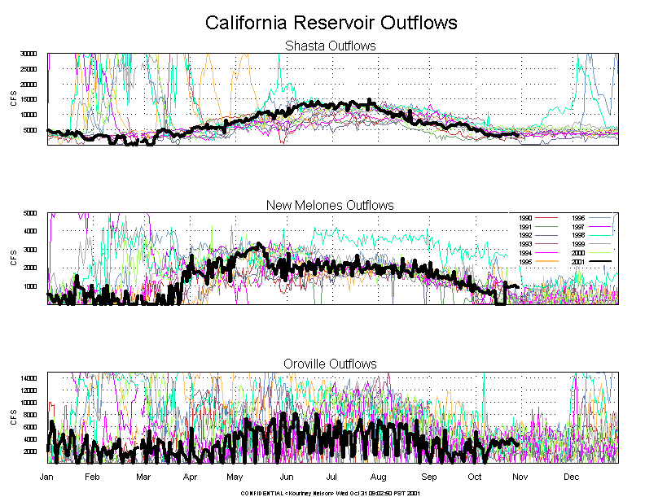
California Outflows

Slide 43
California Hydro Variability

Slide 44
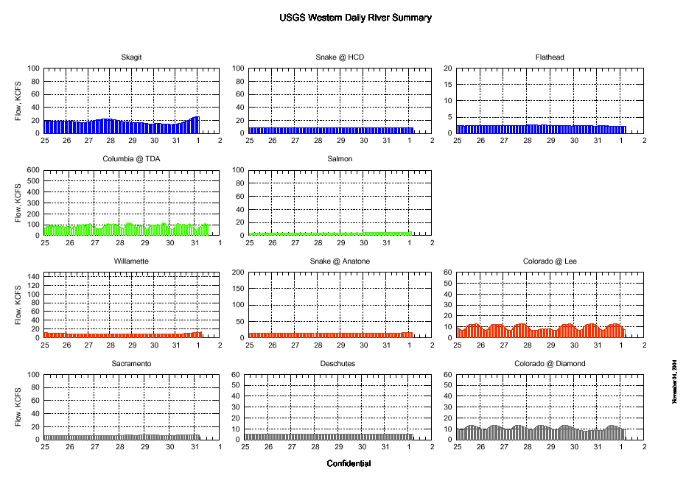
USGS Sttreamflow Reports

Slide 45
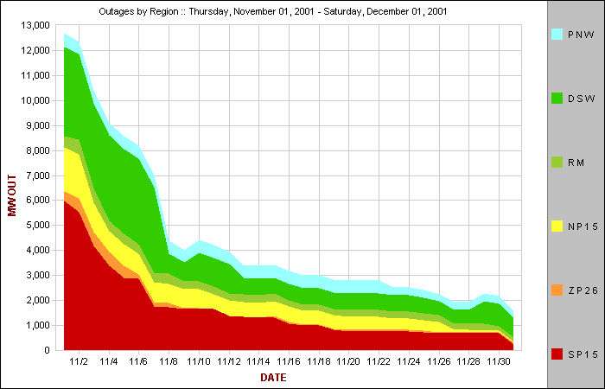
Thermal Unit Outages by Region

Slide 46
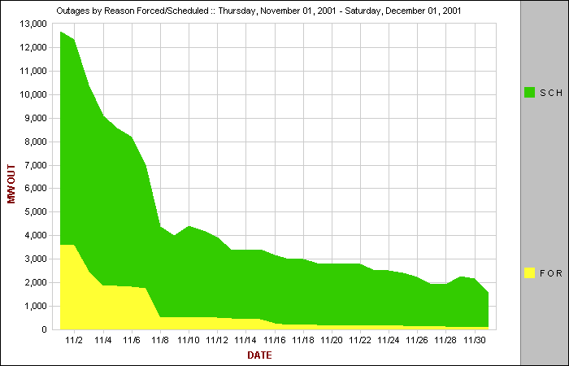
Thermal Unit Outages by Reason

Slide 47
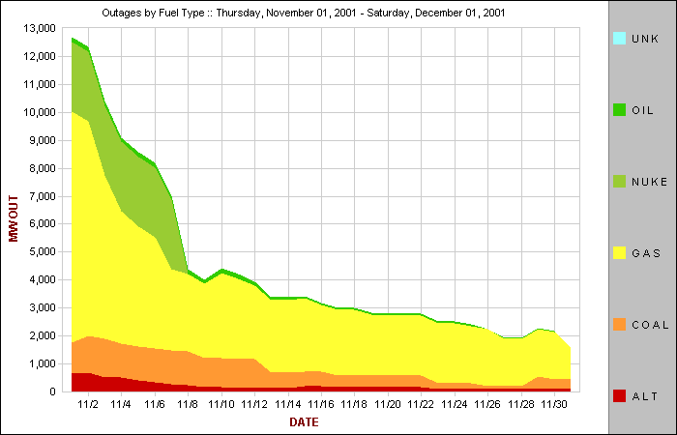
Thermal Unit Outages by Fuel

Slide 48
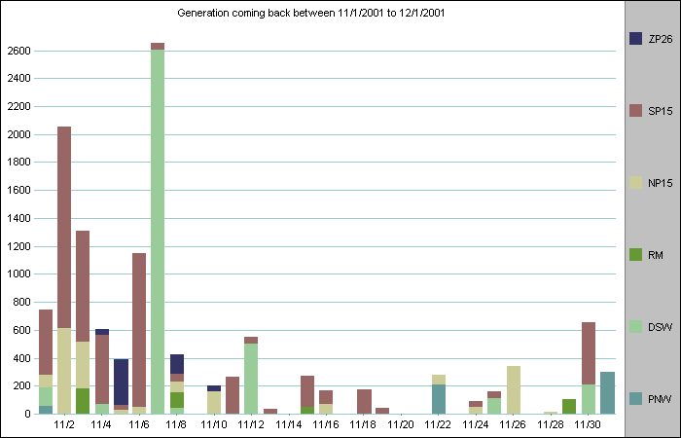
Schedule of Units Returning

Slide 49
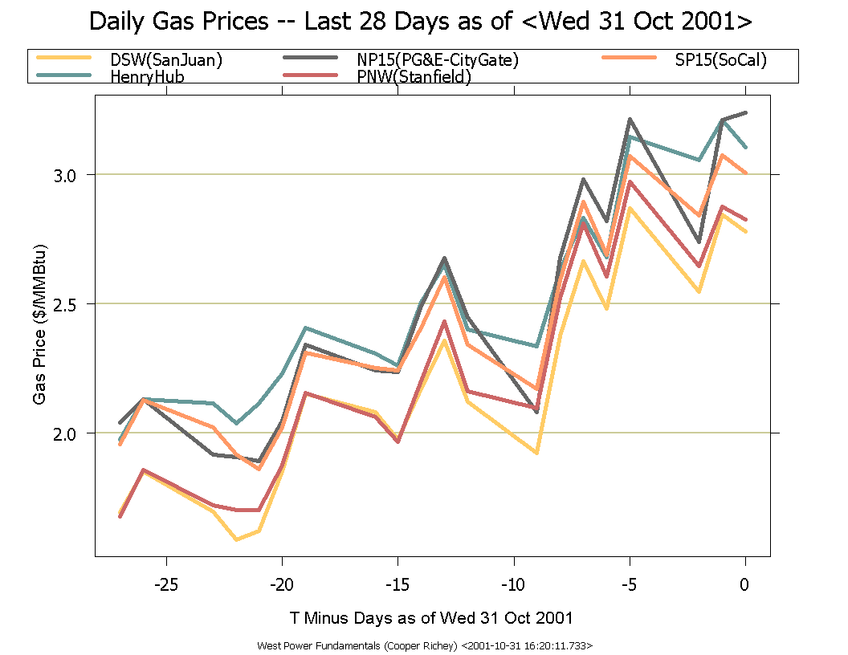
Recent Gas Prices

Slide 50
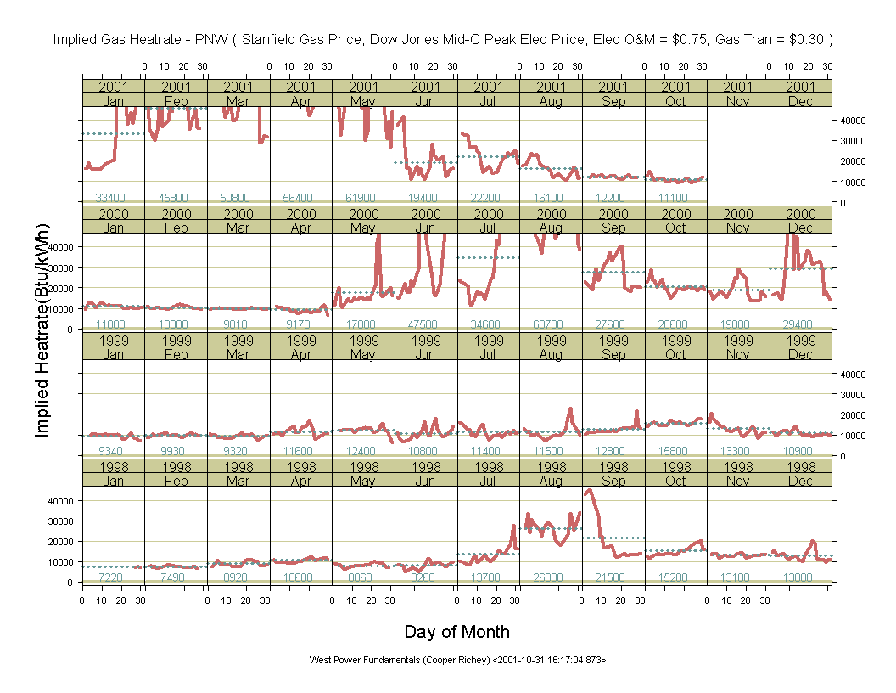
PNW Implied Heatrate

Slide 51
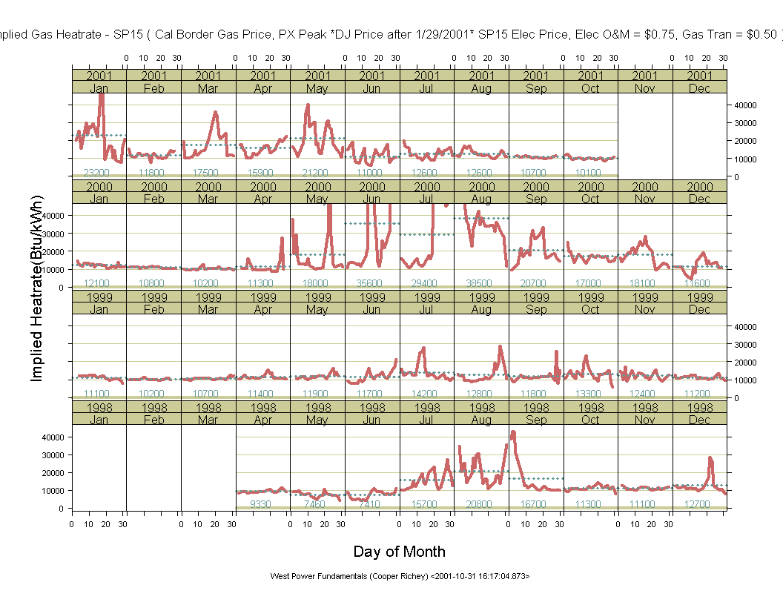
SP 15 Implied Heatrates

Slide 52
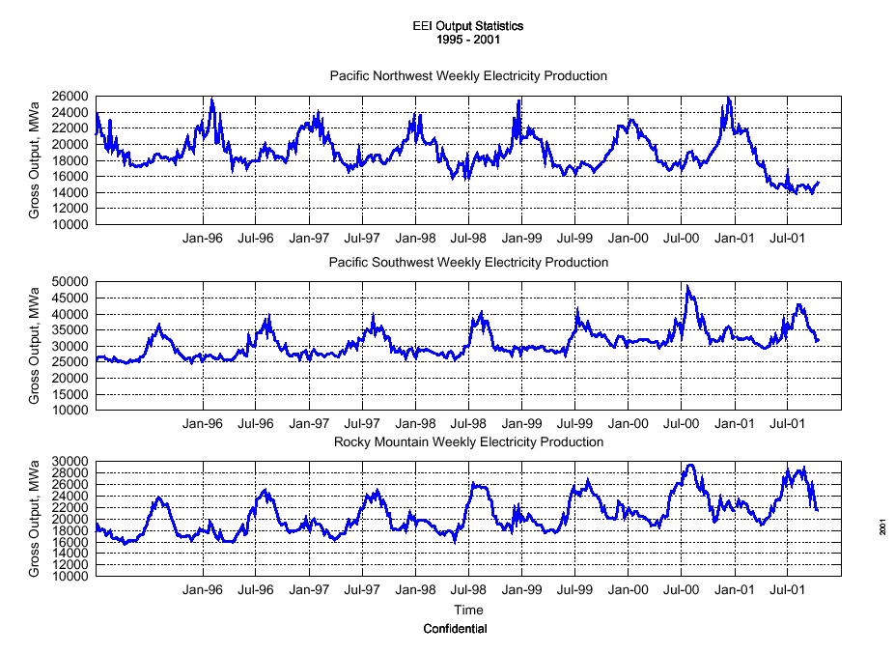
EEI Generation Statistics
Through Week of October 14

Slide 53
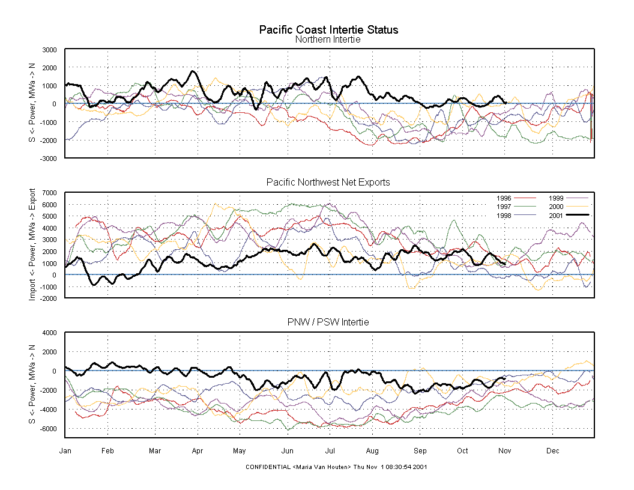
North / South Intertie Traffic

Slide 54
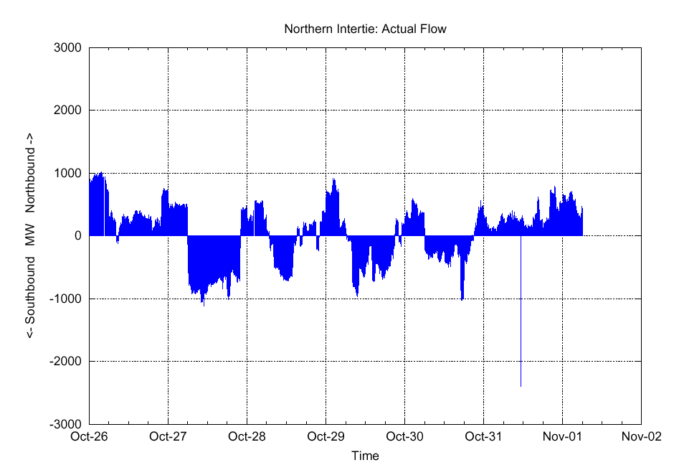
Recent Northern Intertie Traffic

