Slide 1

W
EST
P
OWER
F
UNDAMENTALS
B
RIEFING
10/9/01

Slide 2
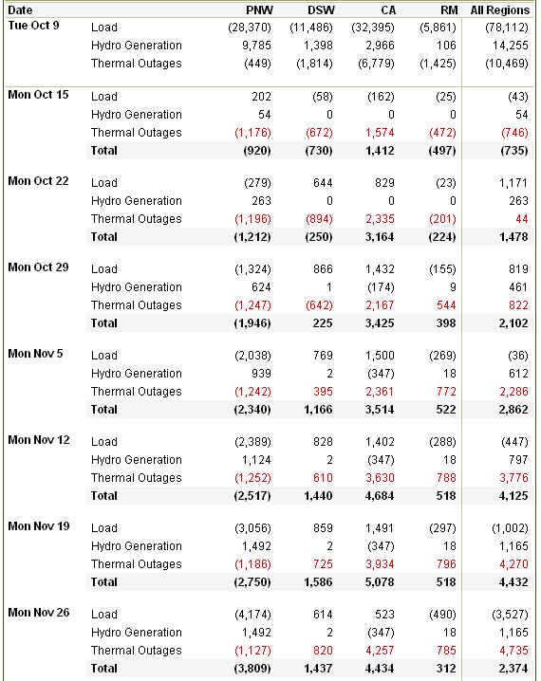
Load / Resource Balance

Slide 3
Updated L/R Adjustments
*Hydro numbers significantly worse
*New Generation online dates pushed back

Slide 4
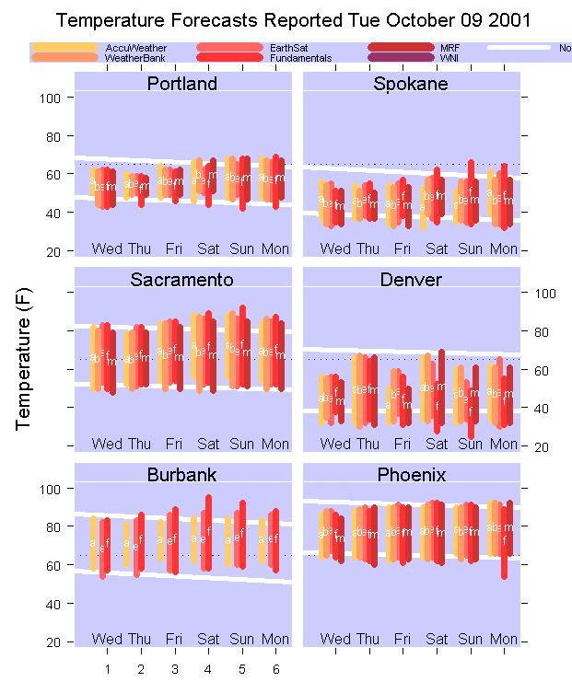

Slide 5
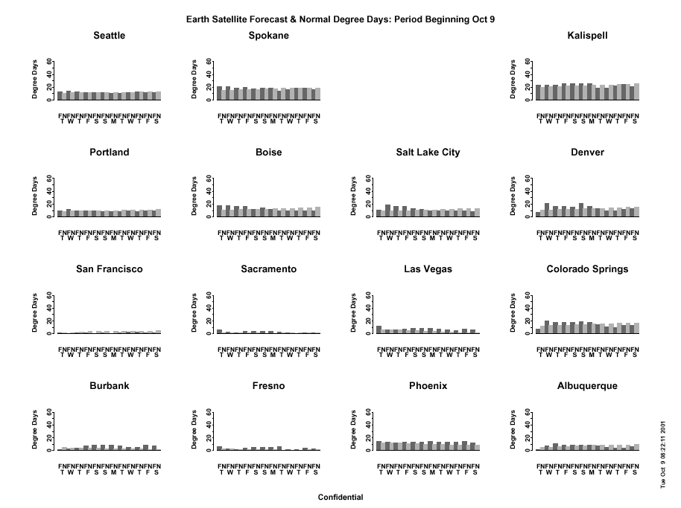

Slide 6
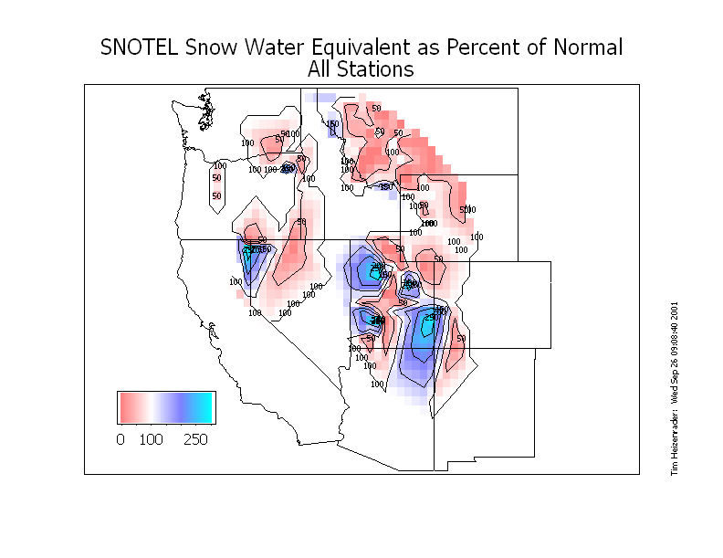

Slide 7
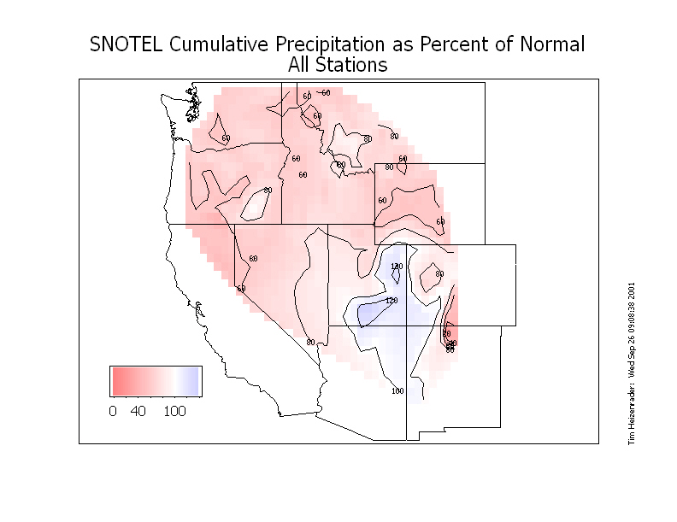

Slide 8
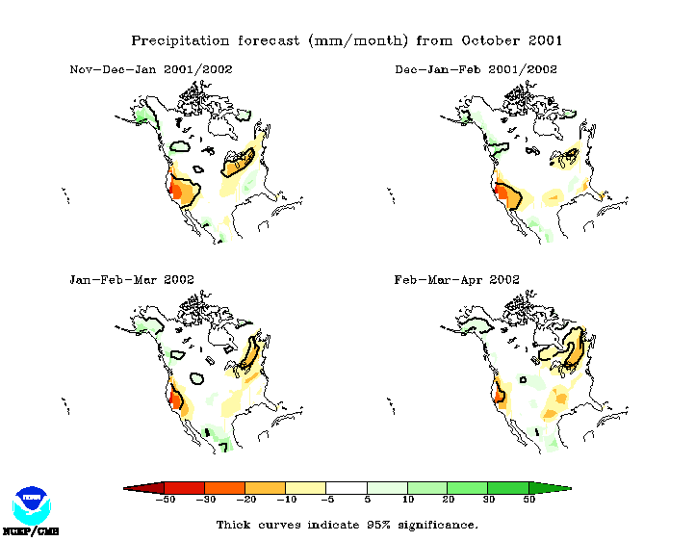
Global Climate (Super) Model
Columbia basin in BC slightly above normal first half of winter…
Very dry in California throughout winter…

Slide 9
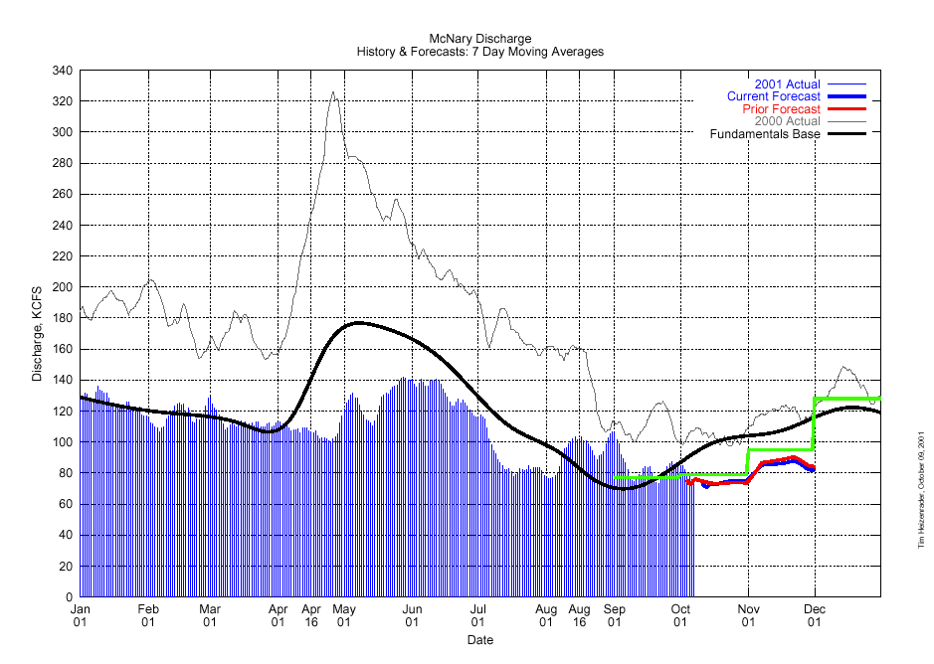

Slide 10
McNary Discharge

Slide 11
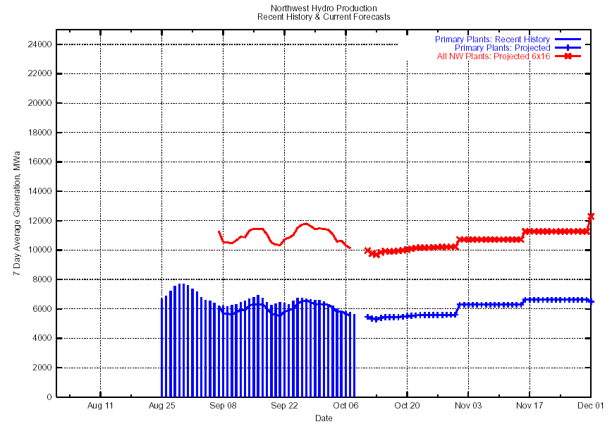
PNW Hydro Production

Slide 12
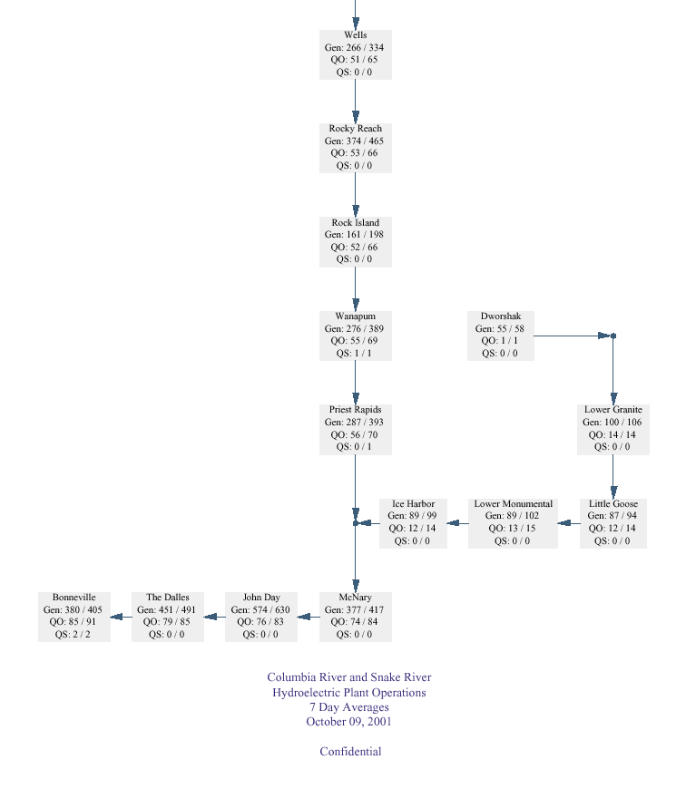


Slide 13
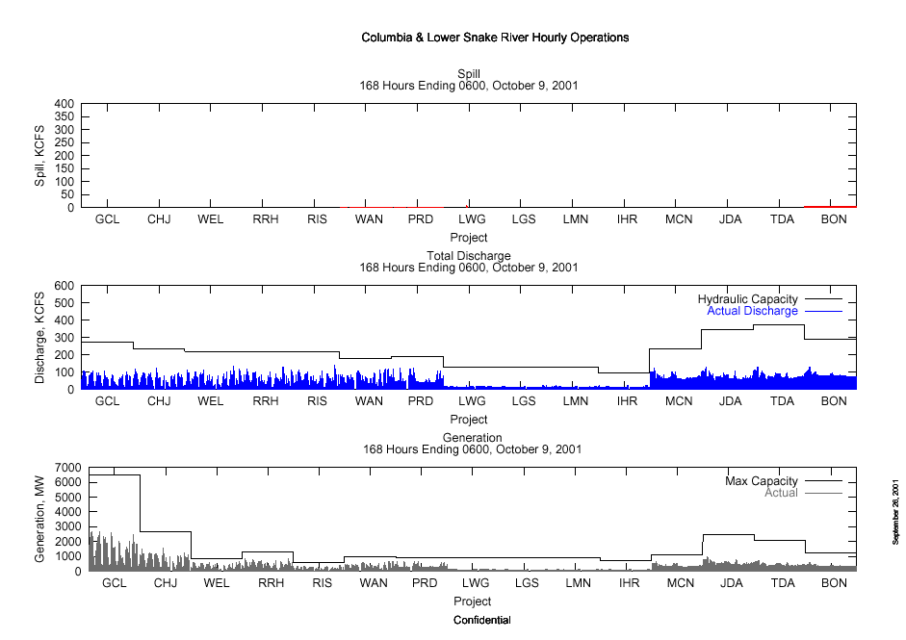

Slide 14
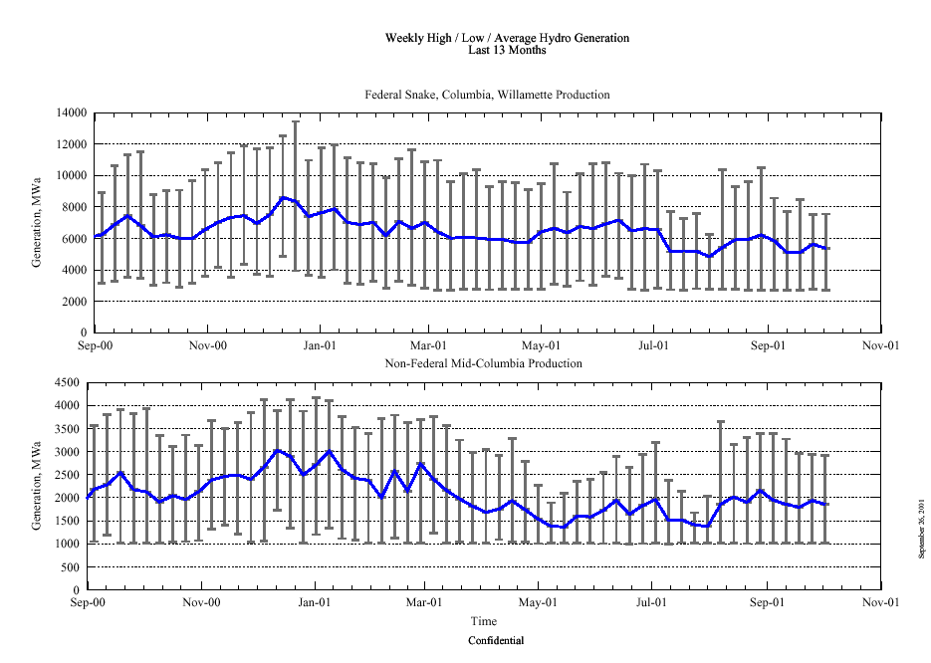

Slide 15
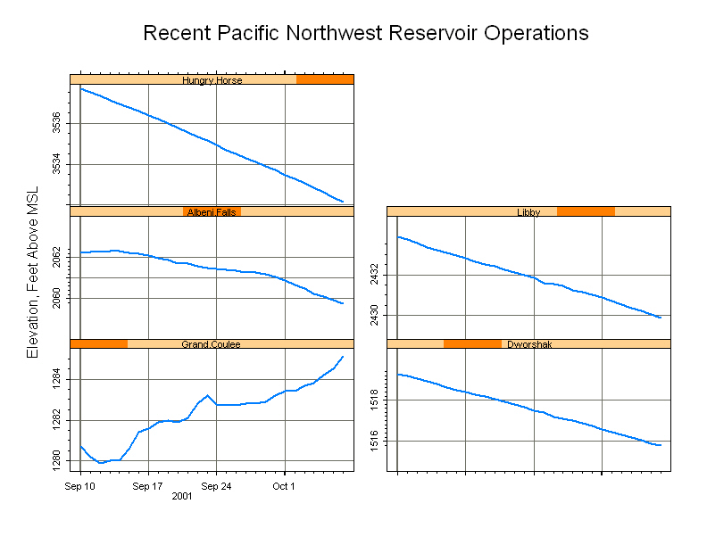

Slide 16
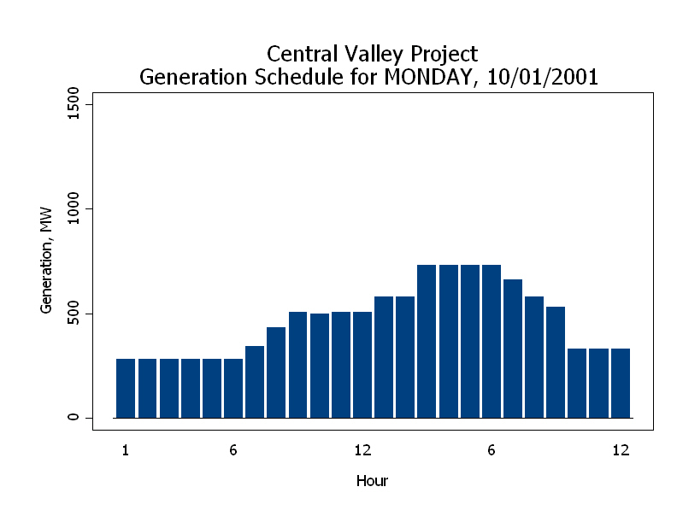

Slide 17
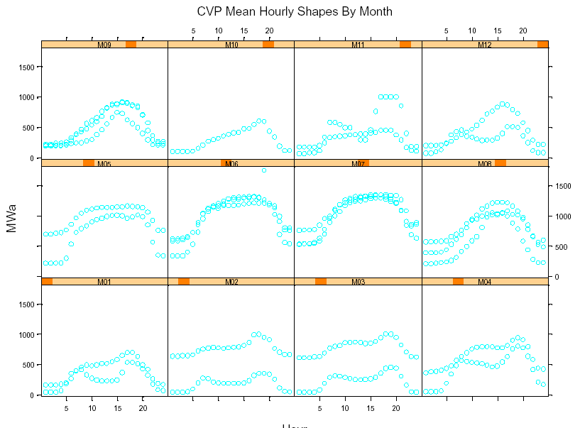

Slide 18
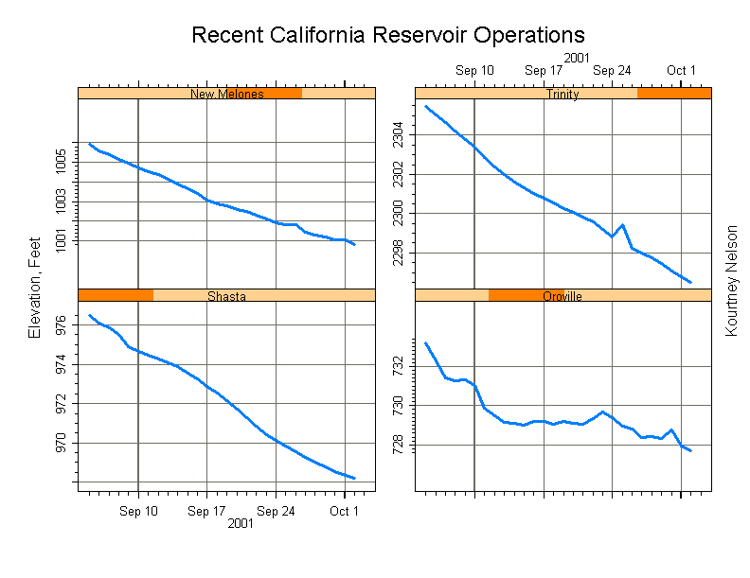

Slide 19
Sacramento Discharge

Slide 20
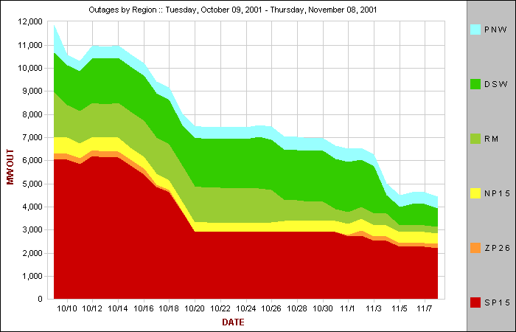

Slide 21
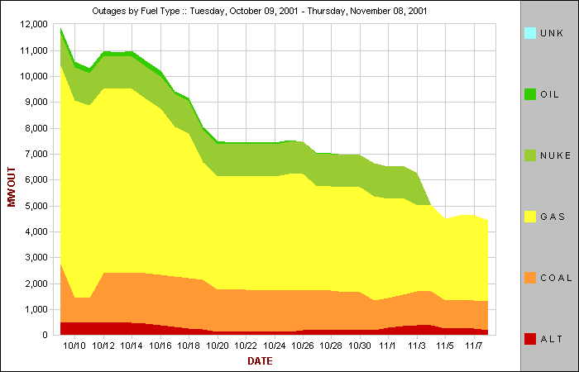

Slide 22
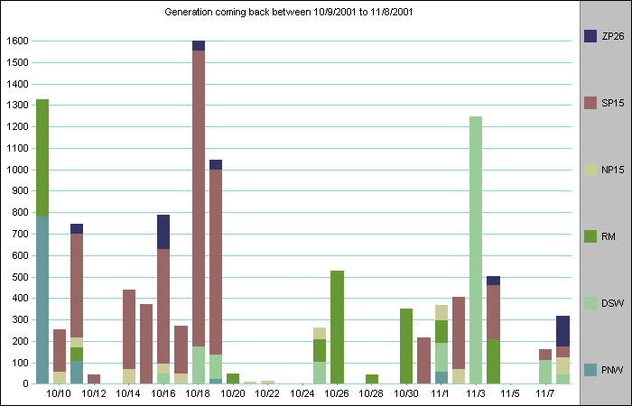

Slide 25
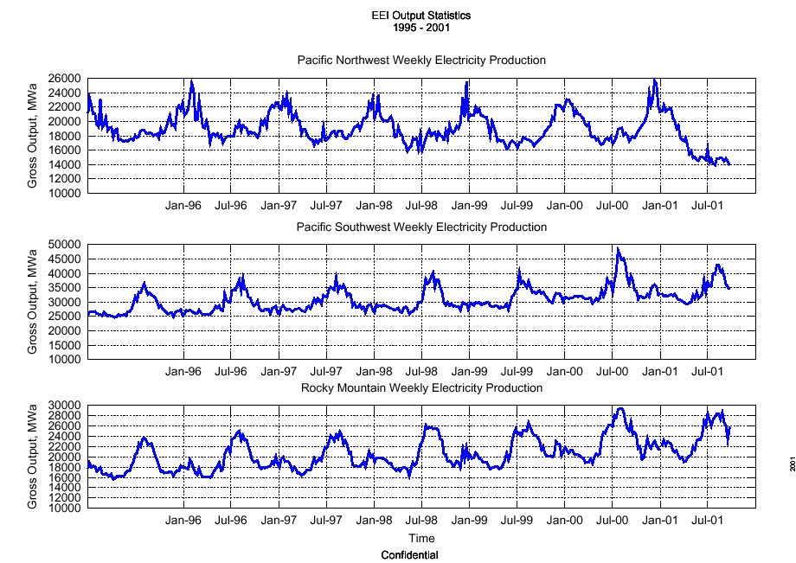
Through week of 9/23…

Slide 26
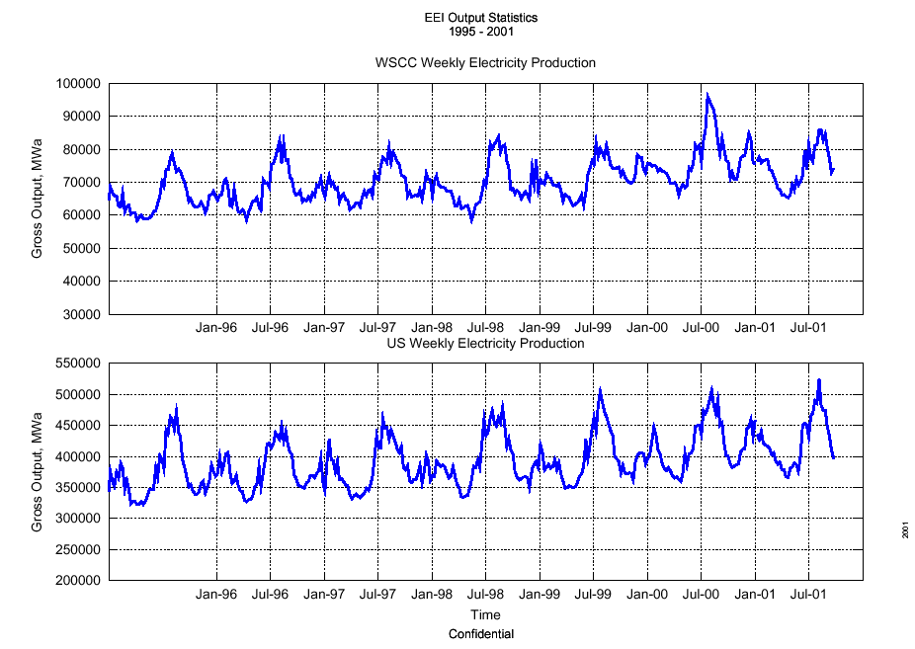
Through week of 9/23…

Slide 28
