Slide 1
Vision/Objectives
Vision: To become the premier Angel investment group in the US
Objectives:
To provide significant deal flow of investment opportunities in the Greater Houston Area
To provide significant networking opportunities

Slide 2
Strategies
Create an organization that:
Makes it easy for Members to participate and invest through the development and execution of an efficient investment process
Leverages a wide variety of backgrounds and expertise of HAN Members
Leverages and cooperates with multiple deal-flow sources (HTC, VC’s, etc.)

Slide 3
Benefits
Greater exposure and access to high quality deals, which will support portfolio diversification
Creates a funding opportunity for Houston Area companies by expanding the capital pool
Attraction/retention of quality companies to Houston Area
‘Whole greater than the sum of the parts’

Slide 4
Key Considerations
All members have equal access to deals and are treated as equals
HAN is a vehicle to provide its Members with information

Slide 5
Deal Flow Recap
Process Committee:
Kirby Atwell
Benjamin Brochstein
Ross Crawford
Scott Cutler
Jeremy Dilbeck
John O’Dell
David Peterman (Counsel)
Charles Powell (Counsel)
Joseph Trahan
Michelle Weisblatt

Slide 6
Venture Process -- Launch Structure
HAN Members
VC's
Incubators
HTC
Ventures
Electronic Submission to HAN
Meets Criteria?
Web site
Advocate
Sponsor
Agenda Committee
General Presentation to HAN
Members
Detailed Meeting with Interested
HAN Members
Member
Funding
Decision

Slide 7
Technology
Web site is the focal point for information
Development ‘in process’
Joseph Trahan, jltrahan@dnsup.com
www.houstonangelnetwork.org

Slide 8
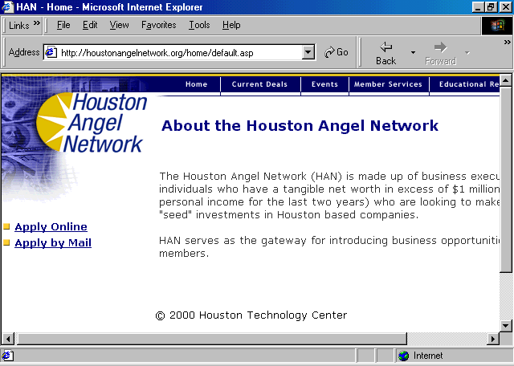

Slide 9
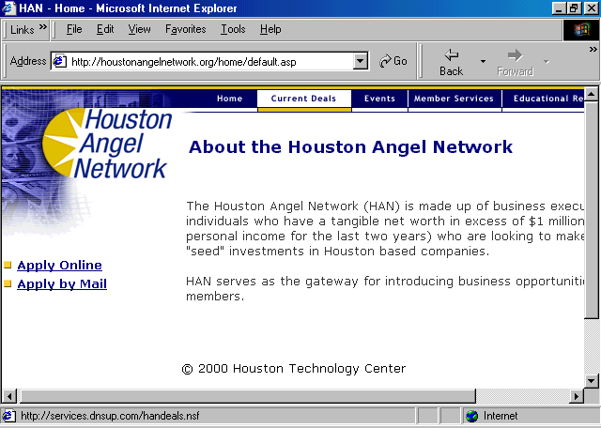

Slide 10
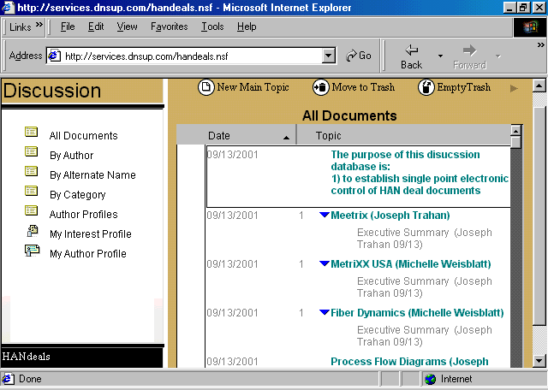

Slide 11
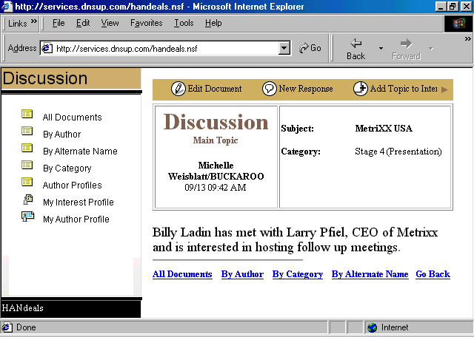

Slide 12
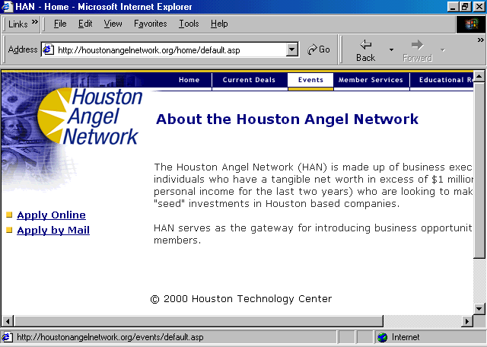

Slide 13
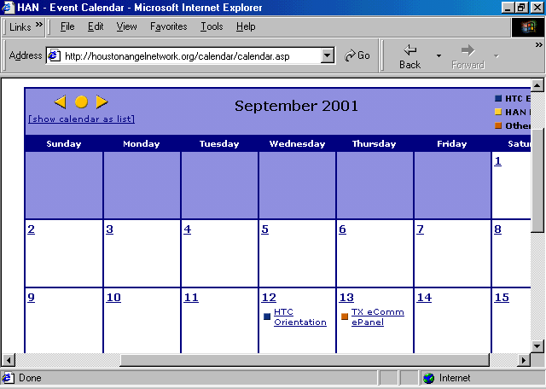

Slide 14
Committees

Slide 15
Membership
Cost is $1,000 per year
Budget Recap:

Slide 16
Membership
Meeting Schedule:
10/17, 11/14, 12/12, 1/16, 2/20, 3/20, 4/17, 5/15, 6/19
Contact:
More information: Michelle Weisblatt (713) 533-9986, email: mweisblatt@yahoo.com
Registration: Kathy Nethercutt (713) 658-1750, email: knethercutt@houstontech.org

