Slide 1

EnronOnline

Slide 2

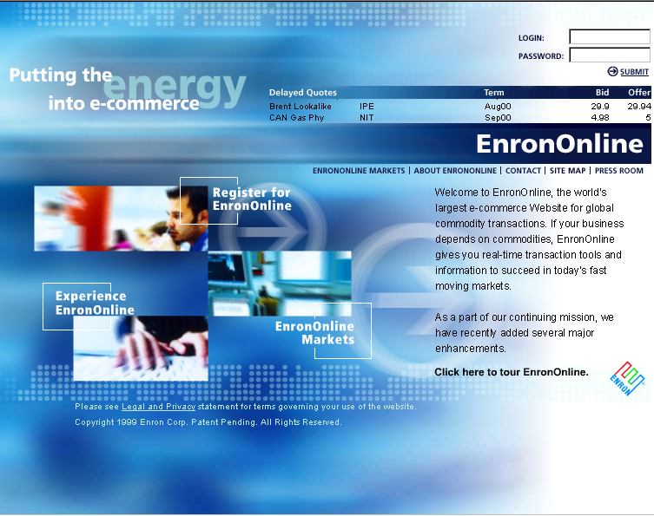
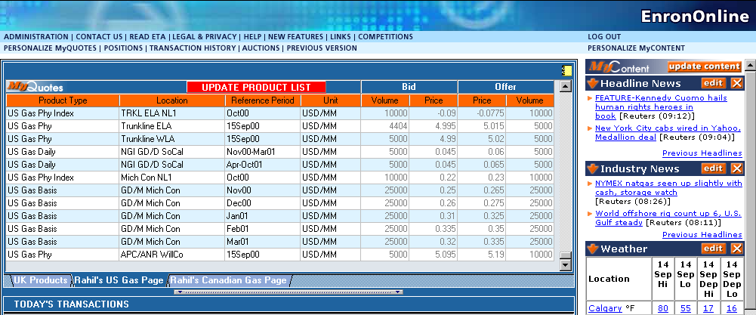
What is EnronOnline?
A Free, Internet-based, Global Transaction System Which Allows Counterparties to View Real Time Prices From Enron’s Traders and Transact Instantly Online
Taking the Big Deal Out of the
Big Deal…

Slide 3

Changing the Way We Conduct Business
Telephone Internet
Enron
Pre Nov 29 1999 Post Nov 29 1999
Telephone
Enron

Slide 4
Markets Available on EnronOnline
Commodity Types
Argentine Natural Gas
Asian Crude & Products
Asian Metals
Australian & Japanese
Weather
Australian Power
Austrian Power
Bandwidth
Belgian Natural Gas
Canadian Natural Gas
Canadian Power
Credit Derivatives
Dutch Power
Dutch Aluminium
Emissions
European Coal
European Weather
German Power
International Coal
Japanese Aluminum
LME Metals Contracts
LPG
Nordic Power
Nordic Power Options
Oil & Refined
Products
Petrochemicals
Plastics
Pulp & Paper
Sea Freight
Spanish Power
Swiss Power
UK Metals
UK Natural Gas
UK Power
US Gas Pipeline Capacity
US Lumber
US Metals
US Natural Gas
US Natural Gas Options
US Power
US Steel
US Weather

Slide 5
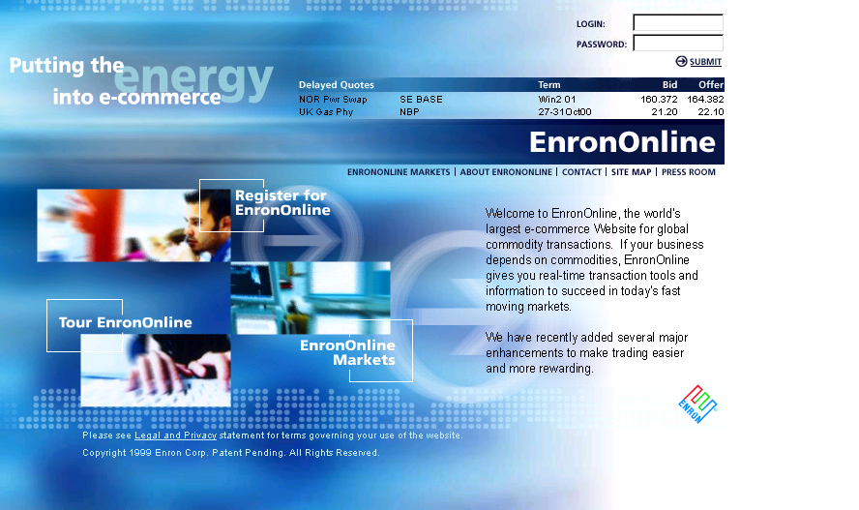
www.EnronOnline.com

Slide 6
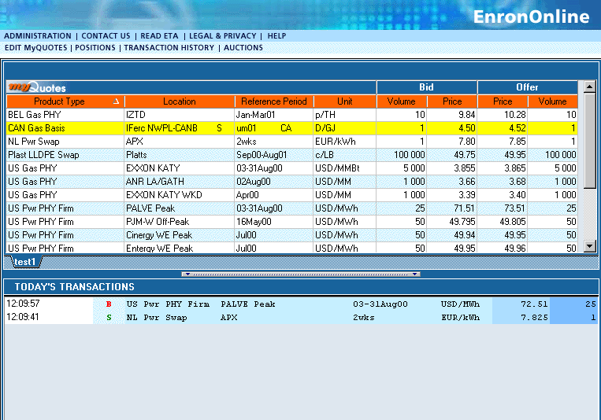
Quotes Page

Slide 7
Making Markets

Slide 8
Making the Global Market

Slide 9
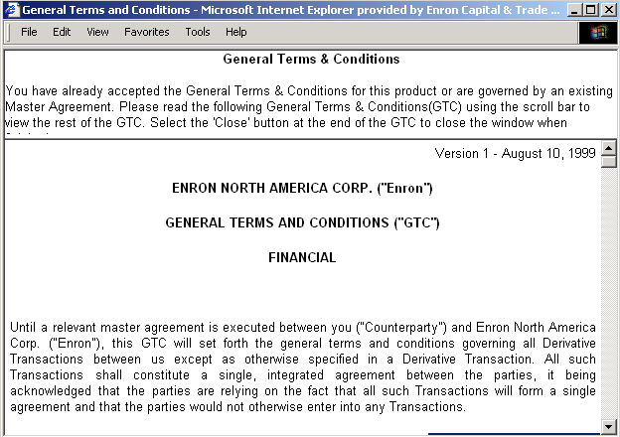
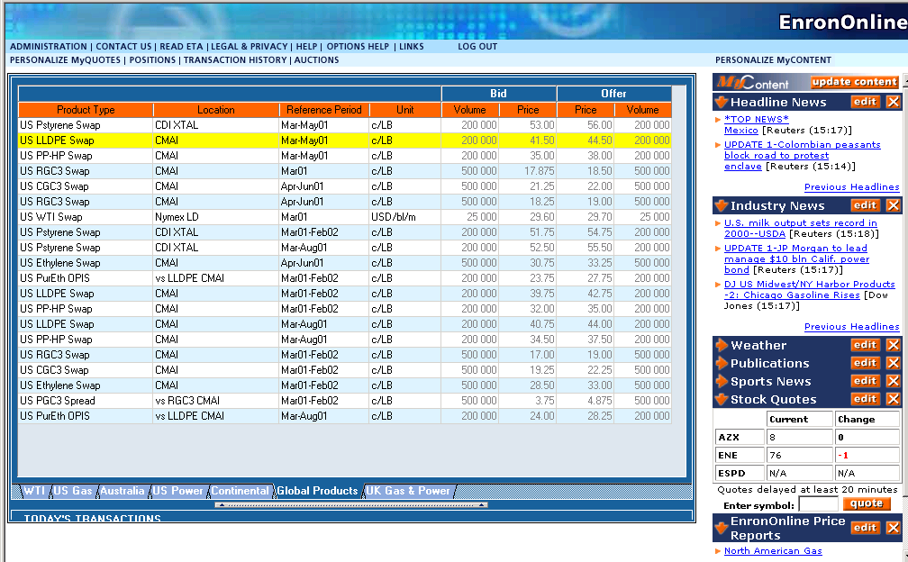
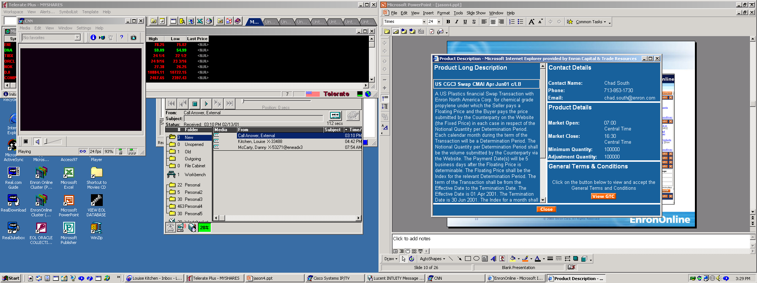
Contract & Description

Slide 10
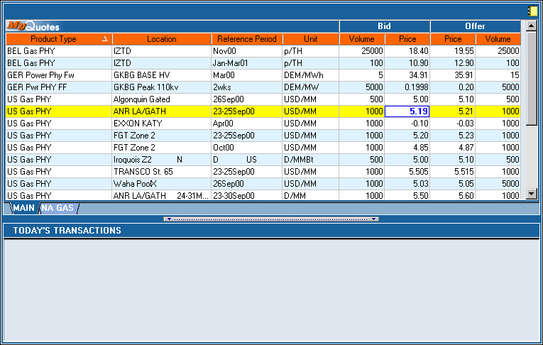
Click On Bid Or Offer Price

Slide 11
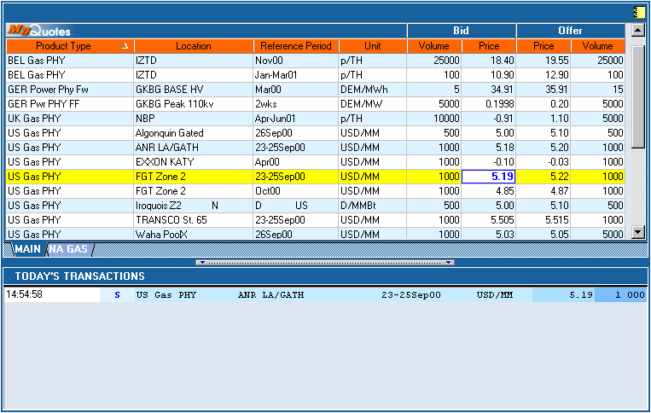
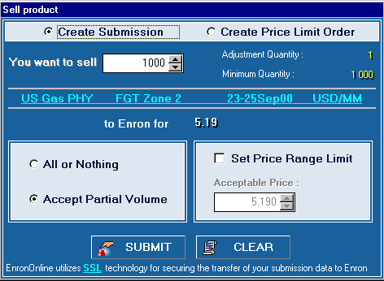
Submission Screen

Slide 12
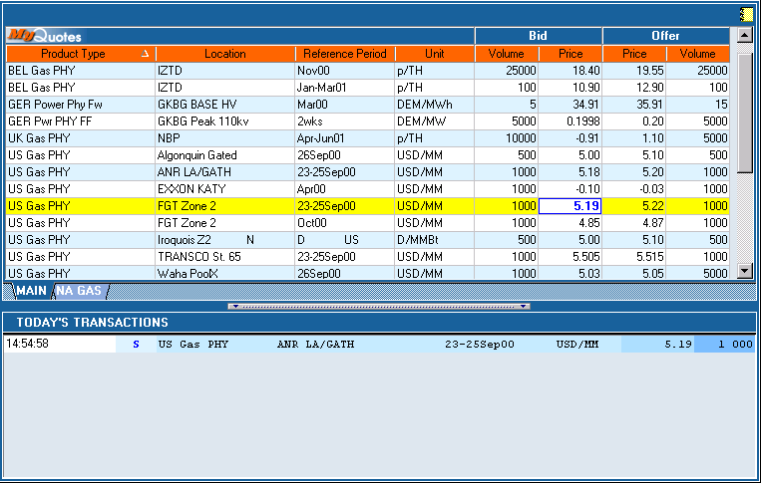
Successful Transaction

Slide 13
EnronOnline Statistics
System launched November 29, 1999
Number of transactions (life to date) 670,000
Number of transactions (daily average) 3,900
Notional value of transactions (life to date) $410 billion
Notional value of transactions (daily average) $3 billion
Products offered (daily average) >1,200
Customers logged on (daily average) 3,000

Slide 14
EnronOnline Utilization
North American Natural Gas and Power
Online Transactions as a % of Total Transactions
Traditional
EnronOnline
26%
33%
39%
54%
74%
67%
77%
61%
46%
23%
4Q 1Q 2Q 3Q 4Q
1999
2000

Slide 15
Wholesale Services - Average Daily Transactions
8,000
Traditional
EnronOnline
6,000
4,000
2,000
0
Nov Dec Jan Feb Mar Apr May Jun Jul Aug Sep Oct Nov Dec
1999
2000

Slide 16
Wholesale Services - Income Before Interest and Taxes
(Millions)
$2,260
Commodity Sales and Services
Assets and Investments
$1,317
$968
$654
48%
36%
72%
1997 1998 1999 2000

Slide 17
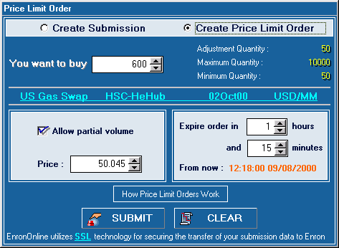




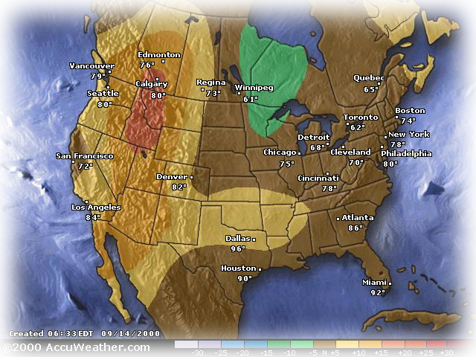




EnronOnline Features
Valuable New Transaction Functionality
    1200 Products Available (bids and offers)
    Instantaneous Pricing
    Options
    Limit Orders
Attractive New Features
New Specialized Access and Content
    Customers Choose From 40 Different Entry Methods
    Dynamically Updated Information Direct from Enron’s Marketers

Slide 18





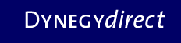










Market responses...

Slide 19
North American Crude, Natural Gas, and Power
EnronOnline vs. All Major Reporting Platforms
(TBtue)
All Major Platforms Reporting Combined
(Includes Altrade, DynegyDirect,
Intercontinental Exchange, and NGX)
EnronOnline
32,151
23,331
23,149
10,625
5,233
2,030
1,817
1,021
1Q00
2Q00
3Q00
4Q00

Slide 20
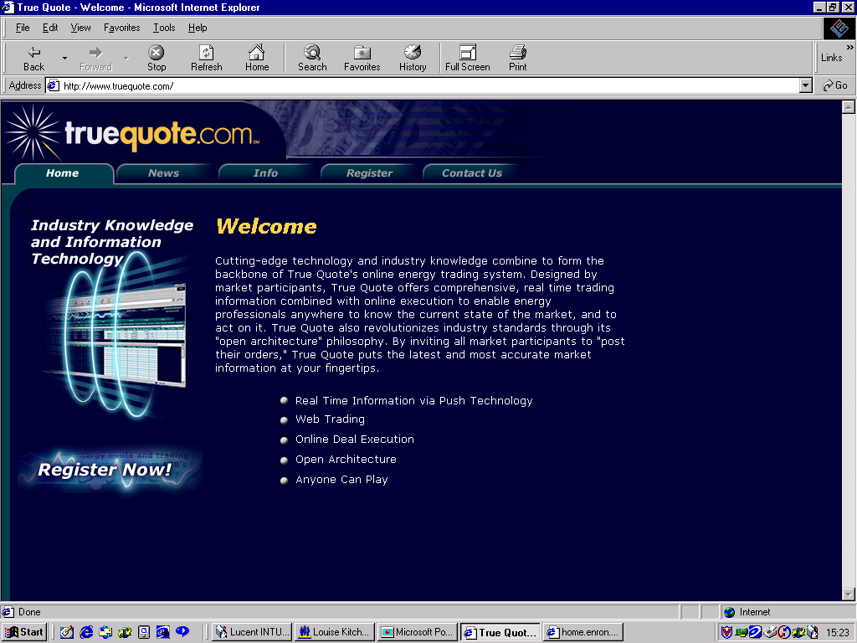
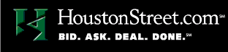
EnronOnline Prices on Other Websites
Increase general customer access to Enron by providing additional transaction channels
Gives Enron access to customers who prefer to transact via multilateral platforms
Leverages the proven technology, liquidity and Enron resources that together provide superior services to all Enron customers
It’s the transaction - not the platform!

Slide 21
Exporting the model to new markets
Market Making
Risk Management and Control
Finance
Back Office Processes
Technology

Slide 22
Entering New Markets
Replicating Proven Business Model to New, High Potential Markets
Applying Technology to Accelerate Penetration and Growth
Demonstrated Success In Rapid Development of Lead Market Positions

Slide 23
Changes in the Marketplace
Interaction Costs Declining Due to Streamlining, Standardization and Automation
  Sales
  Procurement
  Credit
  Inventory
  Settlement
Cost Benefits from Vertical Integration and Consolidation Significantly Reduced
Efficient Sourcing and Packaging Produces Lowest Cost Product
Legal
Research
Documentation
Logistics
Significant Competitive
Advantages for Entering New Markets

Slide 24
Opportunities To Rapidly Expand
Crude and Products
Coal and Emissions
Weather
Metals
Pulp, Paper and Lumber
Steel
Credit
Market Fundamentals are Changing
Demand for Enron’s Products are Increasing
E-Commerce Rapidly Extends Market Reach

Slide 25
Market Opportunities
Global and Industrial
(Revenues in Billions)
$830
$330
$330
$130
$40
Coal & Emissions
Metals
Paper, Pulp & Lumber
Steel
Total

Slide 26
Expansion of Existing Business
Crude and Products
Coal
Weather
(Transactions)
(Transactions)
(Transactions)
9,158
3,111
1,629
8,305
7,435
5,099
715
305
321
46
250
16
1997
1998
1999
2000
1997
1998
1999
2000
1997
1998
1999
2000
Over 7,500 TBtue Avg. Daily Deliveries
240 Customers in 46 Countries
Over 100,000 Tonnes Avg. Daily Deliveries
190 Customers in 17 Countries
Over $1.5 Million (Notional) Average Daily Contracts
30 Customers in 8 Countries

Slide 27
EnronOnline Metals - Metals vs. U.S. Natural Gas
(Number of Transactions)
5,000
U.S. Natural Gas (Week 1 Began Nov. 1999)
Metals (Week 1 Began Oct. 2000)
4,000
3,000
2,000
1,000
0
Week 1
Week 2
Week 3
Week 4
Week 5
Week 6
Week 7
Week 8
Week 9
Week 10
Week 11
Week 12
Week 13
Week 14

Slide 28
Pulp and Paper
Transactions
1,131
Acquired Garden State Paper Company
  210,000 Tons/Yr. Newsprint Facility
  4 Recycling Centers
  Location in Key Market Areas
  Gained Logistics Personnel and Industry Experience
Launched Clickpaper.com
  Offers Over 100 Financial and Physical Products
  Tailored to Paper Industry Participants
436
14
73
1997
1998
1999
2000
Volumes
12,051
(Thousand Tonnes)
6,311
4,480
314
1997
1998
1999
2000
Financial and Physical Settled Volumes

Slide 29
Enron Credit
Market Demands Real Time Credit Decisions as More Business Transacts Online
Enron Launched EnronCredit.com in February 2000
Enron Provides Credit Services To Customers
  Real Time Evaluation and Management of Credit Exposure
  Market-Based Risk Management Products
  Reference Prices for More Than 10,000 Public Companies
  Firm Prices for More Than 400 Public Companies
170 Transactions With $3.3 Billion Notional Value Completed to Date
Innovative Credit Risk Management Product for Customers

Slide 30
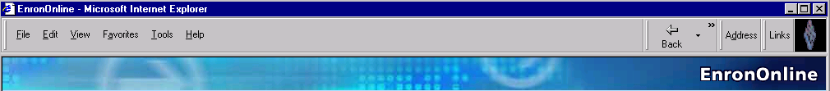
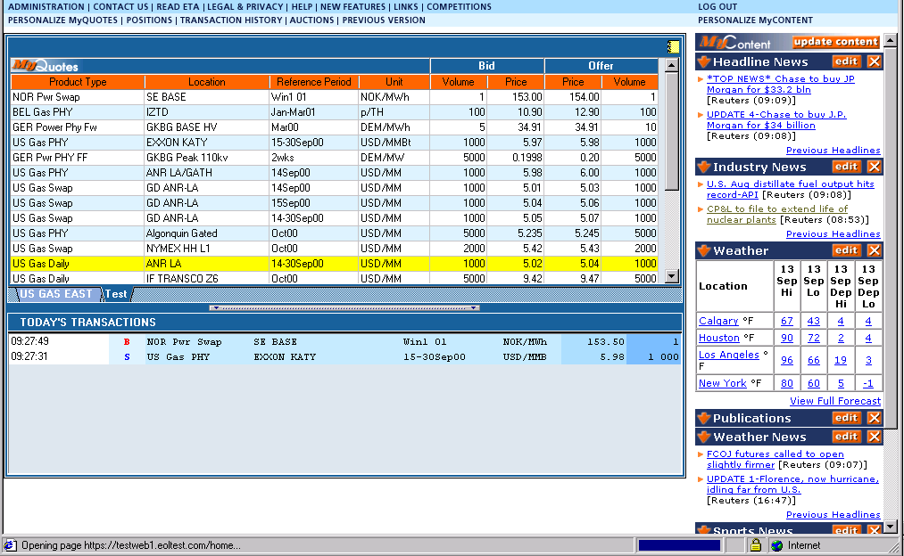
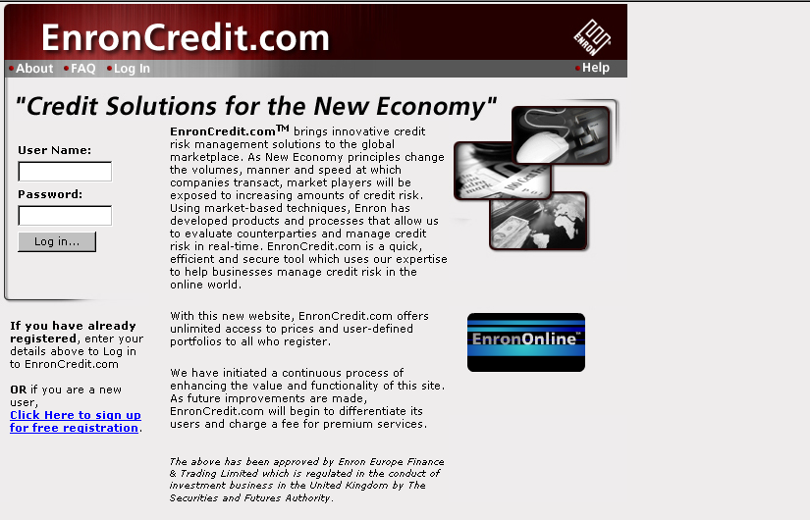
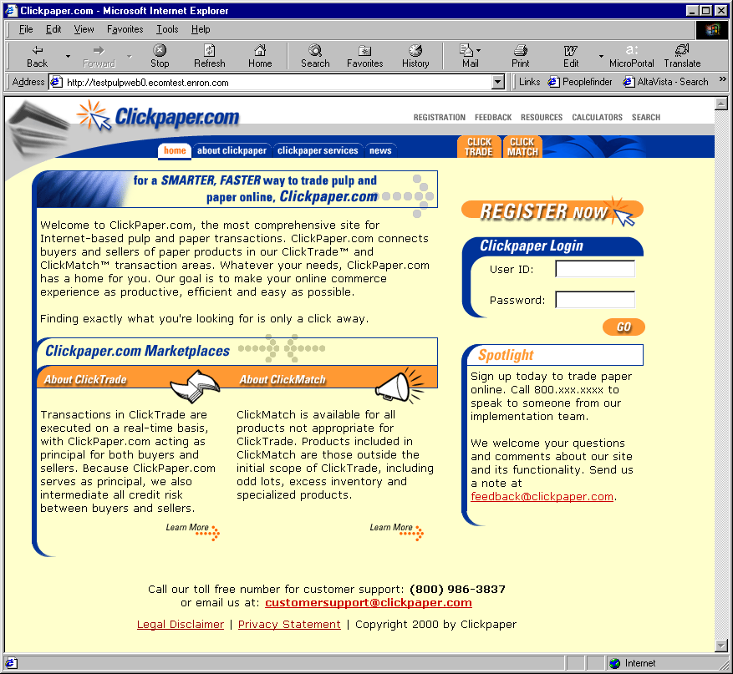
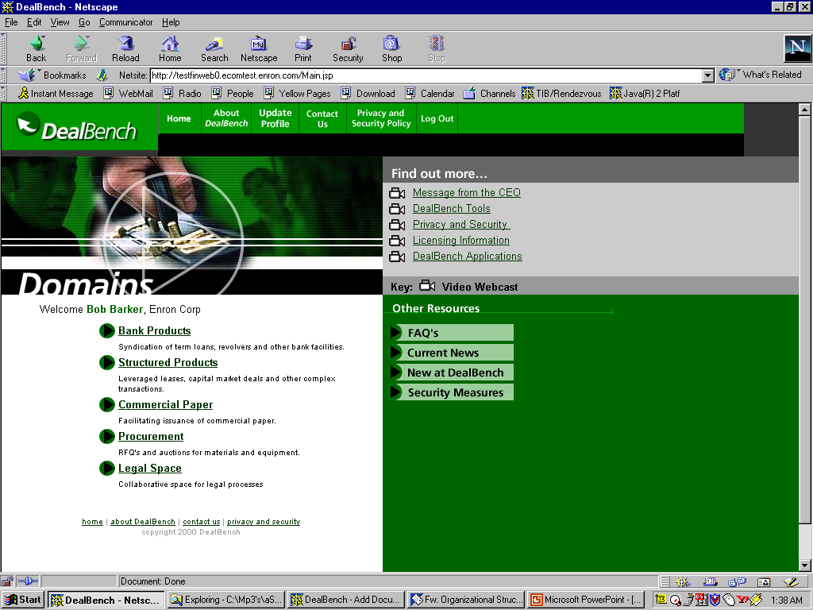
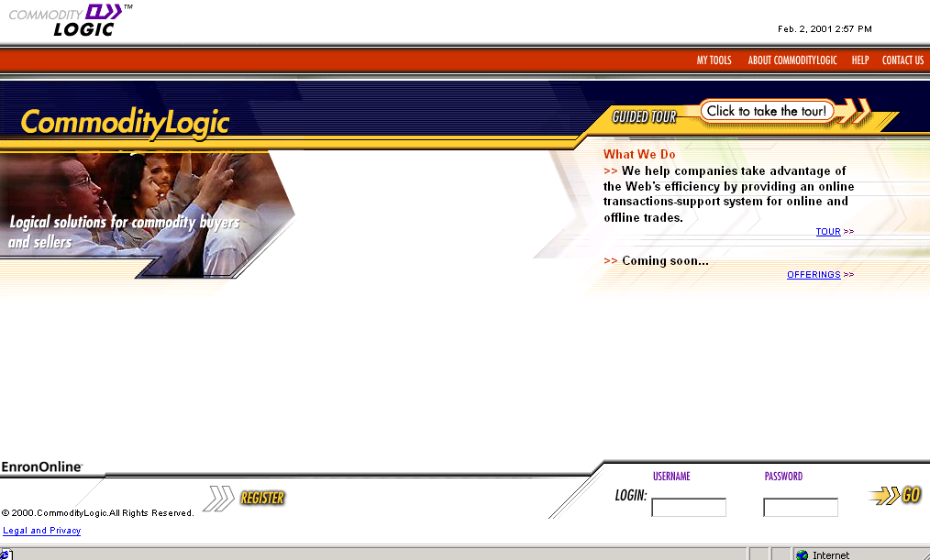
E-Commerce Initiatives
EnronOnline.com
EnronCredit.com
ClickPaper.com
DealBench.com
CommodityLogic.com

Slide 31
CommodityLogic.com
Commodity
Logic
IT
Energy
Operations
Leveraging the combined value of our technology group and energy operations group as a bundled service provider through the commodity logic vehicle

Slide 32
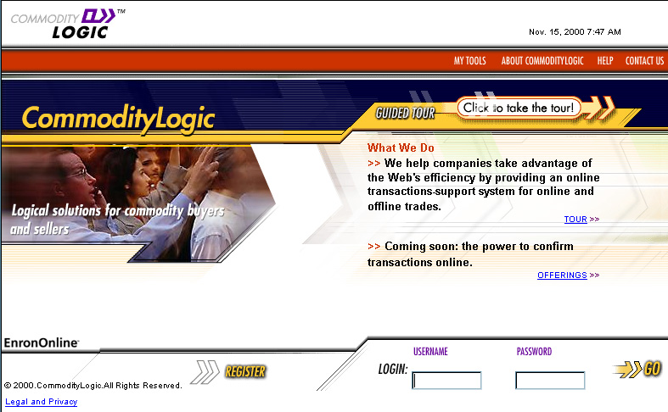
CommodityLogic.com
Enron recognizes the efficiencies that can be made throughout the back office processes, from the electronic transaction
    Step 1 - Create the electronic transaction
    Step 2 - Capture the efficiencies in out back office systems
    Step 3 - Provide this service to external counterparties

Slide 33
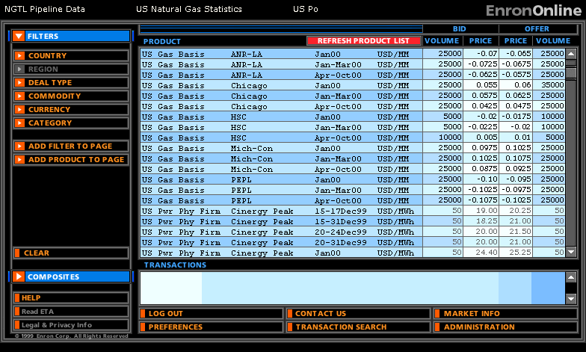
History of EnronOnline
Oct 26, 1999 Launch announcement
Nov 29, 1999 Version 1.0 launched with
North America Natural Gas
December 1999 US Power, Nordic Power, Plastics, Pulp & Paper, Coal
January 2000 European Natural Gas & Power, Emissions, LPG, Oil & Refined Products, Petrochemicals, Weather Derivatives
February 2000 Auctions, Credit Derivatives
May 2000 Bandwidth
June 2000 $50bn of notional value transacted
July 2001 Metals and Shipping
September 18, 2001 Version 2.0 launched
Year 2000 548,000 transactions
Activity: $336bn of notional value transacted
January 2001 Options module
February 2001 Commodity Spreads

Slide 34
Lessons Learned
Technology is not difficult with the right people on the team
Time to market is critical with product roll-out
Prioritization becomes a rationing process (priorities are driven by time to market and potential transaction generation)
Must continue to innovate to maintain first mover advantage
Business model could have broad applications in other industries
Principal-based and Exchange-based are both viable models
It’s not about the platform, it’s about the electronic transactions

Slide 35
Cost of building the systems
Leveraging on current mid/back office technology
Leveraging 300 people from Enron’s global transaction business (priceless!)
Plus $15 million of direct costs (legal plus IT etc)

Slide 36
Building EnronOnline
We have been B2B for years
Expansion and Extension of our Existing Business
Export strong skills in risk intermediation and risk control systems
Provide the catalyst for significant efficiency gains achievable through trading online
Used the Electronic transaction capability to further manage many of the risks inherent in our core trading business
  Contracts are in place prior to transaction
  Credit is verified prior to transaction
  Controls are evident throughout the system to mitigate trading errors

Slide 37
In-House Technology Resources (wholesale)
People
Expenditures
(Millions)
1,882
$522
1,380
$358
1,154
$291
1999
2000
2001E
1999
2000
2001E
New Ecommerce Initiatives

Slide 38
Managing Growth

Slide 39
Valuable Structural Advantages
Expanded Market Reach
Enormous Scalability
Enhanced Risk Control
Broadened Information Access
Increased Liquidity to Enron’s Market-Making Services
Increased Efficiencies

Slide 40
Efficiency Gains
Transactions
Per Market Maker
Marginal
Cost Per Transaction
(Indexed)
3,084
100
$370
25
672
1999
2000
1999
2000

Slide 41
Average Number of Daily Customers
3,000
2,427
1,227
224
44
Q499 Q100 Q200 Q300 Q400

