Slide 1
CANADA UPDATES
(9/4/01 EIS) Canadian Hydro's Cowley North and Sinnott wind generation projects are located in southern Alberta near Pincher Creek. The Cowley North project has seven of fifteen 1.3 MW turbines installed with the remainder to be completed by the end of September. The Sinnott project's five turbines will be installed during October. These projects will add 26 MW of generating capacity, more than doubling the capacity of the existing Cowley Ridge wind plant. After evaluating the production results from the Sinnott machines, and depending on market prices for green electricity, Canadian Hydro may install additional turbines on the Sinnott property during 2002 and 2003.
The 30 MW (15 MW net) Pingston hydroelectric project is located in southeastern British Columbia. Canadian Hydro has made significant progress on the intake facilities as well as the 4 kilometer tunnel that will connect the intake to the powerhouse. Construction of the powerhouse will start in October and be completed by year-end. Work on the tunnel will continue during the winter months. Commissioning and startup is scheduled for July 2002.
Canadian Gas & Electric Inc., a wholly-owned subsidiary of Canadian Hydro, is in the process of ordering equipment, carrying out detailed engineering, and commencing civil works for its 25 MW Grande Prairie Combined Heat & Power Project. Mechanical construction is anticipated to start in spring 2002 with completion and commissioning anticipated for late 2002, subject to certain terms and conditions, including regulatory approvals and project financing.
(Cont.) Canadian Hydro continues to work towards its October 2, 2001 joint hearing with the Alberta Energy and Utilities Board and the Natural Resources Conservation Board for the approval to construct and operate the 80 MW Dunvegan hydroelectric prospect. The Department of Fisheries and Oceans Canada has requested the Corporation provide additional information regarding fish migration and populations prior to completing its environmental review. In addition, management continues to work with Alberta Environment with respect to ice formation and breakup issues on the Peace River. Canadian Hydro plans to have additional meetings with these reviewing authorities prior to the hearing in order to clarify, address and resolve any outstanding issues and questions with regards to the fisheries and ice topics.
(9/11/01 Power Daily) Calgary-based oil company Alberta Energy Monday said it plans to build a US $66-million, 80-MW, natural gas-fired cogeneration plant in northeast Alberta that will supply 14 MW power and steam to its Foster Creek Thermal Recovery Project. The remaining power will be sold into the Power Pool of Alberta.
(9/25/01 MW Daily) Calpine on Friday completed the acquisition of two power plants in Canada, adding a net 275 MW to its holdings. The two properties were obtained for US$255 million and will be part of Calpine’s Canada Power Holdings group. Calpine took control of the Island Cogeneration facility, a 250-MW, gas-fired unit under construction on Vancouver Island, British Columbia. The company will sell electricity output to BC Hydro under a 20-year contract and steam for industrial processing to Norkse Skog under a 15-year contract.
Canada
Notes:
Formerly (stalled) NWPE 220 MW project. FPL bought rights in 1/99. Construction to began 9/1/99 As of 4/25/00 Unit 1 not complete and gas line construction has been stalled.

Slide 2
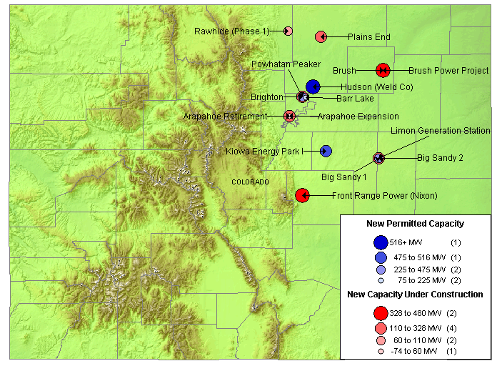
ROCKIES NEW GENERATION MAP
High Probability Plants
Limon Generating Station / 140 MW / Nov-01 / 11,873 HR
Plains End / 110 MW / May-02
Brush / 328 MW / May-02 / 7,500 HR
Brighton / 140 MW / May-02
Rawhide (Phase 1) / 80 MW / Jun-02 / 11,400 HR
Arapahoe Expansion / 45 MW / Jun-02 / 9,500 HR
Front Range Power (Nixon) / 480 MW / May-03
Medium-High Probability Plants
Big Sandy 1 / 75 MW / Nov-01
Powhatan Peaker / 280 MW / May-02
Barr Lake / 128 MW / Jun-02
Gobbler’s Knob Wind / 54 MW / Jun-02
Big Sandy 2 / 225 MW / Nov-02 / 10,500 HR
Hudson (Weld Co) / 516 MW / Jun-04 / 7,100 HR
Kiowa Energy Park I / 475 MW / Jul-04 / 7,160 HR
Rockies

Slide 3
ROCKIES UPDATE
(9/19/01 PMI) PG&E National Energy Group has completed financing for its 111- megawatt Plains End Generating project now under construction in Arvada, Colo., about 8 miles northwest of Denver. Credit Lyonnais was the lead arranger and underwriter for the non-recourse project financing. "We look forward to helping meet the growing energy needs of Colorado, while balancing environmental concerns," said Tom King, president and chief operating officer of PG&E NEG's West Region. "The Plains End Generating project is an excellent example of everyone working together to bring this project on-line within an aggressive time frame." The project will use 20 natural gas-fired reciprocating engines, each rated at 5.5 megawatts, to produce electricity under a 10-year power purchase agreement with Xcel Energy. The peaking facility is designed to be started and quickly brought on-line, allowing for a swift response during increased or decreased power demand, particularly those prompted by extreme weather. The process used at Plains End requires very little water and is expected to operate more efficiently than most other competing sources, providing a good heat rate, despite the area's high altitude.
Rockies

Slide 4
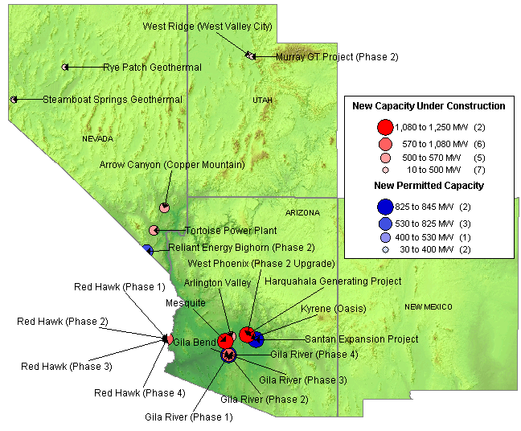
SOUTHWEST NEW GENERATION MAP
High Probability Plants
Environmental Oil Project / 30 MW / Oct-01
West Ridge / 160 MW / Oct-01 / 9,518 HR
Rye Patch Geothermal / 12 MW / Oct-01
Murray GT Project / 27 MW / Oct-01
Kyrene (Oasis) / 265 MW / Feb-02 / 7,125 HR
Red Hawk (Phase 1) / 580 MW / Jun-02 / 7,067 HR
Red Hawk (Phase 2) / 580 MW / Jun-02 / 7,067 HR
Arlington Valley / 570 MW / Aug-02 / 7,067 HR
LV CoGen Expansion / 225 MW / Sep-02
Mesquite / 1,250 MW / Jan-03 / 7,067 HR
Gila River (Phase 1) / 575 MW / Mar-03 / 7,067 HR
Mirant Apex Industrial (Phase 1) / 550 MW / Mar-03 / 7,067 HR
Gila River (Phase 2) / 575 MW / May-03 / 7,067 HR
Arrow Canyon / 500 MW / Jun-03 / 7160 HR
West Phoenix (Phase 2 Upgrade) / 440 MW / Jun-03 / 7,196 HR
Harquahala Generating Project / 1,083 MW / Sep-03 / 6,880 HR
Gila River (Phase 3) / 575 MW / Jul-03 / 7,067 HR
Gila River (Phase 4) / 575 MW / Sep-03 / 7,067 HR
Mirant Apex Industrial Park (Phase 2) / 550 MW / Mar-04 / 7,067 HR
Medium-High Probability Plants
Tortoise Power Plant / 60 MW / Mar-02
Steamboat Springs Geothermal / 30 MW / Jun-02
Reliant Energy Bighorn (Phase 2) / 575 MW / Jun-03
Blue Diamond Hill / 400 MW / Jun-04
Gila Bend / 845 MW / Jun-04
Santan Expansion Project / 825 MW / Dec-05
Red Hawk (Phase 3-4) / 680 MW / Jun-06
DSW

Slide 5
SOUTHWEST UPDATES
(9/12/01 Yahoo) Reliant Energy Wholesale Group, a unit of Reliant Resources, announced plans to build a combined-cycle generating facility in Arizona near its recently completed Desert Basin facility in Pinal County. Phase I, scheduled for commercial operation in 2004, will include two natural gas-powered turbines and one steam-powered turbine and will have a total capacity of 580 megawatts. Named Signal Peak after a nearby landmark, the plant will be Arizona's first “dry” merchant power generating facility. Reliant Energy Signal Peak will use an innovative air-cooled condenser, a technology that drastically reduces water use to only about 300 acre-feet per year, less than a tenth of the water used for natural gas-powered generating facilities with conventional cooling towers. Phase II of the Signal Peak project, which would be the same size and use the same equipment, is scheduled for commercial operation in 2009, contingent upon the region's need for power.
(9/17/01 Power Daily) PPL Montana filed with FERC in late July a notice of Arizona regulators voted last week against a controversial 720-MW merchant project, saying the plant threatened endangered species’ habitat. The Arizona Corporation Commission’s Power Plant and Transmission Line Siting Committee voted 8-1 Sept. 12 to deny a certificate of environmental compatibility for Caithness Energy’s Big Sandy power plant near Wikieup. New York-based Caithness could appeal the decision to the ACC. Caithness officials couldn’t be reached for comment. In recent power plant decisions, the ACC has required stronger environmental standards than required by law. A draft environmental impact study indicated the power project would have harmed the Big Sandy River, home to the endangered Southwestern willow flycatcher. The committee was not convinced that Caithness’ proposed environmental mitigation plan would be effective. The Big Sandy plant is one of more than 20 new power plants proposed for Arizona. The project drew opposition from citizens and environmental groups, some of whom were also concerned the plant would deplete a local aquifer.
(9/5/01 Power Daily) Reliant Energy Thursday announced plans to build in two phases a 1,160-MW gas-fired merchant plant in Casa Grande, Ariz. The facility would join more than 20 power plants under development in the state. The proposed Signal Peak facility will be built next to Reliant’s 560-MW Desert Basin facility, which last month came on-line, delivering all its output to the Salt River Project for 10 years. Reliant’s air-permit application at Pinal County will include two phases for Signal Peak facility. The first phase will include a 580-MW, combined-cycle dry plant that includes two natural gas-powered turbines and one steam-powered turbine. Reliant expects the $430-million plant to go into service in the spring of 2004. The second phase, which would be the same size and use the same equipment, is scheduled to come on-line in 2009, depending on the region’s need for power. The plant’s total cost would be about $740-million.
(9/6/01 EIS) Black Hills Energy Ventures announced the completion of its acquisition from Enron North America of a 273 MW gas-fired co-generation power plant project located northeast of Las Vegas, Nev. The facility currently has a 51 MW co-generation power plant in operation. Most of the power from that facility is under a long-term contract expiring in 2024. The Company has sold 50% of this power plant to another party. The project also has a 222 MW combined-cycle expansion under way, which is 100%-owned by the Company. The facility is scheduled to be fully operational in the third quarter of 2002 and will utilize state-of-the-art LM-6000 technology. The power of the expansion is also under a long-term contract which expires in 2017. This contract for the expansion requires the purchaser to provide fuel to the power plant when it is dispatched. The cost for the entire facility is expected to be approximately $330 million and the Company is in the process of obtaining long-term financing, which primarily will be non-recourse project debt.
DSW

Slide 6
SUMMARY
Summary

Slide 7
Sorted List By Online Date

Slide 8
Sorted List By Online Date

Slide 9
Sorted List By Region

Slide 10
Sorted List By Region

Slide 11
Sorted List By Region

Slide 12
WSCC CAPACITY ADDITIONS
NOTE: 100% of Capacity Under Construction, 50% of Permitted Capacity
Summer Summary

Slide 13
New Gas Generation Summary

