Slide 1
Old Approach to Compliance
Technology
Fuels
Focus on single, physical solution

Slide 2
Enron Approach to Compliance
Emission Management Service
Finance
Credits
Risk Management
Technology
Fuels
Focus on integrated solution

Slide 3
Enron Emission Management Service
A Compliance Solution Partnership
Objectives:
  Optimize the compliance cost of the Client’s system using Enron’s expertise in risk management, finance and trading
  Develop, commercialize and introduce new, innovative emission reduction technologies
Mechanism:
  Offer an Emission Management Service
    Target savings of 20% versus Client’s plan
    Transfer many compliance risks
    Facilitate introduction of new technologies
    Use partnership to create additional savings opportunities

Slide 4
Sample Compliance Cost Analysis
NPV Levelized
Sample Compliance Cost $250MM $31MM/Yr
Enron Plan $200MM $25MM/Yr
CLIENT SAVES $50 Million PV

Slide 5
Enron Emissions Management Service
A Compliance Solution Partnership
A long-term, fixed price service that guarantees emissions compliance by:
1) Physically reducing emissions
    Emission Reduction Technology
      Install Air Pollution Control Equipment
    Heat Rate Improvements
    Alternative Fuels Requires Client’s Approval
    Replacement Power Value shared with Client
        and/or
2) Providing emission allowances
Structured as an Executory Services Contract which results in off-balance sheet and off-credit financing.

Slide 6
Emissions Management Service
Risks Transferred to Enron

Slide 7
Value Continuum of Enron Offering
System
Emission
Management
Service
Plant
Emission
Management
Service
Unit
Emission
Management
Service
Equipment
Sale
Emission Management Service
Provides Largest Value to Client
Optimize Intra and Inter-System
Larger Savings Baseline
Ability to Over-Comply
“Synthetic SCR”
Allowance “Peaker”
SAVINGS OPPORTUNITY

Slide 8
Emissions Management Service
Benefits to Client
Lower overall compliance cost
  Savings of 20% versus 10 year Compliance Plan
  Additional potential shared savings
Reduce/delay capital outlays
Maintain regulatory flexibility
  Deal can match ultimate regulatory timeline
Provide emission compliance certainty
Retain control of generation assets
Reduce risk of “new” technology
  Superior guarantee from Enron
Attractive financing structure
  Off-balance sheet, off-credit treatment

Slide 9
NOxTech NOx Reduction Technology
Technology Highlights
Over $23 MM invested
Enron holds exclusive license
Successful demo operation
    2.8 MW Diesel IC Engine
    Operating since 1995
    96% efficiency
Small scale demo
    Validated process on coal
    Low NOx levels
    < 5 ppm ammonia slip
Initial “alpha” coal boiler demo
    150MW
    Targeted for for late 2001
Technology Process
Gas-phase, autocatalytic process for boilers
Reduces NOx by 90%+
  Theoretical limit of .03 lb/mmbtu
Low ammonia slip (<5ppm)
Reduces CO and UBC
Maintains fuel flexibility
No impact on plant output
Short installation cycle

Slide 10
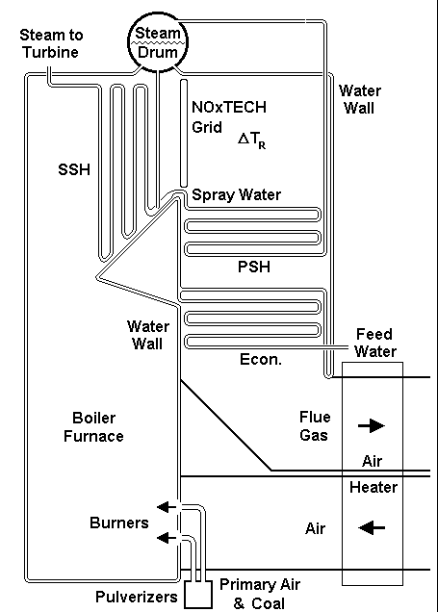
Typical System Installation
Exhaust gas containing
NO_{X} and O₂
Hydrocarbons
(natural gas or diesel)
Reactants
(ammonia or urea)
Autocatalytic Process
Autoignition & Autothermal Heating
(temps of 1400 to 1550º F)
Generating NH₃ and/or HNCO
NO_{X} & CO removal
Depletion of NH₃
Treated exhaust gas
Low NO_{X}, CO & UBC
Minimal NH₃Slip
By products: CO₂, H₂0 & N₂

