Slide 1

Enron Corp.
Steve Kean
Executive Vice President
Chief of Staff
Rice University
Jones Graduate School
Houston, Texas
November 14, 2000

Slide 2
Agenda
Overview
Liberalization in the Energy Industry
Enron’s Business Model
Conclusion

Slide 3

Enron in 1985
Gas Pipeline
And Marketing
Exploration
And
Production
4,000 employees in 2 countries
$12 billion in assets
$2 billion in market cap

Slide 4
Enron Today
Enron
Wholesale
Services
Enron
Transportation
Services
Enron
Energy
Services
Enron
Broadband
Services
18,000 employees in 44 countries
$46 billion in assets
$72 billion in market cap

Slide 5
Contribution to Enron Income of
Non-Regulated Businesses
(Estimated Percent of Net Income)
5%
40%
75%
$226M
$453M
$893M
Net Income
1989
1994
1999
Non-regulated
Regulated and Exploration and Production

Slide 6
Stock Value
Extension of
Business
Model
Launch of New Business
Transition

Slide 7
Liberalization of Energy Markets

Slide 8
Liberalization of Energy Markets
Economic and Legal Structure
Key Policy Decisions
Benefits
Transition Issues
Business Strategies

Slide 9
Overview of U.S. Industry
Network industry
- Multi-party ownership of interconnected grids
- Mix of "natural monopoly" and competitive business
Dual jurisdiction
- Federal: interstate transmission; wholesale sales
- State: local distribution; retail sales
Increasingly continental in scope

Slide 10
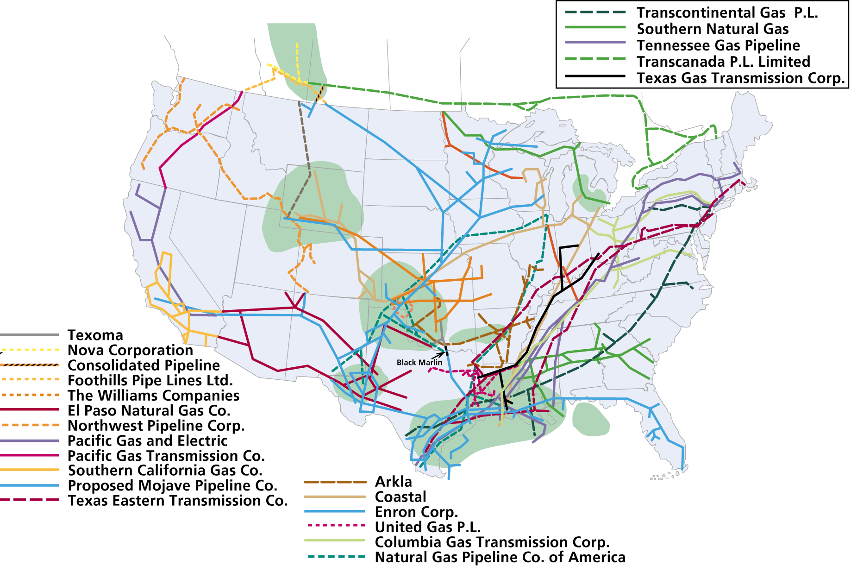

Major U.S. Gas Pipelines
& Supply Basins
Overview of the
Natural Gas Market

Slide 11
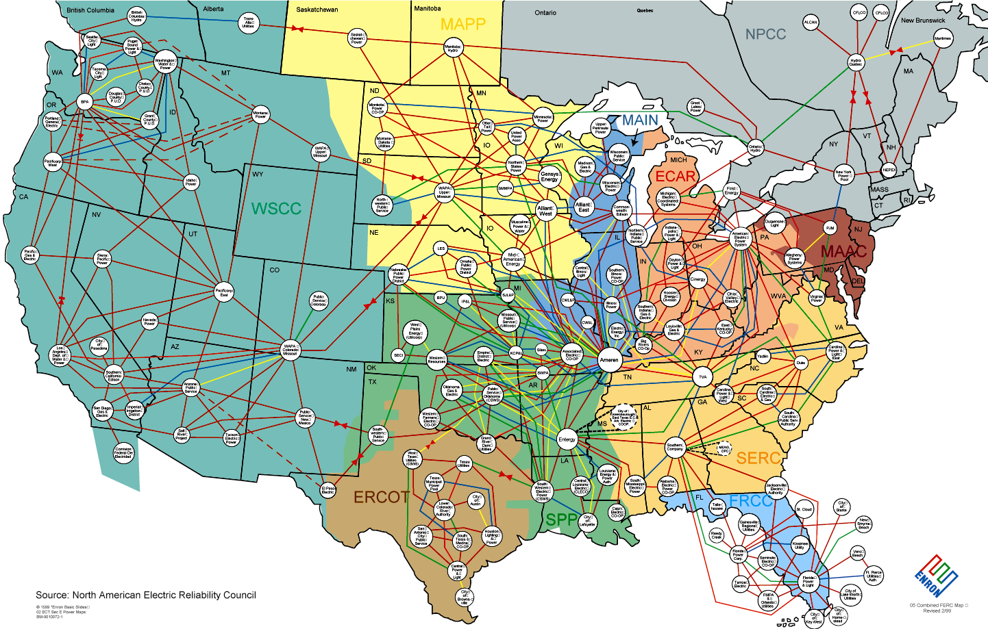
Bulk Power Market
Source: North American Electric Reliability Council

Slide 12
Key Characteristics of U.S. Energy
Market and Regulation
Primary reliance on private companies under regulatory supervision
Regulatory responsibility split between state and federal authorities
- Wholesale - federal
- Retail - state
Increase reliance on open markets over last two decades

Slide 13
Market Structure
Primary Difference Between Gas and
Electricity -- Level of Vertical Integration
Gas
Production
Transmission
Distribution
Merchants
Power
Production
Transmission
Distribution
Merchant
Function

Slide 14
Gas Industry Structure

Slide 15
Electric Industry Structure

Slide 16
Key Policy Decisions
Structural Separation
Access
Choice

Slide 17
Key Policy Decisions
Structure
  Independent regulator
  Separation of natural monopoly functions
  Regulation focused on access to monopoly services
Access
  Equal access to transmission and distribution services through nondiscriminatory tariffs
    separation of costs
    separation of transmission/distribution from sales service
  Interconnection on nondiscriminatory terms
Choice
  Deregulation of transaction terms and prices for competitive services (sales)

Slide 18
Key Policy Decisions
Transmission
Distribution
Consumption
Production
Independent power production
Private and foreign investment permitted
Independent regulator
Open access tariffs
Open interconnection
Cost unbundling
Separate transmission and distribution from commodity sale
Wholesale Merchant
Retail Merchant
Deregulate terms and conditions
Open market making function
  bilateral contracts
Deregulate terms and conditions
Open metering and billing functions
Open investment on demand side

Slide 19









Market Development Timeline
Cash Market
Information
Liquid
Cash
Market
Continued Evolution
Establishment
Development/
Price Discovery
G
G
A
A
S
Liquid
Forward
Market
Continued
S
Forward Market
NYMEX
Establishment
Evolution
P
Information
Development/
Price Discovery
Liquid
Cash
Market
Continued
Evolution
P
Cash Market
Establishment
O
O
W
W
E
Liquid
Forward
Market
E
Forward Market
Establishment
NYMEX
Continued
Evolution
R
R
1984
1985
1986
1987
1988
1989
1990
1991
1992
1993
1994
1995
1996
1997
1998
1999
2000

Slide 20
Evolution of the Energy Merchant
Business
Pre 1985
Gas
Pipelines
Distributors
End
Producers
Users
1985 - 1993
Gas
Wholesale
Transmission
Distributors
End
Producers
Merchant
Pipelines
Users
Function
1993 - 1996
Gas
Wholesale
Transmission
Retail
Distribution
End
Producers
Merchant
Pipelines
Merchant
Pipelines
Users
Function
Function
Gas
Transmission
Distribution
Producers
Wholesale
Pipelines
Retail
Pipelines
1996 +
Merchant
Merchant
End
Function
Function
Users
Electricity
Transmission
Distribution
Producers
Wires
Wires

Slide 21
Benefits of Liberalization
Not a “zero sum game”
  Net benefits created
  Better solutions to transition issues
Cost savings
Improved reliability
Improved product choices
Improved allocation of capital
Improved allocation of risk
Improved development and deployment of technology
Improved
  speed
  flexibility
  solutions
to problems in the market

Slide 22
Benefits - Cost Savings
Price Decrease from Deregulation in Five U.S. Industries
Percent Decrease
40%
Trucking
Railroads
Airlines
Long Distance
Telecom
Natural Gas
Source: Brookings Institution/George Mason University

Slide 23
Benefits - Cost Savings
U.S. Average Gas Prices by Sector
1985 vs. 1998
(In constant 1998 Dollars)
1985
1998
-26%
-34%
-49%
-56%
$/MMBtu
The average price to all end users has fallen 43% to date under open access.
In the decade prior to open access, prices increased by 71% adjusted for inflation.

Slide 24
Benefits:
Reliability
Reliability improves in an open market
Merchants find new paths between supplies and markets, effective reserve margins increase
Information provided by system users is better than predictions
Customers can choose level of service
Investment decisions become more rational, bringing supply and demand into better balance

Slide 25
Benefits:
Product Choice
Electrons are fungible but contract terms and contracting parties are not
Physical product differentiation
  quantity
  delivery terms - firm, nonfirm and everything in between
  flexibility to changes in load requirements (timing)
  flexibility in take obligations - equipment
  ease -- combining services

Slide 26
Benefits:
Efficiency in Capital Investment
(avoiding future stranded costs)
Open market produces forward price signals
  market-driven, not projections
  signals producers whether investment in new facilities will be supported by the market
Open market forces producers to find lowest cost solution
  enhancements to existing facilities
  conservation, DSM investments
  “debottlenecking” of existing system
Forward market makes it possible to finance long term investments more economically

Slide 27
Benefits:
More efficient allocation of risk
Price volatility imposes costs separate and apart from price level
  investors
  manufacturers
Today, risks of price volatility are allocated to those who are least able to handle them - end users
In an open market, risk is allocated to those in the best position to manage it - intermediaries

Slide 28
Transition Issues -
Stranded Cost Reduction
Mitigants:
Absorption
Competitive Pressure
New outlets for stranded assets
Deregulation created more options to solve stranded cost problem
Natural Gas
Billions $

Slide 29
Business Strategies
Open markets create new businesses and transform existing regulated businesses
Most incumbent firms pursue two basic strategies
  Develop unregulated businesses
  Retain existing regulated businesses
The most successful apply learning from new businesses to transform their regulated businesses
  Customer-focus
  Increase speed and responsiveness
  Institutionalize change
  Reward performance

Slide 30
Critical Success Factors
Clearly articulate vision and strategy
Unify company agenda
Institutionalize change; experimentation
Transform relationships with other firms

Slide 31
Critical Success Factors -
Vision and Strategy
Liberalization often diversifies business activities
  Many companies retain regulated businesses while seeking new opportunities
Success requires a clearly articulated vision and strategy for
  Employees
  Shareholders
  Regulators
Vision should identify the aspirations of the company
  Growth targets
  Rank
Strategy should identify
  Industry sector focus
  Geography
  Approach: e.g. alone or with partners

Slide 32
Indicative Strategies
Merchant
Wholesale
Retail
Gas
Assets
Production
Transportation
Distribution
Merchant
Wholesale
Retail
International
Electricity
Assets
Generation
Transmission
Distribution
Regional/National
Applications
Network
Management
Customized
Applications
Voice
Voice
Data
Communications
Facilities
Interstate Network
Local Loop
Regulated Activity

Slide 33
Indicative Strategies - National Grid Co. (U.K.)
Successful operator of regulated assets in UK
Long experience with liberalized market
Extending operations internationally
Merchant
Wholesale
Retail
Gas
Assets
Production
Transportation
Distribution
Merchant
Wholesale
Retail
International
Electricity
Assets
Generation
Transmission
Distribution
Regional/National
Applications
Network
Management
Customized
Applications
Voice
Voice
Data
Communications
Facilities
Interstate Network
Local Loop
Regulated Activity

Slide 34
Indicative Strategies - CMS
Mix of regulated and non-regulated businesses
Continued business as local, vertically integrated electric utility
Expanded into interstate gas pipelines (experienced in open-access environment)
Expanded into overseas generation development and acquisition
Merchant
Wholesale
Retail
Gas
Assets
Production
Transportation
Distribution
Merchant
Wholesale
Retail
International
Electricity
Assets
Generation
Transmission
Distribution
Regional/National
Applications
Network
Management
Customized
Applications
Voice
Voice
Data
Communications
Facilities
Interstate Network
Local Loop
Regulated Activity

Slide 35
Indicative Strategies - Williams
Primarily U.S. focused
Primarily long-haul facilities (gas, telecommunications)
Experience with liberalization in gas transport
(Twice) successful in using pipeline expertise to build out long haul communications network (originally following right-of-way)
Merchant
Wholesale
Retail
Gas
Assets
Production
Transportation
Distribution
Merchant
Wholesale
Retail
International
Electricity
Assets
Generation
Transportation
Distribution
Regional/National
Applications
Network
Management
Customized
Applications
Voice
Voice
Data
Communications
Facilities
Interstate Network
Local Loop
Regulated Activity

Slide 36
Indicative Strategies - Montana Power
Divesting generation
Focused on facilities
  transmission and distribution
  long-haul fiber build
Primarily domestic focus
Merchant
Wholesale
Retail
Gas
Assets
Production
Transportation
Distribution
Merchant
Wholesale
Retail
International
Electricity
Assets
Generation
Transmission
Distribution
Regional/National
Applications
Network
Management
Customized
Applications
Voice
Voice
Data
Communications
Facilities
Interstate Network
Local Loop
Regulated Activity

Slide 37
Indicative Strategies - PECO
Merchant
Focused on domestic electricity industry
Retained vertically integrated utility, but provided open access--wholesale and retail
Developed wholesale and retail merchant activity and aggressively pursued open access on other systems
Acquired/merged to build nuclear generation scale
Gas
Wholesale
Retail
Assets
Production
Transportation
Distribution
Merchant
Wholesale
Retail
International
Electricity
Assets
Generation
Transportation
Distribution
Regional/National
Particularly nuclear
Applications
Network
Management
Customized
Applications
Voice
Voice
Data
Communications
Facilities
Interstate Network
Local Loop
Regulated Activity

Slide 38
Critical Success Factors -
Unifying Company Agenda
Because liberalization takes place in public arena, incumbent firms must take a position
For employees, regulators, shareholders and customers a consistent, clear message is essential
Those who elect to participate in new businesses enabled by liberalization most often position themselves in favor of liberalization
  Reconcile internal conflicts between existing and new businesses
  Direct existing, regulated businesses to a new vision -- selling transmission/delivery service rather than selling commodity
Many companies elect to exit the commodity business

Slide 39
Critical Success Factors -
Institutionalizing Change
Regulated
Structure
Transition
Liberalized
Market
Static organizational structure
Predictable career path
Static customer base and service offerings
Slow, methodical, incremental decision making
Increasing reorganizations
Uncertainty
Customers/competitors/ supplier relationships changing and overlapping
More dramatic decisions (about organizations, markets) but still few in number and top-down
Reorganization expected, accepted (even welcomed)
Uncertainty becomes opportunity (to move into different businesses in the same company)
Learn to relate to other firms productively in each of their roles (customer, competitor, supplier)
Numerous, rapid decisions in reaction to change (or to drive change); decision making becomes “bottom-up” (from employees to management)

Slide 40
Unifying Company Agenda
Regulated Business
New Businesses
Shift from bundled sale to selling unbundled delivery service
  exit volatile commodity business
Identify new customers (e.g. marketers, independent power producers) -- some of whom may be competitors
Compete for business on other systems
Seek open access on other systems
Open access for regulated businesses completely reconciles with pursuit of new businesses

Slide 41
Critical Success Factors - Transform Relationships with Other Firms
As roles change within industry former customers and suppliers may become competitors
Initially, relationships tense
As company articulates a vision/strategy/organization the company begins to relate to other companies productively regardless of their role (“compartmentalize” relationships)
  Customer
  Supplier
  Competitor
  Joint venture partner

Slide 42
Enron’s Experience with Transition
Regulated vs Non-Regulated Earnings
1992 - 1998
($MM)
1,752
1,284
1,060
1,115
925
982
788
807
701
644
558
607
369
439
637
332
349
367
375
416
477
1992
1993
1994
1995
1996
1997
1998
Regulated
Non-Regulated

Slide 43
Workforce Growth in
Enron’s New Businesses

Slide 44
Volume Growth of Enron’s Gas Pipelines
BBtu/d

Slide 45
Enron Business Model

Slide 46
Business Structure
Transformation
Interaction
1.0
1.0
1.0
.90
.85
.90
.80

Slide 47
Business Structure
1.0
1.0
1.0
Transformation
Interaction
.90
Finished
Product
.85
Transformation
Costs
Interaction
Costs
Total
Costs
.90
3.45
3.00
6.45
.80

Slide 48
Business Structure
1.0
1.0
1.0
Transformation
Interaction
.90
Finished
Product
.85
Transformation
Costs
Interaction
Costs
Total
Costs
.90
3.45
3.00
6.45
.80
Finished
Product
Transformation
Costs
Interaction
Costs
Total
Costs
.95
1.10
1.20
1.10
.20
.20
.20
4.35
.60
4.95

Slide 49
Length of Time to
Provision Bandwidth
6-8 months
2-3 months
< 1 second
1995
Today
Next
Year

Slide 50
Length of Time to Execute a
Long-Term Gas Contract
2-3 years
9 months
2 weeks
< 1 second
1981
1989
1997
2000

Slide 51
Change in Economics of Business Structure
Transformation
Interaction
1.0
1.0
1.0
.90
.10
.10
.10
Finished
Product
.85
Transformation
Costs
Interaction
Costs
Total
Costs
.90
3.45
3.00
6.45
3.45
.30
3.75
.80
Finished
Product
Transformation
Costs
Interaction
Costs
Total
Costs
.95
1.10
1.20
1.10
.20
.20
.20
4.35
.60
4.95

Slide 52
Where’s the Opportunity?
.90
.10
.10
.10
.85
.90
.80
.95
.20
1.10
.20
1.20
.20
1.10

Slide 53
Where’s the Opportunity?
.90
.10
.10
.10
.85
.90
.80
Not
Cost
Competitive
.95
.20
1.10
.20
1.20
.20
1.10

Slide 54
Where’s the Opportunity?
.90
.10
.10
.10
Commoditized
Overcapitalized
Globalized
Can’t make compensatory
return in traditional asset
business
.85
.90
.80
.95
.20
1.10
.20
1.20
.20
1.10

Slide 55
Where’s the Opportunity?
.90
.10
.10
.10
Creating low cost, dependable
market interfaces
  Market making
  Logistics
  Back office
  Trade finance
.85
.90
.80
.95
.20
1.10
.20
1.20
.20
1.10

Slide 56
Where’s the Opportunity?
.90
.10
.10
.10
.85
.90
.80
Providing packaged turnkey
solutions for customers
  Complex structures
  Differentiation
  Customization
“Virtual” Integration
.95
.20
1.10
.20
1.20
.20
1.10

Slide 57
Energy Development Model
Applications
Utility Facility
Operations
& Management
Energy
Outsourcing
Fuel
Management
Services
eCommerce
Applications
Physical Delivery
Contracts
Price Risk
Management
Contracts
Settlement
Services
Peaking &
Storage Services
Finance
Market Making
Contract Access
Physical Assets

Slide 58
COB
COB
Hub
Hub
Cinergy
Cinergy
Hub
Hub
Palo
Palo
Verde
Verde
Hub
Hub
Entergy
Entergy
Hub
Hub
Henry
Henry
Hub
Hub

Slide 59
Enron’s European Wholesale Network
Nordic Region
Market Maker and Largest
Power Marketer
U.K.
Established Market Leader in Power and Gas
Nord
Pool
Helsinki
Total Volumes (BBtue/d)
Oslo
Offices
Energy Exchange
LNG Project Under Development
Energy Services
Energy Partnerships
Leased Capacity
Utility Services
Teesside
1,875 MW
Stockholm
3,243
Power and Other
Wilton
154 MW
Gas
Amsterdam
Oxford
APX
Warsaw
Moscow
EEX
Nowa Sarzyna
116 MW
1,825
London
Brussels
Power Plants
Frankfurt
In Operation
In Construction
Under Development
Energovill
Zurich
Enron/Petrom JV
Budapest
+78%
Milan
Jertovec
Energy Marketing
Activity
240 MW
Bucharest
Gas
Power
Coal
Sarlux
551 MW
Madrid
Continental Europe
Only Significant New Entrant in Power and Gas
Marmara
478 MW
1Q99
1Q00
Arcos
1,200 MW

Slide 60
Total Energy Outsourcing
Traditional Suppliers
Customer Needs
Enron
Utilities
Commodity
Management
Software Vendors
Light
Control Manufacturers
Architects
Energy Information Management
Engineers
Equipment Manufacturers
Conditioned Air
Mechanical Contractors
Energy Asset
Management
Electrical Contractors
HVAC Svc Companies
Consultants
Facilities
Management
Specialty Contractors
Managed Facilities
Lenders
Capital
Management
Internal Treasury

Slide 61
Enron Energy Services -
National Network
Enron Offices
HVAC Service
Facility Management
Energy System Design &
Installation
$16 Billion in contracts expected by YE-2000
16,500 total facilities
1 billion square feet of managed space
Customer Sites

Slide 62
Enron Broadband Services
Enron
Intelligent
Network
Bandwidth
Intermediation
Deploy the Most Open, Efficient Network with Broad Connectivity
Content
Services
Be the World’s Largest Provider of Premium Broadband Delivery Services
Be the World’s
Largest Buyer and
Seller of Bandwidth
Fiber
Servers
Pooling Points
Software
Bandwidth Marketing
Comprehensive
Bandwidth
Management
Delivery of Streaming
Content
Data Management
Services
Replicating Enron’s Wholesale Energy Experience and Skill Base in a Highly Scalable, Efficient Broadband Strategy

Slide 63
Key EBS Metrics
Total Headcount
Fiber Route Miles
1,100
18,000
15,000
775
12,325
490
5,538
89
1,755
25
1997
1998
1999
2000E
2001E
1997
1998
1999
2000E
2001E
Servers
Pooling Points
3,000
40
1,500
13
0
0
222
0
0
3
1997
1998
1999
2000E
2001E
1997
1998
1999
2000E
2001E

Slide 64
Candidates for Market
Transformation
Core Products must have Commodity-like Attributes
  Base Grade (index)
  Fungibility
  Switch Points Based on Price
Capital Intensive
  Large Sums Invested and at Risk
  Reliability of Delivery and Product Spec is Customer Concern
Complex Distribution / Logistic System
  Scale and Scope Matters
  Expensive to Replicate Network
Slow Moving Incumbents
  Playing Defense
Metals
Pulp & Paper
Steel
Chemicals
Credit/Finance
Data Storage
Settlements
Logistics

Slide 65
Components of Transformation Process
Define Product Standards and Contracts
Obtain Physical Distribution
Develop Physical Distribution
Market Making Establishes Liquidity
Risk Management
Innovation
Structi
Transformed Markets
Natural Gas
North America
United Kingdom
Power
North America
United Kingdom
Nordic Region
Australia
Continental Europe
Global Coal
Transformation in Process
Base Metals
Broadband
Emissions Credits
Pulp & Paper
Weather

Slide 66

Putting the Energy into e-commerce™

Slide 67

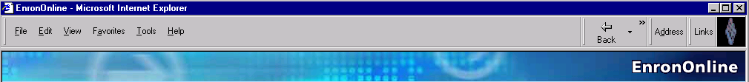
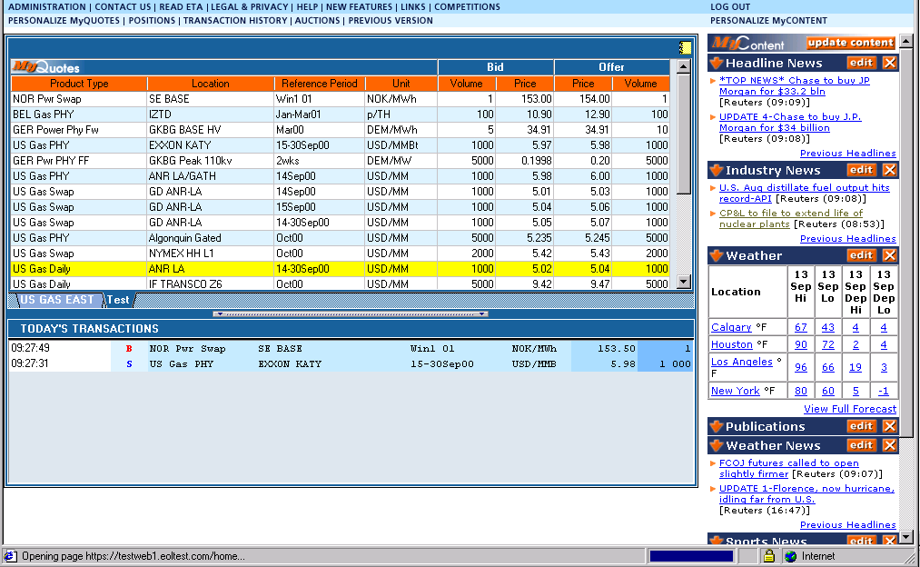
What is EnronOnline?
A Free, Internet-based, Global Transaction System Which Allows Counterparties to View Real Time Prices From Enron’s Traders and Transact Instantly Online

Slide 68
Benefits of EnronOnline
Free of Charge
Enron’s Best Prices
Real-Time Pricing Information
Faster than Traditional Channels
Access to Complementary Markets
and Product Information
Simple Access via the Internet
Easy to Use

Slide 69
Benefits of EnronOnline
Secure Execution
Market News and Quotes
Price Limit Orders
Industry Publications
Weather Insights
Advance Customization
Downloadable Transactions
Floating Windows

Slide 70
Markets Available on EnronOnline
European Coal
European Weather
German Power
International Coal
Japanese Aluminum
LPG
Nordic Power
Oil & Refined
Products
Petrochemicals
Plastics
Pulp & Paper
Sea Freight
Spanish Power
Swiss Power
UK Metals
UK Natural Gas
UK Power
US Gas Pipeline Capacity
US Lumber
US Metals
US Natural Gas
US Power
US Steel
US Weather
Commodity Types
Argentine Natural Gas
Asian Crude & Products
Australian & Japanese
Weather
Australian Power
Austrian Power
Bandwidth
Belgian Natural Gas
Canadian Natural Gas
Credit Derivatives
Dutch Power
Emissions

Slide 71
EnronOnline Statistics
Total Life to Date Transactions > 427,000
Average Daily Transactions > 2,900
Life to Date Notional Value of Transactions > $235 billion
Daily Notional Value Approximately $2.0 billion
Number of Products Offered: Approximately 1,150
Number of Currencies Traded in = 13
EnronOnline Version 1.0 Launch Date: November 29, 1999
EnronOnline Version 2.0 Launch Date: September 18, 2000

Slide 72
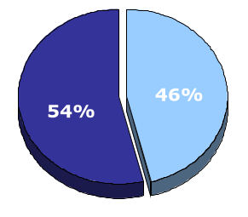
EnronOnline vs. Traditional Channels
Transactions
Daily % (30-day trailing average)
Traditional Channels
EnronOnline

Slide 73
Conclusion

Slide 74
Conclusion
Culture
Controls
Management Systems

Slide 75
Culture
Tolerance for failure
Embrace/drive change
  Challenge conventional wisdom
No “sacred cows”
Move people

Slide 76
Open Up the Market for Talent
Offer an Open Market for Capital
Lower the Risks of Experimentation
Design an Open Market for Ideas
Listen to New Voices
Corporate
Culture

Slide 77
Control: Tight and Loose
Tight Controls
Financial accounting
Risk management
Performance reviews
Legal obligations
Loose Controls
Organization
Creativity/new business ideas
Work schedules
Working environment
  Dress code
  Floor design

Slide 78
Management Systems
Recruiting – A/A program
Performance evaluation
Compensation

Slide 79
Pay Your Innovators Well --
Really Well
Base salary and benefits: industry average
Bonus: pay for performance
Equity: company ownership/long term
[Enron] has created a custom-made compensation scheme that gives the startup team an outsized stake in the new venture’s success. It is not unusual for a young team member to end up with $1 million in Enron stock for helping to build a new business.
- Gary Hamel, Fortune

Slide 80
The Challenge of Tomorrow
“Somewhere out there is a bullet with your company’s name on it. Somewhere out there is a competitor, unborn and unknown, that will render your strategy obsolete. You can’t dodge the bullet—
you’re going to have to shoot first. You’re going to have to out-innovate the innovators.”
Gary Hamel, Leading the Revolution

Slide 81


