Slide 1
ENERGY DERIVATIVES©
Class 4
March 22, 2001
Paulo Issler

Slide 2
Asian Options
Asian payoff depends on the average price of the
underlying asset during the averaging period.
Final Price
Average Price
Strike Price
Price
Payoff
Oct. 10
Dec. 1
Dec. 31

Slide 3
Asian Option Uses
 Hedging regular currency flows
 Hedging exposure to changes in average prices
(calendar month average of crude price)
 Reduced risk of price manipulation on expiration
day (NYMEX last three days of expiring natural
gas contract)
 Lower premium than a European with the same
expiration (quarterly or annual average of a
monthly price index)

Slide 4
Forward Price Curve
Commodity Price
Jan
Apr
July
Oct
Dec
Delivery Month

Slide 5
Asian Strip Option:
Asian on Multiple Forward Prices
Jan Contract
Price
Feb Contract
Mar Contract
Time
Jan
Feb
Mar
Notes:
This is not some sleazy option, ok!

Slide 6
Assumptions for Asian Pricing
  Evolution of prices is described by geometric Brownian motion process
  Futures prices have a drift rate of zero (required in a risk-neutral world)
  Price volatility is constant (obviously not true,
but still assumed in Black-Scholes and most
other option models)
  Markets are frictionless and continuous

Slide 7
Pricing Asian Options:
Possible Approaches
  Closed-form solutions
- Exact solution is not available
- Several approximations have been developed
  Numerical methods
- Simulation
- Transform methods

Slide 8
Simple Asian Option:
Inputs to Valuation
Forward Price
Volatility
Time to start of averaging
Time to end of averaging*
Day count convention
Strike
Interest Rate
* Expiration is at the end of averaging

Slide 9
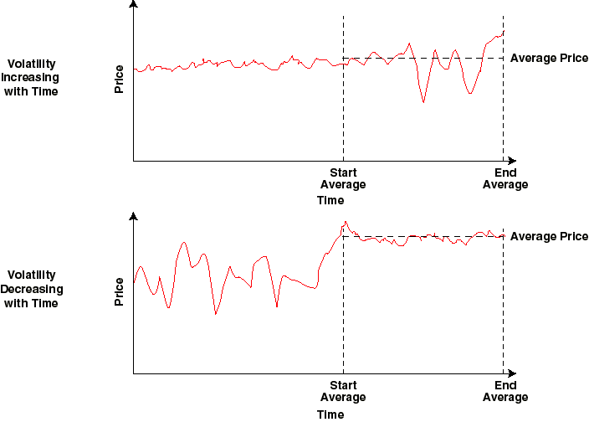
Volatility Term Structure

Slide 10
Simple Asian:
Revised Inputs to Valuation
Forward Price
Volatility to start of averaging
Volatility during averaging
Time to start of averaging
Time to end of averaging
Daycount convention
Strike
Interest Rate

Slide 11
Asian on a Strip:
Inputs to Valuation
Forward Prices [n]
Volatilities [n]
Corrleation [ ]
Start Avg [n]
End Avg [n]
Expiration Date
Daycount Convention
Strike
Interest Rate

Slide 12
Price Behavior of Asian Options
 Asian call expiring in one year
 Averaging period is for the entire year
 Strike = $2.00
 Volatility = 0.30
 Look at option price behavior as a
function of the price of the underlying

Slide 13
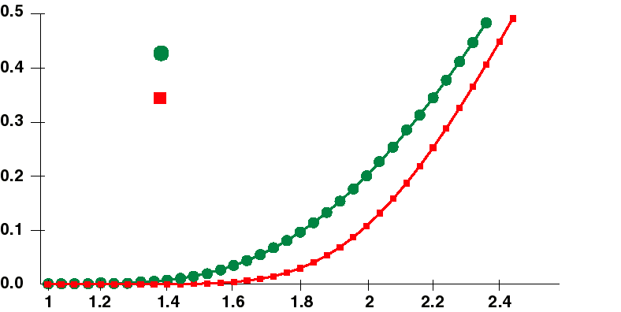
Call Premium
European
Asian
Premium
Underlying Price

Slide 14
Averaging Begins in the Future
Price
Average
t
T
Time

Slide 15
Asian Call Option Value
After Averaging Commences
Strike = Price = 50
Volatility = 30%
Interest Rate = 7%
Premium
Days into Averaging Period

Slide 16
Some Relations of
Europeans to Asians
A European option is just an Asian option
with the averaging period set to one day
An Asian option is generally worth less than
a European with equivalent strike and expiratio
As the averaging period becomes small
compared with the total time to expiration,
the Asian premium will approach the
European premium

Slide 17
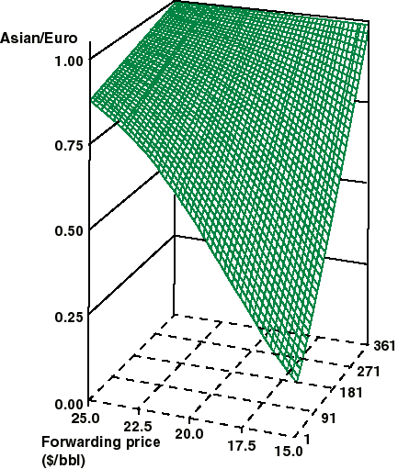
Ratio of Asian to European Call Premium
Strike = $20.00/bbl
Tenor = 365 Days
Volatility = 30%
Time until begin of averaging (days)

