Slide 1
ENERGY DERIVATIVES© Class 3 March 15, 2001
Paulo Issler

Slide 2
Outline
What is an option premium?
Basic concepts in option valuation
The problem of risk preferences
Replicating portfolio and risk neutral valuation
Assumptions underlying Black - Scholes formula
Black - Scholes - Merton formula
Yield/drift rate for futures
Black’s formula
Volatility: Historical, implied and some extensions

Slide 3
Terms
Option premium
Probability distribution
Risk neutrality
Black - Scholes equation
Black’s equation
Historical and implied volatility

Slide 4
What is an Option Premium?
It is money that the seller receives in payment for an option
It is equal to the money the seller expects to have to pay to the option buyer in a probabilistic sense
Actually, the premium is more than that because the seller wants to make a profit

Slide 5
What is an Option Premium?
(An Alternative Interpretation)
Option premium should equal (or exceed) cost of hedging incurred by seller
Hedging involves periodically buying and selling a fraction of the underlying according to the option's “delta” (described later)
Note: Hedging cost in this context does not mean transaction costs

Slide 6
Calculating an Option Premium
To calculate a European option premium requires two ingredients:
Option pay-off structure
Probability distribution of the asset price at expiration date

Slide 7
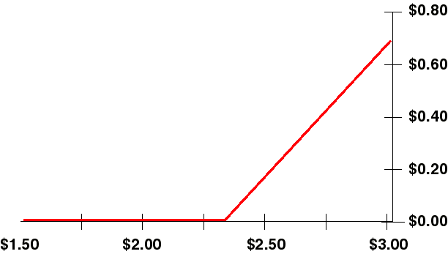
Calculating an Option Premium
(Continued)
Long Call option pay-off structure
Pay-off
(MMBtu)
Gas Price (/MMBtu)
Tells us what the option will pay to the holder at option expiration

Slide 8
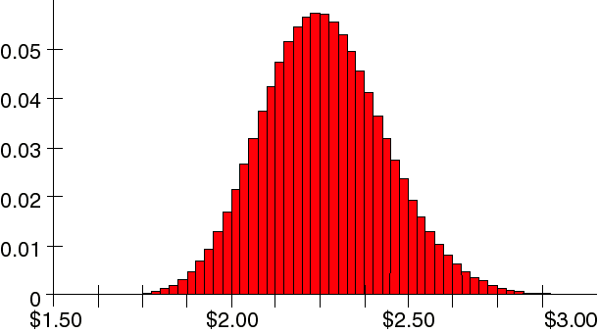
Calculating an Option Premium
(Continued)
Natural gas futures contract price probability distribution
Probability
Gas Price (/MMBtu)
Tells us how likely it is that the asset has a particular price at option expiration

Slide 9
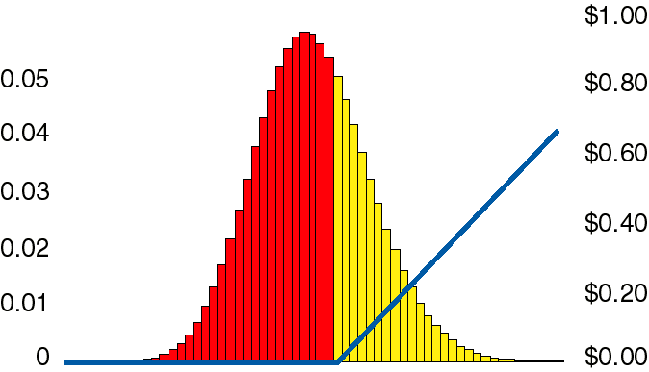
Calculating an Option Premium
(Continued)
Combining the two...
Probability
Pay-Off
Gas Price (/MMBtu)
Option Premium = ∑(Option Pay-off X Probability)

Slide 10
Calculating an Option Premium:
Continued
In more formal terms:
Option premium is expectation of option pay- off
Option premium = PV { E[ƒ(S,K)] }
where ƒ(S,K) = Max[S-K,0] for calls and ƒ(S,K) = Max[K-S,0] for puts
Option Premium =
where P(S) is the probability density function
$\text{PV}\left(\int{f(S,K)P(S)\text{dS}}\right)$

Slide 11
The Problem of Risk Preferences
Option premium is usually paid up-front, so it is the present value of the expected pay-off at expiration
How is an option (or any other investment) Present Valued?
Risk adjusted rate of return is normally used
What is the risk of holding an option?
This perplexed all of mankind until 1973, when Black and Scholes published their famous paper

Slide 12
Risk Preferences
(Continued)
Black and Scholes (1973) showed:
That there exists a riskless hedge between a stock option and the underlying stock - i.e. the option is riskless relative to stock
Cox and Ross (1976) showed:
If everyone agrees on the shape of probability distribution (i.e. the volatility), then everyone will calculate the same option value regardless of their view of risk

Slide 13
Risk Preferences
(Continued)
Riskless hedge example
Suppose a stock starts today at $20 and three months from now will be either $25 or $15
Note that we make no assumptions about probabilities (i.e. rate of return)
$25
$20
$15

Slide 14
Risk Preferences
(Continued)
Consider also a call option with a $20 strike and the expiration in three months
$5
$C
$0

Slide 15
Risk Preferences
(Continued)
Construct a portfolio by buying one share of stock and selling
two call options
What is the value of this portfolio in three months?
Terminal Stock Price: $15 $25
Value from Share: $15 $25
Value from Two Options: $0 -$10
Total Value of Portfolio $15 $15
Portfolio yields $15 regardless of the horizon stock price
That is to say, the portfolio is riskless

Slide 16
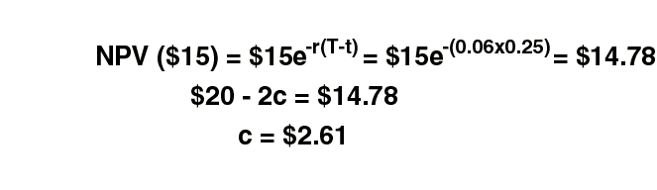
Risk Preferences
(Continued)
The portfolio will be worth $15 in three months
The portfolio costs today: $20 - 2c
Since the portfolio is riskless, expect to earn the risk free rate on portfolio, so (assuming risk free rate is 6%):

Slide 17

Black - Scholes (-Merton)
Equation
Assumptions
Price movements can be described by Geometric Brownian Motion
What does this equation mean, and why do we assume prices follow this equation?

Slide 18


Geometric Brownian Motion
First term
where μ is the drift or rate of return
Prices can drift in a certain direction over time
The percentage return is independent of price level
Price
Time

Slide 19
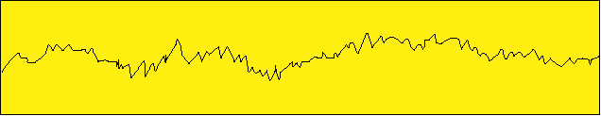
Geometric Brownian Motion
(continued)
Second term: ΔS= σSΔz
z is referred to as a Wiener stochastic process.
Δz behaves like ε√t, where ε is a normally distributed random
variable with zero mean and standard deviation of 1.0.
Relative volatility is likewise independent of price level.
Price
Time

Slide 20
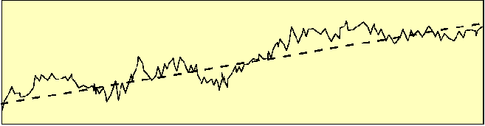
Geometric Brownian Motion
(continued)
Combining the two terms:
Price
Time

Slide 21
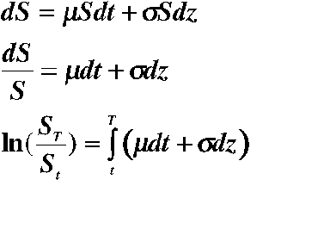
Geometric Brownian Motion
(continued)
This equation implies that prices are log-normally distributed
Note: This is a stochastic integral, so don’t think you can integrate it like you learned in Math 101. For more info, I suggest sections 9.2-9.4, 10.1, 10.2, of Hull’s book

Slide 22
Geometric Brownian Motion
an aside
In fact,
$\text{ln}\left(\frac{S_{t}}{S_{T}}\right)\text{\sim }Φ\left[\left(μ−\frac{σ^{2}}{2}\right)\left(T−t\right),σ\sqrt{T−t}\right]$
Where Φ[μ, σ] denotes a normal distribution with mean μ and
standard deviation σ .

Slide 23
Assumptions
(Continued)
Assume that volatility is time independent
Assume risk neutrality (stock’s rate of return is equal to the risk-free rate).
This makes problem mathematically tractable
If you believe Cox and Ross, it makes no difference
Frictionless, continuous markets
Ignore transaction costs
With all these assumptions, the integral for the option premium can be solved analytically

Slide 24
The Equation
European Calls and Puts on Stocks,
Stock Indices, Currencies, and Futures
$\begin{aligned}c={\text{Se}}^{−q(T−t)}N(d_{1})−{\text{Ke}}^{−r(T−t)}N(d_{2}) \\ p={\text{Ke}}^{−r(T−t)}N(−d_{2})−{\text{Se}}^{−q(T−t)}N(−d_{1}) \\ d=\frac{\text{ln}\left(\frac{S}{K}\right)+\left(r−q+\frac{σ^{2}}{2}\right)\left(T−t\right)}{σ\sqrt{T−t}} \\ d=d−σ\sqrt{T−t}\end{aligned}$

Slide 25
The Equation
(Continued)
S is the asset price today at time t
K is the strike price of the option
r is the annualized risk free interest rate
q is the annualized yield of the underlying asset
σ is the annualized volatility
(T - t) is the time to expiration in years. T is the date of the option expiration, and t is today’s date
N(.) is the cumulative normal distribution

Slide 26
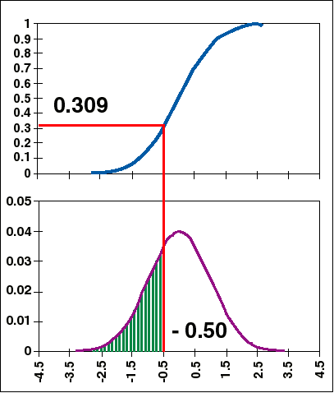
An Aside
The Cumulative Normal Distribution
The cumulative normal
distribution, N(x), measures
the probability that a
normally distributed
variable (mean=0, standard
deviation=1) will be less than
a given number x
Example: N(-0.50) = 0.309

Slide 27
Some Comments
r - q corresponds to the drift or risk neutral rate of return for the asset
For an asset with no yield, the rate of return is simply the risk free rate
For an asset with a yield (e.g. a stock that pays dividends), we expect the asset price to appreciate at less than the risk free rate: r - q
An asset with q = r does not appreciate; the asset price does not, on average, drift up or down over time

Slide 28
Comments
(Continued)
Options on Futures/Forwards
Recall that a forward contract is an agreement today to buy a commodity in the future. The price is what you agree today to pay for a commodity in the future.
Therefore, all time effects should already be reflected in the price; we should not expect the price to drift either up or down on average
Therefore a forward contract is an asset with r - q = 0

Slide 29
Black’s Equation
European Calls/Put Option
on a Future/Forward Contract
$\begin{aligned}c=e^{−r(T−t)}\left[\text{FN}(d_{1})−\text{KN}(d_{2})\right] \\ p=e^{−r(T−t)}\left[−\text{FN}(−d_{1})+\text{KN}(−d_{2})\right] \\ \text{where} \\ d_{1}=\frac{\text{ln}\left(\frac{F}{K}\right)+\frac{σ^{2}}{2}\left(T−t\right)}{σ\sqrt{T−t}} \\ d_{2}=d_{1}−σ\sqrt{T−t}\end{aligned}$

Slide 30
Volatility
Volatility is a measure of the uncertainty of future prices
Volatility is usually expressed as the annualized standard deviation of the
natural log of price returns
There are two classes of volatility estimates: historical and implied

Slide 31
Historical Volatility
Historical volatility is price volatility observed over some time period in the past
Historical volatility has dangers:
Past results are no guarantee of future performance
Volatility may depend on which historical time period you use
Results may depend on time step between observations (daily, weekly, monthly…). This is the case because volatility is not really a constant over time

Slide 32
Calculating Historical
Volatility for Futures
Take daily price observations
Generate a series of natural logs of daily returns i.e. ln(P_{t}/P_{t-1}) for every day
Take standard deviation
Multiply by the square root of the number of days in a year (typically take 250 trading days per year)

Slide 33

Calculating Volatility
(Continued)
Why is this number the volatility?
Recall that
$\text{ln}\left(\frac{S_{t}}{S_{T}}\right)\text{\sim }Φ\left[\left(μ−\frac{σ^{2}}{2}\right)\left(T−t\right),σ\sqrt{T−t}\right]$
where Φ[μ, σ] denotes a normal distribution with
mean μ and standard deviation σ.

Slide 34

Calculating Volatility
(Continued)
It is usual to quote the annual volatility in the same way that it is usual to quote annual interest rates
If prices are weekly or monthly or whatever, then the standard deviation must be normalized by the appropriate factor:

Slide 35
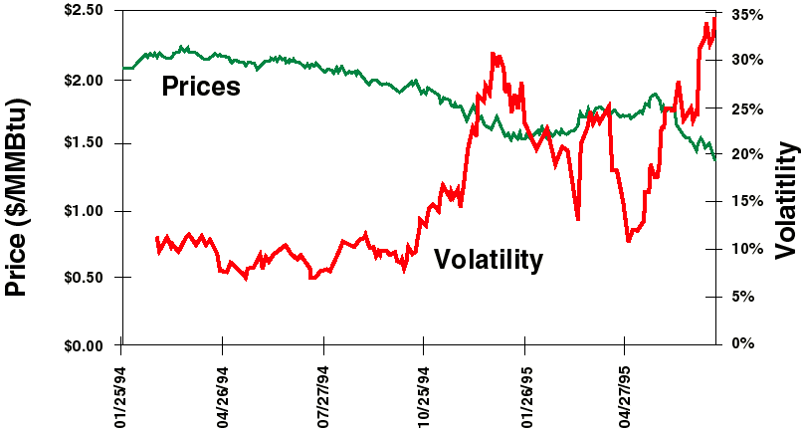
Aug. 95 NYMEX Gas Contract
Price and 21-Day Trailing Historical Volatility

Slide 36
Implied Volatility
Use Black-Scholes in reverse to get volatility
Go to market to find the price of a particular option
Because every input (price, strike, interest rate, time to expiration) except volatility is known, we can solve Black-Scholes using different volatilities to determine which one gives the observed price.
This is the volatility implied by the market price.

Slide 37
Risk Parameter Names
Names derived from Greek Alphabet
Symbol
Name
Delta
Gamma
Theta
Rho
Vega
Eta
Charm
Delta Vega
Sensitivity of
Premium
Delta
Premium
Premium
Premium
Premium
Delta
Delta
Sensitivity of
Underlying Price
Underlying Price
Time to Expiration
Interest Rate
Volatility
Correlation
Time to Expiration
Volatility

Slide 38
Delta Hedging
Delta is the option’s hedge ratio for constructing an instantaneously riskless portfolio
Taking an option position and a “delta” position in the underlying is called “delta hedging” or creating a “delta neutral portfolio”
Delta hedging can be used for “synthetic replication” of an option

Slide 39
Option Pricing: Numerical Methods Outline
Binomial Trees
Option Pricing Procedure
Construction of Binomial Trees
Pros and Cons of using Trees
Simulation Methods
Pricing Approach for Simulation
Simulating Commodity Prices
Notes:
Some of the important items we will cover

Slide 40
Advantages and Disadvantages of Analytical Methods
Closed-form analytical solutions are available for many plain vanilla and exotic plans
Very fast results when an analytical solution is available
Accurate under the given assumptions
Closed-form solutions not available or available only under restrictive assumptions for many types of derivatives.
Example: American-style options. Sometimes more difficult and takes longer time to program than simulation.
Notes:
Why do firms hedge?

Slide 41
Numerical Methods
Binomial Trees
Replace the continuous GBM process for a price movement by a discrete set of values in a tree
Each node of the tree has a time index, a value for price and an associated probability
A very useful tool in pricing derivatives that cannot be priced with other techniques
Notes:
Going back to our Oil and Chemical company,
they can enter into a contract for mutual benefit.
WTI - Crude Oil

Slide 42
Option Pricing Procedure
Using Binomial Trees
Construct a tree of prices for the underlying
Compute the option cash flows associated with leaf nodes of the tree
Step back in the tree by one time period and compute the expected or average cash flows associated with the tree nodes. Use the risk-free interest rate for discounting.
Repeat the previous step moving back in time until the root of the tree is reached
Value computed at the root node is the value of the option

Slide 43
Construction of Binomial Trees
Pu
P
Pd
Divide life of the option into many time intervals
In each interval, price moves from its current value P
up to Pu with a probability p
down to Pd with a probability 1 - p
The smaller the interval length, the greater the accuracy of the results
Notes:
- Use ET contracts for hedging OTC trades.
- Manage at the portfolio level

Slide 44
Binomial Trees
(Continued)
Example: Gas Prices
2.42
2.2
0.6
2.00
2.00
0.4
1.82
1.65
p = 0.6
u = 1.1
d = 1/u
A Binomial Tree of Gas Prices
p, u, d set to give correct mean volatility
Notes:
1. Identical product
Identical timing &
Identical volumes
boring hedge, ha!!

Slide 45
Determination of Tree Parameters
The parameters p, u, and d are chosen to give the correct mean and variance for the price changes during the small time interval Δt.
Mean: In the risk-neutral world, a futures contract is expected to remain the same in price while a stock is expected to grow at the risk-free interest rate r. Thus,starting with a price P at time 0, the average price after Δt is Pa, where a = 1 for a futures contract and a = exp(rΔt) for a stock. Hence,
Pa = pPu + (1 -p)Pd
a = pu + (1 - p)d
Variance: Variance of price after Δt is P²σ² Δt. Thus
P²σ²Δt = E(P_{Δt}²) - [E(PΔt)]²= [p(Pu)² + (1 -p)(Pd)²] - [Pa]²
σ²Δt = pu² + (1 -p)d² - a²

Slide 46
Determination of Parameters
(Continued)
Combining the mean and variance results with the condition
u =
gives us
u = exp(σ√Δt)
d = exp(-σ√Δt)
p =
where a = 1 for a futures contract and a = e^{r Δt} for a stock
Example: Prompt natural Gas Futures σ = 35%, Δt = (1/365) year
u = exp(0.35 * √(1/365)) = 1.0185
d = = 0.98185
p = = 0.495
1
—
d
a - d
——
u - d
1
—
u
1 - d
——
u - d

Slide 47
Pros and Cons of the
Binomial Tree Approach
Can price American-style as well as European- style derivatives
Relatively fast for one or two underlying instruments
Difficult to apply when the payoffs depend on the past history
Can be time consuming when three or more variables are involved
Notes:
Intuition: A forward or futures contract is fundamentally related to simply holding the underlying asset until delivery.

Slide 48
Monte-Carlo Simulation Methods
General Approach
Simulate the price of the underlying instrument
Calculate the payoff at horizon (for a European Option)
Discount the payoff to the present time
Repeat this process n times, storing the results (P_{1,} P_{2,…..,} P_{n})
Calculate the average payoff. This is the estimate of the option price.

Slide 49
Simulation of Prices for Multiple Commodities
Need to simulate prices P₁ an P₂ for two commodities 1 and 2
Compute volatilities σ₁ and σ₂ and the coefficient of correlation ρ between price returns
Generate samples (ε₁, ε₂) from a standard bivariate normal distribution with correlation ρ
Generate sample prices from P_{i}(t+Δt) =P_{i}(t) * exp[(μ_{i} - σ_{i}²/2)Δt + σ_{i}ε_{i}√Δt)]

Slide 50
Generating Correlated
Normal Samples (ε₁, ε₂)
ρ = correlation coefficient between commodities 1 and 2
Draw independent samples χ₁ and χ₂ from a (univariate) standard normal distribution
Compute
ε₁ = χ₁
χ₁ = ρχ₁ + χ₁(1 - ρ₁)^{0.5}

