Slide 1

2001 - 2003 PLAN REVIEW
Enron
Transportation
Services
Northern Natural Gas
Transwestern Pipeline
Florida Gas Transmission
Northern Border Partners
EOTT
Clean Fuels

Slide 2
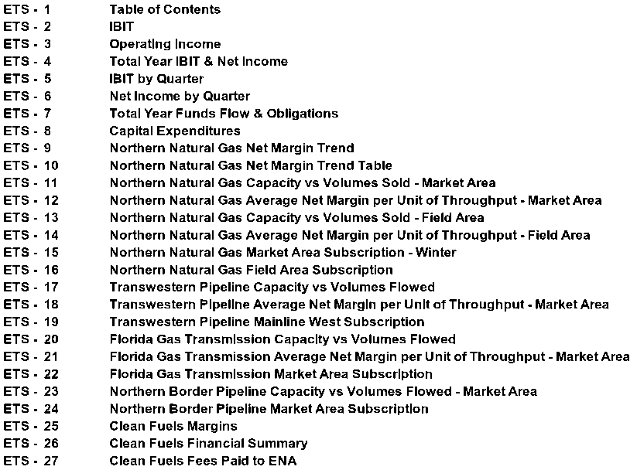
ENRON TRANSPORTATION SERVICES Table of Contents

Slide 3
ENRON TRANSPORTATION SERVICES IBIT ($ In Millions)
753
746
625
653
380
391
388
351
100% Operating Income
Enron’s Share Operating Income
100% Special Income
Enron’s Share Special Income

Slide 4
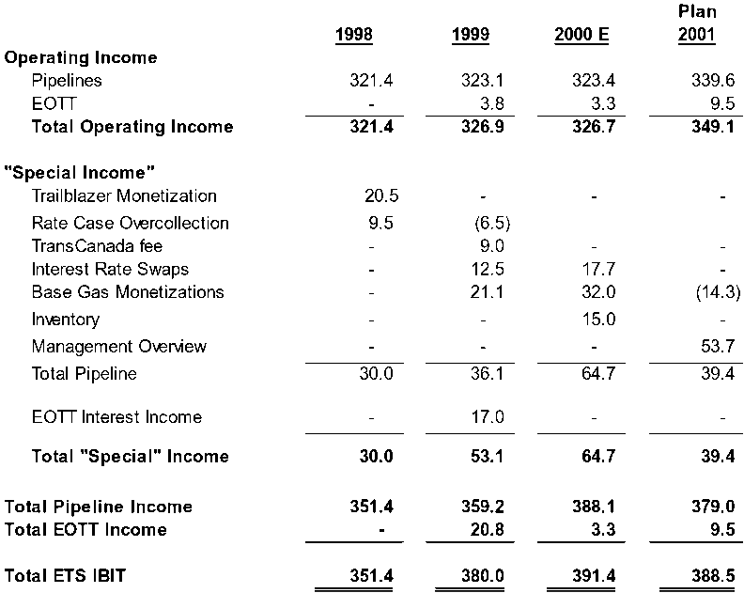
ENRON TRANSPORTATION SERVICES Operating Income (In Millions of Dollars)

Slide 5
ENRON TRANSPORTATION SERVICES Total Year IBIT & Net Income (In Millions of Dollars)

Slide 6
ENRON TRANSPORTATION SERVICES IBIT by Quarter (In Millions of Dollars)

Slide 7
ENRON TRANSPORTATION SERVICES Net Income by Quarter (In Millions of Dollars)

Slide 8
ENRON TRANSPORTATION SERVICES Total Year Funds Flow & Obligations (In Millions of Dollars)

Slide 9
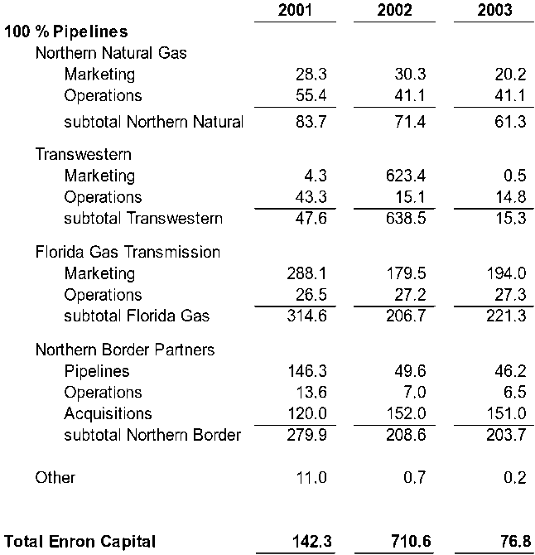
ENRON TRANSPORTATION SERVICES Capital Expenditures (In Millions of Dollars)

Slide 10
NORTHERN NATURAL GAS Net Margins Trends 1996 - 2002
Recurring Base Business $420MM
Note: Base Business at Risk = $45MM

Slide 11
Northern Natural Gas Company Net Margins Trends Table (In Millions of Dollars)
1996 2001 Change
Storage $ 29.4 $ 38.7 $ 9.3
Structured Products - 7.7 7.7
Offshore 12.4 1.3 (11.1)
Field 119.2 75.6 (43.6)
Capital - 20.0 20.0
Market Area 257.3 276.7 19.4
Total $418.3 $420.0 $ 1.7

Slide 12
NORTHERN NATURAL GAS Market Area Capacity vs Demand Volumes Sold
BTU/D

Slide 13
NORTHERN NATURAL GAS Average Net Margin per Unit of Throughput North Market Area
$/MMBTU

Slide 14
NORTHERN NATURAL GAS Capacity vs Demand Volumes Sold Field Area
BTU/D
Notes:
Reasons for Field Area Decreases:
Demand units
Reliant 150/d Trailblazer to Demarc or Mid-continent to Demarc (restricted to one path in 2000)
Capacity Release Strategy in 2000
ElPaso outage in 2000
Aliant 50/d TFF termination
Commodity
Permian spreads out of the money primarily due to higher fuel rates
see attached schedule for break out of TFF and TFX demarc volumes

Slide 15
NORTHERN NATURAL GAS Average Net Margin per Unit of Throughput Field Area
$/MMBTU

Slide 16
NORTHERN NATURAL GAS Market Area Subscription - Winter
MMBTU/D
MMBTU/D

Slide 17
Northern Natural Gas Company Field Area Subscription
MMBTU/D

Slide 18
TRANSWESTERN PIPELINE Capacity vs Actual Volumes Flowed
BTU/D

Slide 19
TRANSWESTERN PIPELINE Average Net Margin per Unit of Throughput Market Area
$/MMBTU

Slide 20
TRANSWESTERN PIPELINE Mainline West Subscription
MMBTU/D

Slide 21
FLORIDA GAS TRANSMISSION Capacity vs Actual Volumes Flowed Market Area
BTU/D

Slide 22
FLORIDA GAS TRANSMISSION Average Net Margin per Unit of Throughput Market Area
$/MMBTU

Slide 23
FLORIDA GAS TRANSMISSION Market Area Subscription
MMBTU/D

Slide 24
NORTHERN BORDER PIPELINE Total Capacity vs Actual Volumes Flowed Market Area
BTU/D

Slide 25
NORTHERN BORDER PIPELINE
Market Area Subscription
MMBTU/D

Slide 26
ENRON CLEAN FUELS 2001-2003 Operating & Strategic Plan MTBE & Methanol Margins Cents Per Gallon
MTBE Margins
Methanol Margins
W/ Nat Gas 21.0 19.1 27.3 19.3 16.6 8.0
W/O Nat Gas 23.0 21.1 30.7 23.2 20.0 11.0
Margin 4.9 6.0 12.2 3.6 5.1 8.6
On-stream % 88.5 94.5 98.4 92.9 87.1 92.9 80.1 96.4 90.0 87.3 97.9 97.9
% of Capacity 90.4 97.2 104.5 100.3 93.4 100.1 75.7 83.6 80.2 86.7 98.1 96.7
MTBE Capacity 15,300 Bbls/day Methanol Capacity 420,000 gal/day
MTBE reflects turnarounds in 1998 and 2002. Methanol reflects a turnaround in 2001.

Slide 27
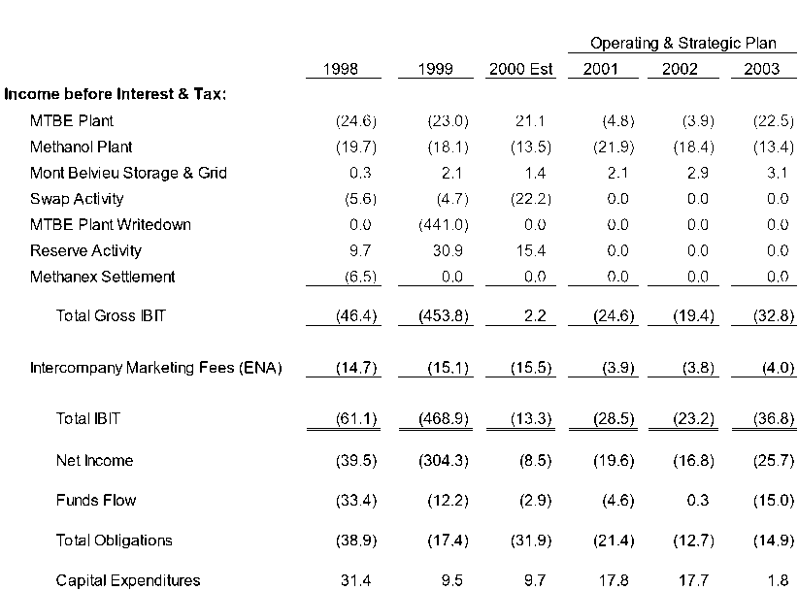
ENRON CLEAN FUELS Financial Summary

Slide 28
