Slide 1
Executive Summary for Internal Transfers
Twelve Months Activity for Internal Employee Transfers
April 2000 to March 2001 activity total 3,174 (25% of domestic workforce) – includes
1,189 Major Reorganizations due to creation of Networks, EGM, EIM, etc
969 Open and Free Talent Market – 9% of domestic workforce
481 Analyst and Associate planned rotations
273 Automatic redeployment due to Business Re-organization
262 Formally redeployed by the Redeployment Team
Formal Redeployment
511 employees have participated in formal redeployment of which 51% or 262 have been successfully placed
149 of the 511 employees are currently still in redeployment today of which most have been there 11-20 days.
Of those successfully placed by the redeployment team, most were placed in 8 days; average is 21 days.
Automatic Redeployment Due to Business Reorganization
273 employees have been automatically redeployed under recent reorganizations.
Note: Domestic headcount as of 11/00.

Slide 2
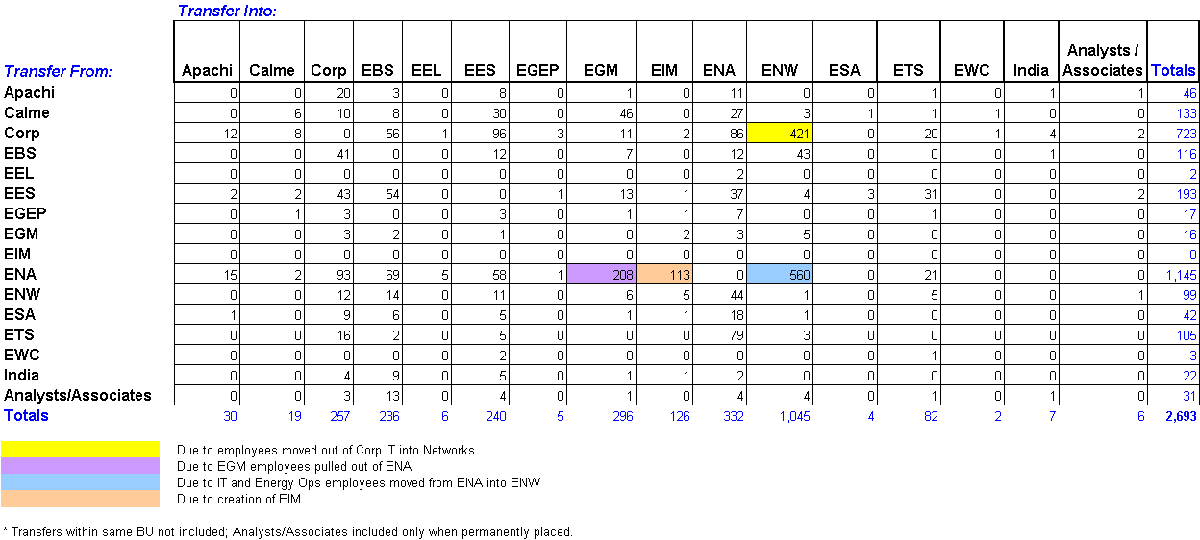
Internal Domestic Transfers
4/1/2000 to 3/31/2001
Analysts and Associates Rotations 481
Total 3,174
Total Internal Domestic Transfers 3,174
Major Reorganization Transfers 1,189
(color coded above)
Actual Transfers 969
Analyst/Associate Planned Rotations 481
Automatic Redeployment 273
(due to Business Reorganization)
Formal Redeployment 262
From April 1, 2000 through March 31, 2000, 437 commercial employees and 2,256 non-commercial employees transferred within Enron.

Slide 3
Summary Statistics – Formal Redeployment
Formal Redeployment Program Participation
June 1, 2000 through April 2, 2001
Number %
Number of Employees Placed 262 51%
Number of Employees Terminated* 100 20%
Number of Employees to be Placed 149 29%
Total Number of Employees Placed in
Formal Redeployment 511 100%
Aging of Employees to be Placed
1-10 Days 1
11-20 Days 127
21-30 Days 5
31-44 Days 9
45+ Days 7
Total Aging in Formal Redeployment
Number of Days
in Redeployment
Average Median
Total Employees 22 9
Placed Employees 21 8
Terminated Employees 40 43
Formal Redeployment Activity
Sent to Formal Received from Formal
BU Redeployment Redeployment
A/A Program 0 3
Apachi 3 0
Azurix 8 1
Calme 54 2
Corp 61 58
EBS 274 11
EECC/EEOS 59 1
EES 1 75
EGEP 6 2
EGM 0 3
EIM 0 4
ENA 10 19
ENW 10 49
ESA 13 2
ETS 2 7
EWC 0 1
India 9 1
PGE 1 0
Other 0 23
Total 511 262
Notes:
Source: Normandy 4-9-01.xls
Total Business Reorg stats from 3-31-01 weekly term update.xls

Slide 4
Summary Statistics – Formal Redeployment
* Unless noted, all data and statistics based on period June 1, 2000 through April 2, 2001.
** Since January 1, 2001, 263 employees have been terminated due to Business Reorganization. During this same period, 58 employees who were in the redeployment group
were terminated.
Notes:
Sources:
Normandy 4-0-01.xls
Total Business Reorg stats from 3-31-01 weekly term update.xls

Slide 5
Automatic Redeployment Due to Business Reorganization
Former Business Unit Employees Transferred New Business Unit
EECC 32 ETS
22 EEOS*
17 EES
3 CORP
2 NEPCO
2 ENA
78
EBS 39 ENW
32 Corp
71
CALME 54 EGM
24 Corp
22 ESA
17 EES
6 ENA
1 EBS
124
TOTAL 273
* Some EECC employees were initially expected to be transferred but remained in the business unit.
Notes:
Sources:

