Slide 1
Executive Summary
Twelve Months Activity for Internal Employee Transfers
  April 2000 to March 2001 activity total 3,174 (25% of domestic workforce) – includes
    1,189 Major Reorganizations due to creation of Networks, EGM, EIM, etc.
    969 Self-initiated New Jobs – 9% of domestic workforce
    481 Analyst/Associate Planned Rotations
    273 Automatic Redeployment due to Business Reorganization
    262 Formal Redeployment by the Redeployment Team
Formal Redeployment
  511 employees have participated in formal redeployment of which 51% or 262 have been
  successfully placed
  149 of the 511 employees are currently still in redeployment today of which most have been
  there 11-20 days.
  Of those successfully placed by the redeployment team, most were placed in 8 days;
  average is 21 days.
Automatic Redeployment Due to Business Reorganization
  273 employees have been automatically redeployed under recent reorganizations.
887 employees have terminated YTD; Annualized termination rate is 19.5%
  Of those who have left, most were poor performers ie contribution loss rate is 11.2%.
  Only 278 or 31% were rated Strong or Above. Most of these employees were Technical, Engineering,
  Administrative and other support functions.
Note: Domestic headcount as of 11/00.

Slide 2
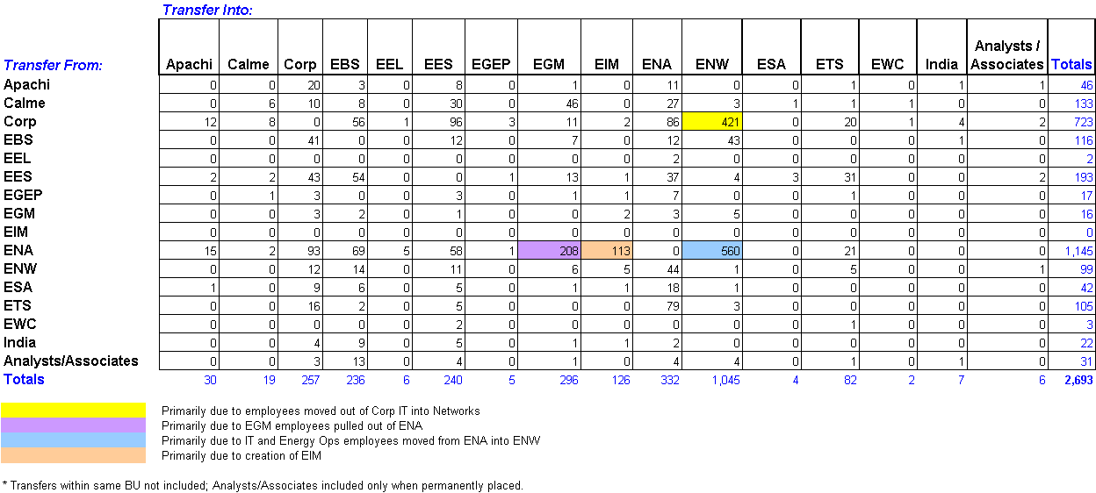
Internal Domestic Transfers
4/1/2000 to 3/31/2001
Analysts and Associates Rotations 481
Total 3,174
Total Internal Domestic Transfers 3,174
Major Reorganizations 1,189
(color coded above)
Self Initiated New Jobs 969
Analyst/Associate Planned Rotations 481
Automatic Redeployment 273
(due to Business Reorganization)
Formal Redeployment 262
From April 1, 2000 through March 31, 2000, 437 commercial employees and 2,256 non-commercial employees transferred within Enron.

Slide 3
Summary Statistics –
Formal Redeployment
Formal Redeployment Program Participation
June 1, 2000 through April 2, 2001
Number %
Number of Employees Placed 262 51%
Number of Employees Terminated* 100 20%
Number of Employees to be Placed 149 29%
Total Number of Employees Placed in
Formal Redeployment 511 100%
Aging of Employees to be Placed
1-10 Days 1
11-20 Days 127
21-30 Days 5
31-44 Days 9
45+ Days 7
Total Aging in Formal Redeployment
Number of Days
in Redeployment
Average Median
Total Employees 22 9
Placed Employees 21 8
Terminated Employees 40 43
Formal Redeployment Activity
Sent to Formal Received from Formal
BU Redeployment Redeployment
A/A Program 0 3
Apachi 3 0
Azurix 8 1
Calme 54 2
Corp 61 58
EBS 274 11
EECC/EEOS 59 1
EES 1 75
EGEP 6 2
EGM 0 3
EIM 0 4
ENA 10 19
ENW 10 49
ESA 13 2
ETS 2 7
EWC 0 1
India 9 1
PGE 1 0
Other 0 23
Total 511 262
Notes:
Source: Normandy 4-9-01.xls
Total Business Reorg stats from 3-31-01 weekly term update.xls

Slide 4
Summary Statistics –
Formal Redeployment
* Unless noted, all data and statistics based on period June 1, 2000 through April 2, 2001.
** Since January 1, 2001, 263 employees have been terminated due to Business Reorganization. During this same period, 58 employees who were in the redeployment group
were terminated.
Notes:
Sources:
Normandy 4-0-01.xls
Total Business Reorg stats from 3-31-01 weekly term update.xls

Slide 5
Automatic Redeployment
Due to Business Reorganization
Employees Receiving
Business Unit Automatically Redeployed Business Unit
EECC 32 ETS
22 EEOS*
17 EES
3 CORP
2 NEPCO
2 ENA
78
EBS 39 ENW
32 Corp
71
CALME 54 EGM
24 Corp
22 ESA
17 EES
6 ENA
1 EBS
124
TOTAL 273
* Some EECC employees were initially expected to be transferred but remained in the business unit.
Notes:
Sources:

Slide 6
Contribution Loss
Terminations YTD
887 employees have terminated (1/1/01 to 3/31/01)
419 have voluntarily terminated
468 have involuntarily terminated
Overall, 23% were rated Needs Improvement / Issues
Total Separation Rate = 19.5% (vs. 11% for yr 2000)
Total Contribution Loss = 11.2% (vs. 8.7% for yr 2000)
All separation and contribution loss rates are annualized
Voluntary Separations
Separation Contribution Number of
Date Rate Loss Separations
Jan 1-Jan 7 3.7% 0.1% 13
Jan 8-Jan 14 5.7% 0.1% 20
Jan 15-Jan 21 8.0% 2.3% 28
Jan 22-Jan 28 2.0% 0.4% 7
Jan 29-Feb 4 7.1% 3.3% 25
Feb 5-Feb 11 4.9% 6.6% 17
Feb 12-Feb 18 9.7% 2.6% 34
Feb 19-Feb 25 11.4% 15.1% 40
Feb 26-Mar 4 19.0% 21.7% 67
Mar 5-Mar 11 12.3% 8.5% 43
Mar 12-Mar 18 11.9% 12.4% 42
Mar 19-Mar 31 23.5% 30.5% 83
YTD 9.2% 7.9% 419
Overall, contribution loss rate is lower than both voluntary and involuntary separations, indicating that Enron is losing more poor than good performers.
However, it should be noted that contribution loss exceeded separation rate for voluntary separations for 5 out of 12 weeks in the first quarter, indicating Enron lost more good than poor performers during those weeks.
Involuntary Separations
Separation Contribution Number of
Date Rate Loss Separations
Jan 1-Jan 7 3.7% -2.9% 17
Jan 8-Jan 14 3.4% -5.8% 12
Jan 15-Jan 21 8.3% -2.0% 31
Jan 22-Jan 28 2.0% -1.0% 7
Jan 29-Feb 4 26.0% 2.7% 91
Feb 5-Feb 11 6.3% 2.1% 22
Feb 12-Feb 18 16.2% 8.8% 57
Feb 19-Feb 25 2.0% 2.4% 7
Feb 26-Mar 4 11.6% -0.8% 41
Mar 5-Mar 11 5.4% 3.0% 19
Mar 12-Mar 18 9.9% 7.6% 35
Mar 19-Mar 31 36.5% 30.7% 129
YTD 10.3% 3.3% 468
Contribution Loss Scale
PRC Rating Weight
1 - Superior 3
2 - Excellent 2.5
3 - Strong 2
0 - No Rating 1
4 - Satisfactory 1
5 - Needs Improvement -2
6 - Issues -3
Job Function Name Number Job Group Name Number
Accounting 24 Clerical 64
Administrative 65 Professional 101
Anal/Assoc 15 Management 98
Eng/Tech 66 Anal/Assoc 15
Govt & Reg Affairs 3
HR 4
Inv/Comm/Gov’t Rel 7
IT 21
Legal 6
Origination 21
Risk Management 37
Trading 9 Total 278
Breakdown of employees rated Strong or above separated 1/1/01 to 3/31/01.

