Slide 1
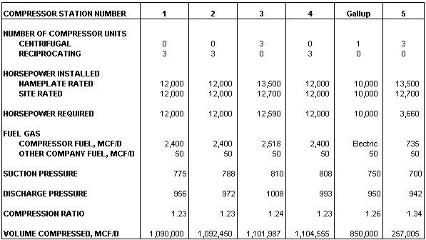
TRANSWESTERN PIPELINE COMPANY
DOCKET NO. CP01-
EXHIBIT G
FLOW DIAGRAM OF EXISTING FACILITIES
DAILY DESIGN CAPACITY (SUMMER DAY)
Note: Volume at take-off points vary depending upon daily nominations and scheduling.
750
San Juan 850,050 Mcf/d
955
972
1008
950
Gallup
942
Needles
740 MMcfd
840
993
1,090,000 Mcf/d
89.6 mi.
58.7 mi.
85.9 mi.
43.1 mi.
27.2 mi.
5
West Texas 257,790 Mcf/d
20 mi.
30”ML/LL
1
30”ML/LL
2
30”ML/LL
3
30”ML/LL
4
30”ML/LL
54.1 mi.
Topock
310 MMcfd
Kingman
40 MMcfd
875 psig
775
788
Flagstaff
7.1 MMcf/d
833 psig
808
700
810
PIPE
MAINLINE 30” X 0.375’ W.T.
LOOP LINE 30” X 0.350’ W.T.
(Mileage can vary due to rounding)
LEGEND
PIPELINE
PIPELINE PRESSURE IN P.S.I.G.
COMPRESSOR STATION
970
7
Notes:
2

Slide 2
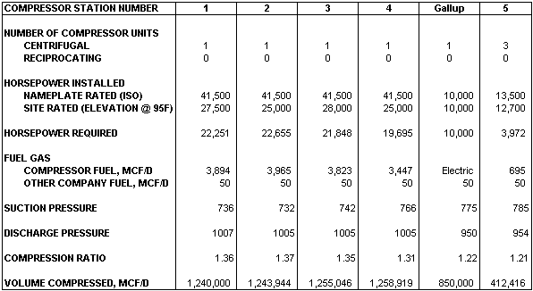
TRANSWESTERN PIPELINE COMPANY
DOCKET NO. CP01-
EXHIBIT G
FLOW DIAGRAM OF PROPOSED FACILITIES
DAILY DESIGN CAPACITY (SUMMER DAY)
Note: Volume at take-off points vary depending upon daily nominations and scheduling.
750
San Juan 850,050 Mcf/d
950
Gallup
1007
1005
1005
1005
954
Needles
855 MMcfd
848
1,240,000 Mcf/d
89.6 mi.
58.7 mi.
85.9 mi.
43.1 mi.
27.2 mi.
5
West Texas 413,161 Mcf/d
20 mi.
30”ML/LL
1
2
3
4
5
54.1 mi.
30”ML/LL
30”ML/LL
30”ML/LL
30”ML/LL
Topock
310 MMcfd
Kingman
75 MMcfd
895 psig
732
Flagstaff
7.1 MMcfd
785 psig
766
785
736
742
PIPE
MAINLINE 30” X 0.375’ W.T.
LOOP LINE 30” X 0.350’ W.T.
(Mileage can vary due to rounding)
LEGEND
PIPELINE
PIPELINE PRESSURE IN P.S.I.G.
COMPRESSOR STATION
970
7
Notes:
2

