Slide 1

Enron Transportation
Market Opportunity
and
Review of Webmodal

Slide 2
AGENDA
I. Market Opportunity for Enron Global Markets
II. Review of Webmodal
<number>

Slide 3
I. Market Opportunity for Enron Global Markets
<number>

Slide 4
PROS AND CONS OF ENTRY
PROS
Significant business opportunity at NPV close to $1 Billion
Platform for future growth into global container/air freight
Leverages several core Enron capabilities
Leading indicator for general trade/currency trends and flows
Tradable units relatively small (Retail versus Wholesale)
Back office
Credit
CONS
<number>

Slide 5
OUTSOURCING OPPORTUNITIES FOR PROCESSES
Accounts/
Set-up
Order
Entry
Confirmation
Scheduling
Tracking
Invoicing
Collection/
Payment
Interface
Webmodal/ENE
Credit Screen
Quebecor
Cysive
Lightbridge
i2
NTE
GE/Factors
Quebecor
Portal Software
CSG
Convergys
Amdocs
i2
Quebecor
GE
Banks
i2
NTE
Factors
Quebecor
Cysive
LOTS
i2
NTE
Certain “Brick and mortar” firms have proficiency in logistics and excess capacity (Quebecor),
Technology based startups like NTE and i2 claim to have solved the “back-office” problem
Accounts/Set-up companies offer outsourcing for credit and subscriber screening
Software providers build or sell solutions to handle the logistics process
Top outsourcing firms for other industries could offer services to the transportation industry
Numerous factoring companies are available to handle collections/payments
<number>

Slide 6
TRANSPORTATION OPPORTUNITY - ENTRY METHOD REVIEW
Industry hiring effort
Engaged in last two months
Potential acquisitions
Reviewed 20+ transportation companies
Requirements
Non-asset based
Critical mass of industry expertise and culture match
Small initial capital investment for entry
Joint ventures
Have reviewed railroad joint venture opportunities
Continuing effort with technology players
<number>

Slide 7
II. Webmodal
<number>

Slide 8
POTENTIAL WEBMODAL ACQUISITION SUMMARY
Acquire 100% of outstanding shares of Webmodal, Inc. for $12.5MM
$10MM for non-employee shareholders (56%)
$2MM in Enron stock for ownership of Founder
$.5MM in debt
Key employee retention
6 of senior management team to sign 3 year employment contracts or transition agreements
Employment package of restricted shares and options
Existing business model to operate within Enron Global Markets, with focus on building capacity market
Merge processes and technology with Enron’s to create basis for transportation trading systems
<number>

Slide 9
PROS AND CONS OF USING WEBMODAL
PROS
Reduces time to enter market
Leverages existing data and supplier/customer relationships
Provides access to critical mass of industry expertise
Investors have to be paid out
Limited customer base
Technology still under development
CONS
<number>

Slide 10
WEBMODAL SOLUTION FOR INDUSTRY
Transaction Process Flow for Transportation Intermediation
Marketing
Approval/
Set-up
Order
Entry
Confirmation
Scheduling
Tracking
Invoicing
Collection/
Payment
Webmodal
Enron
Marketing
Approval/
Set-up
Order
Entry
Confirmation
Scheduling
Tracking
Invoicing
Collection/
Payment
Combined
Marketing
Approval/
Set-up
Order
Entry
Confirmation
Scheduling
Tracking
Invoicing
Collection/
Payment
No current capability or solution to traditional industry process
Partial current capability or solution to traditional industry process
Current capability or solution to traditional industry process
Problem in transportation procurement revolves around numerous manual processes
Webmodal currently addresses this problem:
Has a front-end, web-based interface for order entry and online tracking
Future plans include automation or electronic confirmation, scheduling, and tracking information
<number>

Slide 11
SCALABILITY
Average time to execute transaction can be reduced by 70% using technology
Reduced through
Automated functions such as notification of late loads
EDI, XML, or web communication of pricing, confirmation, tracking, and invoicing between carriers, shippers, and Webmodal
Average Per Load Time to Execute (Minutes)
Order
Entry
Confirmation
Scheduling
Tracking
Invoicing
Collection
Total Average Time
Existing
Process Time
.9 14.3 10.4 5.4 7.7 2.9 41.5
Automation Time
.7 2.3 2.8 1.1 3.2 2.1 12.2
<number>

Slide 12
HISTORICAL AND PROJECTED FINANCIALS - WEBMODAL PROJECTIONS
Expected EBIT of $(7.9) in 2001, with cash needs totaling $8.6 MM
Reflects factoring of 80% of receivables and current pricing
<number>

Slide 13
HISTORICAL AND PROJECTED FINANCIALS - WITH ENRON PROJECTIONS
With five large deals brought through Enron, EBIT rises to $105MM in 2004
NPV rises to about $200MM
Reflects factoring of 80% of receivables and current pricing
<number>

Slide 14
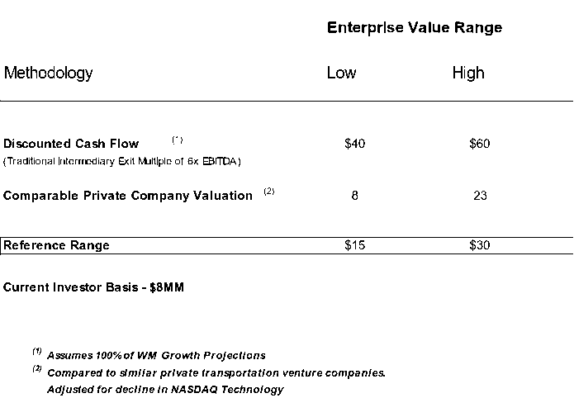
VALUATION AND EXPECTED PURCHASE PRICE
<number>

Slide 15
TRANSPORTATION OPPORTUNITY - BUSINESS MODEL
<number>

Slide 16
TRANSPORTATION OPPORTUNITY - COST EXPECTATION
<number>

Slide 17
TRANSPORTATION OPPORTUNITY - COST EXPECTATION
<number>

Slide 18
Appendix
<number>

Slide 19
HISTORICAL AND PROJECTED FINANCIALS - WEBMODAL PROJECTIONS
Expected EBIT of $(6.9) in 2001, with cash needs totaling $7.6 MM
Reflects factoring of 80% of receivables and increased pricing by 50%
<number>

Slide 20
HISTORICAL AND PROJECTED FINANCIALS - WITH ENRON PROJECTIONS
With five large deals brought through Enron, EBIT rises to $162MM
NPV rises to about $200MM
Reflects factoring of 80% of receivables and 50% price increase
<number>

Slide 21
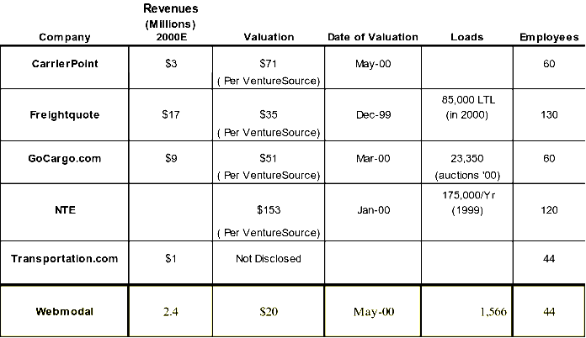
INDUSTRY COMPARABLE - PRIVATE COMPANIES
<number>

Slide 22
PHYSICAL GAS BACK-OFFICE TRANSACTION COSTS
<number>

