Slide 1
INTRODUCTION TO OPTIONS
Vince Kaminski
Enron Corp. Research Group
Houston, February 28, 2000

Slide 2
OPTION DEFINITION
Option – a contract that gives the right, but not an obligation, to sell (buy) the underlying at a given price (exercise price, strike price) on (by) certain day
Option to buy – a call
Option to sell – a put
Options have been used for thousands of years. The first formal option pricing model has been proposed in 1900 by Louis Bachelier.
Currently used option pricing approach goes back to Black and Scholes (1973)

Slide 3
PAYOFF DIAGRAM (CALL)
Payoff
45°
K
Price
K – strike price
Payoff from the buyer’s perspective

Slide 4
PROFIT DIAGRAM (CALL)
Profit
45°
K
Premium
Price
K – strike price
Profit from the buyer’s perspective

Slide 5
PAYOFF DIAGRAM (PUT)
Payoff
45°
K
Price
K – strike price
Payoff from the buyer’s perspective

Slide 6
PROFIT DIAGRAM (PUT)
Payoff
45°
K
Premium
Price
K – strike price
Profit from the buyer’s perspective

Slide 7
COMMON TERMS
Premium – the amount of money paid for the option at the inception of the option contract
Expiration date – the date on which the option ceases to exist. It may be the only date on which the option may be exercised.
Intrinsic value – the payoff received if the option expired today
Time value - the excess of option value above the intrinsic value
Underlying – the financial instrument or the commodity on which the option values depends.

Slide 8
COMMON TERMS (continued)
In-the-money – an option with positive intrinsic value. In the case of a call, the price of the underlying exceeds the strike, in the case of a put, the strike exceeds the price of the underlying.
At-the-money – the price of the underlying is equal to the strike price
Out-of-the money – an option with no intrinsic value. The option may have time value.

Slide 9
COMMON TERMS (continued)
OTC options – options negotiated under bilateral contracts
may be highly customized
no third party credit guarantee
Exchange traded options – options sold/acquired through an exchange
standardized in terms of strike and expiration
credit protection offered by an exchange

Slide 10
COMMON TERMS (continued)
Option writer – the person who promises to deliver/buy (for call or put, respectively) the underlying asset (or an equivalent in cash if the contract allows it)
The writer receives the premium
The writer of an option may have to post a margin if the option is written through an exchange
OTC options may be collateralized as well

Slide 11
MEASUREMENT OF TIME
In the case of options time is measured in years (by convention)
1 = 1 year, 0.5 = 6 months, etc.
The current time is denoted by convention by t
Option expiration date is denoted by T
The life time of option is equal to T- t
Alternative convention: today = 0, expiration time denoted by t or T

Slide 12
DIGRESSION: INTEREST RATE CONVENTIONS
The interest rate used in the option models is the risk free rate, denoted by r
Most textbooks use continuous compounding
Compounding assuming the rate of r p.a.
Annual compounding for n years produces $1(1+r)^{n}
Compounding m times per year produces $1(1+r/m)^{mn}
Increasing the compounding frequency to infinity, the amount of $1 invested for n years grows to $1e^{rn}

Slide 13


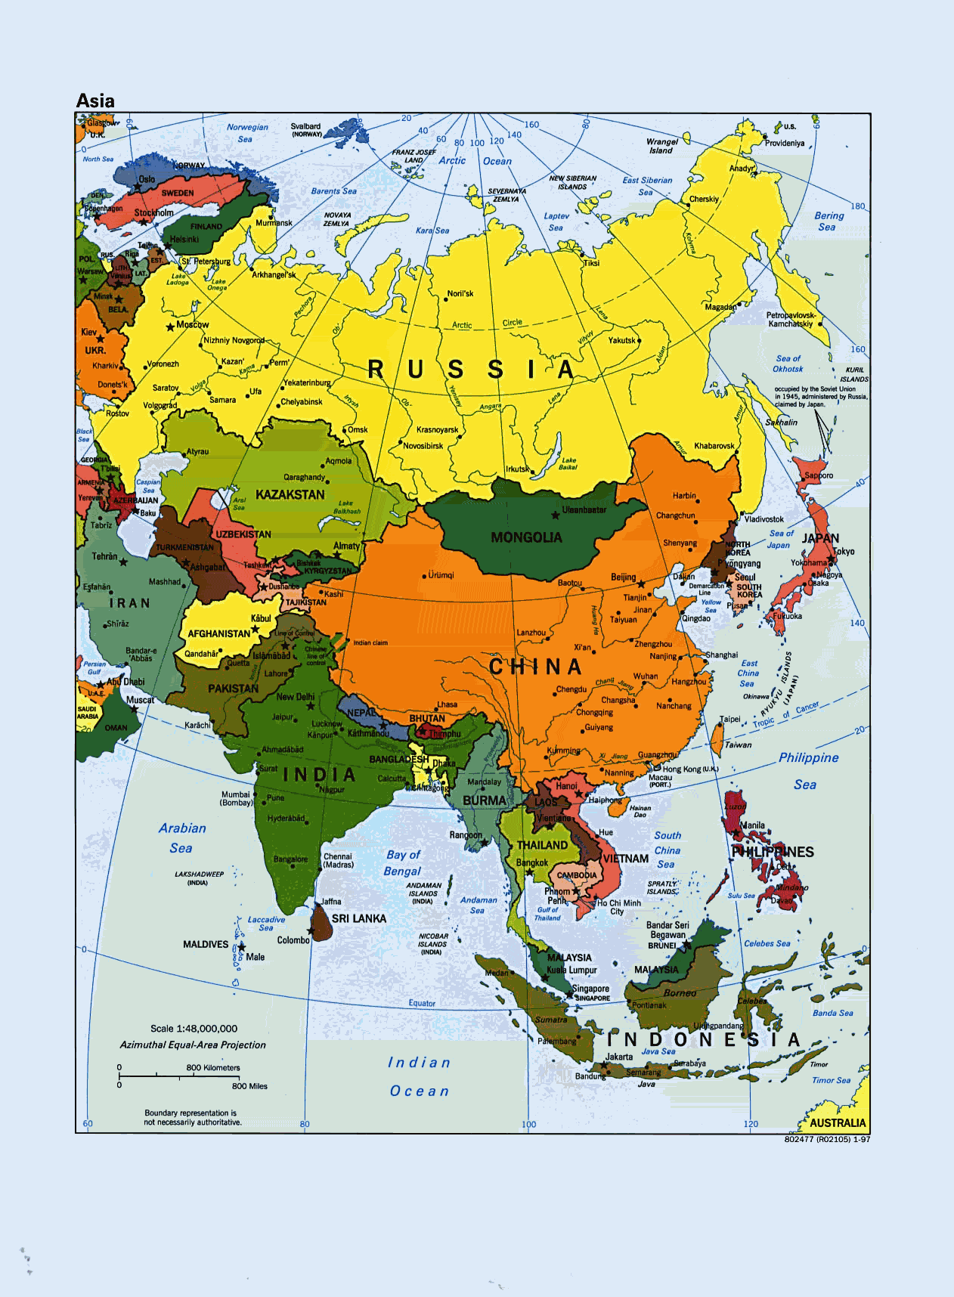
OPTION NATIONALITIES
European option – can be exercised only on the expiration date
American option – can be exercised anytime during its life
Asian option – is defined in terms of an average
Other options: Bermudan, Parisian, Russian

Slide 14
OTHER CLASSIFICATIONS
Complexity:
Vanilla options
Exotic options
Underlying
Stock options
Options on forwards (futures)
Options on spot commodity
Options on options
Options on structures (swaps, option portfolios)

Slide 15
DIGRESSION: FORWARDS AND FUTURES
Forward: a contract for future delivery at the price negotiated at the inception of the contract. Cash flows occurs typically at (or at an agreed time after) delivery .
Futures contract: a forward contract traded on an organized exchange.
Standardization
Credit protection
Interim cash flows through mark-to-market provisions (initial and variation margins)

Slide 16
OPTIONS ON FUTURES
Options on futures are typically traded on organized exchanges.
Exercise of an option into a futures contract position
Two types of settlement
Stock-type settlement
Futures type settlement

Slide 17
PUT-CALL PARITY (stocks)
Portfolio A at time t
European call option: c with strike K
Cash: Ke^{{-r(T-t)}}
Portfolio B
European put: p with strike K
one share (S)
Both options have the same maturity T
The value of two portfolios at time T?

Slide 18
PUT-CALL PARITY
At time T both portfolios are worth max(S_{T},K)
Why?
The two portfolios must have identical values today. Why?
In other words:
p + S_{t} = c + Ke^{{-r(T-t)}}

Slide 19
PUT-CALL PARITY
S_{T} > K
A: S_{T} - K +K = S_{T}
B: S_{T} + max(0, K - S_{T}) = S_{T}
S_{T} < K
A: max(0, S_{T} - K) + K = K
B: S_{T} + max(0, K - S_{T}) = S_{T} + K - S_{T} = K

Slide 20
PUT-CALL RELATIONSHIP: AMERICAN OPTIONS
S_{t} - K ≤ C – P ≤ S_{t} - Ke^{{-r(T-t)}}
Proof of the left hand side inequality. Assume a portfolio that consists of:
Long call C
Short put P
Lending K at the risk free rate r
Short position in one share taken at price S_{t}
Initial position value: -C + P + S_{t} - K

Slide 21
PUT-CALL RELATIONSHIP: AMERICAN OPTIONS
Terminal portfolio value
S_{T} ≤ K
0 – (K- S_{T}) - S_{T} + Ke^{r(T-t)} = K(e^{r(T-t)} - 1)
S_{T} > K
S_{T} – K + 0 - S_{T} + Ke^{r(T-t)} = K(e^{r(T-t)} - 1)
The portfolio terminal value is always positive, as long as r > 0
Initial position value: -C + P + S_{t} - K < 0 (why the initial value of the portfolio has to be negative?)

Slide 22
PUT-CALL RELATIONSHIP: AMERICAN OPTIONS
We still have to examine intermediate time τ (we are dealing with American options)
Portfolio value at time τ : C_{τ} + (K-S_{τ}) –S_{τ} + Κe^{(τ-t)}
If the put is exercised, the bond investment more than covers the strike price, the short position in the stock is covered with the stock delivered by the put holder. The call has value than is non-negative. The portfolio has a positive value at any point in the future.
Conclusion: the initial portfolio value -C + P + S_{t} - K < 0

Slide 23
PUT-CALL PARITY: OPTIONS ON FORWARDS
The call-put parity for futures
p + F_{t}e^{{-r(T-t)}} = c + Ke^{{-r(T-t)}}
F_{t} denotes the futures price at time t (today)
The call-put relationship for American options (for forwards)
F_{t}e^{{-r(T-t)}} - K ≤ C - P ≤ F_{t} - Ke^{{-r(T-t)}}

Slide 24
BINARY OPTIONS
An option with discontinuous payoff structure
A binary (digital) option pays a fixed amount of dollars when certain condition is satisfied or delivers certain asset
A cash-or-nothing or asset-or-nothing options

Slide 25
PAYOFF STRUCTURE: BINARY CALL
Payoff
K
Price
K – strike price

Slide 26
PAYOFF STRUCTURE: BINARY PUT
Payoff
K
Price
K – strike price

Slide 27
BULL AND BEAR SPREADS
A payoff similar to a binary option can be produced with a portfolio of vanilla options
Bullish spread: a long call with a strike of K₁, a short call with a strike of K₂, K₂ > K₁
The position benefits from the bull (rising market)

Slide 28
BULL AND BEAR SPREADS
Bearish spread: a long put with a strike of K₂, a short put with a strike of K₁, K₂ > K₁
The position benefits from the bear market (falling market)

Slide 29
STRADDLES NAD STRANGLES
The straddle consists of a call and a put with the same strike
The position bought by somebody who expects the underlying to fall or to rise, but not to remain at the same level
A position to take during the “calm period before the storm”

Slide 30
EXERCISES
Draw payoff and profit diagrams for vanilla calls and puts from the perspective of a writer
Assume that the rate of interest compounded annually is equal to 10%. Calculate the equivalent interest rates assuming
Semi-annual compounding
Continuous compounding
Prove the right-hand side inequality for the American put-call relationship

