Slide 1
Gas Logistics
Operations October 2001 Director’s Conference
Shelley Corman

Slide 2
Vice President
Gas Logistics
Shelley Corman
Sr. Administrative
Assistant
Ricki Winters
COMMERCIAL SUPPORT
CAPACITY MANAGEMENT
Director
Business Applications
FGT, NNG and TW
Brad Holmes
Director
Transportation
Analysis
Donna Scott
Sr. Director
Gas Control
NNG and TW
Steve January
Director
Gas Control
FGT
Mike Bryant
Director
Contract Support
Services and Controls
FGT, NNG and TW
Rick Dietz
Director
Customer Service Teams
NNG and TW
Lynn Blair
Director
Customer Service Teams
FGT
Sheila Nacey

Slide 3
The Role of Gas Logistics
Liaison between Marketing, Operations, Operators and Customers
Responsible to ensure that transactions (“paper deals”) translate first into physical flows and ultimately into cash flow
Daily point of contact for customers

Slide 4
Major Functions Within Gas Logistics
Gas Control
Contract execution (deal capture)
24/7 Scheduling operation
Confirmation with operators
Imbalance resolution
Customer billing & collections
Customer website (HotTap)
Business application support & development

Slide 5
Daily Gas Flow Process
Post available capacity on website
Meet each morning with marketing to discuss customer load, line pack management and outages
Execute new contracts in morning
Receive nominations for upcoming gas day by 11:30 AM
Allocate where nominations exceed capacity
Confirm scheduled quantities with operators
Notify customers of scheduled quantities
Set up gas control plan for upcoming day
Modify scheduling and gas control plan based on intraday nominations
Monitor actuals compared to scheduled flows

Slide 6
Scheduling Timeline
(All Times Central Clock Time)
Calendar Day 10th
Gas Day 11th
12 AM
Grid Time
12 AM
Grid Time
Bump
9:00 PM
9:00 AM
11:30 AM*
3:00 PM
3:30 PM
4:30 PM
6 PM*
10:00 PM
Timely Noms
Penalty
Operator
Scheduled
Evening
Operator
Scheduled
due
Notification
Confirmation
Quantities
Intraday
Confirmation
Quantities
for Gas Day
for Bumping
Available
Noms due
Available
11th
(Gas Flow to
Calendar Day 11th
begin @ 9:00AM)
12 AM
Non Grid
7 AM* NNG & FGT
7:30 AM* TW
Grid Time
Gas Day 11th
12 AM
Bump
Grid Time
8:00 AM
9:00 AM
10 AM*
1 PM
5 PM*
8:00 PM
9:00 PM
2:00 PM
Intraday
Operator
Intraday
Intraday 1
Operator
Intraday 1
Intraday 2
Operator
Intraday 2
Noms
(Gas Flow
to begin
@ 9 AM)
Confirmation
Scheduled
(Gas Flow to
Confirmation
Scheduled
(Gas Flow to
Confirmation
Scheduled
Quantities
begin @ 5:00pm)
Quantities
begin @ 9:00pm)
Quantities
Available
Available
Available
Gas Day
11th begins
Calendar Day 12th
12 AM
Gas Day 11th
12 AM
NonGrid
9:00 AM
9:30AM
8 AM
Storage
Gas Day
EDI
Noms
11th ends
Available
Final
Scheduled
Volumes
Available
due for
Final
Gas Day 11th
Scheduled
*Add 15 minutes to deadlines for EDI
(NNG only)
Volumes
Available

Slide 7
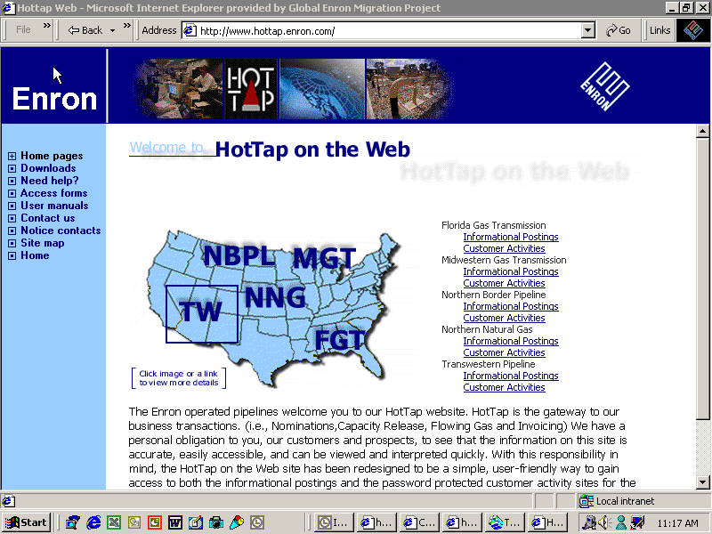

Slide 8
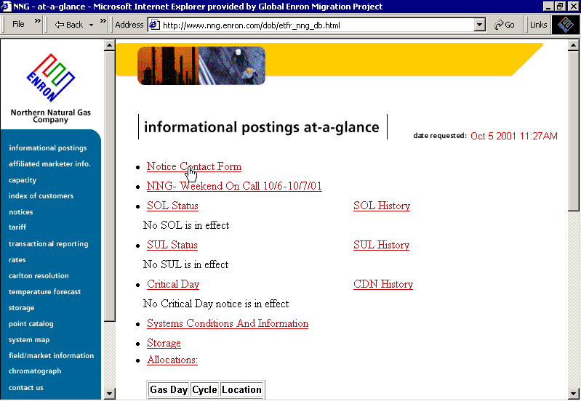

Slide 9
Cash Flow Process
Provide customers with data to resolve imbalance positions
Measurement desk to address measurement concerns
Invoices out by 9th business day
Settle outstanding imbalances
Resolve billing disputes
* Prior Period Adjustments are no longer an acceptable course of business in gas industry

Slide 10
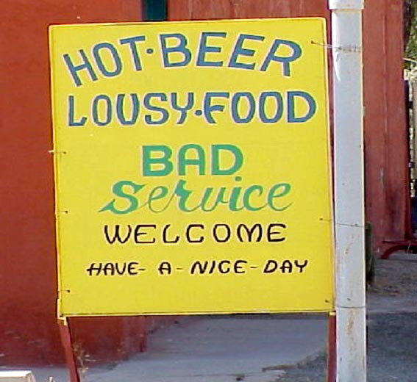

Slide 11
What is Good Customer Service?
Access to timely and accurate information
Use of technology to deliver information in a convenient format
Representatives that understand the customers’ needs and are able to answer a range of questions (or committed to tracking down a response ASAP)

Slide 12
How are We Doing?
Strengths
E-Commerce and on-line trading capabilities
Quality of information on the HotTap website
Ease of nominations
Areas for Improvement
Customer training & meetings
Availability of representatives to answer questions
Measurement issues

Slide 13
2001 Customer Service Enhancements
Measurement Desk to resolve customer measurement issues
Expanded HotTap Helpdesk to provide central contact for logon and application questions
Reorganized teams to improve customer coverage
Invoice and Imbalance detail added to website
New contract system and electronic contracting capability

Slide 14
Top Concerns for Gas Logistics
Follow-through on customer service commitment
Continued automation of transactional processes
Best practices sharing / common computer systems
Outage coordination with marketing, operations & customers
Minimize ETS Exposure to commodity risk by minimizing imbalances, UAF and reducing prior period adjustments
Address recent computer system failures
Update and improve emergency communication plans

